Slide 1
INTERNSHIP
PRESENTATION
SHIVABALAN M
2022115101
B.TECH IT

Slide 2
CONTENT
INTRODUCTION
COMPANY PROFILE & MY ROLE
PROBLEM DEFINITION
OBJECTIVE
IDEAS
SYSTEM ARCHITECTURE
DESIGN
TOOLS AND TECHNOLOGIES
SCREENSHOTS & VIDEOS
RESULTS
REFERENCES

Slide 3
COMPANY PROFILE & MY ROLE
COMPANY NAME : IDEATEC SOFTWARES PVT LTD
LOCATION : COIMBATORE
ROLE : DATA ANALYTICS FULLSTACK DEVELOPER
DURATION : 30 DAYS
SUPERVISED BY : Mr.Ramkumar (Software Engineer , Ideatec)

Slide 4
INTRODUCTION :
Completed a data analytics internship at Ideatec Softwares Pvt Ltd from June 13th to July 28th, 2024.
Developed a live dashboard to track the status of each filtration bed in the Delhi Water Board, allowing operators to see real-time updates and manage the system more efficiently.
Also created a summary dashboard that provided a clear view of how each filtration bed performed over time, helping user get an insight of how the beds are working.
It was a great opportunity to learn how data analytics can be applied in industrial environments, helping me grow both professionally and technically.

Slide 5
PROBLEM DEFINITION :
The Delhi Water Board plant needed a system to monitor water filtration beds in real time. Operators required an efficient way to track the status of each bed using sensor data.
Additionally, they needed a tool to analyze long-term performance trends. The challenge was to develop a dashboard that combined real-time updates with historical data insights.
This system would improve decision-making and operational efficiency.

Slide 6
OBJECTIVE:
The main objective of the entire solution is to monitor the status of the filtration beds in an effective manner.
To develop a dashboard that updates in real time.
Once the system is developed , it must help the operators to make quick decisions based on live data.
To enhance the plant’s operational efficiency through better data use.
Making the system easy to use.

Slide 7
IDEAS:
1.Sensor Installation and Data Collection
Sensors were installed on each filtration pipeline to gather real-time data. These sensors continuously monitored various aspects of each bed’s status, such as whether the bed was operational, idle, or in backwash status.
The data collected by these sensors was sent to a live server, where it was processed for display in the dashboards.

Slide 8
IDEAS:
2.Summary Dashboard for Data Analytics
In addition to the live dashboard, a summary dashboard was created to provide a broader view of the system's performance over time.
This dashboard aggregates historical data and shows key metrics such as the total time spent in different operational states. By reviewing this data, operators can identify patterns or recurring issues, helping them make long-term improvements to the plant's efficiency.

Slide 9
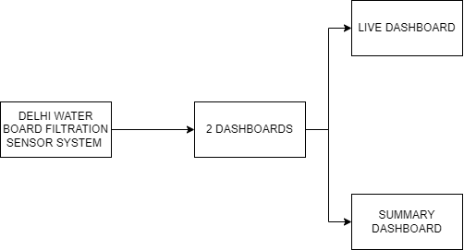
SYSTEM ARCHITECTURE:
SIMPLE OVERVIEW

Slide 10
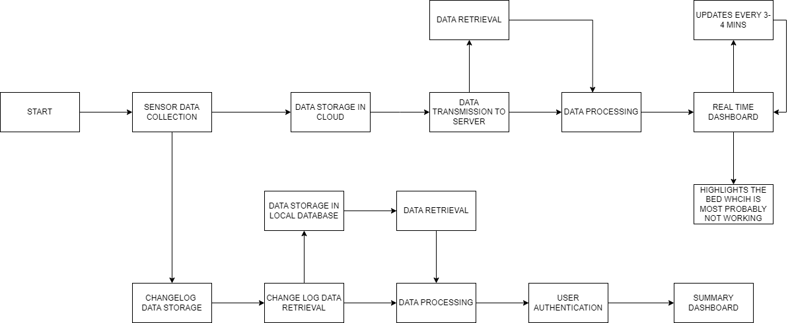
SYSTEM ARCHITECTURE:
DETAILED ARCHITECTURE

Slide 11
TOOLS & TECH STACK :
•PYTHON
•DJANGO
•ORM
•HTML
•CSS
•JAVASCRIPT
•CHART JS
•BOOTSTRAP
•Sass CSS
•PYTORCH
•OPENCV
•NUMPY
•FIGMA

Slide 12
DETAILED DESIGN:
Sensor Data
Collection
Real-Time
Dashboard
Summary
Dashboard
1. Sensor
installed on water pipelines
2. Collect live data (e.g., flow, pressure)
3. Send data to cloud storage
1. Display real-time status of each filtration bed
2. Update dashboard every few seconds
3. Show visual indicators of each bed (e.g., red for inactive)
1. Store status changes of all filtration beds
2. Retrieve changelog data from storage
3. Process and analyze historical data for summary

Slide 13
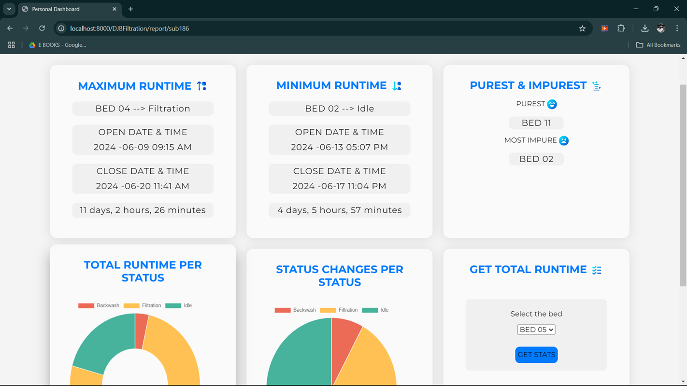
SCREENSHOTS AND VIDEOS:

Slide 14
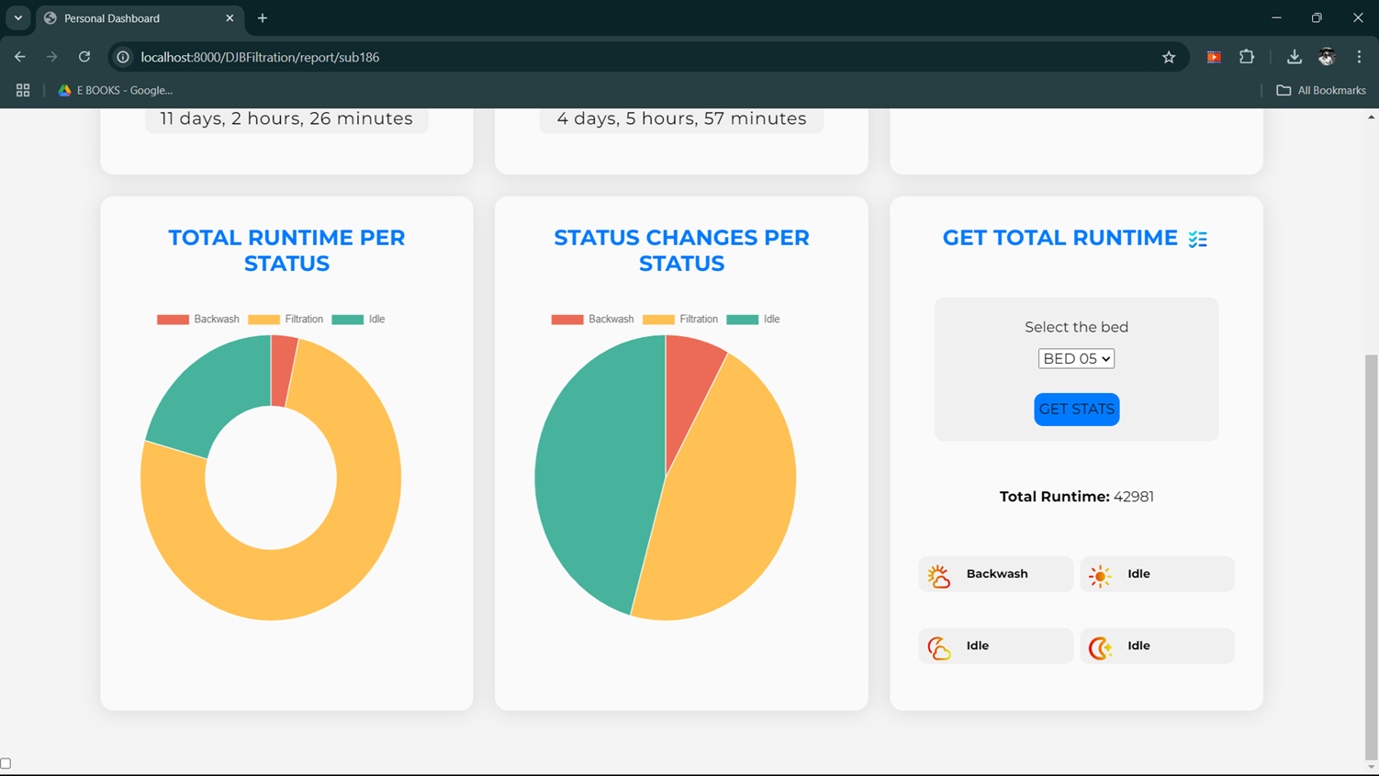
SCREENSHOTS AND VIDEOS:

Slide 15
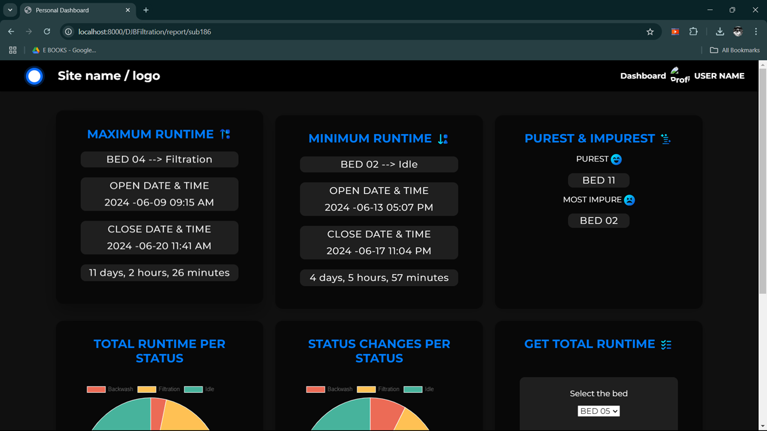
SCREENSHOTS AND VIDEOS:

Slide 16
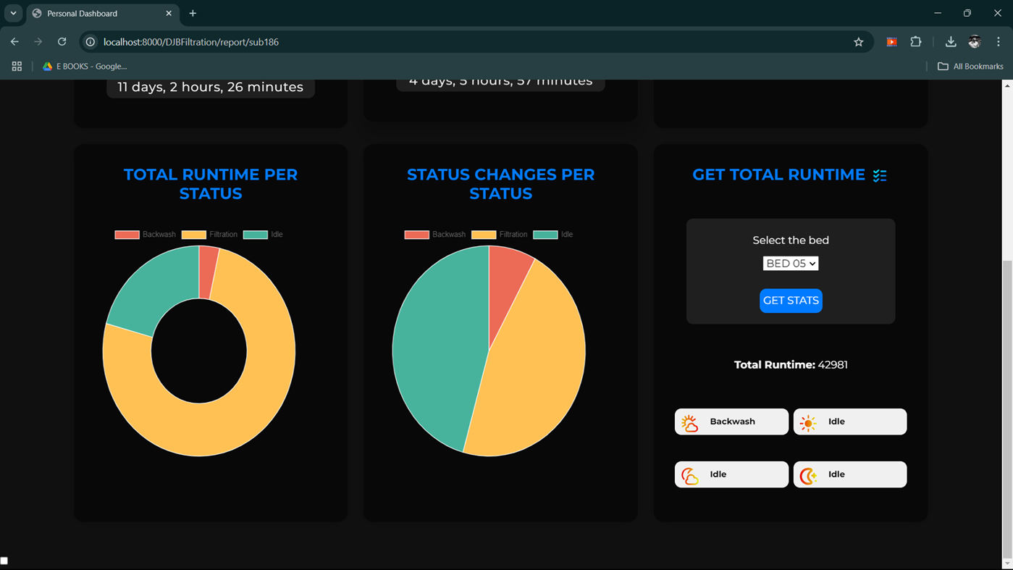
SCREENSHOTS AND VIDEOS:

Slide 17
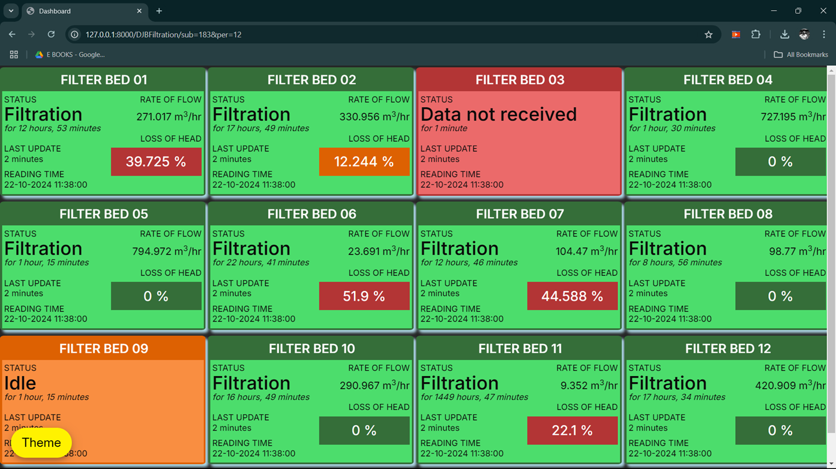
SCREENSHOTS AND VIDEOS:

Slide 18
RESULTS:
The major goals that were kept in our mind during the beginning of the project were all achieved!
The dashboard enabled instant tracking of filtration bed statuses, allowing for quicker issue detection.
Operators could respond faster to bed malfunctions, minimizing downtime and improving system efficiency.
The summary dashboard provided historical trends, enabling better planning and informed decision-making.

Slide 19
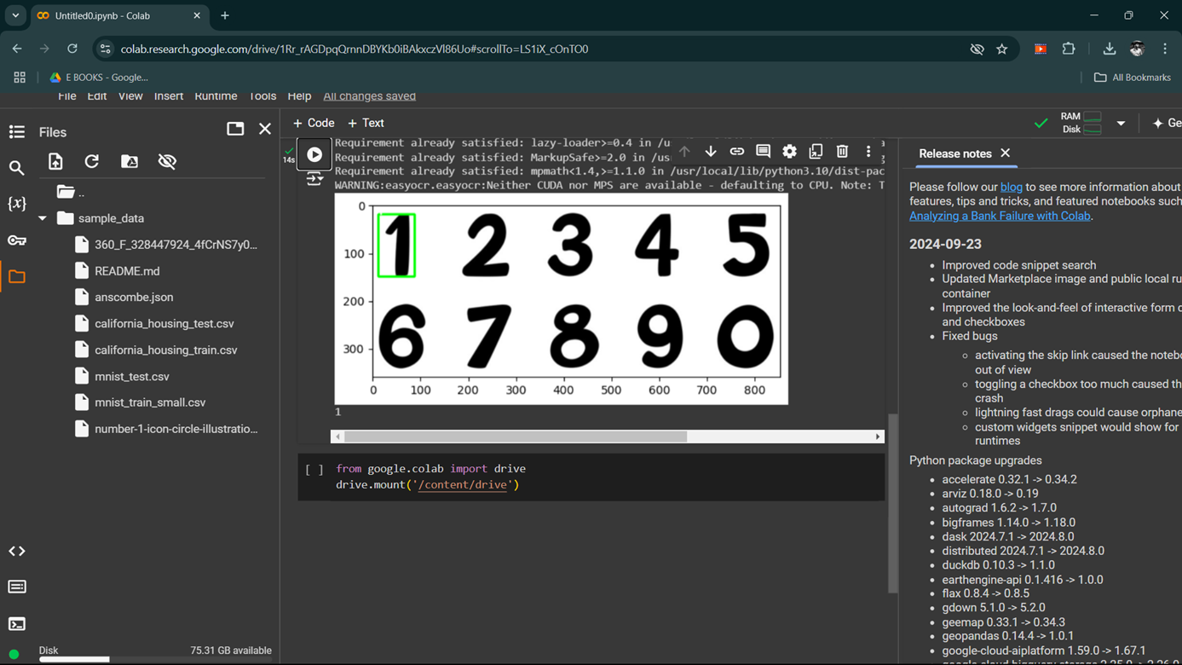
SUB TASKS:
NUMBER EXTRACTION FROM IMAGE FOR ODOMETER VALUE RECOGNITION.

Slide 20
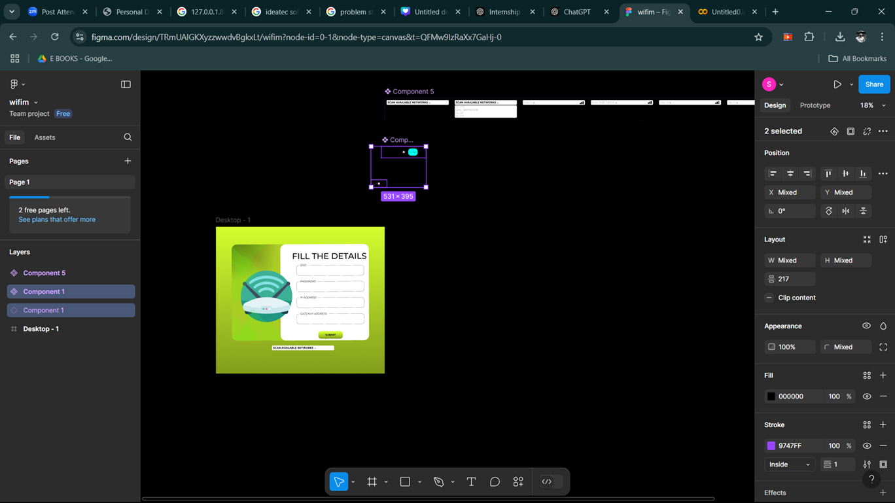
SUB TASKS:
UI/UX DESIGN FOR WIFI-MANAGER PORTAL

Slide 21
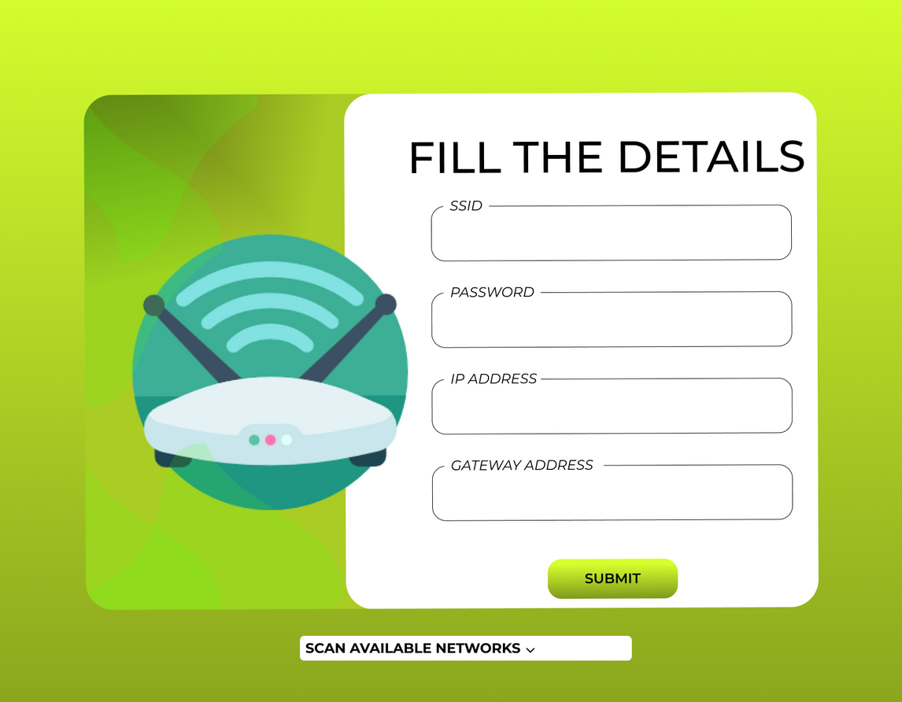
SUB TASKS:
UI/UX DESIGN FOR WIFI-MANAGER PORTAL

Slide 22
REFERENCES:
Django Apps Documentation
Python Official Chartjs and Django Documentation
Django Official Documentation
Python Official Documentation

