Slide 1














Summer Project
BTech Information Science and Technology
Anna University CEG Campus, Guindy
Inner voice
Real Time Obstacle Sensing with Proximity Alerts
Mentor
Dr. Vidhya
Presented by
Mytreyan Jeyabalan Gadhiraju Dinesh
2022115102 2022115064 2022115094

Slide 2
INTRODUCTION
Objective:
Developing a real-time object detection system that provides both positional feedback (left, center, right) and distance estimation of objects in a frame using YOLOv10.
Use Case :
Enhance safety in street navigation systems by identifying potential obstacles or points of interest and providing their relative position and distance to the user for better awareness.
Key Feature:
Real-time processing that provides immediate feedback on both the position (left, center, right) and approximate distance of detected objects to assist in safer navigation.

Slide 3
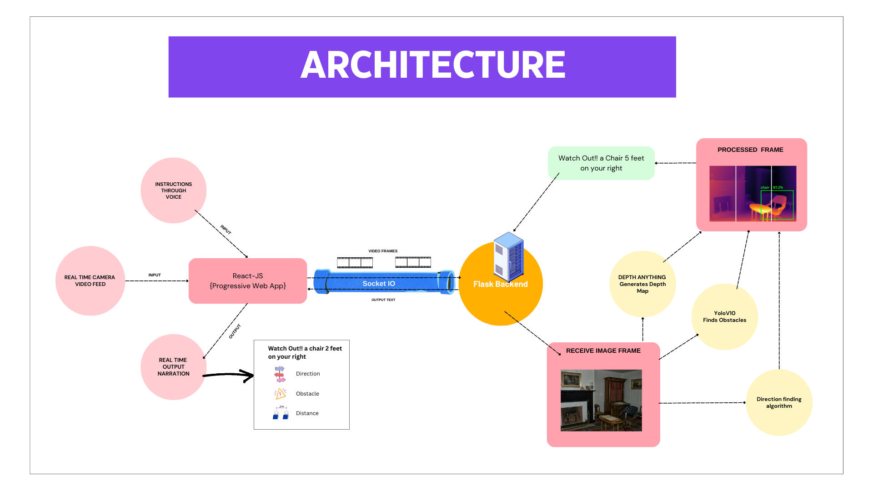

Slide 4
SafeStreet Features :
Positional Feedback:
Divides the frame into three segments (left, center, right) and provides object position relative to the user's view.
Distance Estimation
The system now estimates the distance of detected objects using a depth model, enhancing the user’s spatial awareness by providing both position and proximity of objects.
Real Time Alerts :
Ensures that users are immediately informed of objects in their path with messages like "Car detected on your left, 5 meters away."
The x-coordinate of the bounding box center is used to categorize the object's position, while the depth model computes the object's distance based on size and position within the frame.

Slide 5
Depth Estimation
A depth estimation model processes each video frame to generate a depth map, which indicates the distance of each pixel from the camera. The depth values are inverted and smoothed using a Gaussian blur to enhance usability.
Audio Utilization
Sound Emission: The system provides auditory cues when objects are detected in the user's path. The audio output indicates both the position (left, center, right) and the approximate distance of the object.
Continuous Monitoring: The audio feedback is continuously updated as long as the object remains in the frame. If the object moves out of view or is no longer detected, the audio feedback stops.

Slide 6
YOLO OBJECT DETECTION :
Real-time Object Detection:
YOLO processes images in real-time, offering near-instantaneous feedback, crucial for applications like street navigation.
Single Network Evaluation:
Unlike traditional methods, YOLO evaluates the entire image in one go, which improves speed and reduces false positives by considering the context of objects.
Confidence Score:
Each detected object is assigned a confidence score, indicating how certain the model is about the presence of the object, allowing for customizable thresholds for detection accuracy.

Slide 7
Implementation Details:
Frame Processing :
Frames are captured from the webcam and transmitted as base64-encoded strings to reduce data size and maintain image integrity during transmission.
The base64-encoded image is decoded into binary data, which is then converted into a Numpy array for efficient manipulation and compatibility with OpenCV.
Object Position Calculation:
After YOLO detects objects, it returns bounding boxes for each object. These boxes define the region of the frame where the object is located.
The center x-coordinate of each bounding box is computed by averaging the minimum and maximum x-values (x_min and x_max), determining the object's position relative to the frame.
WebSocket Communication:
The system uses Flask-SocketIO to continuously send base64-encoded images from the front-end to the back-end, where they are decoded and processed.
After processing, YOLO detection results (including object type, position, and distance) are sent back to the client in real-time using the same WebSocket connection, providing instant feedback to the user.

Slide 8
Technology Stack
React JS for Progressive Web App
SocketIO for Transmitting Video Frames
Flask for Backend
Transformers - Hugging Face
Ultralytics - YoloV10
Python Libraries - Numpy , CV2

Slide 9
Challenges Faced :
Frame Resizing Challenges:
Ensuring frames are resized appropriately for YOLO's input size without losing critical object details or distorting the image can be tricky, affecting detection accuracy.
The system must convert frames from BGR (used by OpenCV) to RGB (used by YOLO) before processing, adding an additional step that may affect frame rate.
Handling Real-time Data:
Ensuring low-latency, bi-directional communication between the server and the frontend to maintain real-time feedback without noticeable delays.
Managing the risk of frame drops during video streaming, ensuring synchronization between detected object positions and audio feedback.

Slide 10
Refrerences:
depth anything - arXiv:2401.10891v2 [cs.CV] 2024
yolov10- https://docs.ultralytics.com/models/yolov10/

Slide 11
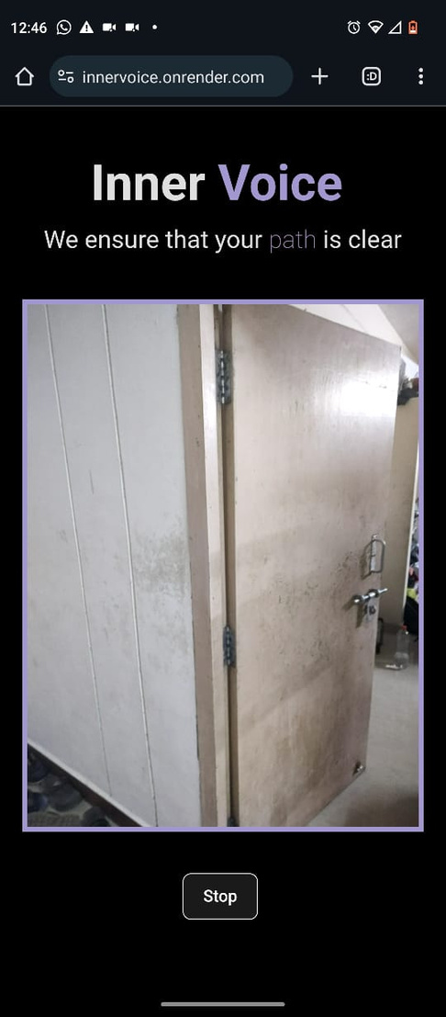
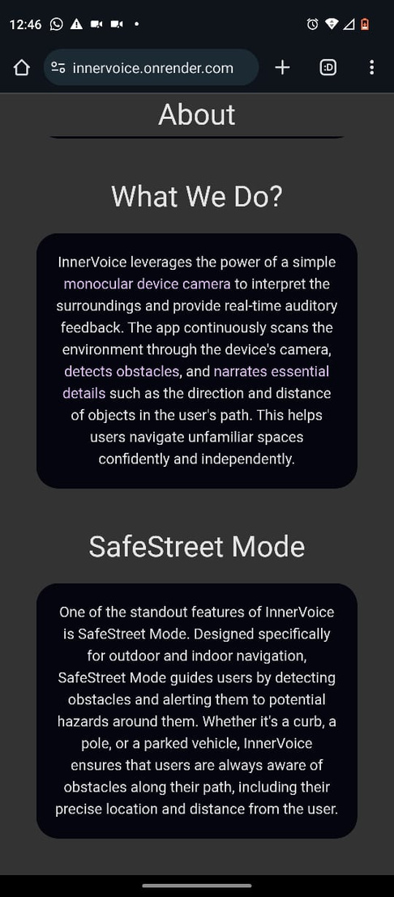
Visit Us
Hosted URL :
https://innervoice.onrender.com
Github URL :
InnerVoice

Slide 12
Thank you very much!

