Slide 1
Maximizing Efﬁciency: Streamlining Excel Automation for Project Revenue, Employee Hours, and Accurate Forecasts

Slide 2

Introduction to Excel Automation Using python libraries
In today’s fast-paced business environment, Excel automation is crucial for maximizing efficiency. This presentation will explore how to streamline processes related to project revenue, employee hours, and accurate forecasts to enhance productivity and decision making

Slide 3
Problem Definition
Manual processing of large volumes of Excel data for project revenue, employee hours, and forecast comparisons is error-prone and time-consuming.
Mismatches between employee data and project records can lead to inaccurate reporting of work hours.
Inconsistent data between base and weekly forecasts needs to be identified and corrected efficiently.

Slide 4

Objective
Automate the consolidation of project data and
revenue across multiple Excel files.
Ensure accuracy by matching employee work hours based
on project names and email IDs.
Identify discrepancies between base and weekly forecasts
to streamline project tracking and reporting.
.

Slide 5

Ideas
Existing manual methods for consolidating project data were
inefficient and prone to human error.
Python scripts were proposed to handle Excel processing,
leveraging libraries like pandas for data manipulation.
Configuration files were introduced to allow flexible control over
file paths, sheet names, and data ranges.

Slide 6
Detailed design
Consolidation of Project Data and Revenue:
Read project data and revenue from Excel files.
Populate consolidated files with forecast and actual revenue data.
Handle multiple Excel files with consistent data structures.
Employee Hours Matching:
Match project names and email IDs between project data and employee reports.
Write matched hours into weekly forecast sheets or log mismatches.
Uncommon Data Identification:
Compare base and weekly forecast data for discrepancies.
Output differences to a consolidated report with project names, emails, and forecast hours.

Slide 7
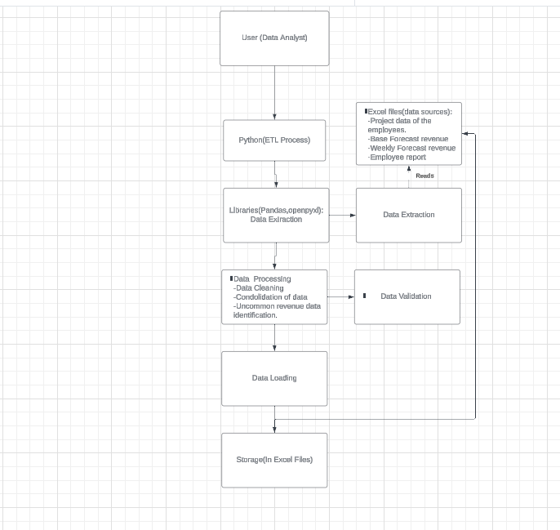
System Architecture:

Slide 8
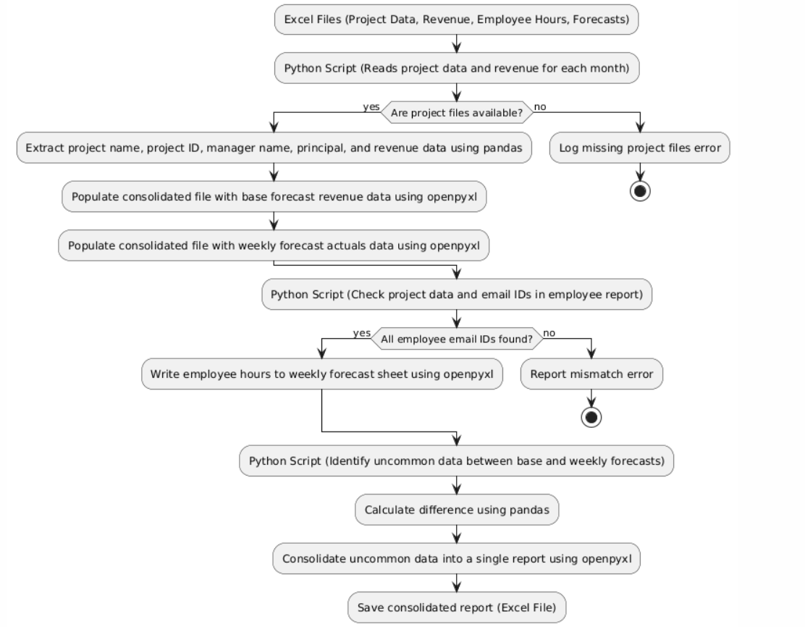
System design flow

Slide 9
Tools and Technologies Used:
Programming Language: Python
Libraries: pandas (for data processing), openpyxl (for Excel file manipulation),ConfigParser.
Configuration Files: .ini format for flexibility in specifying file paths, sheet names, and data ranges.
Tools: Excel for data input/output and Python scripts for automation.

Slide 10
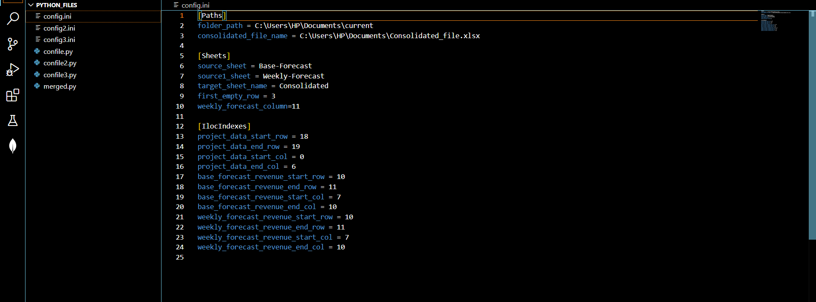
Screenshots
Config.ini files:

Slide 11
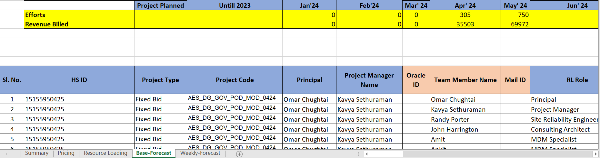
Revenue data:

Slide 12
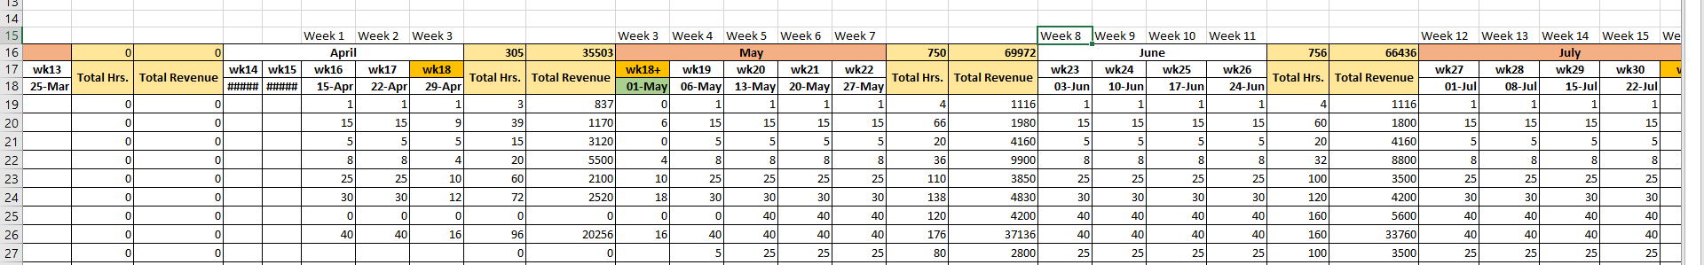
Base-Forecast hours of Each employee For a particular project assigned:

Slide 13
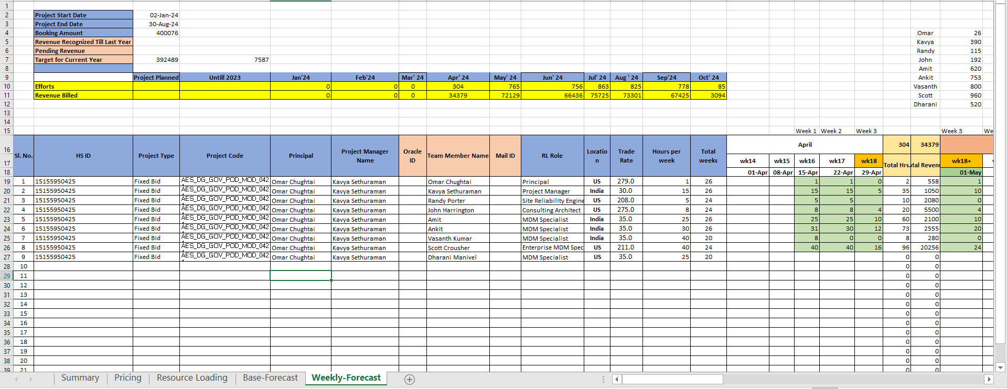
Weekly Forecast hours(Actual time the employee has worked)

Slide 14
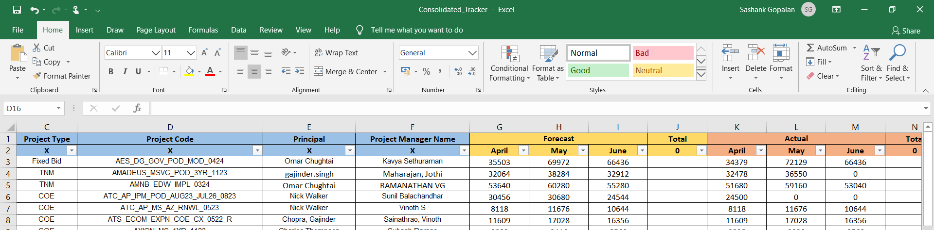
Output: Consolidated Revenue data

Slide 15
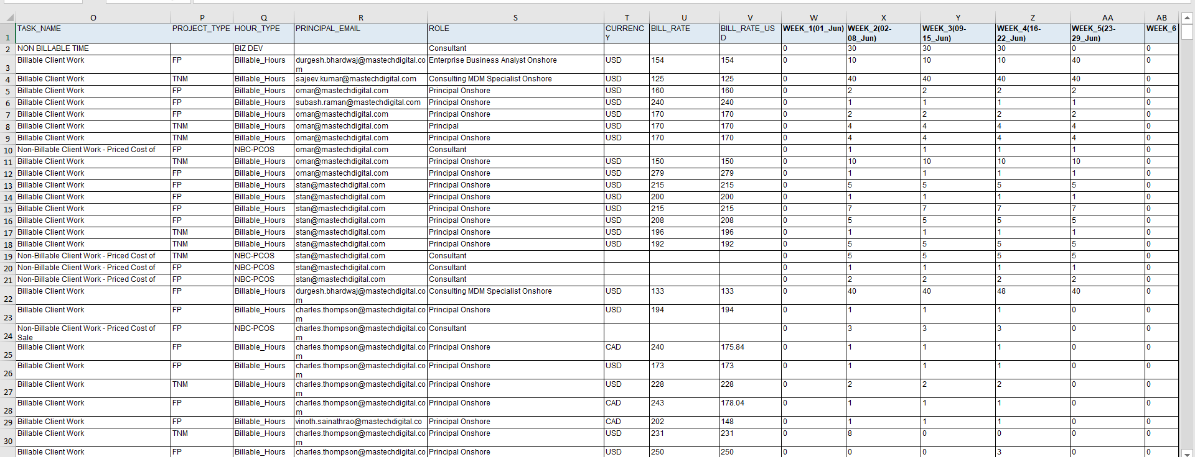
Output: Employee report forecast

Slide 16
Results and conclusions
Consolidation Efficiency: The project data and revenue consolidation script successfully processes multiple Excel files, reducing manual effort and increasing accuracy.
Improved Accuracy: The employee hours matching script detects mismatches between employee reports and project data, ensuring that only valid data is written to weekly forecasts.
Enhanced Forecast Tracking: The uncommon data script identifies discrepancies
between base and weekly forecasts, aiding in better project management and resource allocation.

