Slide 1
Sign2Speech
Talk to AI with Hand Signs
MENTOR - Mr.H.Riasudheen
Team
Arun Karthick S - 2022115082
Madhan D - 2022115084
Abhinav M S - 2022115039

Slide 2
Introduction
Our project integrates American Sign Language (ASL) with AI, allowing users to chat through hand gestures.
ASL signs are converted into text, sent to Ollama for AI-generated responses, and then spoken aloud.
Additionally, it includes special features like gesture-based volume control (using thumb-index distance), a presentation controller for moving and writing on slides, and a virtual mouse for controlling the cursor and taking screenshots.
This system enhances accessibility and interaction by combining AI with intuitive hand gestures.

Slide 3
Problem Definition
Our project addresses communication challenges for deaf, mute, and blind individuals.
It detects ASL hand signs, converting them into text for AI-based chatting, with responses read aloud for blind users who understand ASL.
Additionally, the system includes gesture-based features like volume control, presentation navigation, and virtual mouse control, aiding people with limited mobility and enhancing interaction. This creates a more accessible and intuitive way to engage with technology.

Slide 4
Idea
We aim to improve communication for deaf and mute individuals in public spaces like IRCTC booking counters, bus stations, and train stations. To do this, we will survey users to understand their challenges when seeking assistance and gathering information while traveling. We will evaluate the relevance of our ASL detection and AI chat system, along with gesture-based features for users with limited mobility. This feedback will help us refine our solution to better meet their needs in these environments.

Slide 5
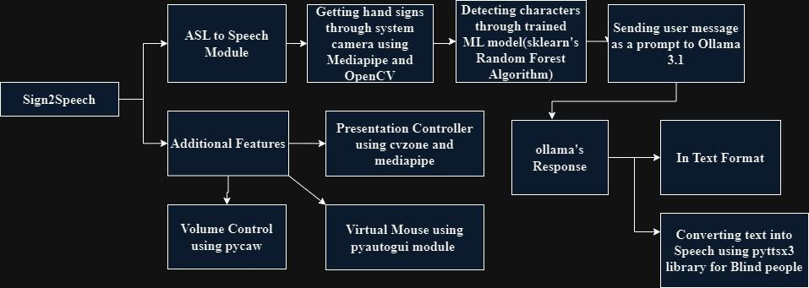
System Architecture

Slide 6
Design
Front End:
The Sign2Speech front-end, built with Streamlit, lets users perform ASL gestures and see real-time text translation, with the option to send text to Ollama 3.1 for AI responses.
Users can toggle between text and speech output using pyttsx3.
Gesture-based controls include volume adjustment, presentation navigation, and a virtual mouse.
Back End:
The backend of Sign2Speech uses MediaPipe and OpenCV for real-time ASL gesture capture.
A Scikit-Learn Random Forest model processes gestures into text, which is sent to Ollama 3.1 for AI responses. pyttsx3 handles text-to-speech conversion, while cvzone, pycaw, and pyautogui enable gesture-based presentation control, volume adjustment, and virtual mouse functions.

Slide 7
Tools and Technologies
Frontend:
- Streamlit - For UI
Machine Learning Model:
- Scikit-Learn (Random Forest)
- Ollama 3.1 - for AI response
- Pickle
Python Modules:
- MediaPipe
- OpenCV
- Pycaw
- Pyttsx3
- PyAutoGUI
- Cvzone

Slide 8
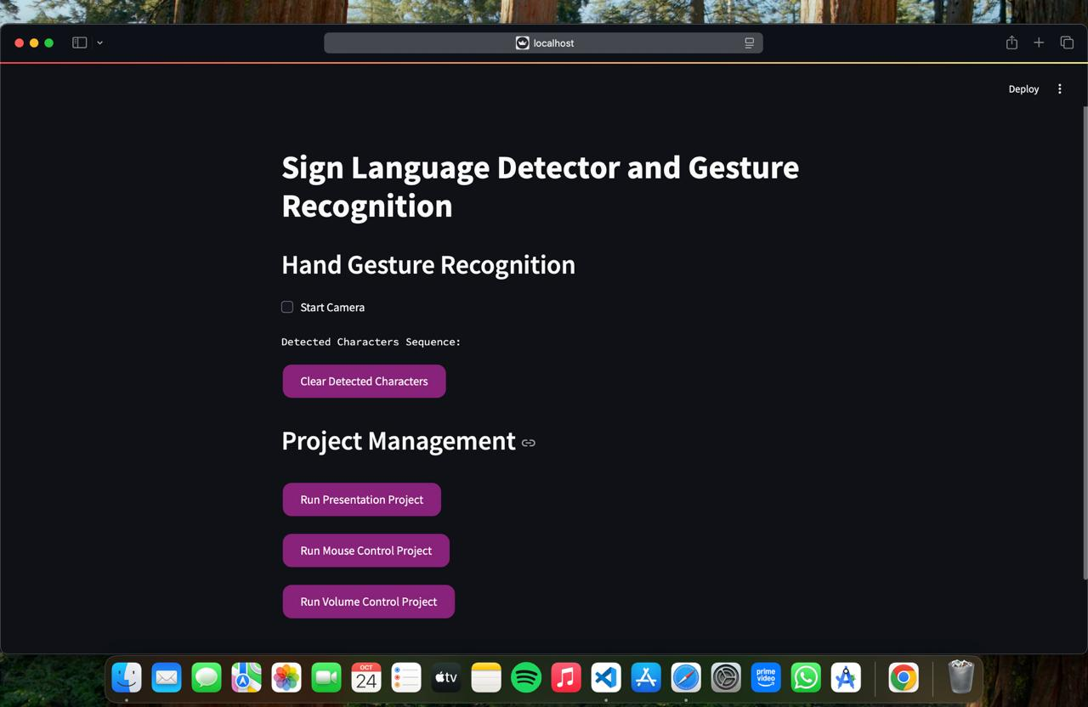
OUTPUT - SCREENSHOTS (ASL)

Slide 9
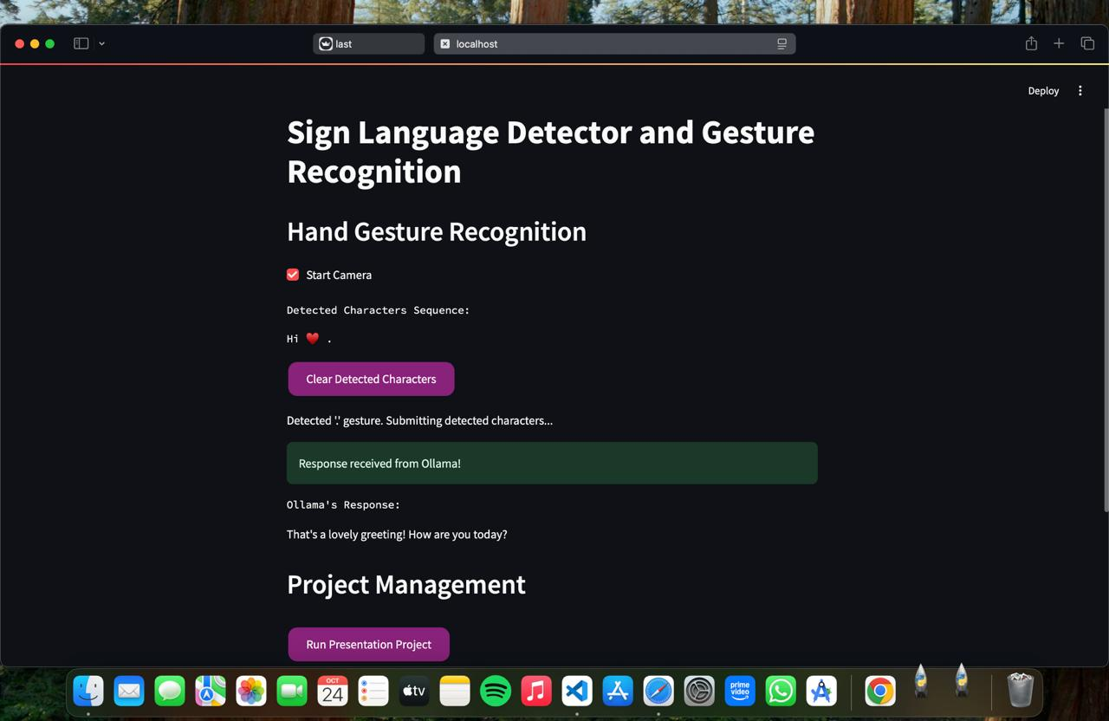

Slide 10
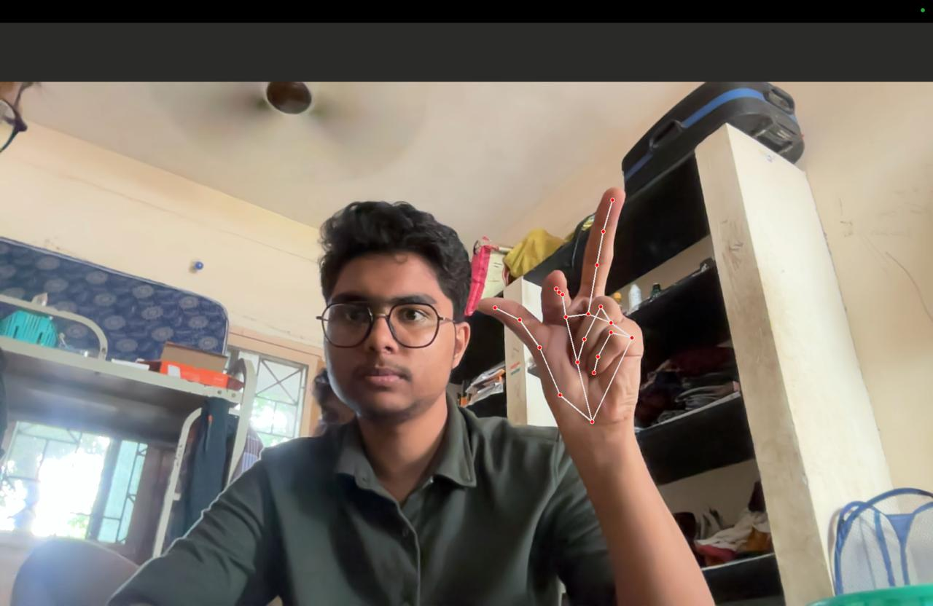
VIRTUAL MOUSE

Slide 11
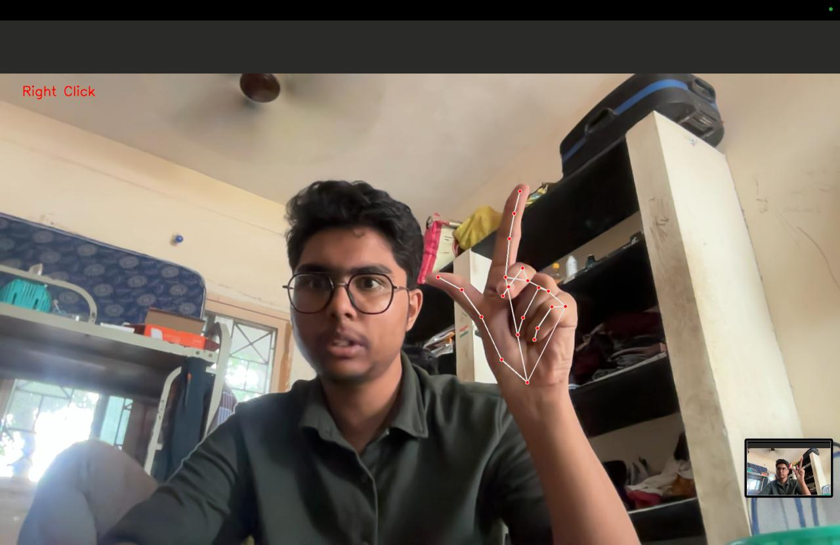

Slide 12
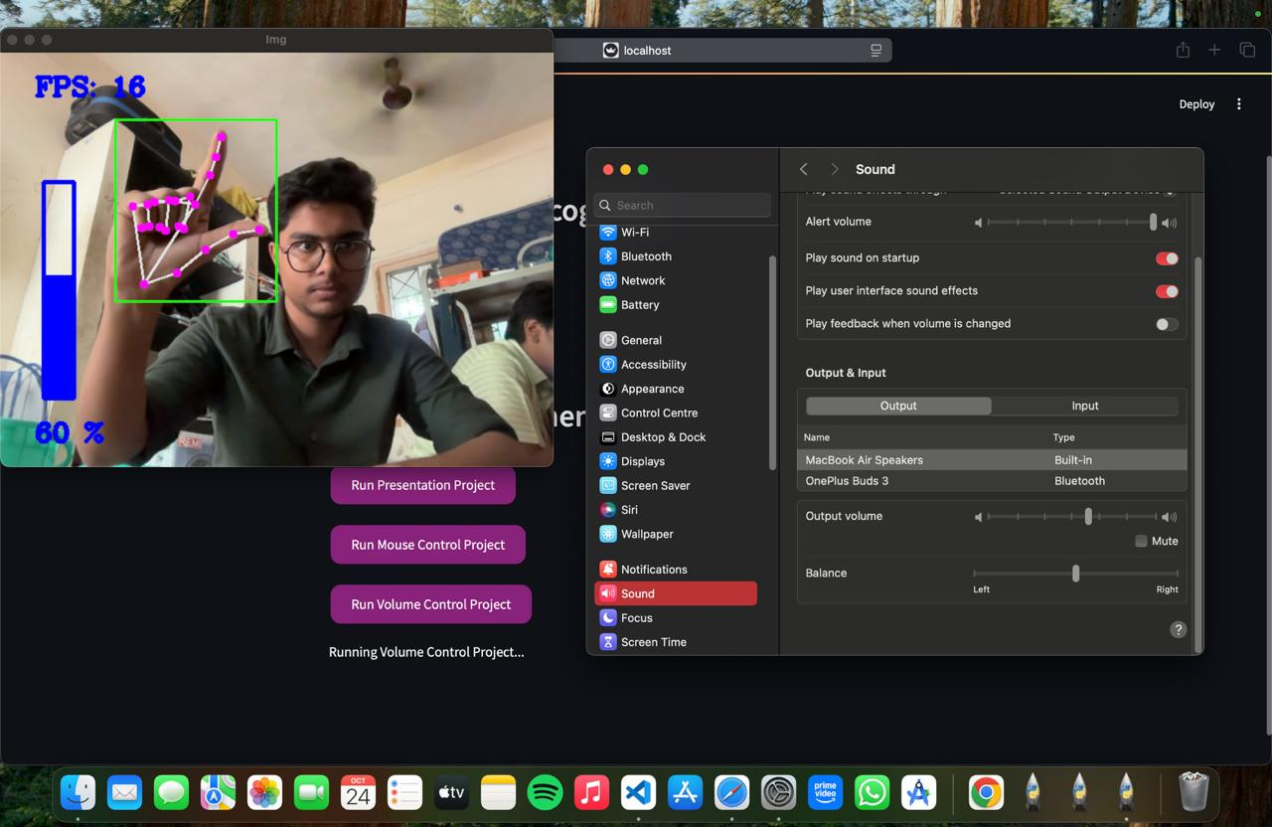
VOLUME CONTROL

Slide 13
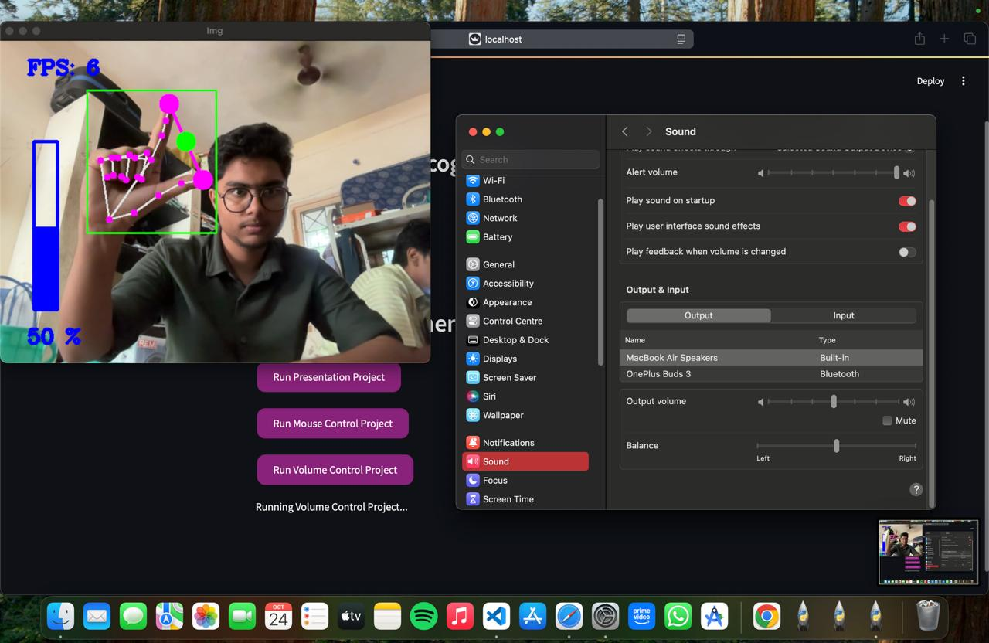

Slide 14
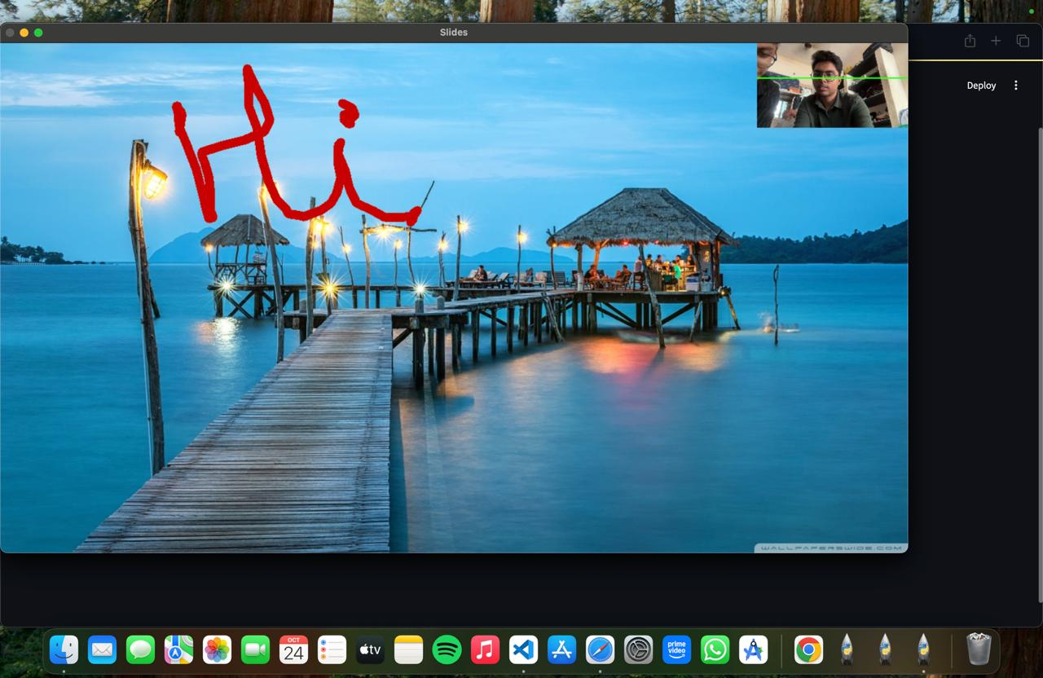
PRESENTATION CONTROLLER

Slide 15
Results
The ASL-AI Communication System enables deaf and mute individuals to communicate by translating ASL into text and generating AI responses, which are converted to speech for blind users.
Its gesture control features, including volume adjustment and virtual mouse functionality, enhance accessibility for users with limited mobility.
Designed for public spaces like train stations and booking centers, the system assists users in navigating services and gathering information.

