Slide 1

VigilEye
Home Security Automation using Face Recognition and Suspicious Activity Detection

Slide 2

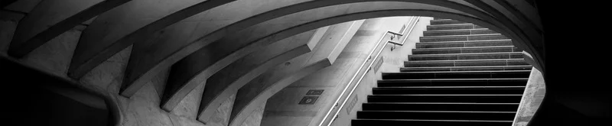
Table of contents
Title | 3
Introduction | 3
Problem definition | 4
Objective | 5
Ideas | 6
System Architecture and Detailed Design | 8
Tools and Technologies | 10
Screenshots | 10
References | 13

Slide 3
Problem Definition
Home security remains a major concern due to increasing threats like burglary and unauthorized access.
Many traditional security systems rely on basic motion detection, leading to false alarms and difficulty distinguishing between authorized and unauthorized people.
Current systems do not effectively balance ease of use, ID verification, and breathing comfort, affecting overall security integration.
Elderly individuals often find it difficult to interact with these systems due to poor user interfaces.

Slide 4




Objective
Profile-based restrictions for visitors to personalize access control.
Automatically detect unusual activities using CCTV or hidden cameras
Provide a simple and intuitive user interface for easy operation
Ensure accessibility for elderly people with user-friendly features.

Slide 5
VigilEye
VigilEye is an evolved home security system combining three essential units working as a whole
mobile application
face recognition tool
surveillance camera
The mobile app allows users to create and manage their profiles, while the face recognition system ensures accurate identification of individuals.
The discreetly placed surveillance camera captures and analyzes activities in real-time, detecting suspicious behavior.
Additionally, VigilEye offers profile-based access restrictions, automatic detection of unusual activities, and an elder-friendly interface with voice control to ensure easy operation for seniors, making it a comprehensive and accessible security solution.

Slide 6
Ideas
Suspicious Activity Detection
prepared dataset for said model
Profile-Based Restrictions
Add, update and maintain a repository of faces
Voice Control for Elders
Enable elderly people to use voice commands for easier access and operation.

Slide 7
DeepFace
Face Recognition
Yolo v8
suspicious activity detection
Tech Stack
Flask
RestAPI
React Native - Expo
Android development
React Native Paper
UI Component Library

Slide 8
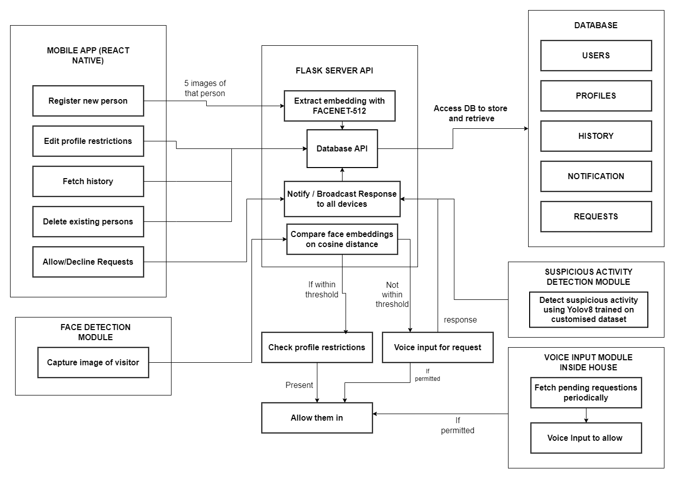
System Architecture

Slide 9
Detailed Design
MongoDB was selected to handle unstructured data, such as facial embeddings, due to its flexibility and scalability.
API to interact with the DB and models was built using Flask as python gives access to ML libraries such as scikit learn, PyTorch and numPy.
The mobile app was developed using React Native due to its platform independent framework with high developer velocity
For the UI, React Native Paper was used to align with Google's Material Design principles.
Suspicious activity detection is trained using YOLOv8 for building state-of-the-art Image detection CNNs

Slide 10

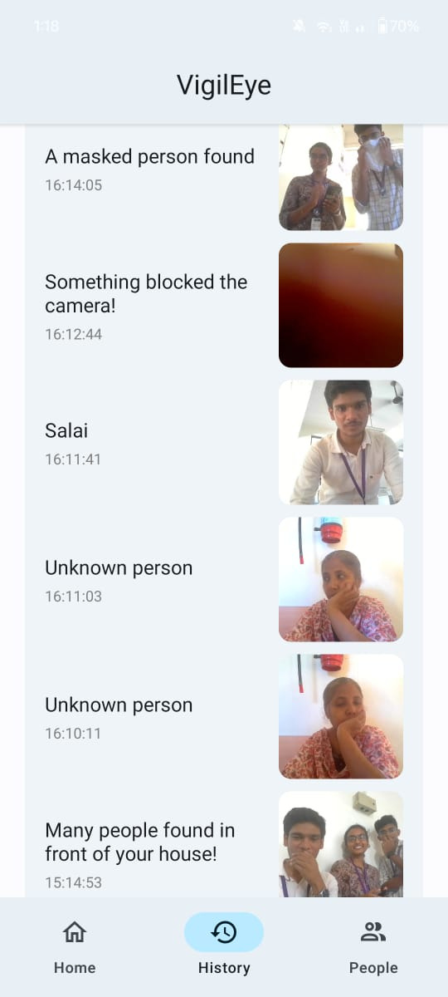
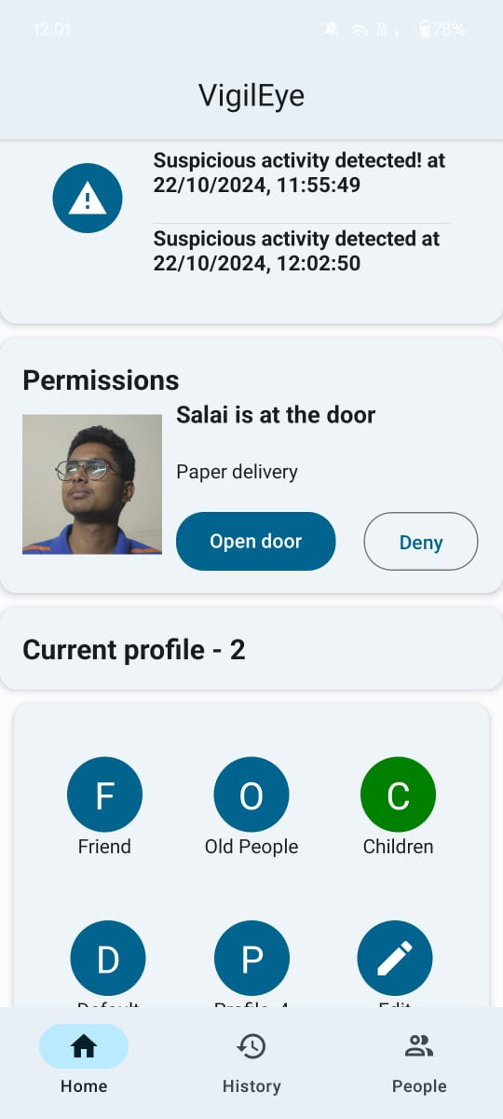
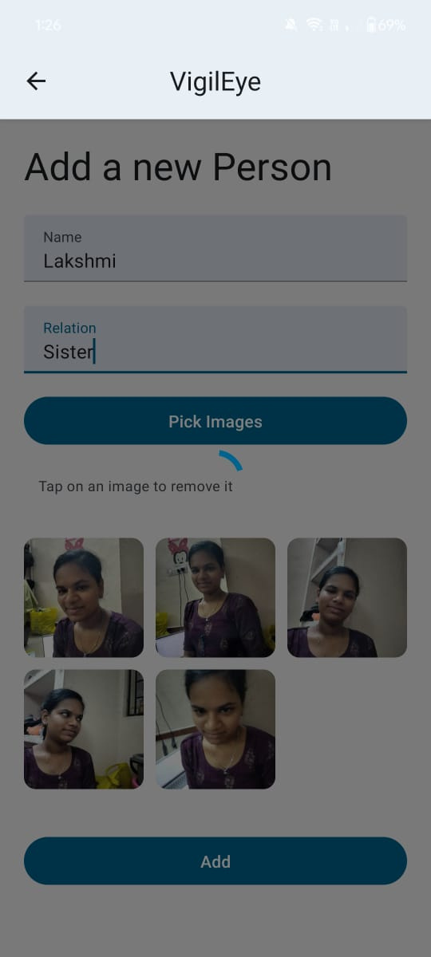
Screenshots

Slide 11
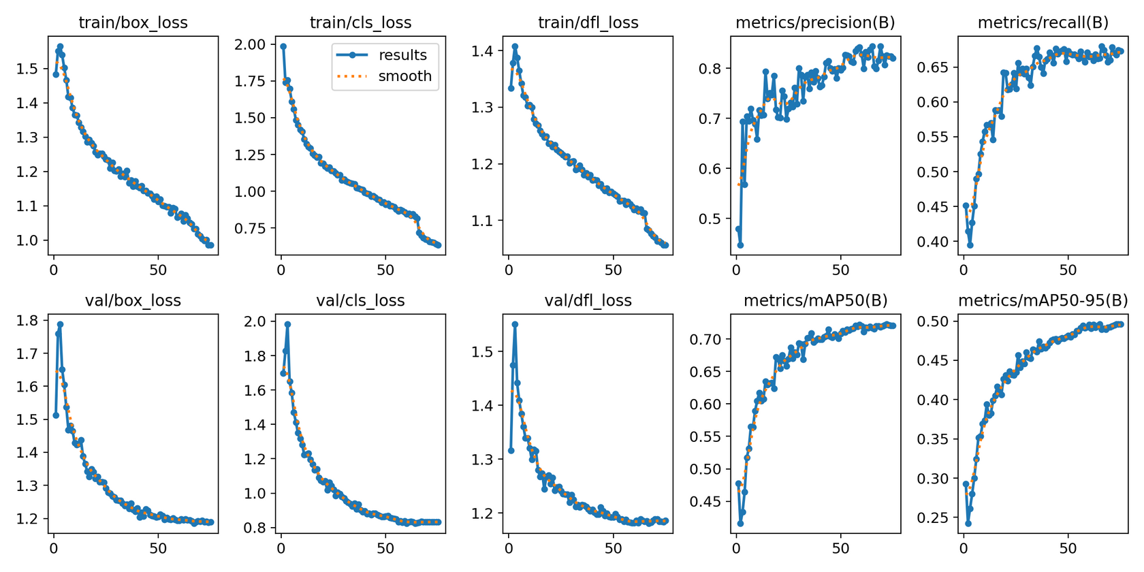
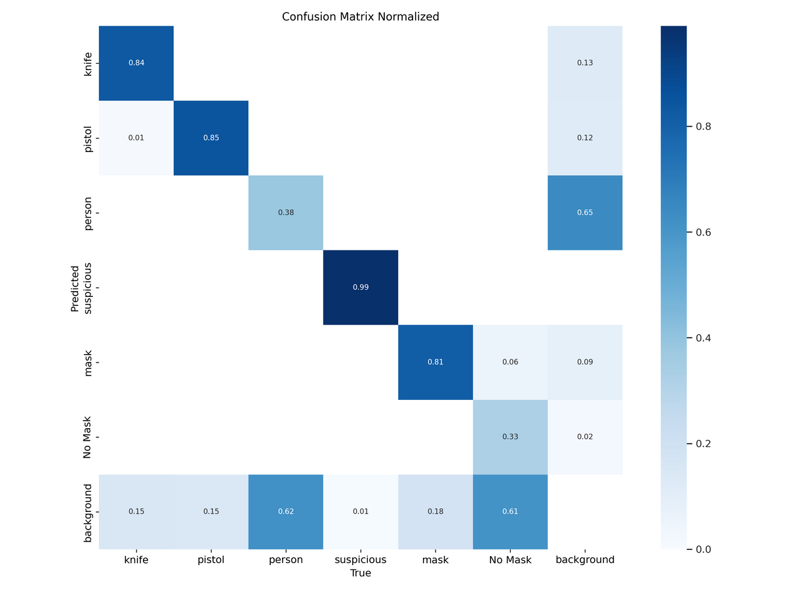
Suspicious Activity Detection
Results
Confusion matrix

Slide 12
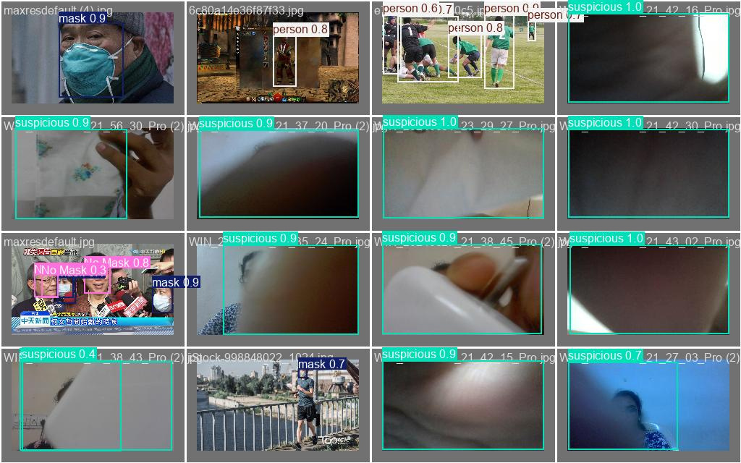
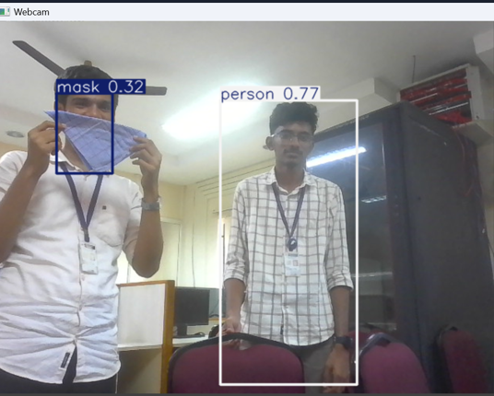
Suspicious Activity Detection
Predictions

Slide 13
Meet The Team
1) Varun Karthik T - 2022115060
2) Ezhil Dhiraviya J - 2022115077
3) Salai Kowshikan S - 2022115081
Mentored by:
Dr. K Vani,
Professor, Department of IST

