Slide 1
System Analysis and Design
Assignment 1
Online Affordable Delivery Platform (Mobile Application)
© 2020 Xuanao Zhao, Ryan Cheah, Yong Liang Poo, Tiew Shou Cheng.

Slide 2

Assignment Information
Xuanao Zhao 20023404
Subject Name/Code
System Analysis and Design
DIT2143
Poo Yong Liang 20023404
Lecturer
Ryan Cheah 20018222
Ms Kumatha Velli Muruyandy
Programme / Intake
Diploma In Information Technology (March - 2020)
Tiew Shou Cheng 20038550

Slide 3


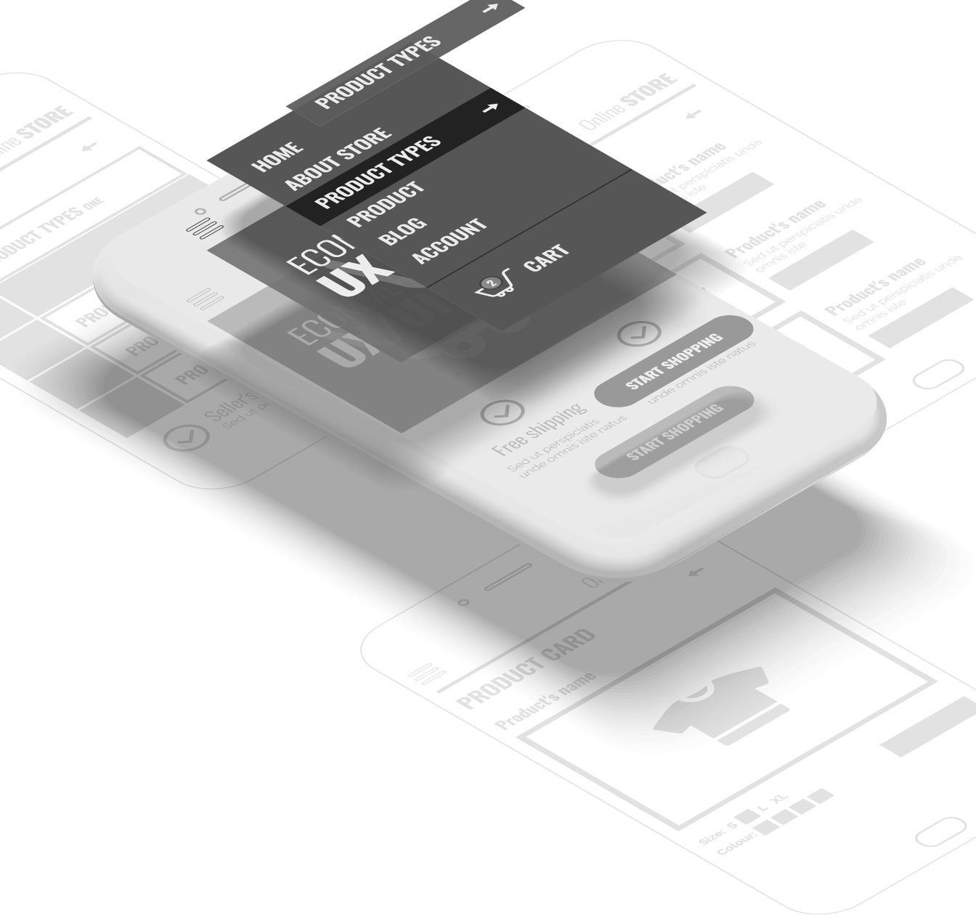
In this presentation
Background Information Introduction to the project
Requirements & Design Functional/Non-Functional Requirements, Modeling
UI Design UI Concept and Demos

Slide 4
Background Information
In this section:
Introduction
Objective
User Groups and Other Stakeholders
Background Information Introduction to the project

Slide 5

Background Information
Introduction
Those reliable delivery services are very expensive.
I can’t leave my house; I need to take care of my kids.
Can’t match my delivery time and customer’s delivery time.
Notes:
Where did this idea came from?

Slide 6
Background Information
Objective
User-friendly
Can be easily understood & used by anyone
Reliable
Can be trusted and be sure of what's happening
Convenient
Use it anytime and anytime

Slide 7
Background Information
User Groups
Sellers
From home; Sells item with short expiration / relatively low in price/quality.
People needs income
People who requires extra income to support daily life

Slide 8
Background Information
Other Stakeholders
Staff & Admins
Monitor the platform, marketing etc.
Developers
Develops & maintain the system

Slide 9
Requirements & Design
In this section:
Requirement by Client
Technical Summery of Functional Requirements
Other Non-Functional Requirements
Requirements & Design Functional/Non-Functional Requirements, Modeling

Slide 10
Requirements & Design
Request by Client
Seller
Notes:
Where did this idea came from?

Slide 11
Request by Client
Seller
Notes:
Where did this idea came from?

Slide 12
Request by Client
Seller
Notes:
Where did this idea came from?

Slide 13
Request by Client
Seller
Receiver
Notes:
Where did this idea came from?

Slide 14
Request by Client
Seller
Receiver
Notes:
Where did this idea came from?

Slide 15
Request by Client
Seller
Receiver
Riders
Notes:
Where did this idea came from?

Slide 16
Request by Client
Request 5
Seller
Receiver
Request 1
Request 2
Request 3
Request 4
Request 5
Riders
Request 6
Notes:
Where did this idea came from?

Slide 17
Request by Client
Request 5
Request 1
Seller
Receiver
Request 2
Request 3
Request 4
Request 5
Request 6
Riders
Notes:
Where did this idea came from?

Slide 18
Request by Client
Request 5
Request 1
Seller
Receiver
Request 2
Request 3
Request 4
Request 5
Request 6
Riders
Notes:
Where did this idea came from?

Slide 19
Request by Client
Seller
Riders
Receiver
Notes:
Where did this idea came from?

Slide 20
Request by Client
Seller
Riders
Receiver
Notes:
Where did this idea came from?

Slide 21
Request by Client
Seller
Receiver
Notes:
Where did this idea came from?

Slide 22
Request by Client
Seller
Riders
Receiver
Notes:
Where did this idea came from?

Slide 23
Requirements & Design
Request by Client
Seller
Riders
Receiver
Notes:
Where did this idea came from?

Slide 24
Requirements & Design
Technical Summery
Account System & User Registration
Every user should have an account
Post & Manage Delivery Requests
Post, Edit, Remove by Sender
Accept & Manage Accepted Delivery Requests
Accept, Complete, Cancel a request by Rider

Slide 25
Requirements & Design
Non-Functional Requirements
Notification of Account Accept/Reject
Get a notification for account being accepted/Rejected
Map for Seller/Rider
Sender can track the Rider; Rider can follow the GPS to destination
Messaging/Calling feature.
Rider and Sender can contact by messaging and calling feature provided

Slide 26
Requirements & Design
System model
Delivery Platform for Seller/Riders
Registration
User
<< i >>
Admin
Update Personal Information
Verification of Registration
Post Request
Edit Request
<< e >>
Sender
Manage Requests
<< e >>
Remove Request
Accept Requests
Rider
Complete Requests
Cancel Request

Slide 27
Requirements & Design
System model
Delivery Platform for Seller/Riders
User Account
Registration
Account ID
Username
User
<< i >>
Admin
Password
Update Personal Information
Verification of Registration
Email Address
Post Request
Rider
Sender
1 .. *
1
Store
Edit Request
Vehicle Info
Store ID
<< e >>
1 .. *
Store Address
Sender
Manage Requests
1 .. *
Remove Request
Store Description
<< e >>
Request
Accept Requests
1
Request ID
DateTime
1
Rider
Complete Requests
Destination
Cancel Request

Slide 28
Requirements & Design
System model
Use case name | Registration
Scenario | New user wants to join the platform by creating a new user-account
Triggering Event | Select Create Account in Menu
Brief description | Users either create a sender-account/rider-account by entering their basic information and vehicle information if necessary.
Actors | User, Admin
Stakeholders | Platform’s User management, User
Preconditions | Make sure user is not repeating the registration
Postconditions | New user accounts must be saved in the database. User information must be validate
Flow of activities | User (Actor 1) | Admin (Actor 2) | System
 | User enter basic information |  | 1.1 Validate user information 1.2 Check if its rider
 | 2. User enter vehicle information (only if rider)
 |  | 3. Admin verifies vehicle information | 3.1 Updates database and save new account information
Exception Conditions | 1.1: User information not valid 3: Admin reject user registration
Delivery Platform for Seller/Riders
Registration
User
<< i >>
Admin
Update Personal Information
Verification of Registration
Post Request
Edit Request
<< e >>
Sender
Manage Requests
<< e >>
Remove Request
Accept Requests
Rider
Complete Requests
Cancel Request

Slide 29
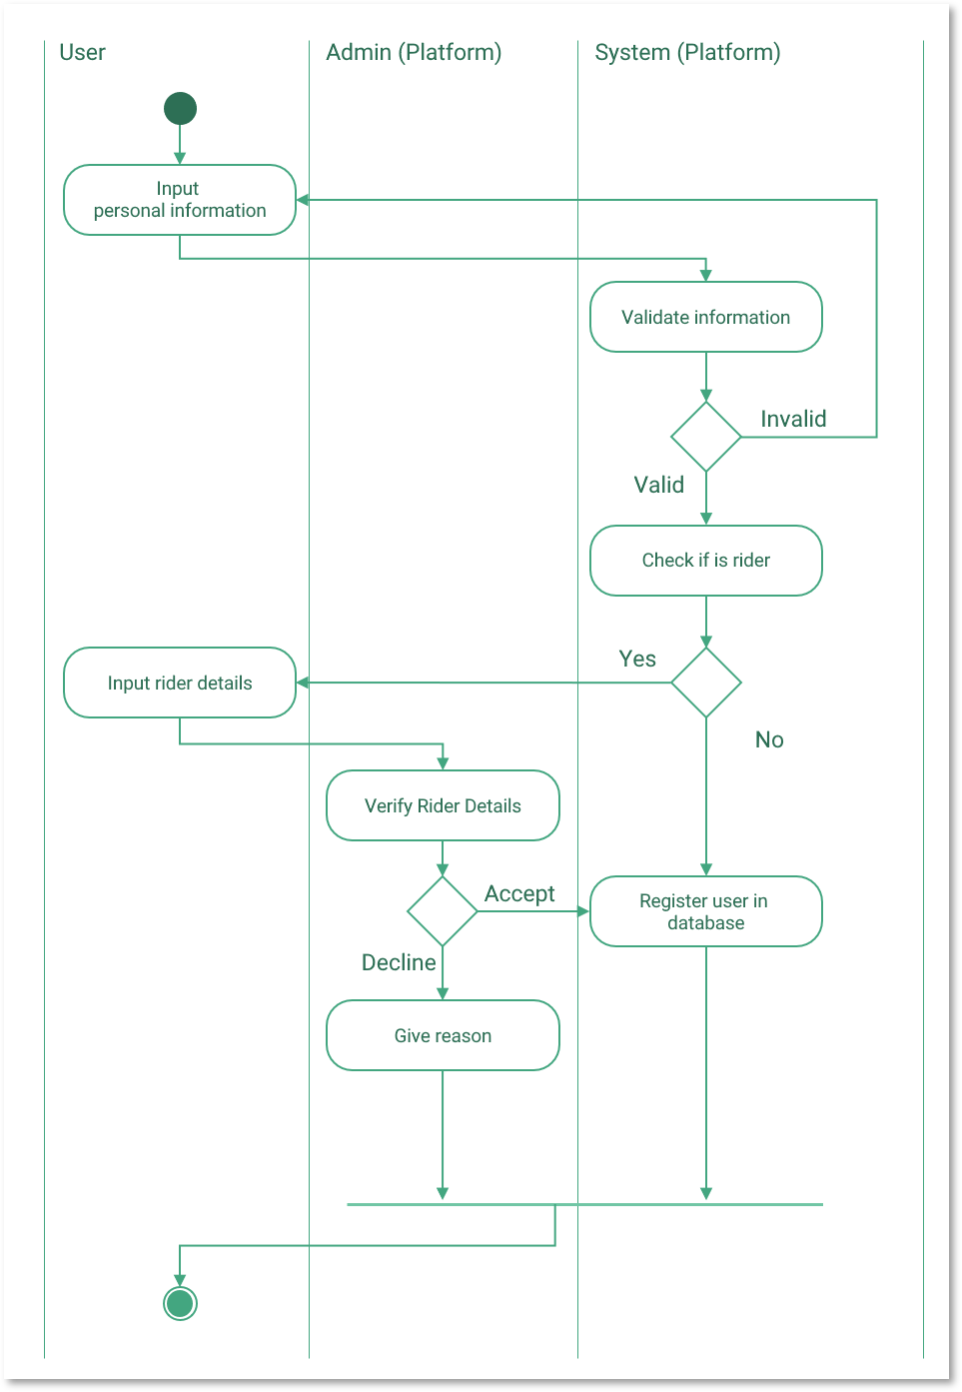
Requirements & Design
System model
Delivery Platform for Seller/Riders
Registration
User
<< i >>
Admin
Update Personal Information
Verification of Registration
Post Request
Edit Request
<< e >>
Sender
Manage Requests
<< e >>
Remove Request
Accept Requests
Rider
Complete Requests
Cancel Request

Slide 30
Requirements & Design
System model
Delivery Platform for Seller/Riders
Registration
User
<< i >>
Admin
Update Personal Information
Verification of Registration
Post Request
Edit Request
<< e >>
Sender
Manage Requests
<< e >>
Remove Request
Accept Requests
Rider
Complete Requests
Cancel Request

Slide 31
Requirements & Design
System model
Delivery Platform for Seller/Riders
Use case name | Update personal information.
Scenario | When a user wishes to update their personal information (name, email, password etc).
Triggering Event | User selects Update My Information in the settings menu.
Brief description | Users update their personal information by entering new information.
Actors | User
Stakeholders | Platform’s User Management, User
Preconditions | None
Postconditions | New information has to be valid New information must be updated in the database.
Flow of activities | User (Actor) | System
 | 1. Select an information to change
 | 2. Enter a new information | 2.1 Validate entered information
Exception Conditions | 1. Information unchangeable (Date of birth, IC Number) 2.1 Information invalid
Registration
User
<< i >>
Admin
Update Personal Information
Verification of Registration
Post Request
Edit Request
<< e >>
Sender
Manage Requests
<< e >>
Remove Request
Accept Requests
Rider
Complete Requests
Cancel Request

Slide 32
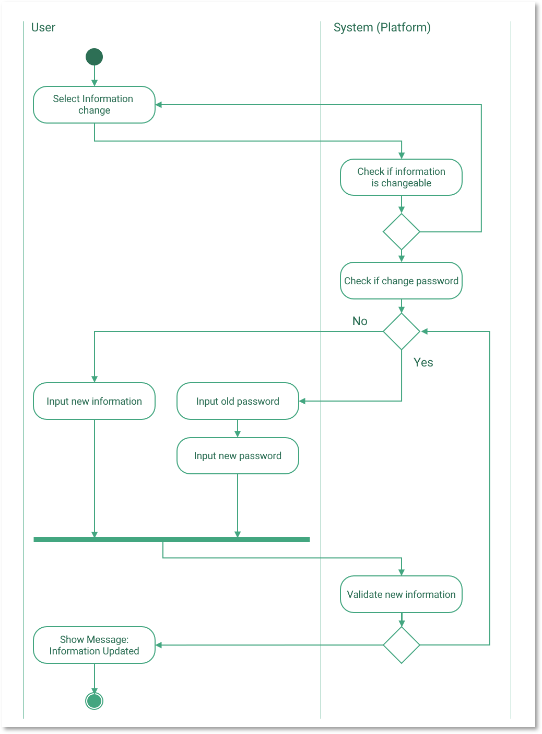
Requirements & Design
System model
Delivery Platform for Seller/Riders
Registration
User
<< i >>
Admin
Update Personal Information
Verification of Registration
Post Request
Edit Request
<< e >>
Sender
Manage Requests
<< e >>
Remove Request
Accept Requests
Rider
Complete Requests
Cancel Request

Slide 33
Requirements & Design
System model
Delivery Platform for Seller/Riders
Registration
User
<< i >>
Admin
Update Personal Information
Verification of Registration
Post Request
Edit Request
<< e >>
Sender
Manage Requests
<< e >>
Remove Request
Accept Requests
Rider
Complete Requests
Cancel Request

Slide 34
Requirements & Design
System model
Delivery Platform for Seller/Riders
Use case name | Post Requests
Scenario | When a user wishes a rider can come and pick up some items and deliver to a relatively nearby destination
Triggering Event | Sender selects the Post Request button from the menu.
Brief description | Senders post a “Delivery Request” by selecting a start point (a store) and entering a destination address.
Actors | Sender
Stakeholders | User (Sender, Rider)
Preconditions | None
Postconditions | Requests should be open for riders who are nearby the selected starting point.
Flow of activities | Sender (Actor) | System (Actor)
 | 1. Select a starting point and destination address | 1.1 Validate destination address 1.2 Generate a new request
Exception Conditions | 1.1 Destination address invalid
Registration
User
<< i >>
Admin
Update Personal Information
Verification of Registration
Post Request
Edit Request
<< e >>
Sender
Manage Requests
<< e >>
Remove Request
Accept Requests
Rider
Complete Requests
Cancel Request

Slide 35
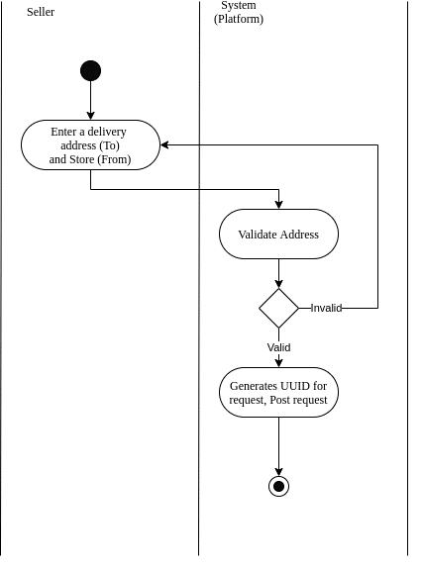
Requirements & Design
System model
Delivery Platform for Seller/Riders
Registration
User
<< i >>
Admin
Update Personal Information
Verification of Registration
Post Request
Edit Request
<< e >>
Sender
Manage Requests
<< e >>
Remove Request
Accept Requests
Rider
Complete Requests
Cancel Request

Slide 36
Requirements & Design
System model
Delivery Platform for Seller/Riders
Use case name | Manage Request (Edit, Remove).
Scenario | When a user wishes to update their posted request (Starting point, destination).
Triggering Event | Sender select edit button for a certain request
Brief description | Sender modifies the address, starting point by selecting a new address or starting point, or removes the request.
Actors | Sender, Rider
Stakeholders | Users (Sender, Rider)
Preconditions | Request must exist
Postconditions | Request must be updated If the request is being accepted, the modification must be notified to the rider.
Flow of activities | Sender (Actor 1) | Rider (Actor 2) | System
 | 1. Select edit or remove, and type in a new information if edit |  | 1.1 Validate information 1.2 See if any rider accept 1.3 Establish communication between Rider & Sender
 |  | 2. Accept changes | 2.1 Update the changes in system/Database
Exception Conditions | 1.1 Information invalid 2. Rider do not accept the changes
Registration
User
<< i >>
Admin
Update Personal Information
Verification of Registration
Post Request
Edit Request
<< e >>
Sender
Manage Requests
<< e >>
Remove Request
Accept Requests
Rider
Complete Requests
Cancel Request

Slide 37

Requirements & Design
System model
Delivery Platform for Seller/Riders
Registration
User
<< i >>
Admin
Update Personal Information
Verification of Registration
Post Request
Edit Request
<< e >>
Sender
Manage Requests
<< e >>
Remove Request
Accept Requests
Rider
Complete Requests
Cancel Request

Slide 38
Requirements & Design
System model
Delivery Platform for Seller/Riders
Registration
User
<< i >>
Admin
Update Personal Information
Verification of Registration
Post Request
Edit Request
<< e >>
Sender
Manage Requests
<< e >>
Remove Request
Accept Requests
Rider
Complete Requests
Cancel Request

Slide 39
Requirements & Design
System model
Delivery Platform for Seller/Riders
Use case name | Accept Request
Scenario | Rider wishes to accept a delivery request
Triggering Event | Rider select an available request and select accept request
Brief description | Rider accepts a delivery request by selecting the accept option of an request
Actors | Rider
Stakeholders | Rider, Sender
Preconditions | Request is not being accepted by anyone else Request is nearby
Postconditions | No other rider should be able to accept the same request
Flow of activities | Rider (Actor) | System
 | 1. Select accept request option | 1.1 Send notification to sender: Request being accepted
Exception Conditions | None
Registration
User
<< i >>
Admin
Update Personal Information
Verification of Registration
Post Request
Edit Request
<< e >>
Sender
Manage Requests
<< e >>
Remove Request
Accept Requests
Rider
Complete Requests
Cancel Request

Slide 40
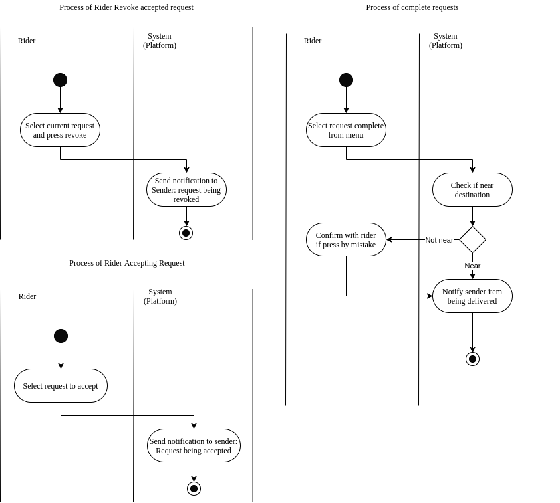
Requirements & Design
System model
Delivery Platform for Seller/Riders
Registration
User
<< i >>
Admin
Update Personal Information
Verification of Registration
Post Request
Edit Request
<< e >>
Sender
Manage Requests
<< e >>
Remove Request
Accept Requests
Rider
Complete Requests
Cancel Request

Slide 41
Requirements & Design
System model
Delivery Platform for Seller/Riders
Use case name | Revoke/Cancel Accepted Request
Scenario | Rider wishes to drop/cancel an accepted delivery request
Triggering Event | Rider select the accepted request and press revoke/cancel button
Brief description | Rider revokes an accepted request.
Actors | Rider
Stakeholders | Rider, Sender
Preconditions | Request is being accepted
Postconditions | Request status must be updated and saved in system/database
Flow of activities | Rider (Actor) | System
 | 1. Select revoke/cancel option | 1.1 Send notification to sender: Request being canceled
Exception Conditions | None
Registration
User
<< i >>
Admin
Update Personal Information
Verification of Registration
Post Request
Edit Request
<< e >>
Sender
Manage Requests
<< e >>
Remove Request
Accept Requests
Rider
Complete Requests
Cancel Request

Slide 42
Requirements & Design
System model
Delivery Platform for Seller/Riders
Registration
User
<< i >>
Admin
Update Personal Information
Verification of Registration
Post Request
Edit Request
<< e >>
Sender
Manage Requests
<< e >>
Remove Request
Accept Requests
Rider
Complete Requests
Cancel Request

Slide 43
Requirements & Design
System model
Delivery Platform for Seller/Riders
Registration
User
<< i >>
Admin
Update Personal Information
Verification of Registration
Post Request
Edit Request
<< e >>
Sender
Manage Requests
<< e >>
Remove Request
Accept Requests
Rider
Complete Requests
Cancel Request

Slide 44
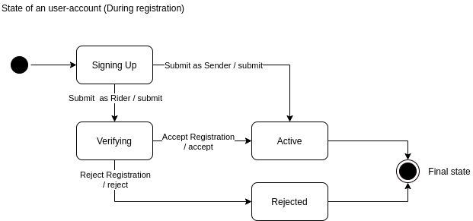
Requirements & Design
System model
User Account
Account ID
Username
Password
Email Address
Rider
Sender
1 .. *
1
Store
Vehicle Info
Store ID
1 .. *
Store Address
1 .. *
Store Description
Request
1
Request ID
DateTime
1
Destination

Slide 45
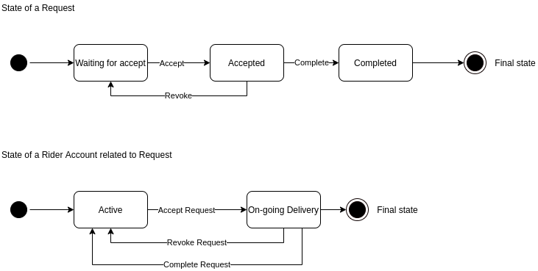
Requirements & Design
System model
User Account
Account ID
Username
Password
Email Address
Rider
Sender
1 .. *
1
Store
Vehicle Info
Store ID
1 .. *
Store Address
1 .. *
Store Description
Request
1
Request ID
DateTime
1
Destination

Slide 46
Requirements & Design
System model
User Account
Account ID
Username
Password
Email Address
Rider
Sender
1 .. *
1
Store
Vehicle Info
Store ID
1 .. *
Store Address
1 .. *
Store Description
Request
1
Request ID
DateTime
1
Destination

Slide 47
UI Design
In this section:
Wireframing of the User Interface
Demos of some use cases
UI Design UI Concept and Demos

Slide 48
UI Design
Wireframing
Notes:
Where did this idea came from?

