Slide 1
System Analysis and Design
Assignment 1
Online Affordable Delivery Platform (Mobile Application)

Slide 2
Assignment Information
Xuanao Zhao 20023404
Subject Name/Code
System Analysis and Design
DIT2143
Poo Yong Liang 20023404
Lecturer
Ms Kumatha Velli Muruyandy
Programme / Intake
Ryan Cheah 20018222
Diploma In Information Technology (March - 2020)
Tiew Shou Cheng 20038550

Slide 3



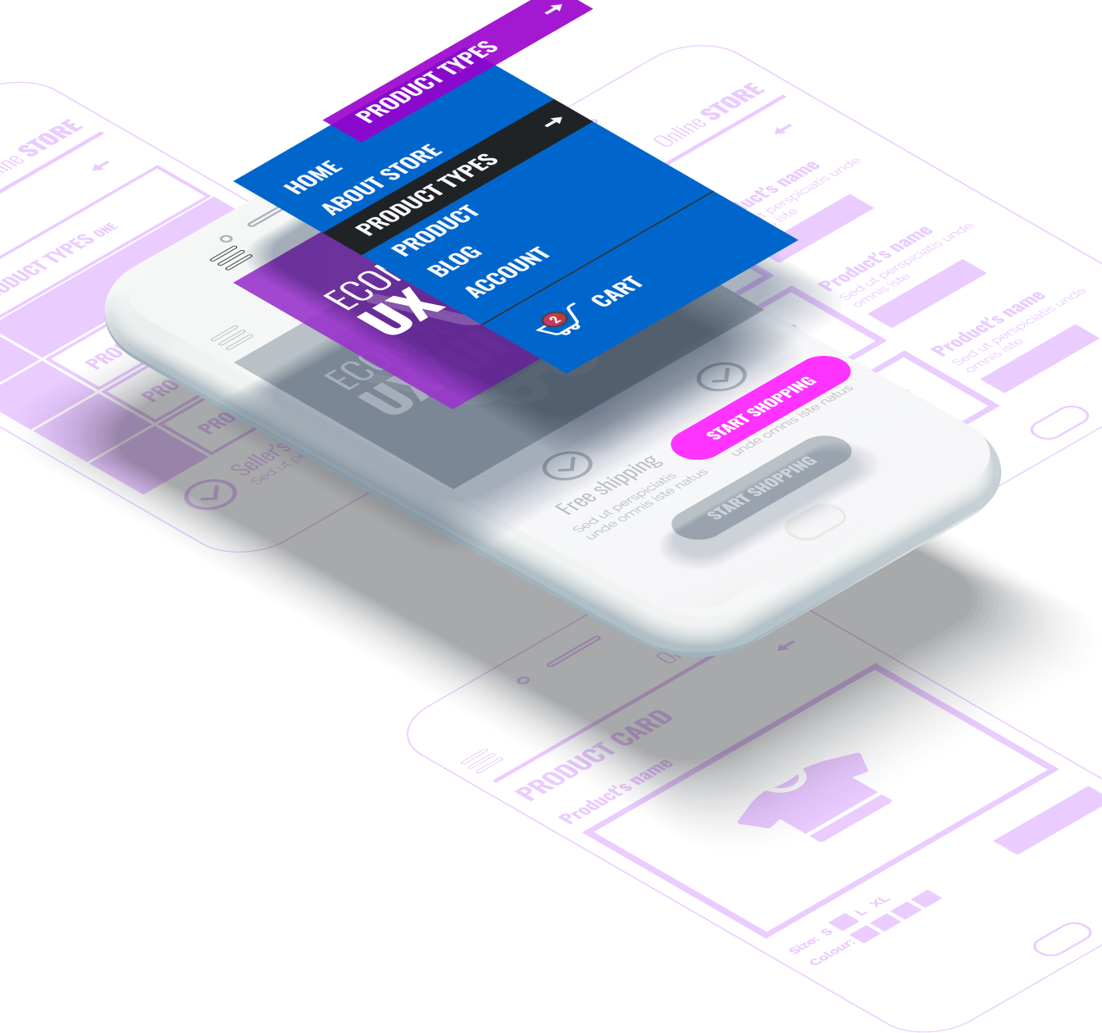
In this presentation
Background Information Introduction to the topic
System Design Processes, Modeling
Requirements Functional/Non-Functional
UI Design UI Concept and Demos

Slide 4
Background Information

