Slide 1
System Analysis and Design
Assignment 1
Online Affordable Delivery Platform (Mobile Application)
© 2020 Xuanao Zhao, Ryan Cheah, Yong Liang Poo, Tiew Shou Cheng.

Slide 2

Assignment Information
Xuanao Zhao 20023404
Subject Name/Code
System Analysis and Design
DIT2143
Poo Yong Liang 20023404
Lecturer
Ryan Cheah 20018222
Ms Kumatha Velli Muruyandy
Programme / Intake
Diploma In Information Technology (March - 2020)
Tiew Shou Cheng 20038550

Slide 3


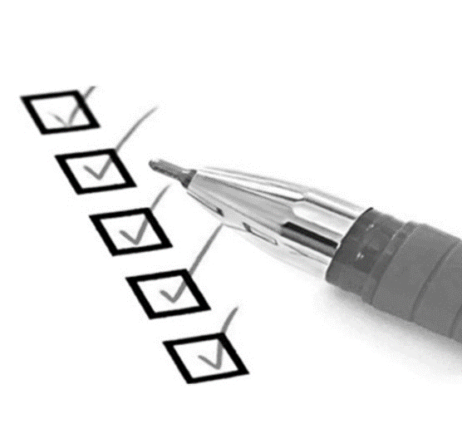
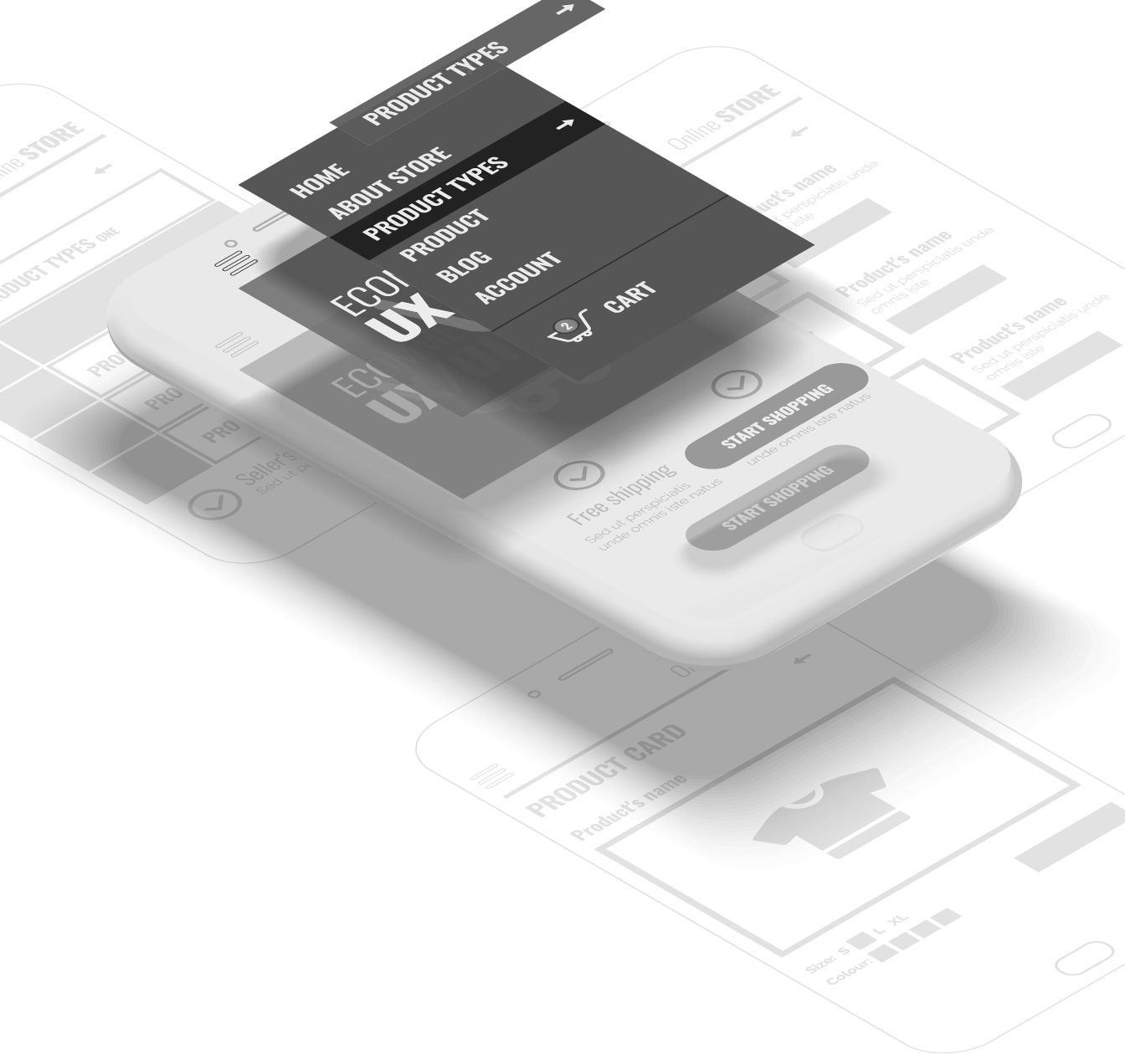
In this presentation
Background Information Introduction to the project
System Design Processes, Modeling
Requirements Functional/Non-Functional
UI Design UI Concept and Demos

Slide 4
Background Information
In this section:
Introduction
Objective
User Groups and Other Stakeholders
Background Information Introduction to the project

Slide 5

Background Information
Introduction
Those reliable delivery services are very expensive.
I can’t leave my house; I need to take care of my kids.
Can’t match my delivery time and customer’s delivery time.
Notes:
Where did this idea came from?

Slide 6
Background Information
Objective
User-friendly
Can be easily understood & used by anyone
Reliable
Can be trusted and be sure of what's happening
Convenient
Use it anytime and anytime

Slide 7
Background Information
User Groups
Sellers
From home; Sells item with short expiration / relatively low in price/quality.
People needs income
People who requires extra income to support daily life

Slide 8
Background Information
Other Stakeholders
Staff & Admins
Monitor the platform, marketing etc.
Developers
Develops & maintain the system

Slide 9
Requirements
In this section:
Requirement by Client
Technical Summery of Functional Requirements
Other Non-Functional Requirements
Requirements Functional/Non-Functional

Slide 10
Requirements
Request by Client
Seller
Notes:
Where did this idea came from?

Slide 11
Request by Client
Seller
Notes:
Where did this idea came from?

Slide 12
Request by Client
Seller
Notes:
Where did this idea came from?

Slide 13
Request by Client
Seller
Receiver
Notes:
Where did this idea came from?

Slide 14
Request by Client
Seller
Receiver
Notes:
Where did this idea came from?

Slide 15
Request by Client
Seller
Receiver
Riders
Notes:
Where did this idea came from?

Slide 16
Request by Client
Request 5
Seller
Receiver
Request 1
Request 2
Request 3
Request 4
Request 5
Riders
Request 6
Notes:
Where did this idea came from?

Slide 17
Request by Client
Request 5
Request 1
Seller
Receiver
Request 2
Request 3
Request 4
Request 5
Request 6
Riders
Notes:
Where did this idea came from?

Slide 18
Request by Client
Request 5
Request 1
Seller
Receiver
Request 2
Request 3
Request 4
Request 5
Request 6
Riders
Notes:
Where did this idea came from?

Slide 19
Request by Client
Seller
Riders
Receiver
Notes:
Where did this idea came from?

Slide 20
Request by Client
Seller
Riders
Receiver
Notes:
Where did this idea came from?

Slide 21
Request by Client
Seller
Receiver
Notes:
Where did this idea came from?

Slide 22
Request by Client
Seller
Riders
Receiver
Notes:
Where did this idea came from?

Slide 23
Requirements
Request by Client
Seller
Riders
Receiver
Notes:
Where did this idea came from?

