Slide 1
System Analysis and Design
Assignment 1
Online Affordable Delivery Platform (Mobile Application)
© 2020 Xuanao Zhao, Ryan Cheah, Yong Liang Poo, Tiew Shou Cheng.

Slide 2

Assignment Information
Xuanao Zhao 20023404
Subject Name/Code
System Analysis and Design
DIT2143
Poo Yong Liang 20023404
Lecturer
Ms Kumatha Velli Muruyandy
Ryan Cheah 20018222
Programme / Intake
Diploma In Information Technology (March - 2020)
Tiew Shou Cheng 20038550

Slide 3


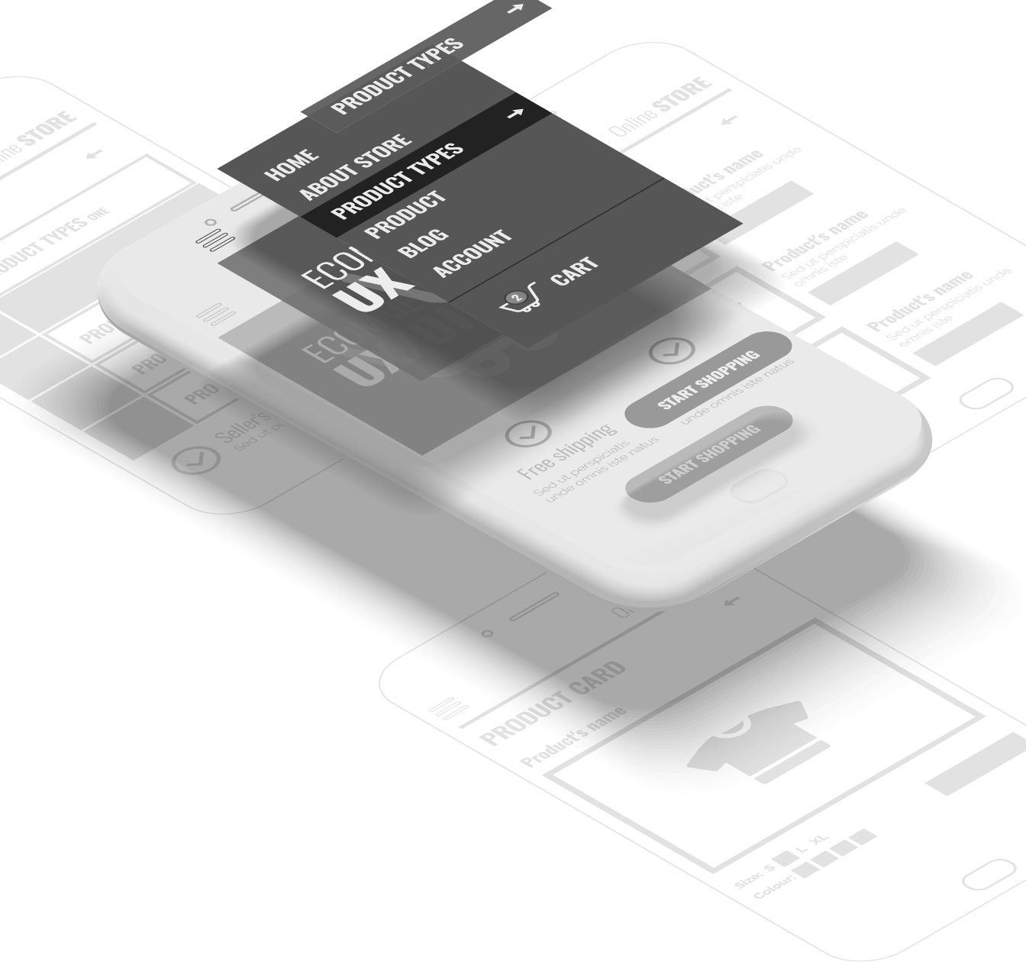
In This Presentation
Background Information Introduction to the project
Requirements & Design Functional/Non-Functional Requirements, Modeling
UI Design UI Concept and Demos

Slide 4
Background Information
In this section:
Introduction
Objective
User Groups and Other Stakeholders
Background Information Introduction to the project

Slide 5

Background Information
Introduction
Those reliable delivery services are very expensive.
I can’t leave my house; I need to take care of my kids.
Can’t match my delivery time and customer’s delivery time.
Notes:
Where did this idea came from?

Slide 6
Background Information
Objective
User-friendly
Can be easily understood & used by anyone
Reliable
Can be trusted and be sure of what's happening
Convenient
Use it anytime and anywhere

Slide 7
Background Information
User Groups
Sellers
From home; Sells item with short expiration / relatively low in price/quality.
People needs income
People who requires extra income to support daily life

Slide 8
Background Information
Other Stakeholders
Staff & Admins
Monitor the platform, marketing etc.
Developers
Develops & maintain the system

Slide 9
Requirements & Design
In this section:
Requirement by Client
Technical Summery of Functional Requirements
Other Non-Functional Requirements
Requirements & Design Functional/Non-Functional Requirements, Modeling

Slide 10
Requirements & Design
Request by Client
Seller
Notes:
Where did this idea came from?

Slide 11
Request by Client
Seller
Notes:
Where did this idea came from?

Slide 12
Request by Client
Sender
Notes:
Where did this idea came from?

Slide 13
Request by Client
Sender
Receiver
Notes:
Where did this idea came from?

Slide 14
Request by Client
Sender
Receiver
Notes:
Where did this idea came from?

Slide 15
Request by Client
Sender
Receiver
Riders
Notes:
Where did this idea came from?

Slide 16
Request by Client
Request 5
Sender
Receiver
Request 1
Request 2
Request 3
Request 4
Request 5
Riders
Request 6
Notes:
Where did this idea came from?

Slide 17
Request by Client
Request 5
Request 1
Sender
Receiver
Request 2
Request 3
Request 4
Request 5
Request 6
Riders
Notes:
Where did this idea came from?

Slide 18
Request by Client
Request 5
Request 1
Sender
Receiver
Request 2
Request 3
Request 4
Request 5
Request 6
Riders
Notes:
Where did this idea came from?

Slide 19
Request by Client
Sender
Riders
Receiver
Notes:
Where did this idea came from?

Slide 20
Request by Client
Sender
Riders
Receiver
Notes:
Where did this idea came from?

Slide 21
Request by Client
Sender
Receiver
Notes:
Where did this idea came from?

Slide 22
Requirements & Design
Request by Client
Sender
Riders
Receiver
Notes:
Where did this idea came from?

Slide 23
Requirements & Design
Technical Summery
Account System & User Registration
Every user should have an account
Post & Manage Delivery Requests
Post, Edit, Remove by Sender
Accept & Manage Accepted Delivery Requests
Accept, Complete, Cancel a request by Rider

Slide 24
Requirements & Design
Non-Functional Requirements
Notification of Account Accept/Reject
Get a notification for account being accepted/Rejected
Map for Seller/Rider
Sender can track the Rider; Rider can follow the GPS to destination
Messaging/Calling feature.
Rider and Sender can contact by messaging and calling feature provided

Slide 25
Requirements & Design
System Modeling
Delivery Platform for Seller/Riders
Registration
User
<< i >>
Admin
Update Personal Information
Verification of Registration
Post Request
Edit Request
<< e >>
Sender
Manage Requests
<< e >>
Remove Request
Accept Requests
Rider
Complete Requests
Cancel Request

Slide 26
Requirements & Design
System Modeling
Delivery Platform for Seller/Riders
User Account
Registration
Account ID
Username
User
<< i >>
Admin
Password
Update Personal Information
Verification of Registration
Email Address
Post Request
Rider
Sender
1 .. *
1
Store
Edit Request
Vehicle Info
Store ID
<< e >>
1 .. *
Store Address
Sender
Manage Requests
1 .. *
Remove Request
Store Description
<< e >>
Request
Accept Requests
1
Request ID
DateTime
1
Rider
Complete Requests
Destination
Cancel Request

Slide 27
Requirements & Design
System Modeling
Use case name | Registration
Scenario | New user wants to join the platform by creating a new user-account
Triggering Event | Select Create Account in Menu
Brief description | Users either create a sender-account/rider-account by entering their basic information and vehicle information if necessary.
Actors | User, Admin
Stakeholders | Platform’s User management, User
Preconditions | Make sure user is not repeating the registration
Postconditions | New user accounts must be saved in the database. User information must be validate
Flow of activities | User (Actor 1) | Admin (Actor 2) | System
 | User enter basic information |  | 1.1 Validate user information 1.2 Check if its rider
 | 2. User enter vehicle information (only if rider)
 |  | 3. Admin verifies vehicle information | 3.1 Updates database and save new account information
Exception Conditions | 1.1: User information not valid 3: Admin reject user registration
Delivery Platform for Seller/Riders
Registration
User
<< i >>
Admin
Update Personal Information
Verification of Registration
Post Request
Edit Request
<< e >>
Sender
Manage Requests
<< e >>
Remove Request
Accept Requests
Rider
Complete Requests
Cancel Request

Slide 28
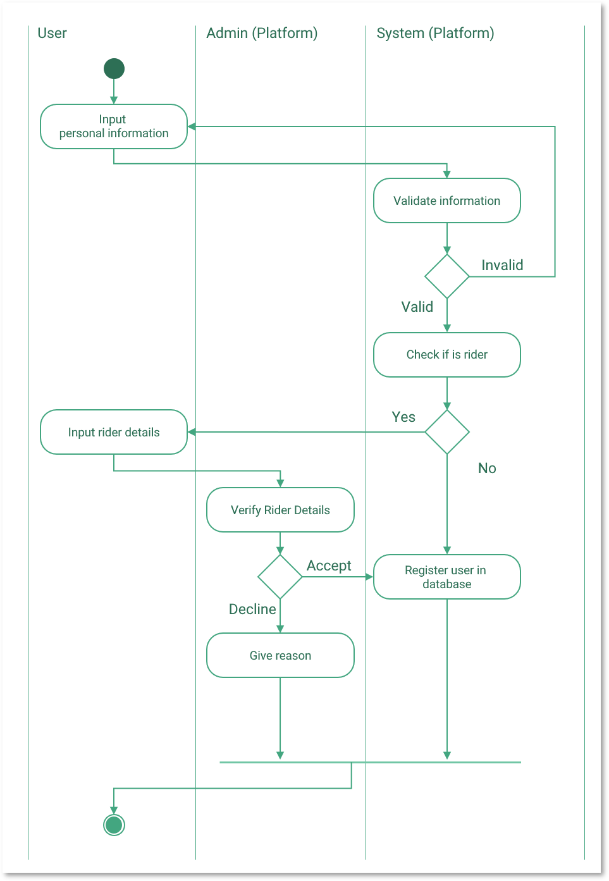
Requirements & Design
System Modeling
Delivery Platform for Seller/Riders
Registration
User
<< i >>
Admin
Update Personal Information
Verification of Registration
Post Request
Edit Request
<< e >>
Sender
Manage Requests
<< e >>
Remove Request
Accept Requests
Rider
Complete Requests
Cancel Request

Slide 29
Requirements & Design
System Modeling
Delivery Platform for Seller/Riders
Registration
User
<< i >>
Admin
Update Personal Information
Verification of Registration
Post Request
Edit Request
<< e >>
Sender
Manage Requests
<< e >>
Remove Request
Accept Requests
Rider
Complete Requests
Cancel Request

Slide 30
Requirements & Design
System Modeling
Delivery Platform for Seller/Riders
Use case name | Update personal information.
Scenario | When a user wishes to update their personal information (name, email, password etc).
Triggering Event | User selects Update My Information in the settings menu.
Brief description | Users update their personal information by entering new information.
Actors | User
Stakeholders | Platform’s User Management, User
Preconditions | None
Postconditions | New information has to be valid New information must be updated in the database.
Flow of activities | User (Actor) | System
 | 1. Select an information to change
 | 2. Enter a new information | 2.1 Validate entered information
Exception Conditions | 1. Information unchangeable (Date of birth, IC Number) 2.1 Information invalid
Registration
User
<< i >>
Admin
Update Personal Information
Verification of Registration
Post Request
Edit Request
<< e >>
Sender
Manage Requests
<< e >>
Remove Request
Accept Requests
Rider
Complete Requests
Cancel Request

Slide 31
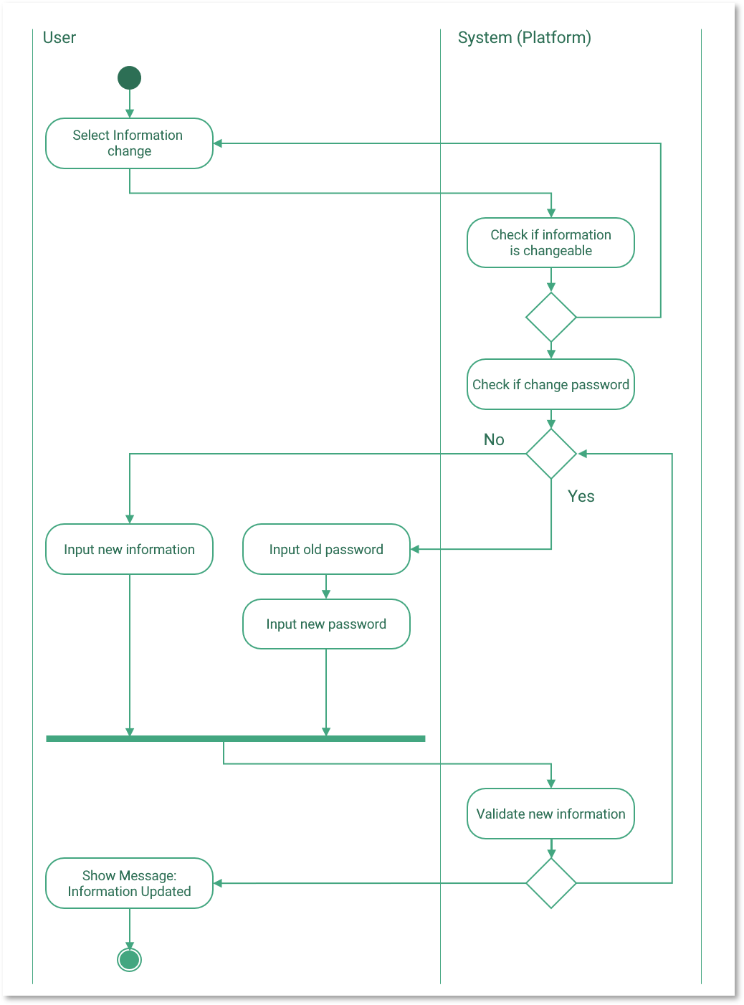
Requirements & Design
System Modeling
Delivery Platform for Seller/Riders
Registration
User
<< i >>
Admin
Update Personal Information
Verification of Registration
Post Request
Edit Request
<< e >>
Sender
Manage Requests
<< e >>
Remove Request
Accept Requests
Rider
Complete Requests
Cancel Request

Slide 32
Requirements & Design
System Modeling
Delivery Platform for Seller/Riders
Registration
User
<< i >>
Admin
Update Personal Information
Verification of Registration
Post Request
Edit Request
<< e >>
Sender
Manage Requests
<< e >>
Remove Request
Accept Requests
Rider
Complete Requests
Cancel Request

Slide 33
Requirements & Design
System Modeling
Delivery Platform for Seller/Riders
Use case name | Post Requests
Scenario | When a user wishes a rider can come and pick up some items and deliver to a relatively nearby destination
Triggering Event | Sender selects the Post Request button from the menu.
Brief description | Senders post a “Delivery Request” by selecting a start point (a store) and entering a destination address.
Actors | Sender
Stakeholders | User (Sender, Rider)
Preconditions | None
Postconditions | Requests should be open for riders who are nearby the selected starting point.
Flow of activities | Sender (Actor) | System (Actor)
 | 1. Select a starting point and destination address | 1.1 Validate destination address 1.2 Generate a new request
Exception Conditions | 1.1 Destination address invalid
Registration
User
<< i >>
Admin
Update Personal Information
Verification of Registration
Post Request
Edit Request
<< e >>
Sender
Manage Requests
<< e >>
Remove Request
Accept Requests
Rider
Complete Requests
Cancel Request

Slide 34
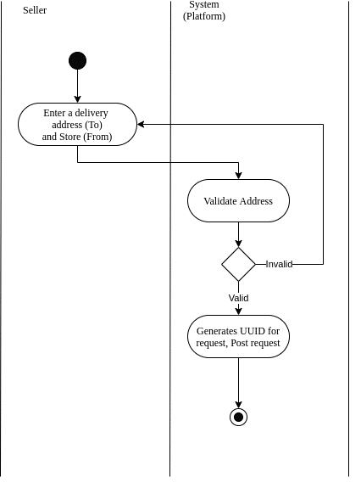
Requirements & Design
System Modeling
Delivery Platform for Seller/Riders
Registration
User
<< i >>
Admin
Update Personal Information
Verification of Registration
Post Request
Edit Request
<< e >>
Sender
Manage Requests
<< e >>
Remove Request
Accept Requests
Rider
Complete Requests
Cancel Request

Slide 35
Requirements & Design
System Modeling
Delivery Platform for Seller/Riders
Use case name | Manage Request (Edit, Remove).
Scenario | When a user wishes to update their posted request (Starting point, destination).
Triggering Event | Sender select edit button for a certain request
Brief description | Sender modifies the address, starting point by selecting a new address or starting point, or removes the request.
Actors | Sender, Rider
Stakeholders | Users (Sender, Rider)
Preconditions | Request must exist
Postconditions | Request must be updated If the request is being accepted, the modification must be notified to the rider.
Flow of activities | Sender (Actor 1) | Rider (Actor 2) | System
 | 1. Select edit or remove, and type in a new information if edit |  | 1.1 Validate information 1.2 See if any rider accept 1.3 Establish communication between Rider & Sender
 |  | 2. Accept changes | 2.1 Update the changes in system/Database
Exception Conditions | 1.1 Information invalid 2. Rider do not accept the changes
Registration
User
<< i >>
Admin
Update Personal Information
Verification of Registration
Post Request
Edit Request
<< e >>
Sender
Manage Requests
<< e >>
Remove Request
Accept Requests
Rider
Complete Requests
Cancel Request

Slide 36

Requirements & Design
System Modeling
Delivery Platform for Seller/Riders
Registration
User
<< i >>
Admin
Update Personal Information
Verification of Registration
Post Request
Edit Request
<< e >>
Sender
Manage Requests
<< e >>
Remove Request
Accept Requests
Rider
Complete Requests
Cancel Request

Slide 37
Requirements & Design
System Modeling
Delivery Platform for Seller/Riders
Registration
User
<< i >>
Admin
Update Personal Information
Verification of Registration
Post Request
Edit Request
<< e >>
Sender
Manage Requests
<< e >>
Remove Request
Accept Requests
Rider
Complete Requests
Cancel Request

Slide 38
Requirements & Design
System Modeling
Delivery Platform for Seller/Riders
Use case name | Accept Request
Scenario | Rider wishes to accept a delivery request
Triggering Event | Rider select an available request and select accept request
Brief description | Rider accepts a delivery request by selecting the accept option of an request
Actors | Rider
Stakeholders | Rider, Sender
Preconditions | Request is not being accepted by anyone else Request is nearby
Postconditions | No other rider should be able to accept the same request
Flow of activities | Rider (Actor) | System
 | 1. Select accept request option | 1.1 Send notification to sender: Request being accepted
Exception Conditions | None
Registration
User
<< i >>
Admin
Update Personal Information
Verification of Registration
Post Request
Edit Request
<< e >>
Sender
Manage Requests
<< e >>
Remove Request
Accept Requests
Rider
Complete Requests
Cancel Request

Slide 39
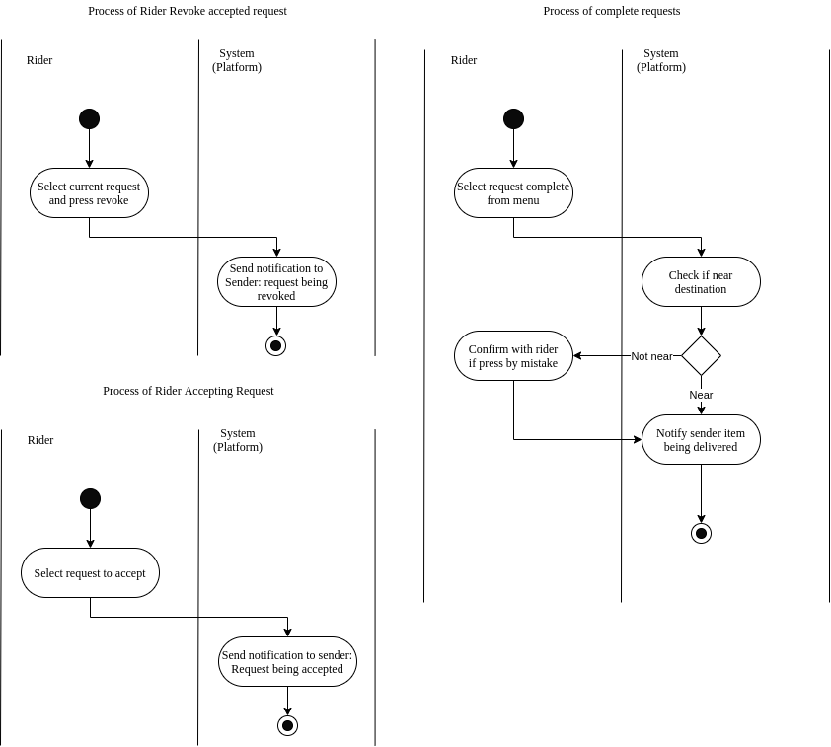
Requirements & Design
System Modeling
Delivery Platform for Seller/Riders
Registration
User
<< i >>
Admin
Update Personal Information
Verification of Registration
Post Request
Edit Request
<< e >>
Sender
Manage Requests
<< e >>
Remove Request
Accept Requests
Rider
Complete Requests
Cancel Request

Slide 40
Requirements & Design
System Modeling
Delivery Platform for Seller/Riders
Use case name | Revoke/Cancel Accepted Request
Scenario | Rider wishes to drop/cancel an accepted delivery request
Triggering Event | Rider select the accepted request and press revoke/cancel button
Brief description | Rider revokes an accepted request.
Actors | Rider
Stakeholders | Rider, Sender
Preconditions | Request is being accepted
Postconditions | Request status must be updated and saved in system/database
Flow of activities | Rider (Actor) | System
 | 1. Select revoke/cancel option | 1.1 Send notification to sender: Request being canceled
Exception Conditions | None
Registration
User
<< i >>
Admin
Update Personal Information
Verification of Registration
Post Request
Edit Request
<< e >>
Sender
Manage Requests
<< e >>
Remove Request
Accept Requests
Rider
Complete Requests
Cancel Request

Slide 41
Requirements & Design
System Modeling
Delivery Platform for Seller/Riders
Registration
User
<< i >>
Admin
Update Personal Information
Verification of Registration
Post Request
Edit Request
<< e >>
Sender
Manage Requests
<< e >>
Remove Request
Accept Requests
Rider
Complete Requests
Cancel Request

Slide 42
Requirements & Design
System Modeling
Delivery Platform for Seller/Riders
Registration
User
<< i >>
Admin
Update Personal Information
Verification of Registration
Post Request
Edit Request
<< e >>
Sender
Manage Requests
<< e >>
Remove Request
Accept Requests
Rider
Complete Requests
Cancel Request

Slide 43
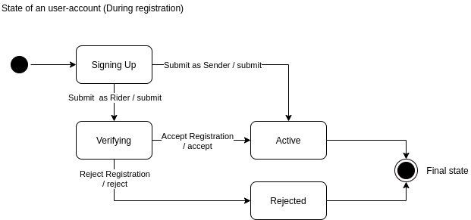
Requirements & Design
System Modeling
User Account
Account ID
Username
Password
Email Address
Rider
Sender
1 .. *
1
Store
Vehicle Info
Store ID
1 .. *
Store Address
1 .. *
Store Description
Request
1
Request ID
DateTime
1
Destination

Slide 44
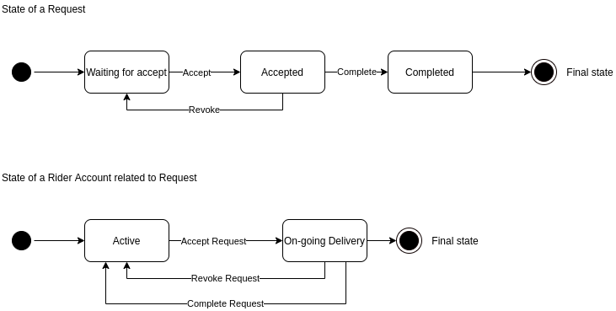
Requirements & Design
System Modeling
User Account
Account ID
Username
Password
Email Address
Rider
Sender
1 .. *
1
Store
Vehicle Info
Store ID
1 .. *
Store Address
1 .. *
Store Description
Request
1
Request ID
DateTime
1
Destination

Slide 45
Requirements & Design
System Modeling
User Account
Account ID
Username
Password
Email Address
Rider
Sender
1 .. *
1
Store
Vehicle Info
Store ID
1 .. *
Store Address
1 .. *
Store Description
Request
1
Request ID
DateTime
1
Destination

Slide 46
UI Design
In this section:
Wireframing of the User Interface
Demos of User Experiences
UI Design UI Concept and Demos

Slide 47
UI Design
Wireframing & Demo UX
Login/Registration Form
Registration for Rider
Registration Successful/Rejected
Edit Personal Information
Sender Post Requests
Sender Manage Requests
Rider Accepts Requests
Rider Manage Accepted Requests
Notes:
Where did this idea came from?

Slide 48
Wireframing & Demo UX
Login/Registration Form
Registration for Rider
Registration Successful/Rejected
Edit Personal Information
Sender Post Requests
Sender Manage Requests
Rider Accepts Requests
Rider Manage Accepted Requests
16:9

Slide 49
Wireframing & Demo UX
Logo
Login/Registration Form
Registration for Rider
Registration Successful/Rejected
Edit Personal Information
Sender Post Requests
Sender Manage Requests
Rider Accepts Requests
Rider Manage Accepted Requests
Username
Password
Login
Swipe up to Register
Username
E-mail
Password
Re-Enter Password
I’m a …
Sender
Rider
Next

Slide 50
Wireframing & Demo UX
Swipe up to Register
Logo
Login/Registration Form
Registration for Rider
Registration Successful/Rejected
Edit Personal Information
Sender Post Requests
Sender Manage Requests
Rider Accepts Requests
Rider Manage Accepted Requests
Username
E-mail
Username
Password
Password
Re-Enter Password
Login
I’m a …
Sender
Rider
Next

Slide 51
Wireframing & Demo UX
Swipe up to Register
Logo
Login/Registration Form
Registration for Rider
Registration Successful/Rejected
Edit Personal Information
Sender Post Requests
Sender Manage Requests
Rider Accepts Requests
Rider Manage Accepted Requests
Username
John
E-mail
John123@example.com
Username
Password
••••••••••••
Password
Re-Enter Password
••••••••••
Login
I’m a …
Sender
Rider
Next

Slide 52
Wireframing & Demo UX
Swipe up to Register
Logo
Login/Registration Form
Registration for Rider
Registration Successful/Rejected
Edit Personal Information
Sender Post Requests
Sender Manage Requests
Rider Accepts Requests
Rider Manage Accepted Requests
Username
John
E-mail
John123@example.com
Username
Password
••••••••••••
Password
Re-Enter Password
••••••••••
Login
I’m a …
Sender
Rider
Multiple fields are incorrect
Next

Slide 53
Wireframing & Demo UX
Swipe up to Register
Logo
Login/Registration Form
Registration for Rider
Registration Successful/Rejected
Edit Personal Information
Sender Post Requests
Sender Manage Requests
Rider Accepts Requests
Rider Manage Accepted Requests
Username
John
E-mail
John123@example.com
Username
Password
••••••••••••
Password
Re-Enter Password
••••••••••••
Login
I’m a …
Sender
Rider
Next

Slide 54
Wireframing & Demo UX
Swipe up to Register
Logo
Login/Registration Form
Registration for Rider
Registration Successful/Rejected
Edit Personal Information
Sender Post Requests
Sender Manage Requests
Rider Accepts Requests
Rider Manage Accepted Requests
Username
John
E-mail
John123@example.com
Password
Username
••••••••••••
Password
Re-Enter Password
You’re Complete!
••••••••••••
Press ‘Done’ and proceed to login page.
Login
I’m a …
Sender
Rider
Done

Slide 55
Wireframing & Demo UX
Swipe up to Register
Logo
Login/Registration Form
Registration for Rider
Registration Successful/Rejected
Edit Personal Information
Sender Post Requests
Sender Manage Requests
Rider Accepts Requests
Rider Manage Accepted Requests
Username
John
E-mail
John123@example.com
Username
Password
••••••••••••
Password
Re-Enter Password
••••••••••••
Login
I’m a …
Sender
Rider
Next

Slide 56
Wireframing & Demo UX
Swipe up to Register
Logo
Login/Registration Form
Registration for Rider
Registration Successful/Rejected
Edit Personal Information
Sender Post Requests
Sender Manage Requests
Rider Accepts Requests
Rider Manage Accepted Requests
Username
Please complete the rider information
John
E-mail
Vehicle Description (Model, Color)
John123@example.com
Password
Username
••••••••••••
Vehicle Plate No.
Re-Enter Password
Password
••••••••••••
Login
I’m a …
Sender
Rider
Next

Slide 57
Wireframing & Demo UX
Swipe up to Register
Logo
Login/Registration Form
Registration for Rider
Registration Successful/Rejected
Edit Personal Information
Sender Post Requests
Sender Manage Requests
Rider Accepts Requests
Rider Manage Accepted Requests
Please complete the rider information
Vehicle Description (Model, Color)
CMC ARIO 110, Black
Vehicle Plate No.
Username
ABC 1234
Password
Login
Next

Slide 58
Wireframing & Demo UX
Swipe up to Register
Logo
Login/Registration Form
Registration for Rider
Registration Successful/Rejected
Edit Personal Information
Sender Post Requests
Sender Manage Requests
Rider Accepts Requests
Rider Manage Accepted Requests
Please complete the rider information
Vehicle Description (Model, Color)
CMC ARIO 110, Black
Vehicle Plate No.
Username
ABC 1234
Password
You’re Complete for now
Please wait for the admin to verify your vehicle
Login
Done

Slide 59
Wireframing & Demo UX
Login/Registration Form
Registration for Rider
Registration Successful/Rejected
Edit Personal Information
Sender Post Requests
Sender Manage Requests
Rider Accepts Requests
Rider Manage Accepted Requests

Slide 60


Wireframing & Demo UX
Login/Registration Form
Registration for Rider
Registration Successful/Rejected
Edit Personal Information
Sender Post Requests
Sender Manage Requests
Rider Accepts Requests
Rider Manage Accepted Requests
XXX Delivery System • 12:30
Logo
Your registration has been approved
Press this message for more details
12:30
23/9/2020, Wed

Slide 61
Wireframing & Demo UX
Login/Registration Form
Registration for Rider
Registration Successful/Rejected
Edit Personal Information
Sender Post Requests
Sender Manage Requests
Rider Accepts Requests
Rider Manage Accepted Requests
You’re registration has been
approved
Press ‘Done’ to login.
Done

Slide 62
Wireframing & Demo UX
Login/Registration Form
Registration for Rider
Registration Successful/Rejected
Edit Personal Information
Sender Post Requests
Sender Manage Requests
Rider Accepts Requests
Rider Manage Accepted Requests
You’re registration has been rejected
Your vehicle information is invalid. Press ‘Done’ to register again.
Done

Slide 63
Wireframing & Demo UX
Logo
Login/Registration Form
Registration for Rider
Registration Successful/Rejected
Edit Personal Information
Sender Post Requests
Sender Manage Requests
Rider Accepts Requests
Rider Manage Accepted Requests
Username
Password
Login
Swipe up to Register

Slide 64
Wireframing & Demo UX
Logo
Login/Registration Form
Registration for Rider
Registration Successful/Rejected
Edit Personal Information
Sender Post Requests
Sender Manage Requests
Rider Accepts Requests
Rider Manage Accepted Requests
Username
John
Password
••••••••••••
Login
Swipe up to Register

Slide 65
Wireframing & Demo UX
Home
Your Username
Sender
Active Requests
Login/Registration Form
Registration for Rider
Registration Successful/Rejected
Edit Personal Information
Sender Post Requests
Sender Manage Requests
Rider Accepts Requests
Rider Manage Accepted Requests
Manage currently active requests
My Stores
Post Request
Request History
View currently active history
About

Slide 66
Wireframing & Demo UX
Home
Your Username
Sender
Active Requests
Login/Registration Form
Registration for Rider
Registration Successful/Rejected
Edit Personal Information
Sender Post Requests
Sender Manage Requests
Rider Accepts Requests
Rider Manage Accepted Requests
Manage currently active requests
Post Request
View currently active history
My Stores
Request History
About

Slide 67
Wireframing & Demo UX
Home
Active Requests
Login/Registration Form
Registration for Rider
Registration Successful/Rejected
Edit Personal Information
Sender Post Requests
Sender Manage Requests
Rider Accepts Requests
Rider Manage Accepted Requests
Manage currently active requests
Post Request
View currently active history

