Slide 1
Welcome to the practical session #2 « big data & predictive models »
Deep Learning
Loic Verlingue
Yoann Pradat
IFSBM Module 12
January 24th 2020

Slide 2
Running instructions
Open R studio
Open New File -> R Notebook
Go to the web https://github.com/gustaveroussy/IFSBM-bigdata/edit/master/TP_IFSBM_module12/
Copy paste the content of TP_notebook_DL_R.Rmd in your new R Notebook
Follow the notebook instructions
Enjoy!

Slide 3
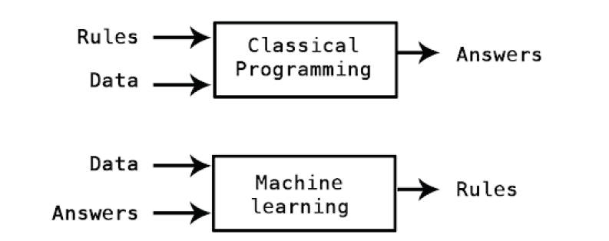

Slide 4
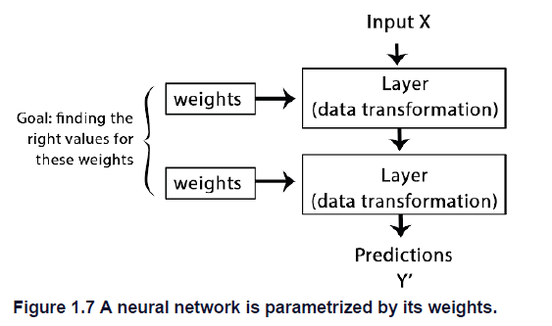
How DL works in 3 figures

Slide 5
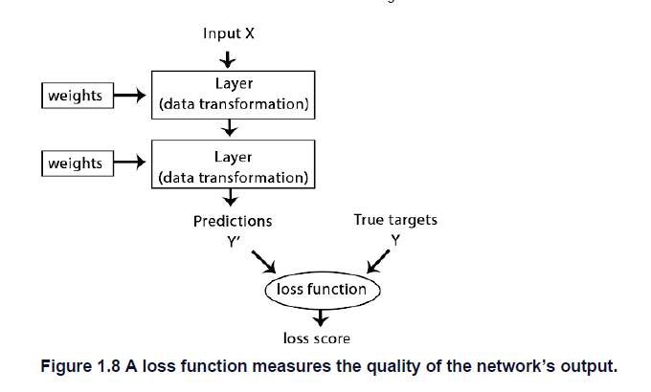
How DL works in 3 figures

Slide 6
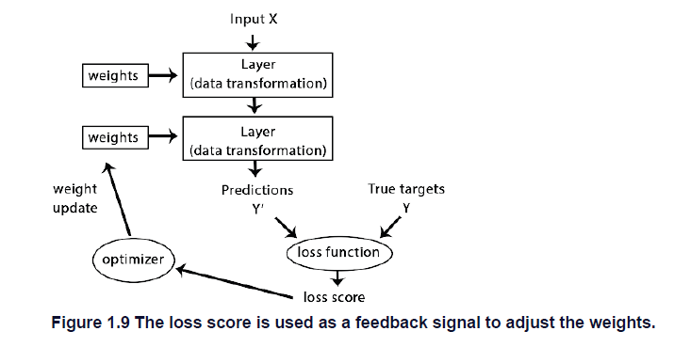
How DL works in 3 figures

Slide 7
Learning workflow
Learning
Data processing
Model
Performance metric

Slide 8
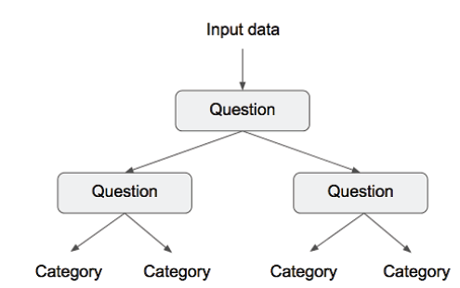
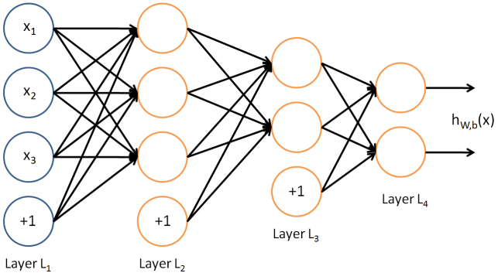
Families of models for classification
Regression /
Kernel approach eg SVM
Ensemble approach: decision tree
Multi Layer Percetron = Artificial Neural Network

Slide 9
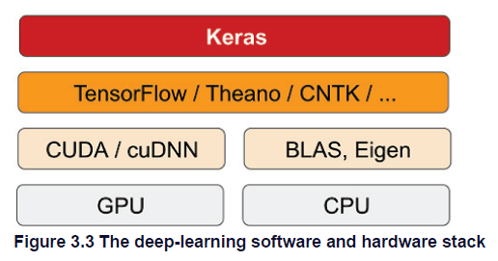
Keras & tensorflow
Keras is a model-level library, providing high-level building blocks for developing
deep-learning models. It doesn’t handle low-level operations such as tensor manipulation
and differentiation. Instead, it relies on a specialized, well-optimized tensor library to do
so, serving as the backend engine of Keras. Rather than choosing a single tensor library
and tying the implementation of Keras to that library, Keras handles the problem in a
modular way

Slide 10

Computational graph

Slide 11
Computational graph

Slide 12

Data Processing
Learning
Data processing
Model
Performance metric
Numerical data -> ok for models
*
Natural langage data -> turn to numerical
*
Images -> use pixels values

Slide 13

Quelle méthode d’apprentissage ?
Learning
Data processing
Model
Performance metric

Slide 14
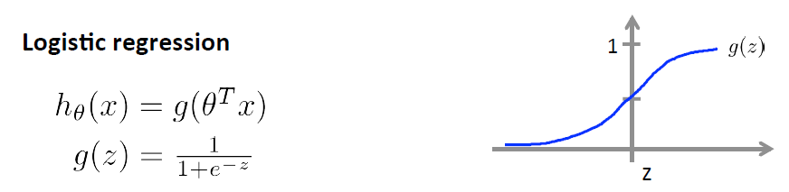
Probability to belong to a class
with a sigmoid function
Ok for:
Regression /
Kernel approach eg SVM
Multi Layer Percetron = Artificial Neural Network

Slide 15
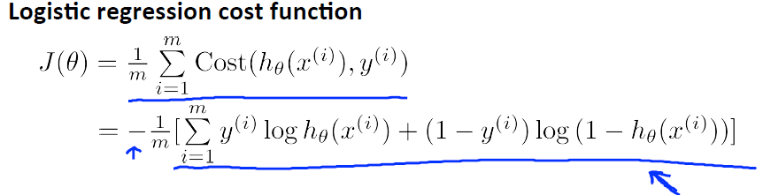
Calculate the cost / error
prediction
h(x)=
truth
If y=1
If y=0
0
h(x)
1
0
h(x)
1

Slide 16
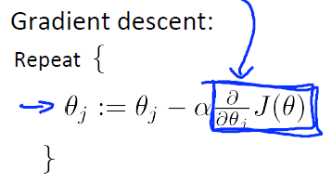
Parameters’ updates with gradient descent
Compute the cost
Derivative of the cost
Parameters’
updates
Learning rate

Slide 17
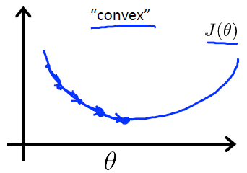
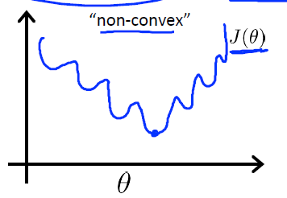
Optimisation of the cost
Best fit!
?
Updates with gradient descent
Figures from Andrew Ng Coursera

Slide 18
Etes vous sûr que les futurs exemples seront bien prédits?

Slide 19
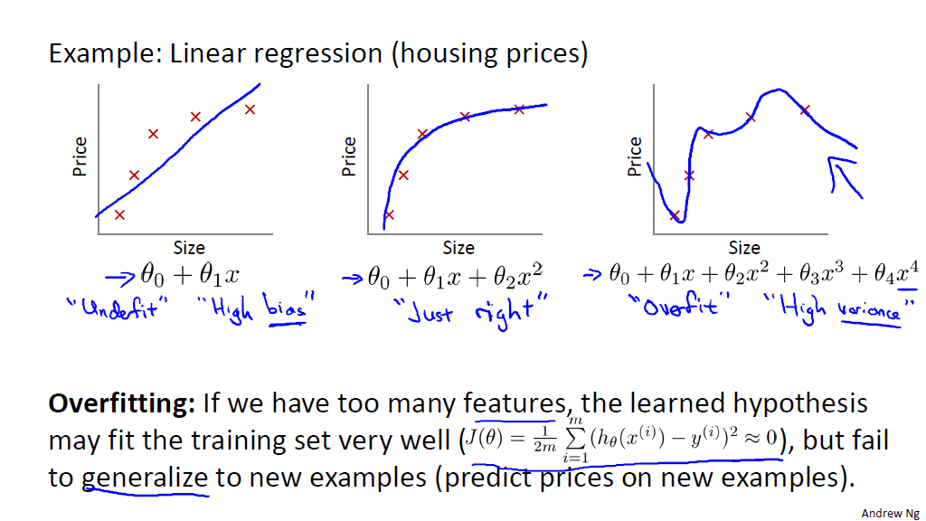
Généralisation du modèle
Biais
Variance

Slide 20
The problem of overfitting
One solution: increase observations
Other solutions: penalize the learning
constrain the model

Slide 21
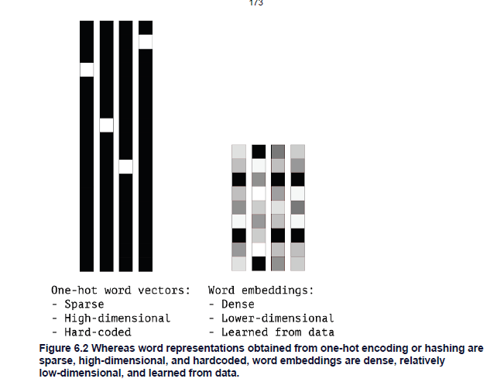
ML generalization testing workflow
split
 |  | Classe réelle
 |  | 0 | 1
Classe prédite | 0 | 141 | 11
 | 1 | 28 | 56
train
Examples
Evaluate generalizability
Variables
 |  | Classe réelle
 |  | 0 | 1
Classe prédite | 0 | 25 | 1
 | 1 | 2 | 14

Slide 22
Evaluation metrics
Learning
Data processing
Model
Performance metric
Comment évaluer les prédictions du modèle?

Slide 23
Métriques pour classification binaire
→ Matrice de confusion (1=SF)
→ Que préférez-vous evaluer?
 |  | Classe réelle
 |  | 0 | 1
Classe prédite | 0 | TN | FN
 | 1 | FP | TP
Notes:
Recall = tp / (tp + fn)
Le point particulier qui nous intéresse est la minimisation du nombre de Faux Négatifs

Slide 24
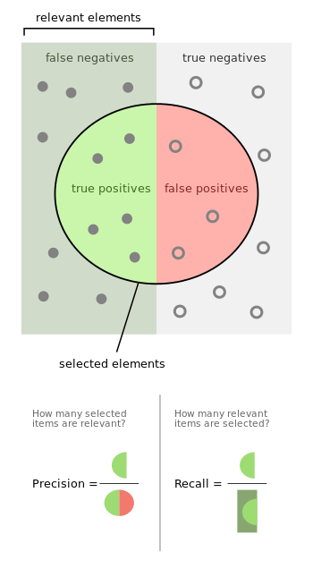
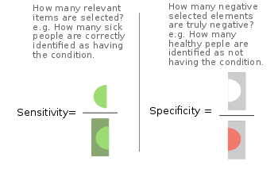
Métriques pour classification binaire
Positives
Negatives
 |  | Classe réelle
 |  | 0 | 1
Classe prédite | 0 | TN | FN
 | 1 | FP | TP
wikipedia

Slide 25
Métriques pour classification binaire
Positives
Negatives
 |  | Classe réelle
 |  | 0 | 1
Classe prédite | 0 | TN | FN
 | 1 | FP | TP
wikipedia

Slide 26
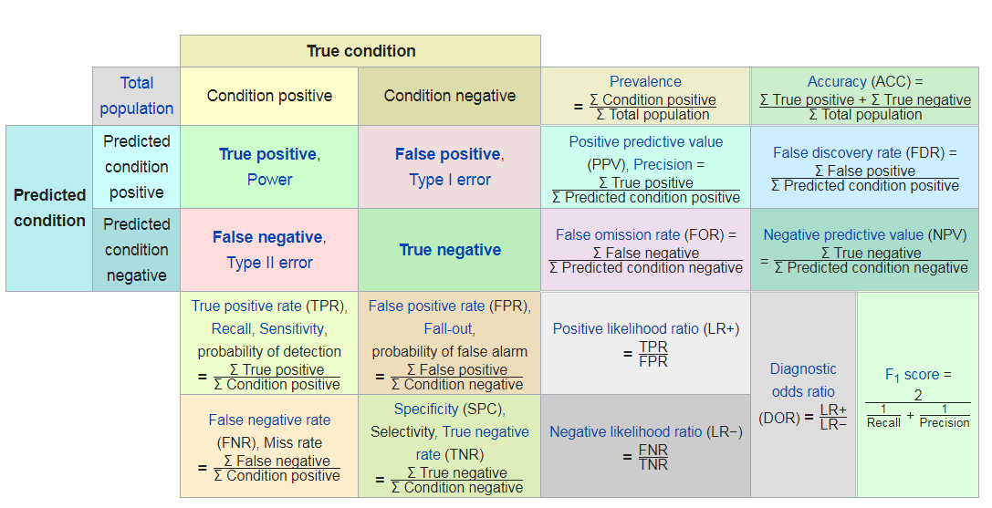
Métriques pour classification binaire
wikipedia

Slide 27
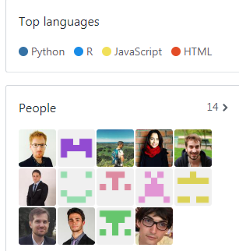
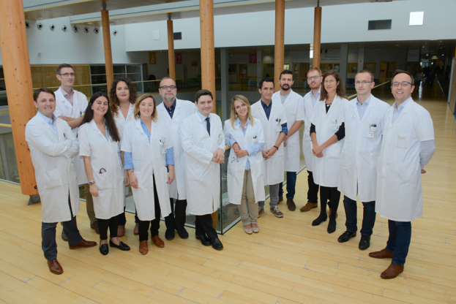
DITEP
Medical team
Data Science team
loic.verlingue@gustaveroussy.fr
https://github.com/DITEP

