Slide 1
Welcome to the practical session #1 « big data & predictive models »
Loic Verlingue
Yoann Pradat
IFSBM Module 12
January 23th 2020

Slide 2
Running instructions
Go to the web https://github.com/gustaveroussy/IFSBM-bigdata/blob/master/TP_IFSBM_module12/2020/labs/instructions/instructions.pdf
Follow instructions

Slide 3
Running instructions
Open your R studio project « labs »
In R studio « Files » open: /IFSBM-bigdata/TP_IFSBM_module12/2020/labs/lab_1/src/TP_MachineLearning.Rmd
Follow the notebook instructions
Enjoy!

Slide 4
For very advanced R programmers
You can erase the R code in the Notebook from the section:
« Description of the data »
To
« A glimpse into survival analysis »
And try to do the code by your own with help of the original Notebook

Slide 5
Classification
Decision boundary
Lung cancer
Glioblastoma
Expression gene A
?
Expression gene B

Slide 6
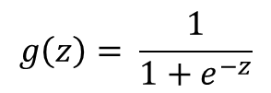
Logistic regression in 2D
Lung cancer=0
Glioblastoma=1
Sigmoid function = logistic function
Expression gene A
?
1
0
z
$$g\left(z\right)= \frac{1}{1+e^{−z}}$$
Expression gene B

Slide 7



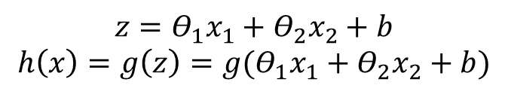
Logistic regression in 2D
Lung cancer
Glioblastoma
1
0
z
Expression gene A =${ x}_{1}$
?
$$z={\text{Θ}}_{1}x_{1}+{\text{Θ}}_{2}x_{2}+b$$
$$h\left(x\right)=g\left(z\right)=g({\text{Θ}}_{1}x_{1}+{\text{Θ}}_{2}x_{2}+b)$$
→ How do you find ${\text{Θ}}_{1}$, ${\text{Θ}}_{2}$ & b?
Expression gene B = $x_{2}$

Slide 8
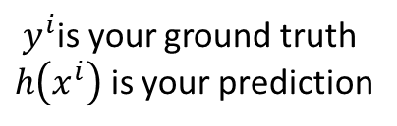
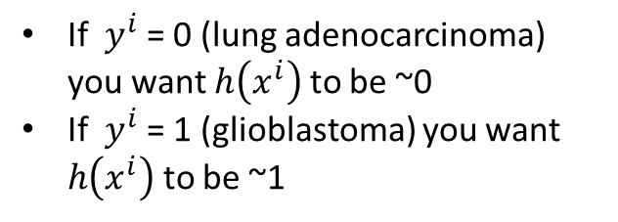

Logistic regression in 2D
Define a cost function
${ y}^{i}$is your ground truth
$h\left(x^{i}\right)$ is your prediction
$$→cost( h\left(x^{i}\right),{ y}^{i} )$$
Expression gene A =${ x}_{1}$
?
If ${ y}^{i}$ = 0 (lung adenocarcinoma) you want $h\left(x^{i}\right)$ to be ~0
If ${ y}^{i}$ = 1 (glioblastoma) you want $h\left(x^{i}\right)$ to be ~1
Expression gene B = $x_{2}$

Slide 9



Logistic regression in 2D
For example
$$cost( h\left(x^{i}\right),{ y}^{i} )$$
$$−\log\left(1− h\left(x^{i}\right)\right) if y^{i}=0$$
Expression gene A =${ x}_{1}$
?
$$−\log\left(h\left(x^{i}\right)\right) if y^{i}=1$$
Expression gene B = $x_{2}$

Slide 10




Logistic regression in 2D
For example
$$cost( h\left(x^{i}\right),{ y}^{i} )$$
$$if y^{i}=0$$
Expression gene A =${ x}_{1}$
?
$$∞$$
0
$$h\left(x^{i}\right)$$
1
Expression gene B = $x_{2}$
$$cost= −\log\left(1− h\left(x^{i}\right)\right)$$
Notes:
Log(0.1) = -2.3

Slide 11


Logistic regression in 2D
For example
$$cost( h\left(x^{i}\right),{ y}^{i} )$$
$$if y^{i}=1$$
Expression gene A =${ x}_{1}$
?
$$∞$$
0
$$h\left(x^{i}\right)$$
1
Expression gene B = $x_{2}$
$$cost= −\log\left(h\left(x^{i}\right)\right)$$

Slide 12
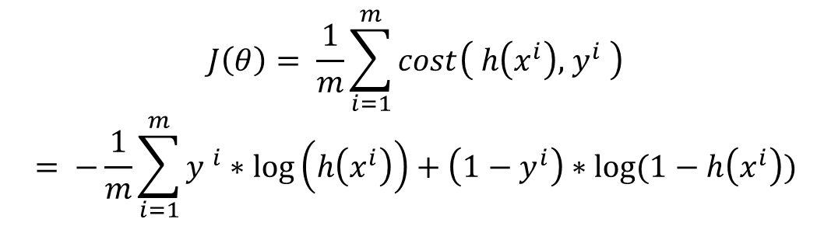
Logistic regression in 2D
Do it on all your data
$$J\left(θ\right)= \frac{1}{m}\sum_{i=1}^{m}{cost\left( h\left(x^{i}\right),{ y}^{i} \right)}$$
$$= {−\frac{1}{m}\sum_{i=1}^{m}{y} }^{i}∗\log\left(h\left(x^{i}\right)\right)+\left(1−y^{i}\right)∗log⁡(1−h\left(x^{i}\right))$$
And then minimize it!

Slide 13

Minimization with gradient descent
Decision boundary
Lung cancer
3
Glioblastoma
Expression gene A
2
?
1
$${J(θ)= −\frac{1}{m}\sum_{i=1}^{m}{y} }^{i}∗\log\left(h\left(x^{i}\right)\right)+\left(1−y^{i}\right)∗log⁡(1−h\left(x^{i}\right))$$
Expression gene B

Slide 14
Are you wright? Probably yes !
Lung cancer
Glioblastoma
Expression gene A
?
Expression gene B

Slide 15
Are you wright? No !
Lung cancer
Glioblastoma
Expression gene A
Expression gene B

Slide 16
Are you wright? No !
Distribution lung adk
Distribution Glio
Lung cancer
Glioblastoma
Expression gene A
Expression gene B

Slide 17
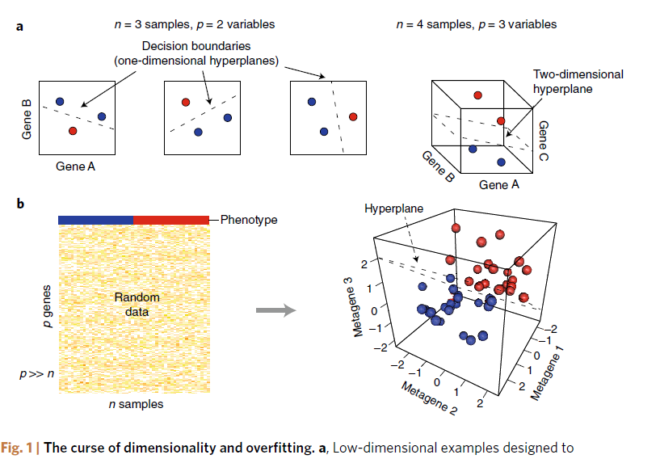
Generalisation and overfitting
Teschendorff AE. Avoiding common pitfalls in machine learning omic data science. Nat Mater. 2018 Nov 26. doi: 10.1038/s41563-018-0241-z. PubMed PMID: 30478452.

Slide 18
The curse of dimensionality!
Teschendorff AE. Avoiding common pitfalls in machine learning omic data science. Nat Mater. 2018 Nov 26. doi: 10.1038/s41563-018-0241-z. PubMed PMID: 30478452.

Slide 19

How do you evaluate generalization?
M examples
3
N x M matrix
Train your model
2
M*0.8
1
N genes
M*0.2
Test your model

Slide 20


Are there strategies not to ?
Eg: SVM, regularisation / penalisation..
On the modeling / learning:
Eg: data augmentation (real or artificial), work with distribution…
On the data:

Slide 21
Back to TPBigData.Rmd

Slide 22
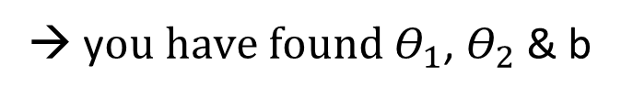
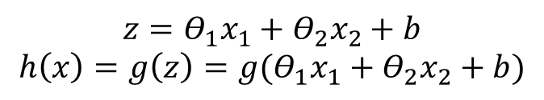
Intepret things biologically
Lung cancer
Glioblastoma
1
0
z
Expression gene A =${ x}_{1}$
$$z={\text{Θ}}_{1}x_{1}+{\text{Θ}}_{2}x_{2}+b$$
$$h\left(x\right)=g\left(z\right)=g({\text{Θ}}_{1}x_{1}+{\text{Θ}}_{2}x_{2}+b)$$
?
→ y$ou have found$ ${\text{Θ}}_{1}$, ${\text{Θ}}_{2}$ & b
Expression gene B = $x_{2}$

Slide 23
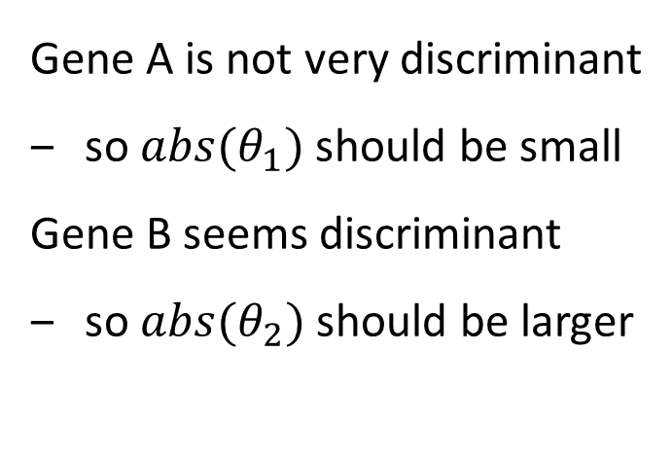
Intepret things biologically
Gene A is not very discriminant
so ${abs(θ}_{1})$ should be small
Gene B seems discriminant
so ${abs(θ}_{2})$ should be larger
Expression gene A =${ x}_{1}$
?
Expression gene B = $x_{2}$

Slide 24
Back to TPBigData.Rmd

Slide 25
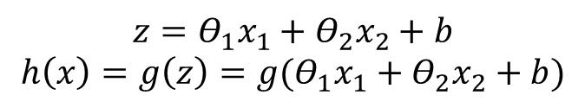
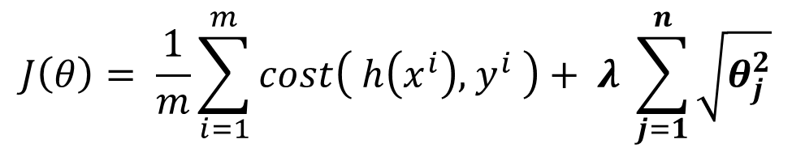

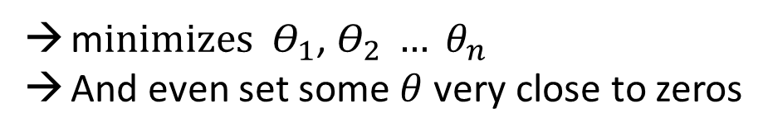
Lasso regularization or L1N
$$J\left(θ\right)= \frac{1}{m}\sum_{i=1}^{m}{cost\left( h\left(x^{i}\right),{ y}^{i} \right)}+ λ \sum_{j=1}^{n}{\sqrt{θ_{j}^{2}}}$$
$$\text{= }\text{||}\text{β}\text{||}\text{1}$$
m$inimizes$ ${\text{Θ}}_{1}$, ${\text{Θ}}_{2} … θ_{n}$
And even set some $θ$ very close to zeros
$$z={\text{Θ}}_{1}x_{1}+{\text{Θ}}_{2}x_{2}+b$$
$$h\left(x\right)=g\left(z\right)=g({\text{Θ}}_{1}x_{1}+{\text{Θ}}_{2}x_{2}+b)$$

Slide 26
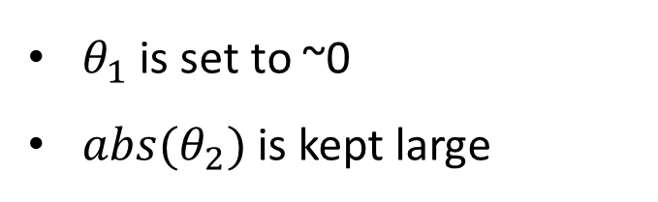
With Lasso regularization
$θ_{1}$ is set to ~0
${abs(θ}_{2})$ is kept large
Expression gene A =${ x}_{1}$
?
Expression gene B = $x_{2}$

Slide 27
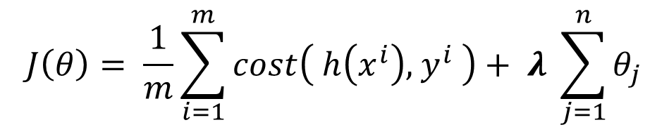
But you have one more parameter to search = lambda!
$$J\left(θ\right)= \frac{1}{m}\sum_{i=1}^{m}{cost\left( h\left(x^{i}\right),{ y}^{i} \right)}+ λ \sum_{j=1}^{n}{θ_{j}}$$

Slide 28
Train and evaluate with Lasso
M examples
Find λ
4
N, M matrix
3
M*0.8
2
Train your model
1
N genes
M*0.2
Test your model
Extract non-zeros coefficients

Slide 29
Find λ ? Do a K fold cross-validation!
New 80% / 20% split
N,
M *0.8
Find λ using
K fold cross-validation
λ = 0.12
λ = 1.4
λ = 2.1
λ = 4.5 …
4
4
4
3
3
3
Keep best λ from cross-validation set
2
2
2
1
1
1

Slide 30
Back to TPBigData.Rmd

Slide 31
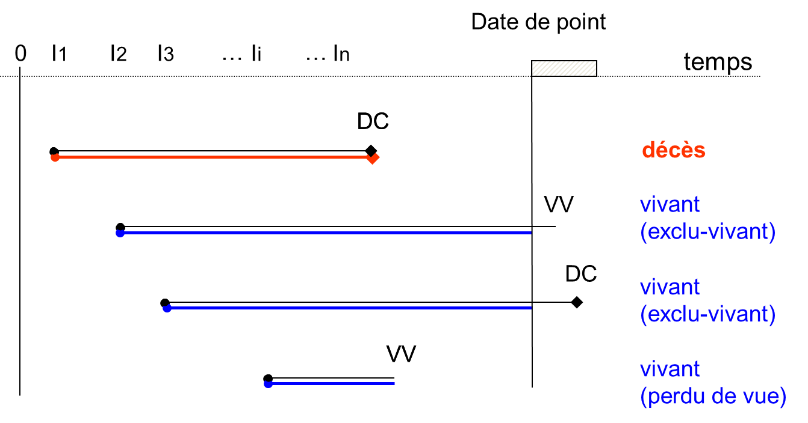
La survie : une donnée censurée
dernières nouvelles

Slide 32
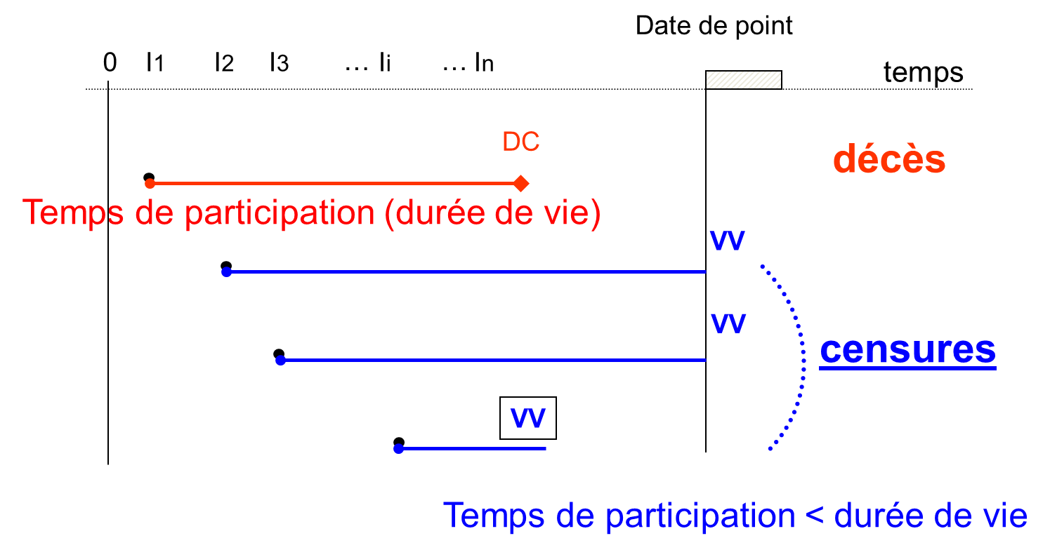
La survie : une donnée censurée

Slide 33
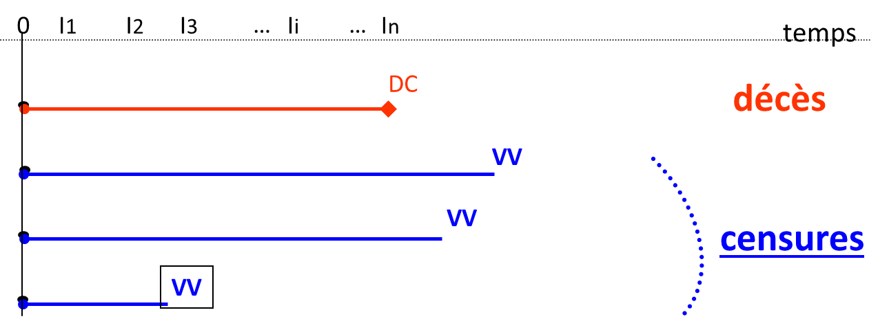
La survie : une donnée censurée

Slide 34
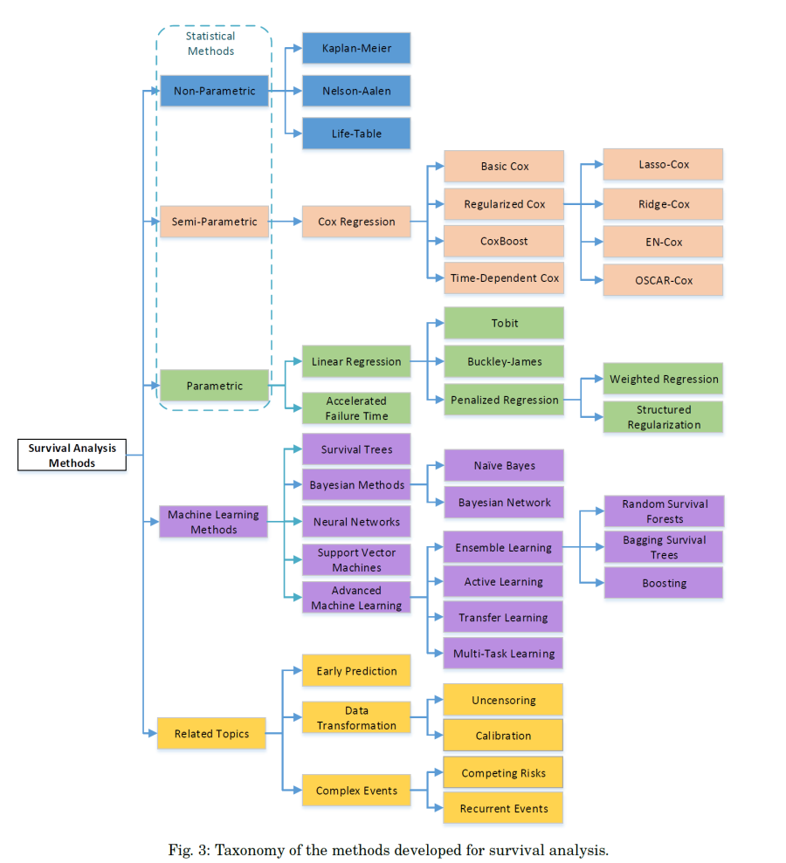
Modeling Survival
Machine Learning for Survival Analysis: A Survey, PING WANG et al. ArXiv, 2017

Slide 35
Modeling Survival

Slide 36
Modeling Survival

Slide 37
C index
c = Pr(^y1 > ^y2 | y1 > y2)

Slide 38
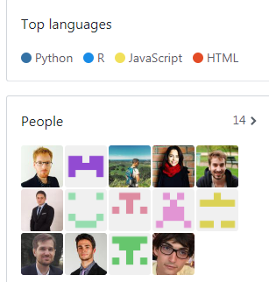

DITEP
Medical team
Data Science team
loic.verlingue@gustaveroussy.fr
https://github.com/DITEP

