Slide 1
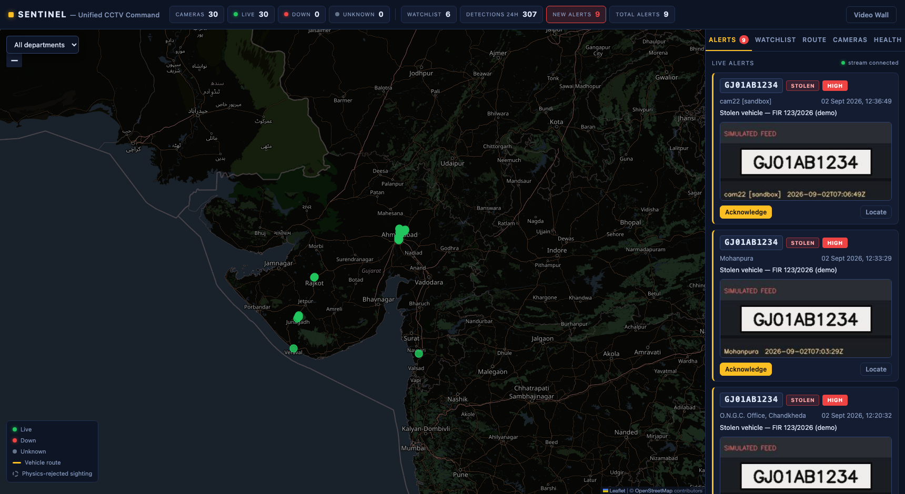
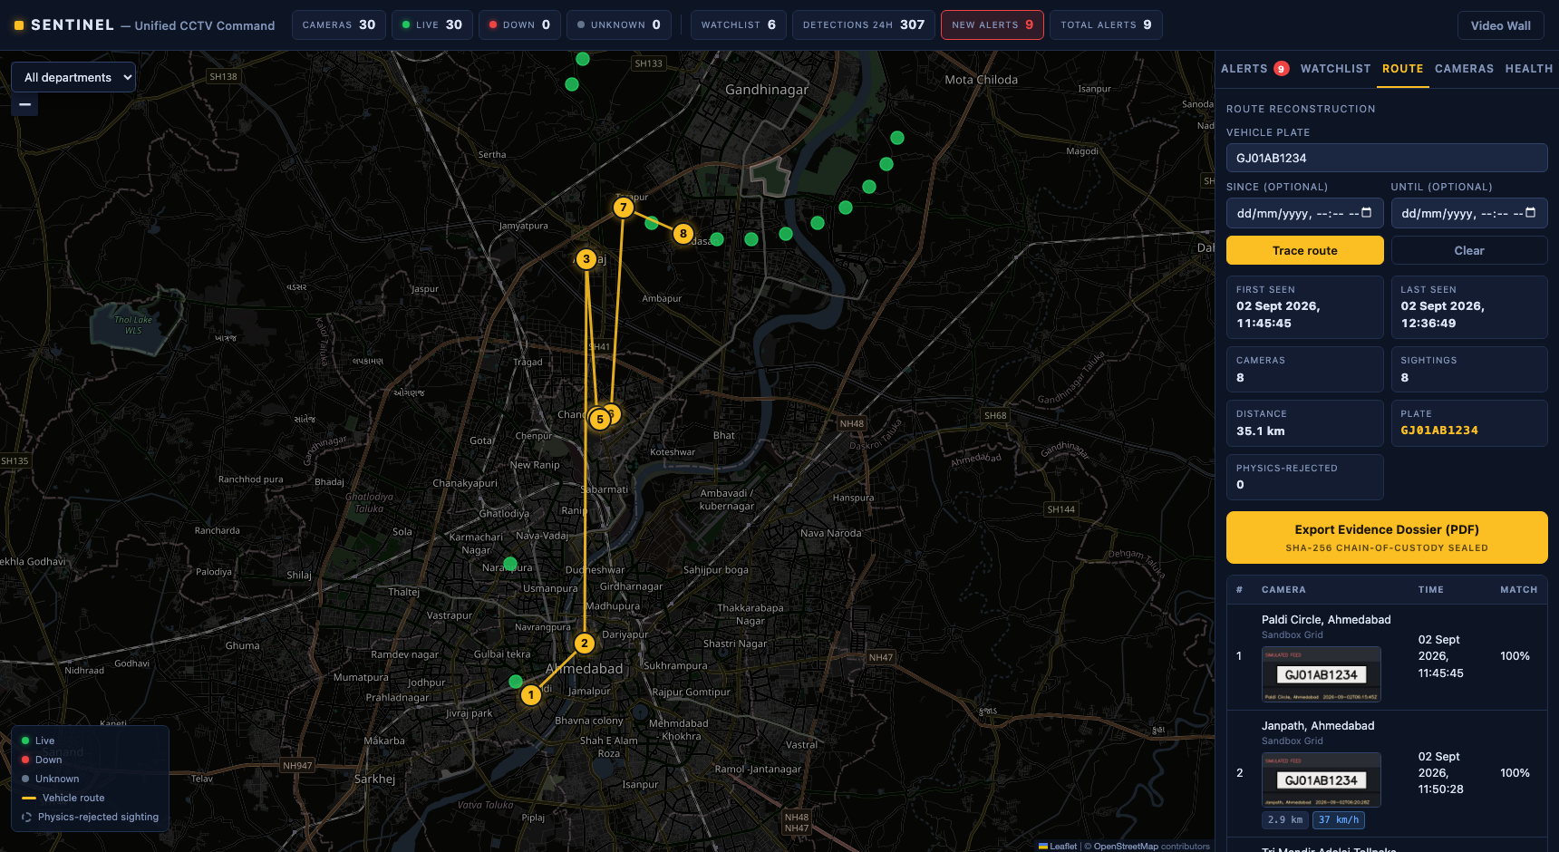
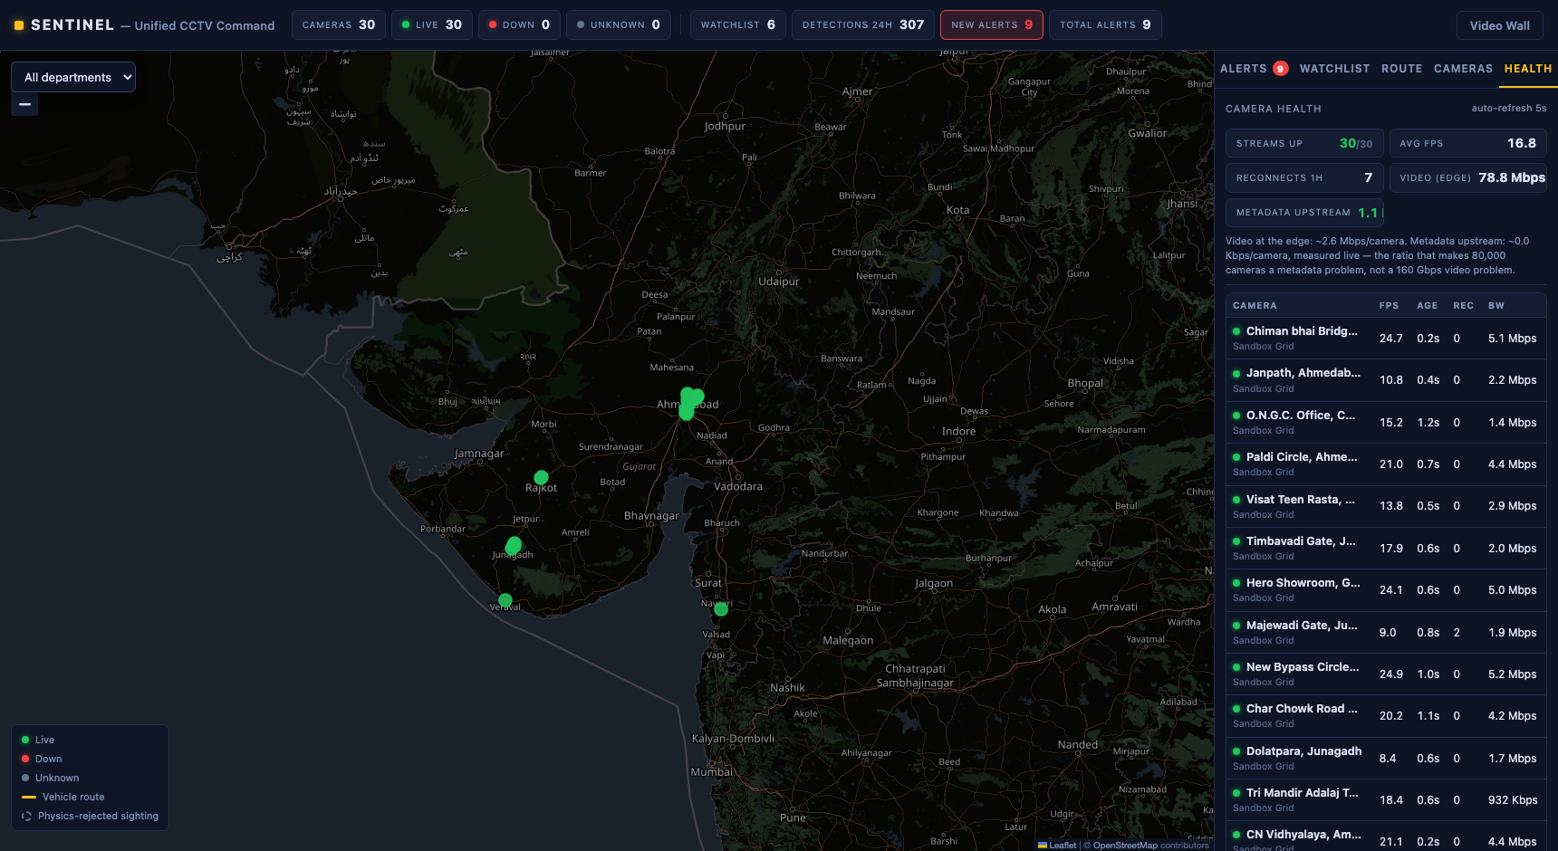
GUJARAT POLICE CCTV HACKATHON 2026 · SUBMISSION DECK
SENTINEL
Plate to Court in 60 Seconds — the Evidence Machine
“Where did this car go?” Answered from a single plate number to a court-admissible, hash-sealed evidence dossier in under a minute — live on the 30-camera government sandbox grid, on the cameras Gujarat already owns.
PROPOSED MODEL: Hybrid — Model 1 (Registry & GIS) + Model 2/4 (Unified Viewing + Central AI Analytics & Watchlist Alerts)
SUBMITTED BY: Divij Patel — Individual participant, Category 1 · vatsunp11@gmail.com
30/30 government cameras live
27 plate reads on real feeds today
SHA-256 chain-of-custody dossier
Zero new cameras needed
Live watchlist alerts — real platform, running now
The test-case UI — shown on the simulated-journey harness (slide 4)
Per-camera health — fps & bandwidth per feed

Slide 2
PROPOSED MODEL & WHY
One hybrid platform, because the test case spans three models
KEY INNOVATIONS
MODEL 1 — REGISTRY & GIS (mandatory)
Every camera catalogued with GIS position, department, codec and stream URLs — synced from the gateway catalogue API. Nothing hard-coded: cameras and ids can change and the platform absorbs it.
1
PTS-anchored evidence clock — every timestamp derives from stream PTS, never wall-clock or declared fps — survives the gateway's own timing traps.
MODEL 2 — UNIFIED VIEWING
26 departments on one pane of glass: live map, HLS video wall, per-camera drawer, department filters — on existing cameras and DVR/NVRs.
2
Confusion-tolerant plate matcher — 0↔O, 1↔I, 5↔S, 8↔B misreads recovered at displayed confidence — never silently merged.
3
Physics plausibility filter — impossible hops rejected with plain-language reasons (“214 km/h over 3.1 km — discarded”).
MODEL 4 — CENTRAL AI + WATCHLIST ALERTS
Vehicle detection + ANPR on live feeds, watchlist correlation with real-time alerts, route reconstruction, and a court-ready evidence export.
4
Hash-chained evidence dossier — SHA-256 chain-of-custody PDF: snapshots, GPS/timestamp table, operator identity, audit trail.
WHY HYBRID
The evaluation exercises all three at once: onboard ~50 heterogeneous cameras (M1), monitor them centrally (M2), then trace a designated plate and alert on a watchlist (M4). One registry-driven platform covers the full graded path with no duplicated infrastructure.
5
Edge-first 80,000-camera design — video stays on departmental NVRs; ~1–3 Kbps per camera of metadata travels upstream.
SENTINEL — Divij Patel (Individual, Category 1) — Gujarat Police CCTV Hackathon 2026
2 / 12

Slide 3
SOLUTION OVERVIEW · END-TO-END WORKFLOW
The 60-second story — five beats, one arc, the exact live demo
1
2
3
4
5
COLD OPEN
All 30 government feeds live on one pane of glass. Health board green, per-feed bandwidth counters visible. No login screen, no loading.
THE ASK
Judge reads a plate. Typed once. The route animates camera-by-camera: timestamps, plate-crop evidence cards, per-hop confidence chips.
PROOF OF LIFE
The same plate crosses a live camera — the watchlist alert fires with an audible ping; the operator's acknowledgment lands in the audit log on screen.
CHAOS BEAT
We kill a feed on purpose. Amber → reconnecting → green — the same backoff code that survives the sandbox's looping feeds.
PLATE TO COURT
One click: chain-of-custody PDF — hashed frames, GPS/timestamp table, operator identity. Handed to the panel, printed.
Rehearsal protocol: every beat rehearsed cold-start daily; three timed dress runs (real grid / injected failure / fully offline). Beat 2 is never canned — the judge-plate trace is always live.
SENTINEL — Divij Patel (Individual, Category 1) — Gujarat Police CCTV Hackathon 2026
3 / 12

Slide 4
CRITERION 1 — THE GOVERNMENT TEST CASE
The plate trace, proven on the real grid — not hoped for
ONBOARDED LIVE — SEPT 2
The full government sandbox grid via catalogue sync: 30 heterogeneous cameras — 24 H.264 + 6 HEVC, five resolutions, declared 10–30 fps. RTSP forced over TCP, max 4 concurrent captures (pacing rule).
MEASURED, NOT TRUSTED
cam01 declares 30 fps but delivers ~12.5 fps (median PTS gap exactly 80 ms) — the integration guide's own warning, demonstrated live. All timing is PTS-anchored; never arrival time, never declared fps.
REAL DETECTIONS TODAY
293 detections on 11 real cameras, incl. 27 plate reads on 7 of them — each with a PTS-anchored UTC timestamp, snapshot and bbox, stored where GET /api/detections serves them.
The route UI on the platform's simulated-journey demo harness (snapshots watermarked SIMULATED FEED) — the same engine serves real-grid queries: e.g. 5 timestamped sightings of CMCI801 on cam23 with 4 OCR misreads fuzzy-recovered.
Score-sheet line: “identify, trace and present the complete timestamped route” → demo beat 2.
SENTINEL — Divij Patel (Individual, Category 1) — Gujarat Police CCTV Hackathon 2026
4 / 12

Slide 5
CRITERION 5 — AI ANALYTICS APPROACH
We show you what the system refused to believe — and why
RTSP over TCP
PTS-anchored frames
YOLOv8n
vehicle detection
Plate localization
YOLO-v9-t 384
fast-plate-ocr
plate reading
Normalize + match
exact / fuzzy, ranked
CPU-only inference, per-camera buffers (no fixed-shape batch across heterogeneous cameras), detector reset on loop discontinuities.
THE 0.93 RECOVERY
OCR reads GJ01A81234 → matched GJ01AB1234 at 0.93, flagged fuzzy.
8 misread as B — an exact-match system shows a hole in the route; SENTINEL shows a recovered sighting at displayed confidence. Ranked, flagged, never silently merged; an all-fuzzy route says so in a banner.
THE REJECTED HOP
“Implied speed 214 km/h over 3.1 km — physically impossible, discarded as false ANPR match.”
A physics filter over GIS distance / PTS-anchored Δt greys the hop on the map with a plain-language reason; a retro-rejection guard stops a false first sighting from poisoning the route.
Uncounterfeitable: this proves the system models vehicles moving through the world — not strings matching in a database. Face recognition: roadmap only, deliberately not demoed.
SENTINEL — Divij Patel (Individual, Category 1) — Gujarat Police CCTV Hackathon 2026
5 / 12

Slide 6
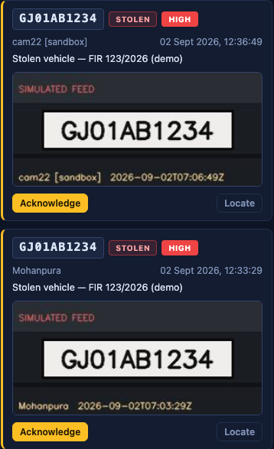
WATCHLIST CORRELATION & REAL-TIME ALERTS
Every detection, against every active entry — in real time
1
NORMALIZE
One shared rule for every plate everywhere: uppercase, A–Z and 0–9 only. The watchlist and the detector can never disagree on format.
2
CORRELATE
Each detection is matched against all active watchlist entries: exact on the normalized plate, plus fuzzy via Indian-plate canonicalization + weighted edit distance over OCR-confusion pairs (0↔O, 1↔I, 5↔S, 8↔B, 6↔G, 2↔Z cost 0.25; any other edit 1.0; total ≤ 1.0 matches) — always labelled fuzzy with displayed confidence (a single confusion misread scores 0.93).
3
ALERT IN UNDER A SECOND
Matches push over WebSocket to every operator screen: audible ping, snapshot evidence card, category and priority badges, map pan to the camera.
4
ACKNOWLEDGE & AUDIT
The operator's acknowledgment lands in the append-only audit log — the same log the evidence dossier cites. Nothing disappears silently.
Live alert cards on the running platform.
SENTINEL — Divij Patel (Individual, Category 1) — Gujarat Police CCTV Hackathon 2026
6 / 12

Slide 7
CRITERION 3 — HIGH-LEVEL DESIGN
Tiered edge architecture: video stays where it lives
80,000 CAMERAS + DVR/NVRs
26 departments' existing CCTV estate — untouched. Video is decoded and analysed near the camera and never leaves departmental storage.
EDGE / REGIONAL PoPs (~30)
Decode + ANPR run locally per district PoP; per-camera health metrics measured at the edge; store-and-forward for low-connectivity sites.
STATE CENTRE
Registry + GIS · watchlist correlation · route engine · evidence dossier · append-only audit. Metadata-scale only — no video backhaul.
metadata
~1–3 Kbps/cam
Interoperability: the catalogue registry API is the contract — cameras and ids can change and the platform absorbs it; per-camera codec/resolution read from the catalogue, no uniform-grid assumption. VAHAN / SARTHI / eGujCop integration readiness documented (HLD §10). Evolution path on the same contracts: SQLite → PostgreSQL+PostGIS, REST → Kafka, threads → K8s per PoP.
TECHNOLOGIES USED
Python 3.12
FastAPI
SQLAlchemy
OpenCV + FFmpeg (RTSP/TCP)
Ultralytics YOLOv8n
fast-plate-ocr
open-image-models
React 18 + Vite
Leaflet GIS
hls.js
WebSocket
JWT RBAC
SQLite → PostGIS
SENTINEL — Divij Patel (Individual, Category 1) — Gujarat Police CCTV Hackathon 2026
7 / 12

Slide 8
CRITERION 6 — SCALABILITY TO 80,000 CAMERAS
Computed, not asserted — and measured live on the health board
CENTRALIZED (THE WRONG WAY)
160 Gbps
80,000 cameras × 2 Mbps of video hauled into one site. Unbuildable on GSWAN — and pointless to build.
EDGE-FIRST (SENTINEL)
80–240 Mbps
Detection metadata only: ~1–3 Kbps per camera upstream — a 650× to 2,000× reduction. Video stays on departmental NVRs, exactly as today.
Shown live, on screen: the camera-health board puts both numbers side by side for the real grid — per-camera video bandwidth staying at the edge next to the metadata actually travelling upstream (rows are measured in real time for every camera with a live worker attached).
Honest scope: architecture plus measured ratios on one machine — not a deployed fleet. GPU sizing, analytics tiering and retention are stated as explicit assumptions in the HLD (§6).
SENTINEL — Divij Patel (Individual, Category 1) — Gujarat Police CCTV Hackathon 2026
8 / 12

Slide 9
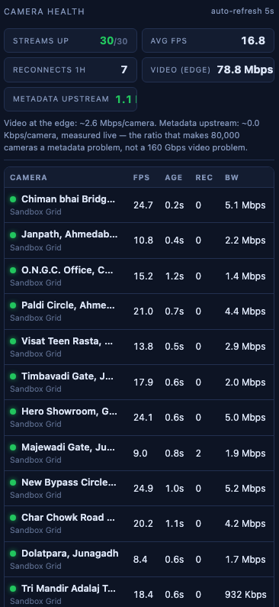
CRITERION 4 — PLATFORM MATURITY & SECURITY
Built for the 2 a.m. shift — resilience shown, not claimed
HEALTH BOARD
Per-feed measured fps, last-frame age, reconnect count and live bandwidth — problem feeds sort first; auto-alert on feed drop.
KILL-A-FEED, LIVE
We cut a feed on stage: green → amber → reconnecting → green. Exponential backoff 2 s → 30 s plus loop-discontinuity reset — rehearsed daily.
RBAC + AUDIT
Token-authenticated viewer / operator / admin roles gate watchlist changes, acks and dossier export; append-only audit log; the identity on the dossier comes from the token, never a spoofable header.
TRIPLE-LAYER FALLBACK
DEMO_MODE flag, a fully local 50-camera gateway needing zero venue network, and one dress rehearsal run entirely offline.
SENTINEL — Divij Patel (Individual, Category 1) — Gujarat Police CCTV Hackathon 2026
Health board: 30/30 streams reporting.
9 / 12

Slide 10
COST & OPERATIONAL BENEFITS FOR POLICING
You do not need a single new camera
₹3–7k
per EXISTING camera to bring it onto SENTINEL
vs ₹25k+ per new camera installed.
Video never leaves departmental storage — no new backhaul, no forklift replacement.
8–16 hours → sub-second — a vehicle trace that today costs an operator a shift of manual DVR review becomes one query.
The watchlist never sleeps — every live feed cross-referenced 24×7; alerts reach the control room in under a second, with evidence attached.
Evidence that survives court — the dossier reaches the charge sheet hash-sealed, with operator identity and audit trail — CCTV evidence stops dying between control room and court.
Same infrastructure amortizes every future analytic at software-only cost — the brief's “existing infrastructure to the maximum practical extent”, done literally.
Phased, low-risk rollout — P1 pilot: one commissionerate, ~2,000 cameras, ~₹1.5 cr — validates every ratio before scaling. Statewide sketch ₹15–20 cr excl. cameras (HLD §11, ±30%).
SENTINEL — Divij Patel (Individual, Category 1) — Gujarat Police CCTV Hackathon 2026
10 / 12

Slide 11
THE SCORE SHEET, MIRRORED
Seven criteria + every bonus line — each tick names its proof
THE SEVEN EVALUATION CRITERIA
BONUS CRITERIA — NO UNPROVEN TICKS
✓
1 · Government test case
designated plate → timestamped route, live on the real grid (slide 4, demo beat 2)
✓
Multi-camera correlation
route engine w/ physics filter + retro-rejection guard (regression-tested); fuzzy recoveries proven on the real grid
✓
2 · Presentation
this deck: one slide per criterion, transcribable straight into the rubric
✓
Cybersecurity / audit / RBAC
SHA-256 dossier chain, JWT roles, append-only audit the export cites
✓
3 · High-level design
tiered edge architecture; 12-section HLD submitted as PDF (slide 7)
✓
Edge / bandwidth efficiency
~1–3 Kbps/cam upstream; ratio measured live on the health board
✓
4 · Platform maturity
health board + on-stage kill-a-feed recovery + RBAC/audit (slide 9)
✓
Camera-health monitoring
per-feed fps / frame-age / reconnects / bandwidth + drop alerts
✓
5 · Analytics quality
physics-filter rejection + 0.93 fuzzy recovery, confidence shown (slide 5)
✓
Existing-infrastructure reuse
zero new cameras; DVR/NVRs untouched; ₹3–7k per existing camera
✓
6 · Scalability to 80k
160 Gbps vs 80–240 Mbps — computed and measured (slide 8)
✓
Real-time alerting
watchlist alert < 1 s over WebSocket, snapshot attached, ack audited
✓
7 · Completeness
deck, HLD, two videos, timestamped report, repo — all banked early (slide 12)
Not claimed: face recognition is roadmap, not demo; every legal statement scoped as design provision.
SENTINEL — Divij Patel (Individual, Category 1) — Gujarat Police CCTV Hackathon 2026
11 / 12

Slide 12
“Plate to court in sixty seconds —
on the cameras Gujarat already owns.”
EVERYTHING THE CHECKLIST ASKS FOR — BANKED EARLY, SUBMITTED BEFORE NOON ON 7 SEPTEMBER
DECK
this file + PDF
HLD
12-section PDF
VIDEO ×2
own-feed + government-feed
REPORT
timestamped = dossier export
REPO
clean-clone quickstart, make test
LIVE DEMO
cold-start rehearsed, offline fallback
SENTINEL · Hybrid Model 1 + 2/4 · Divij Patel (Individual, Category 1) · Gujarat Police CCTV Hackathon 2026
SENTINEL — Divij Patel (Individual, Category 1) — Gujarat Police CCTV Hackathon 2026
12 / 12

