Slide 1
Food recommendation system
Yukta Sharma – 17BCS1931
Ujawall Dwivedi – 17BCS1947
Utkarsh Singh – 17BCS1954
Deepak Yadav – 17BCS1993

Slide 2
Introduction
Do you often find yourself confused when you’re about to place an order?
Our food recommendation system learns, based on your previous order history using content-based filtering and recommends you the best food choices.

Slide 3
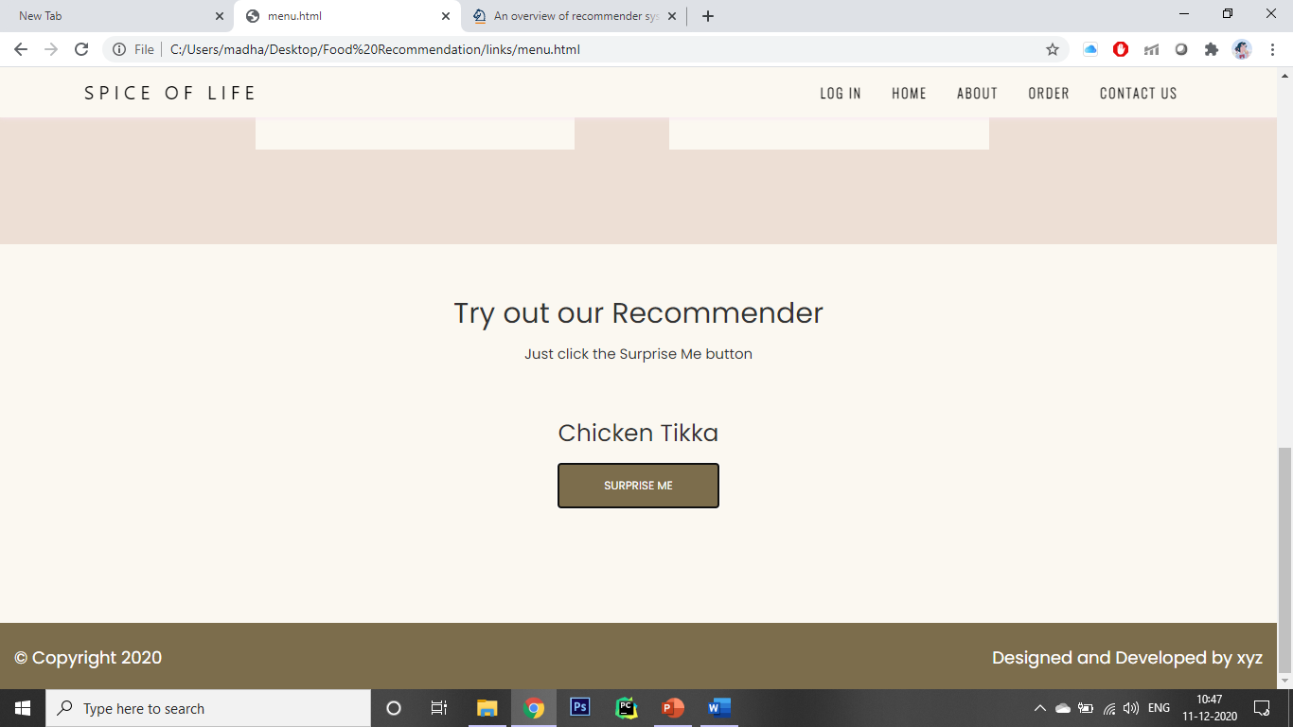
Our Recommender

Slide 4
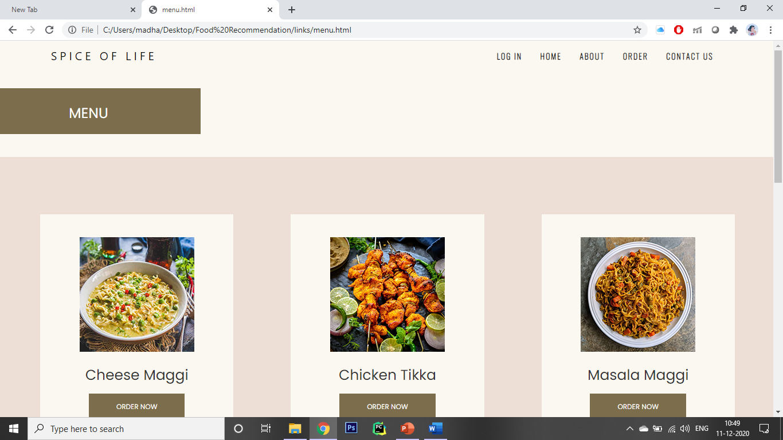
Menu

Slide 5
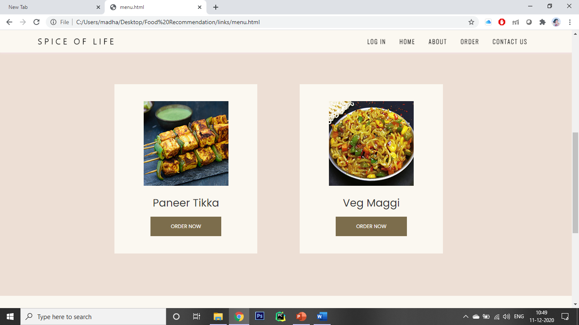
Menu

Slide 6
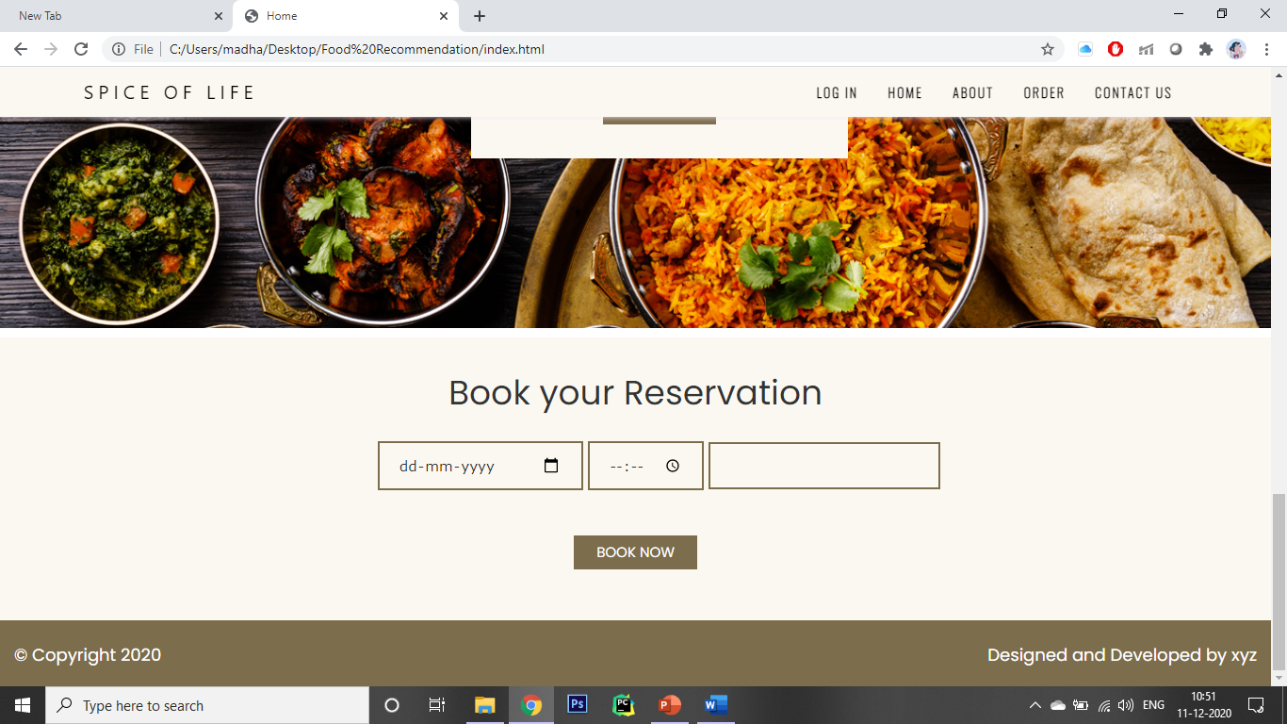
reservations

Slide 7
Technologies Used
HTML
CSS
JavaScript
Machine Learning using Python
MySQL

Slide 8
Software requirements
A working PC with Windows 7/8/10
An internet connection
Google Chrome v87.0
MySQL server installed

Slide 9
Future Scope
Food may also be suggested according to the weather outside.
A person may also get recommendations based on his/her mood.
The recommender will suggest something which the user hasn’t ordered before or its been a while since he has ordered that item.

Slide 10
Thank you

