Slide 1
ECHO ADDITION AND REMOVAL
IN
AUDIO SIGNALS
Project Based Learning –Digital Signal Processing
PHASE III

Slide 2
 | NAME | ROLL NUMBER
1. | DIVYA GAVANE | 3122
2. | VAISHNAVI FULSUNDAR | 3123
3. | SHITAL INDULWAR | 3131
4. | SAMIRA JADHAV | 3132

Slide 3
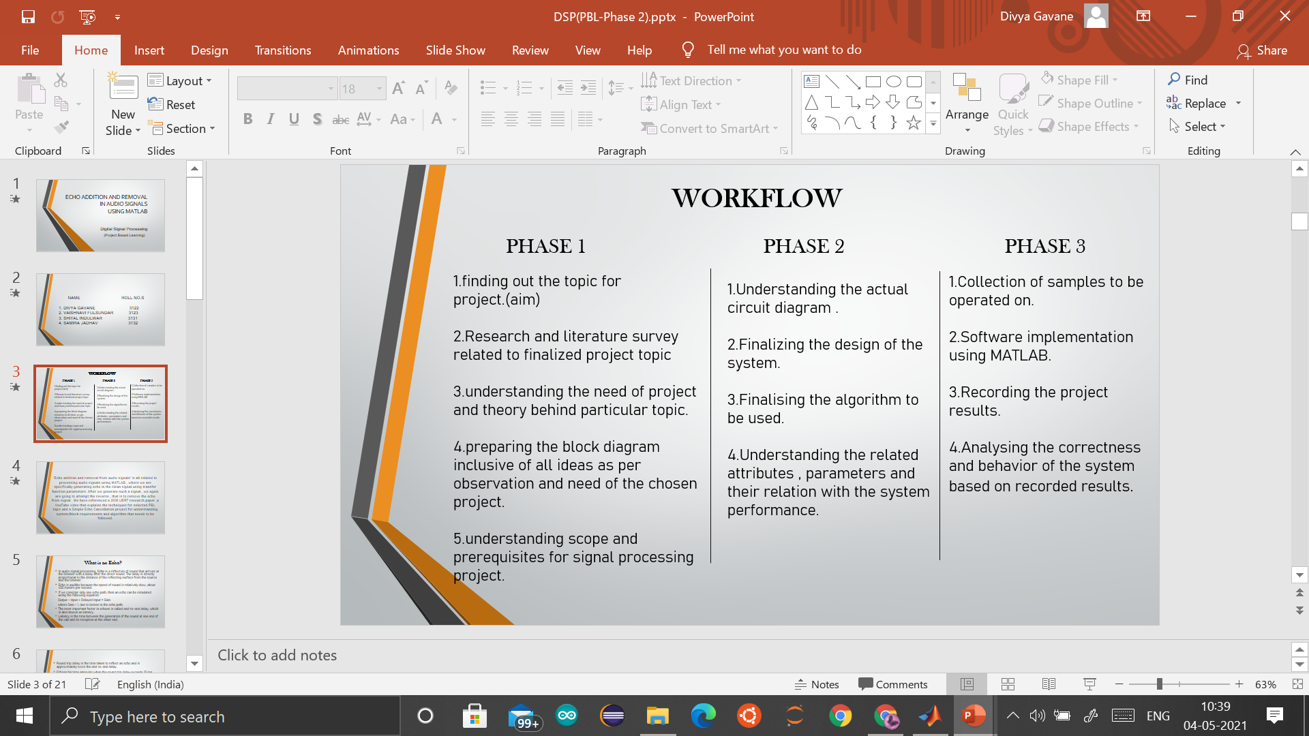

Slide 4
PARAMETERS
Sampling frequency,(f) we have taken high so as to achieve better reconstructed signal.
x(n) y(n)
H(n)
X(n): input signal y(n):output signal=input signal +echo(delayed version of input signal)
Sound with delayed version won’t be of same intensity ; it will be attenuated.
Y(n)=x(n) + αx(n-D) D:delay , α:attenuation constant<1

Slide 5
^{DIFFERENCE EQUATION:}
^{if we assume D=1 and α=0.1}
^{THEN}
^{Y(n)=x(n)+ 0.1 x(n-1)}
^{TAKING Z TRANSFORM:}
^{y(z)=x(z)+0.1 x(z)z -1}
H(z)=y(z)/x(z)=1+0.1z⁻¹
^{Numerator:[1,0.1]}
Denominator:[1]………more amount of delay should be taken so as to differentiate between the original signal and echo added signal.
^{Similarly,}
for D=2…………..numerator=[1,0,0.1] ,denominator=[1]
For D=3…………..numerator=[1,0,0,0.1] , denominator=[1]

Slide 6
To get back the original signal we will have to find G(z) such that
H(z).G(z)=1
That is
G(z)=1/H(z)
for example ,
If H(z)=1+0.8z^-11 /z^-11 , G(z)=z^-11 /1+0.8z^-11
So now the numerator and denominator values must be swapped in order to get back the original echo free audio signal.
Now,
Numerator=[1];
Denominator=[1,zeros(limit),α];

Slide 7
CODE USED AND OUTPUTS
FOR TWO VARIATIONS
IN THE PROCESSING

Slide 8
1. USING SAMPLE THAT IS RECORDED IN MATLAB

Slide 9
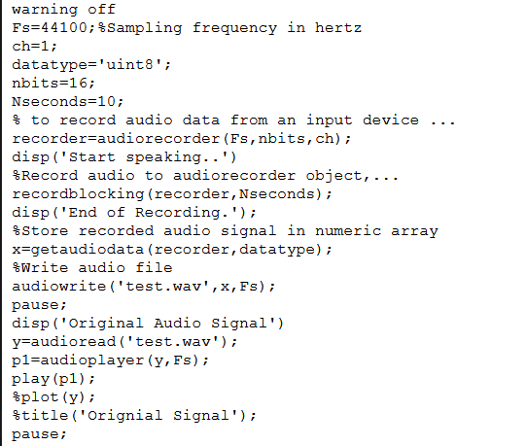
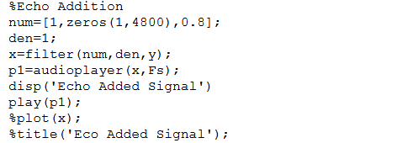
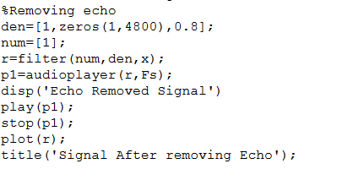
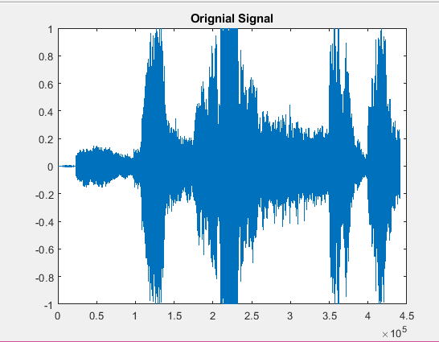
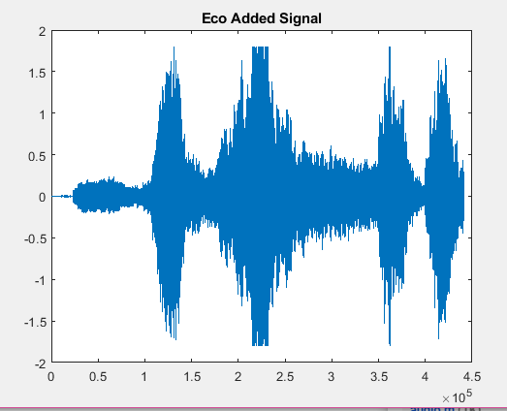
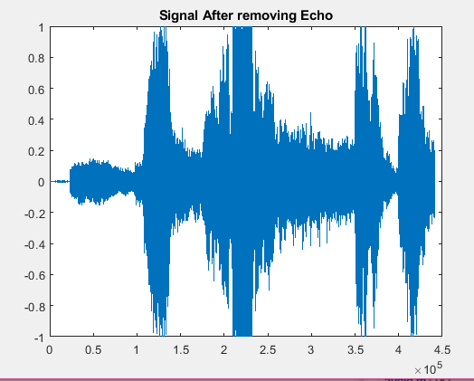

Slide 10
2. USING A READY TO USE AUDIO FILE

Slide 11
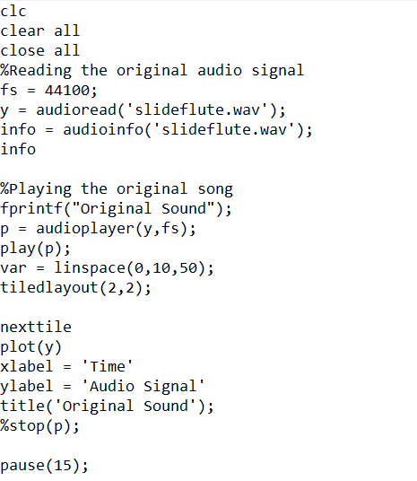
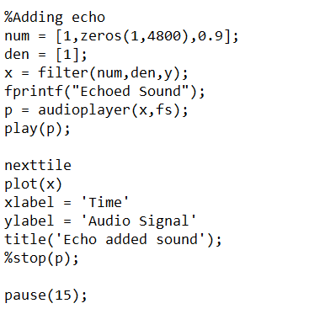
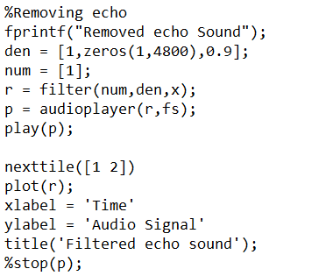
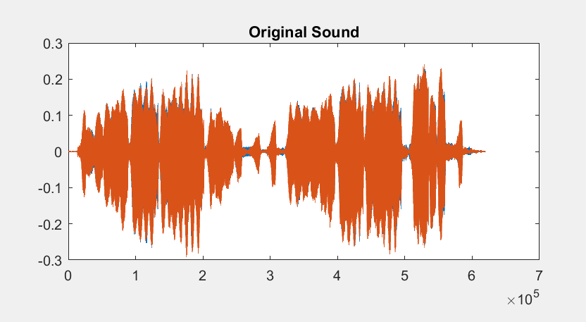
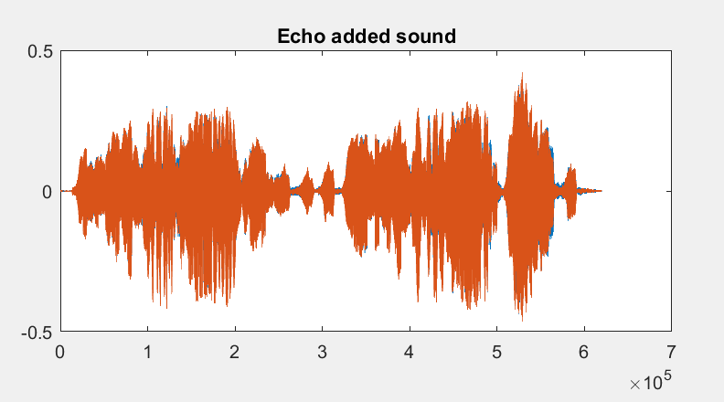
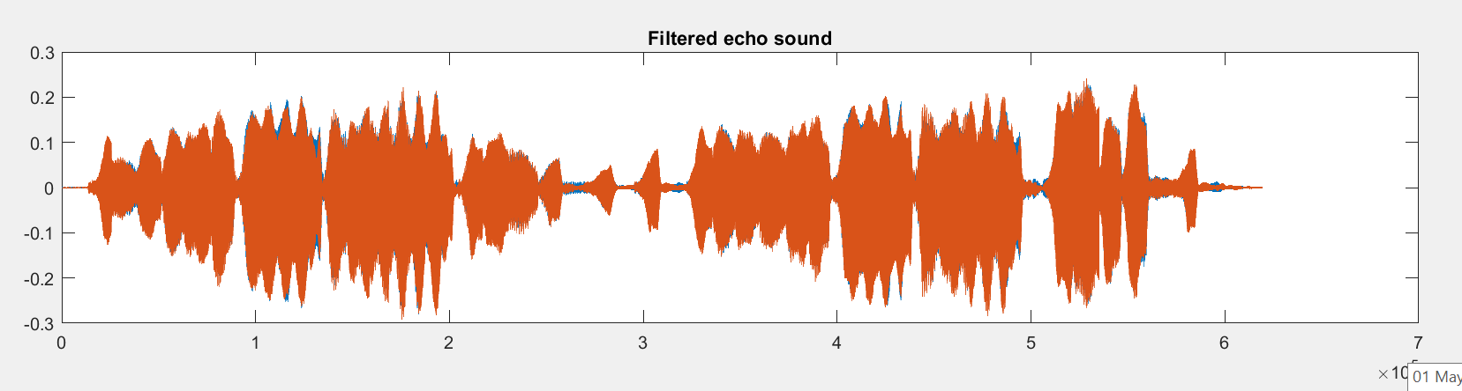

Slide 12
CONCLUSION
Echo can be added to a input signal just by adding its delayed and attenuated version to it.
Parameters like delay constant , sampling frequency , attenuation constant and hence numerator and denominator coefficients determine the amount of echo added in the input signal.
Echo removal can be done by adjusting the delay and attenuation constant in such a way that inverse of a transfer function when multiplied by itself gives 1 as product.
Echo addition and removal in audio signals using MATLAB ,is easy to implement on the software after having studied the parameters and their relation with difference equation.

Slide 13
THANK YOU!

