Slide 1
MOS Devices Literature Review
Ferroelectric Nanosheet FETs

Slide 2
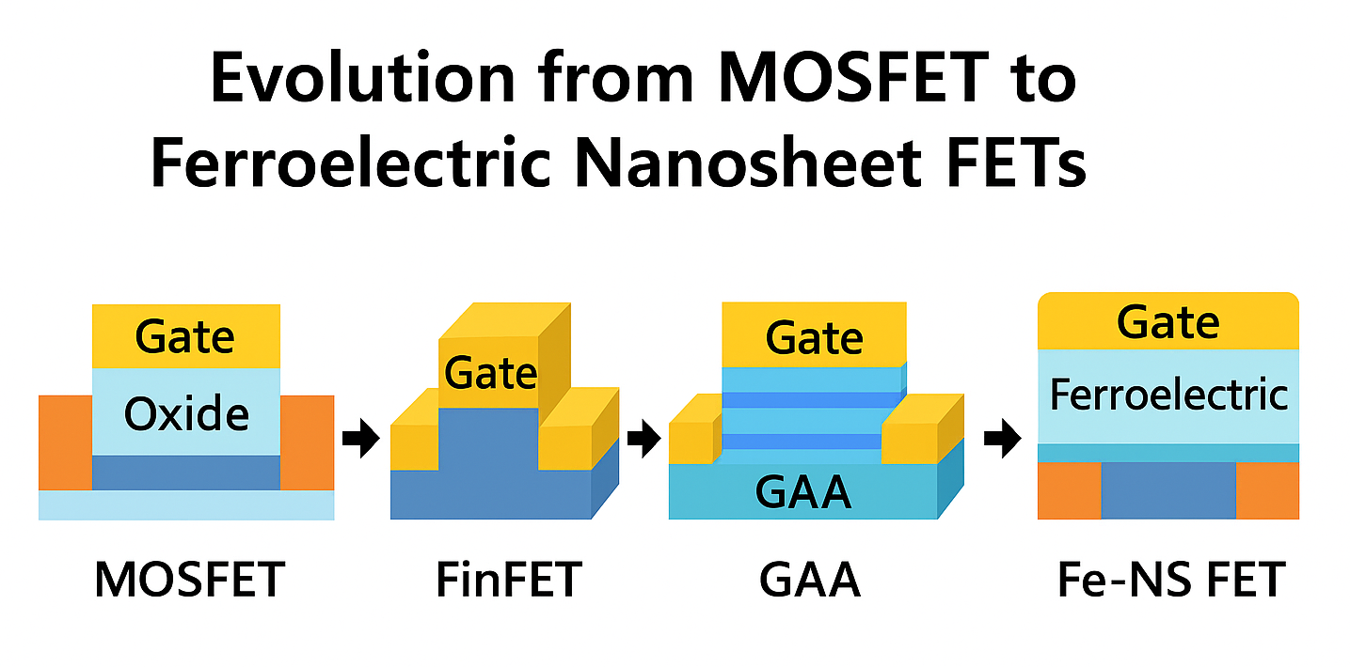
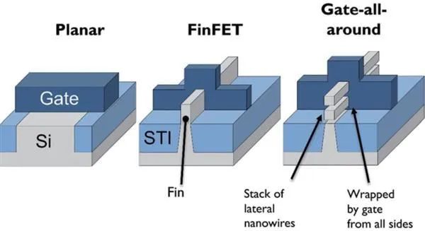
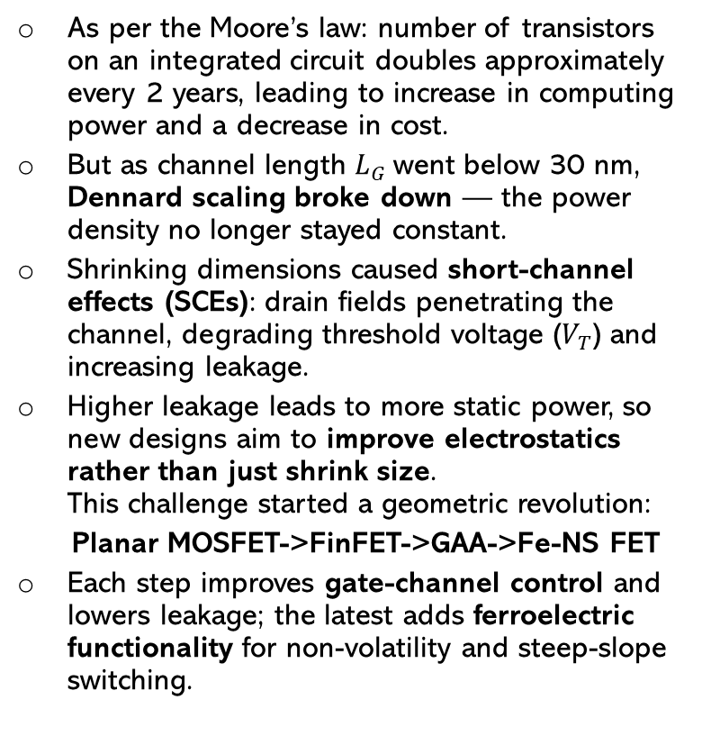
Evolution of Transistor Architectures
As per the Moore’s law: number of transistors on an integrated circuit doubles approximately every 2 years, leading to increase in computing power and a decrease in cost.
But as channel length $L_{G}$went below 30 nm, Dennard scaling broke down — the power density no longer stayed constant.
Shrinking dimensions caused short-channel effects (SCEs): drain fields penetrating the channel, degrading threshold voltage ($V_{T}$) and increasing leakage.
Higher leakage leads to more static power, so new designs aim to improve electrostatics rather than just shrink size.
This challenge started a geometric revolution:
Planar MOSFET->FinFET->GAA->Fe-NS FET
Each step improves gate-channel control and lowers leakage; the latest adds ferroelectric functionality for non-volatility and steep-slope switching.
Refs: Bohr & Young 2017 (IEEE Micro); Kim et al.,Nat. Sci. Rev. 2024 [1][3]

Slide 3
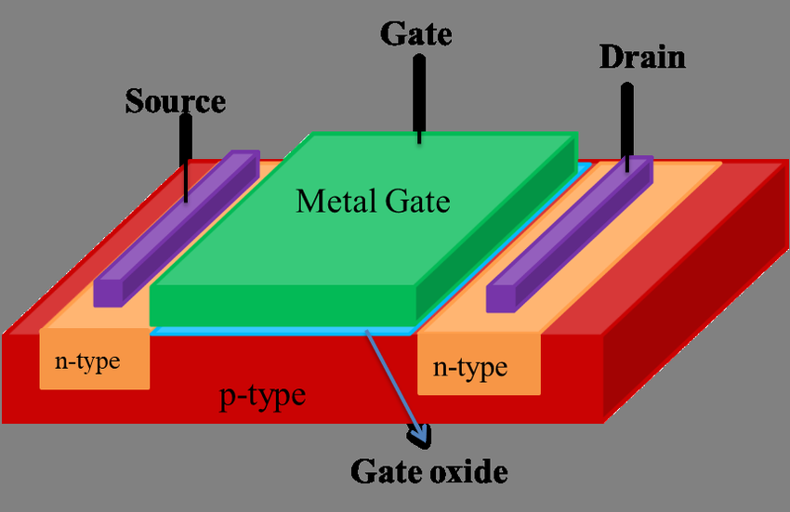
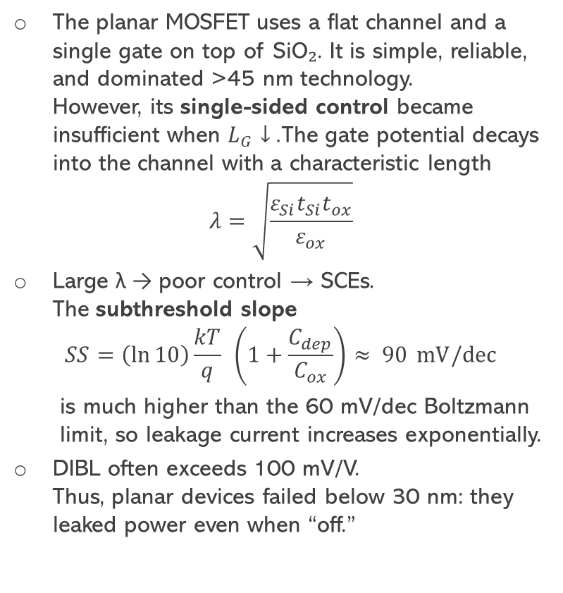
Planar MOSFET: Strength and Limitations
The planar MOSFET uses a flat channel and a single gate on top of SiO₂. It is simple, reliable, and dominated >45 nm technology.
However, its single-sided control became insufficient when $L_{G}↓$. The gate potential decays into the channel with a characteristic length
$$λ=\sqrt{\frac{ε_{Si}t_{Si}t_{ox}}{ε_{ox}}}$$
Large λ → poor control → SCEs.
The subthreshold slope
$$SS=\left(\ln{10}\right)\frac{kT}{q} \left(1+\frac{C_{dep}}{C_{ox}}\right)≈ 90 mV/dec$$
  is much higher than the 60 mV/dec Boltzmann limit, so leakage current increases exponentially.
DIBL often exceeds 100 mV/V.
Thus, planar devices failed below 30 nm: they leaked power even when “off.”
Refs: Y. Taur & T. Ning, Fundamentals of Modern VLSI Devices (2009)

Slide 4
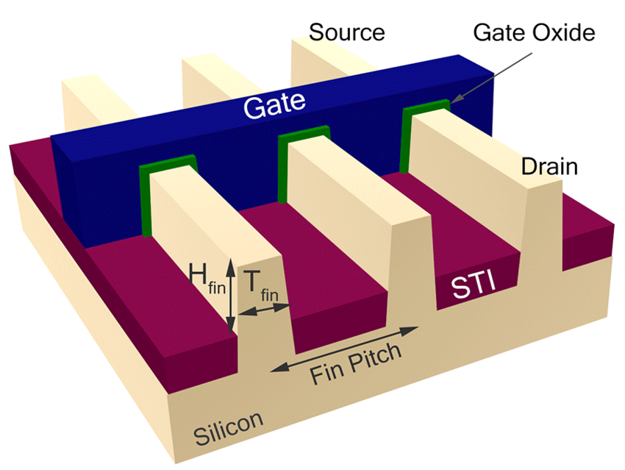
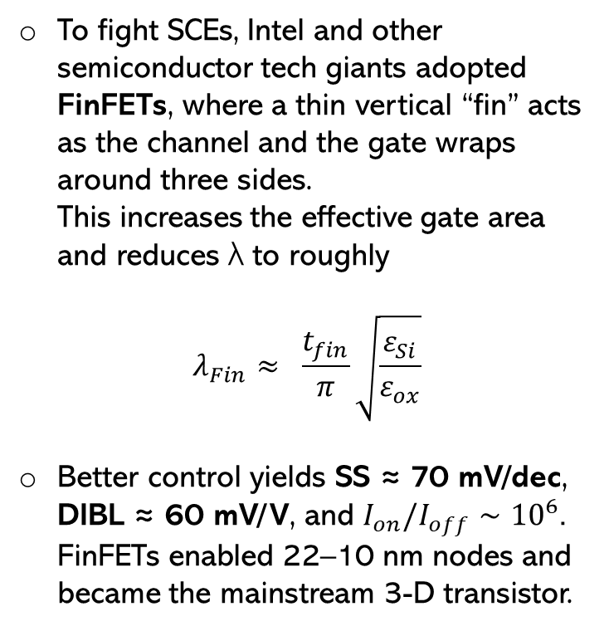
FinFET: First 3D solution
To fight SCEs, Intel and other semiconductor tech giants adopted FinFETs, where a thin vertical “fin” acts as the channel and the gate wraps around three sides.
This increases the effective gate area and reduces λ to roughly
$$λ_{Fin}≈ \frac{t_{fin}}{π}\sqrt{\frac{ε_{Si}}{ε_{ox}}}$$
Better control yields SS ≈ 70 mV/dec, DIBL ≈ 60 mV/V, and $I_{on}/I_{off}∼{10}^{6}$.
FinFETs enabled 22–10 nm nodes and became the mainstream 3-D transistor.
Refs: Hisamoto et al., IEEE TED 2000; B. Yu et al., IEDM 2002

Slide 5
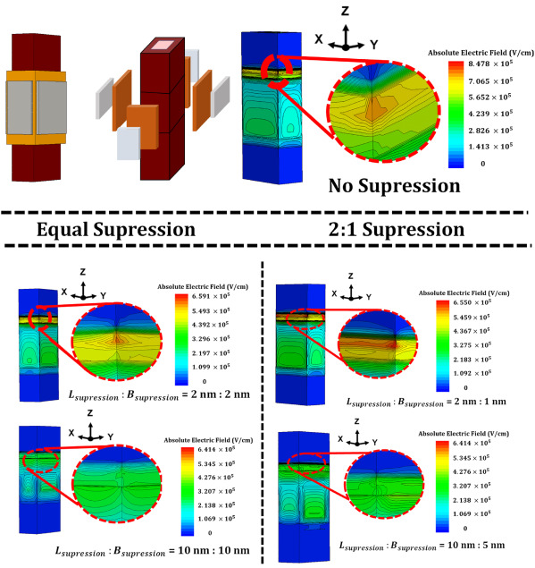
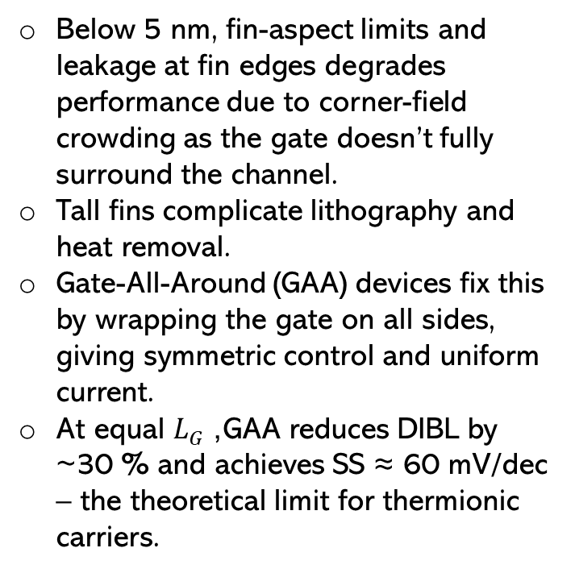
FinFET Limits and GAA Transition
Below 5 nm, fin-aspect limits and leakage at fin edges degrades performance due to corner-field crowding as the gate doesn’t fully surround the channel.
Tall fins complicate lithography and heat removal.
Gate-All-Around (GAA) devices fix this by wrapping the gate on all sides, giving symmetric control and uniform current.
At equal $L_{G}$, GAA reduces DIBL by ~30 % and achieves SS ≈ 60 mV/dec – the theoretical limit for thermionic carriers.
Refs: Kim et al., Nat. Sci. Rev. 2024

Slide 6
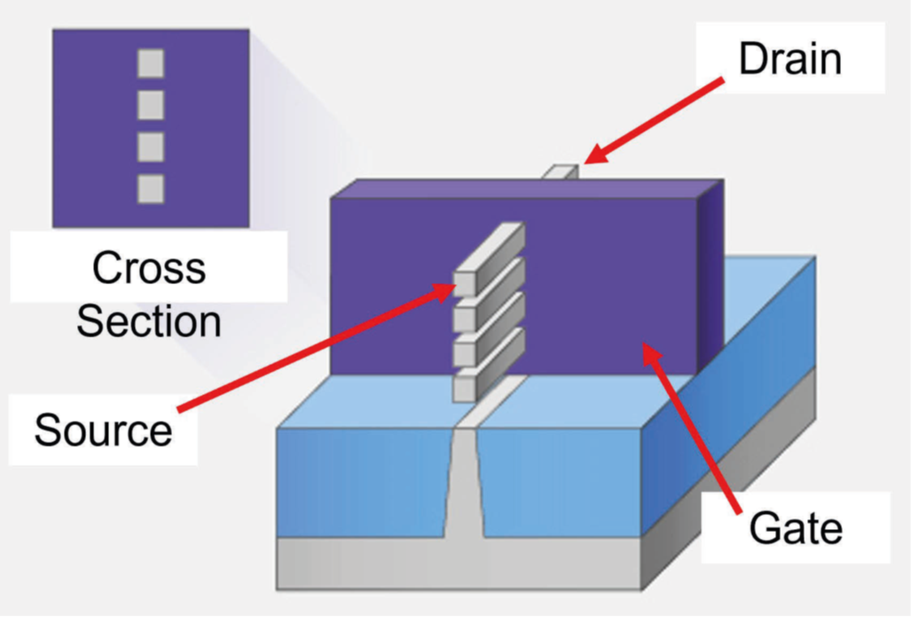
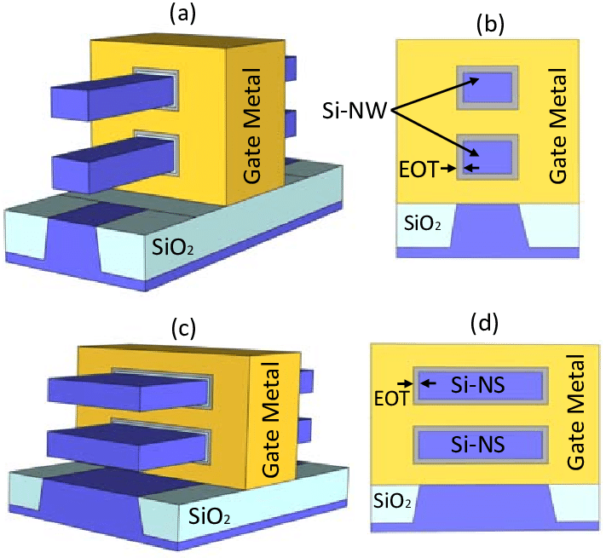
GAA / Nanosheet FET: Concept and Structure
Motivation:
Below 5 nm, FinFETs face short-channel limits due to side-wall-only gate control.
The Gate-All-Around (GAA) design surrounds the channel completely, giving 360° electrostatic control and enabling further scaling.
Horizontal nanosheet FETs replace fins with stacked Si/SiGe sheets—each a conduction path fully wrapped by gate metal and dielectric.
Structure
3–5 stacked Si/SiGe sheets → higher drive current (Iᴅ) per footprint.
High-κ HfO₂/SiO₂ dielectric and metal gate wrap around each sheet.
Fully-depleted channel suppresses leakage and improves control.
Why it Matters
Excellent electrostatics (SCE suppression < 2 nm).
Higher Iₒₙ, lower Iₒff, CMOS-compatible process.
Basis for Fe-NS FET → adds non-volatility and sub-60 mV/dec operation.
Refs: J. P. Duarte et al., IEEE TED, 2023; S. Mukesh et al., Electronics, 2022

Slide 7
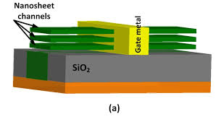
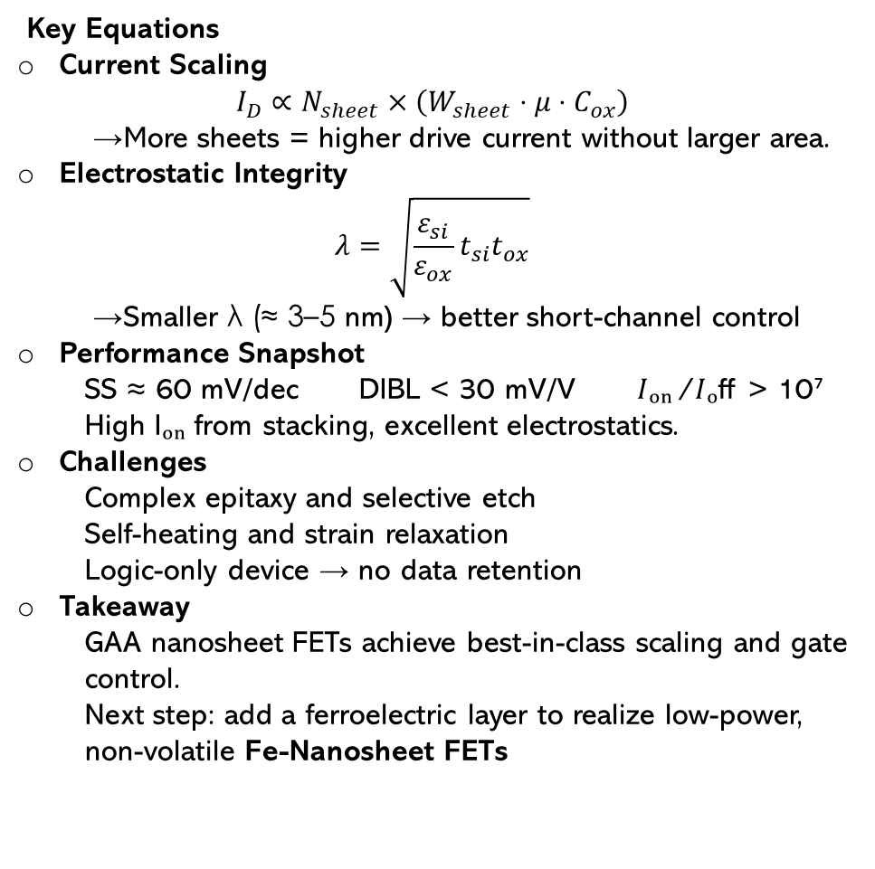
GAA FET: Equations and Performance
Key Equations
Current Scaling
$$I_{D}∝N_{sheet}×\left(W_{sheet} ⋅ μ ⋅ C_{ox}\right)$$
  → More sheets = higher drive current without larger area.
Electrostatic Integrity
$$λ=\sqrt{\frac{ε_{si}}{ε_{ox}}t_{si}t_{ox}}$$
  → Smaller λ (≈ 3–5 nm) → better short-channel control
Performance Snapshot
  SS ≈ 60 mV/dec DIBL < 30 mV/V 𝐼ₒₙ⁄𝐼ₒff > 10⁷
  High Iₒₙ from stacking, excellent electrostatics.
Challenges
  Complex epitaxy and selective etch
  Self-heating and strain relaxation
  Logic-only device → no data retention
Takeaway
  GAA nanosheet FETs achieve best-in-class scaling and gate control.
  Next step: add a ferroelectric layer to realize low-power, non-volatile Fe-Nanosheet FETs
Refs: J. P. Duarte et al., IEEE TED, 2023; S. Mukesh et al., Electronics, 2022

Slide 8
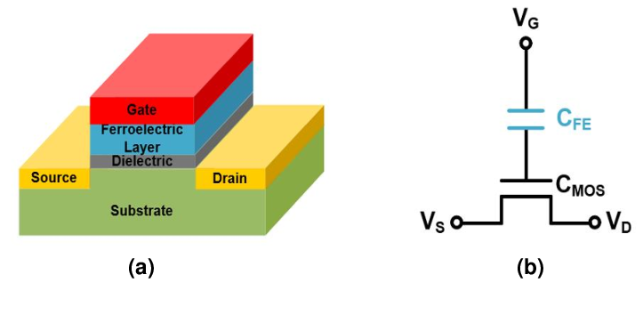
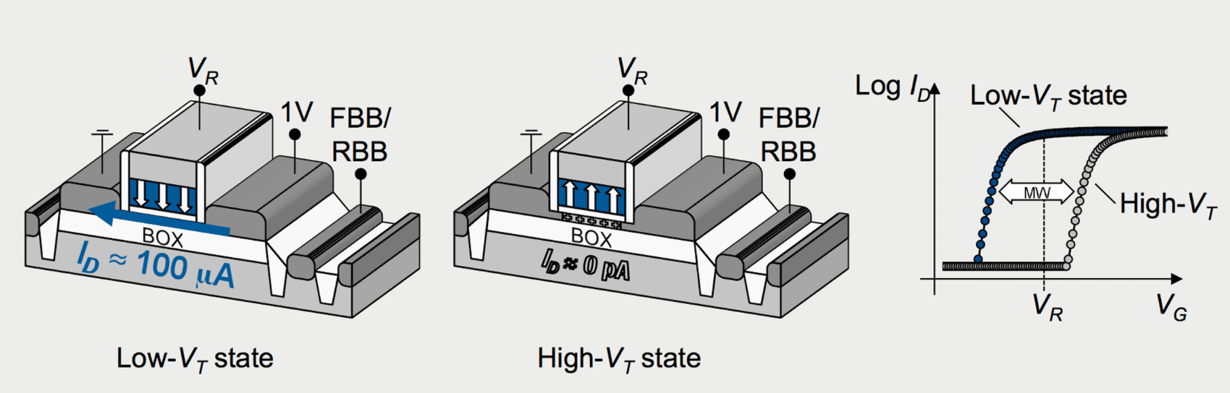
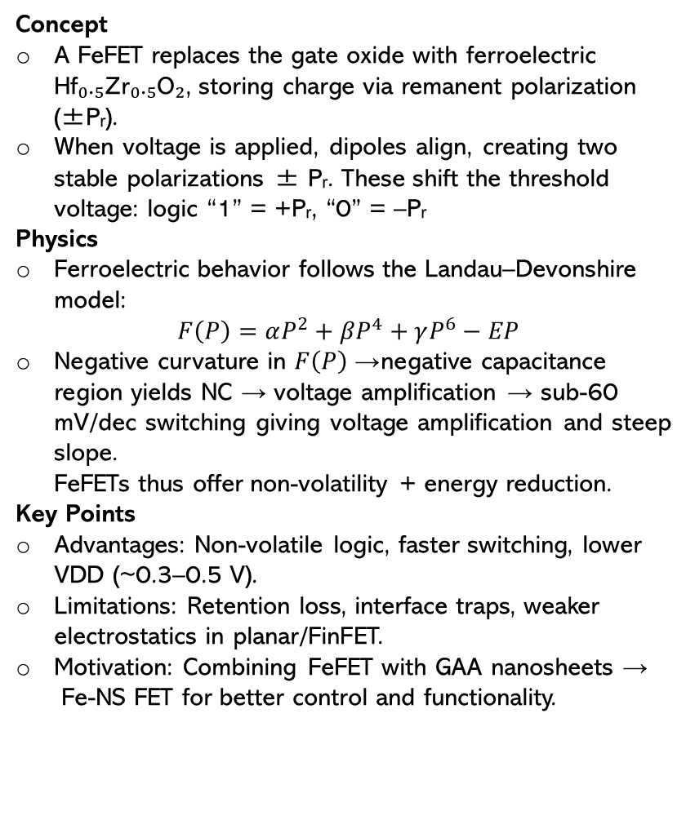
Ferroelectric FET (FeFET): Concept and Physics
Concept
A FeFET replaces the gate oxide with ferroelectric Hf₀.₅Zr₀.₅O₂, storing charge via remanent polarization (±Pᵣ).
When voltage is applied, dipoles align, creating two stable polarizations ± Pᵣ. These shift the threshold voltage: logic “1” = +Pᵣ, “0” = –Pᵣ
Physics
Ferroelectric behavior follows the Landau–Devonshire model:
$$F\left(P\right)=αP^{2}+βP^{4}+γP^{6}−EP$$
Negative curvature in $F\left(P\right)$→ negative capacitance region yields NC → voltage amplification → sub-60 mV/dec switching giving voltage amplification and steep slope.
FeFETs thus offer non-volatility + energy reduction.
Key Points
Advantages: Non-volatile logic, faster switching, lower VDD (~0.3–0.5 V).
Limitations: Retention loss, interface traps, weaker electrostatics in planar/FinFET.
Motivation: Combining FeFET with GAA nanosheets →
Fe-NS FET for better control and functionality.
Refs: Böscke et al., Appl. Phys. Lett. 2011; Salahuddin & Datta, Nano Lett. 2008

Slide 9
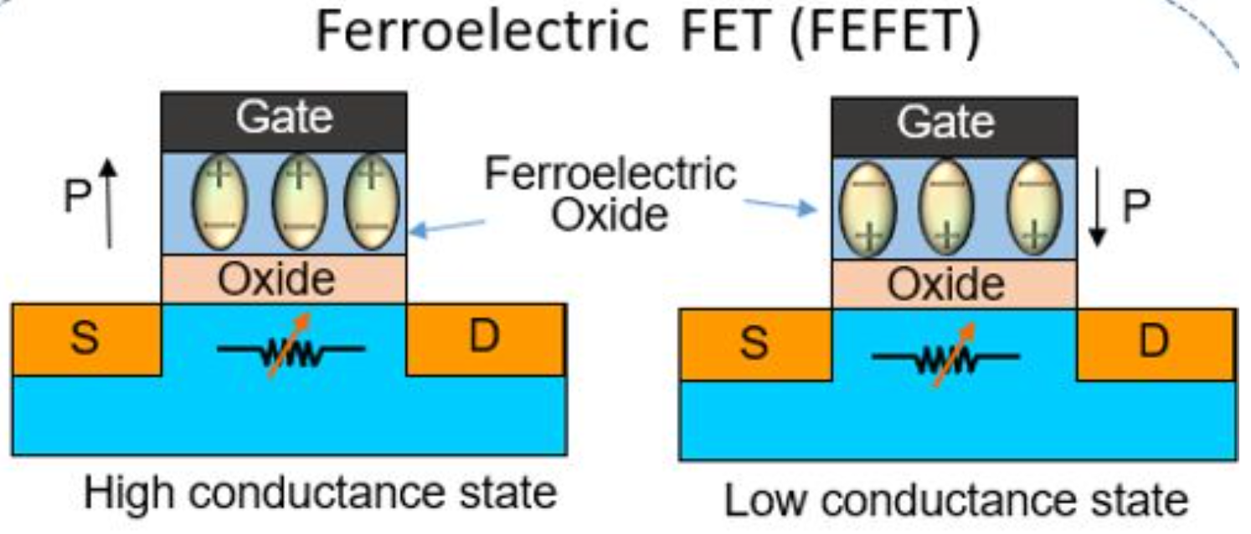
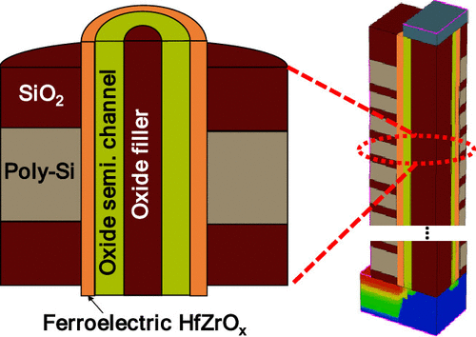
Ferroelectric Nanosheet FET (Fe-NS FET):
The Next Step
Why Combine Ferroelectric and Nanosheet Architectures
Gate-All-Around (GAA) nanosheet FETs offer the best electrostatic control by fully surrounding the channel.
Even the GAA device cannot break the Boltzmann sub-threshold slope limit (≈ 60 mV/dec) that governs thermionic carriers.
Adding a ferroelectric layer (e.g., Hf₀.₅Zr₀.₅O₂) introduces a negative capacitance (NC) region, which amplifies gate voltage internally—producing steeper subthreshold slopes (< 60 mV/dec).
Combining both provides:
  GAA geometry→ perfect electrostatics & scalability
  Ferroelectric gate → new functionality: non-volatile polarization & voltage gain
Structure and Materials
Metal Gate: provides work-function tuning
Ferroelectric Layer: switchable polarization (± Pᵣ)
Interfacial Oxide: ensures stability & leakage suppression
Nanosheet Channel: high mobility Si/SiGe stacked layers fully enclosed by gate
Refs: P.-Y. Chen et al., Adv. Funct. Mater. 2024; Cheng et al., IEEE EDL 2025

Slide 10
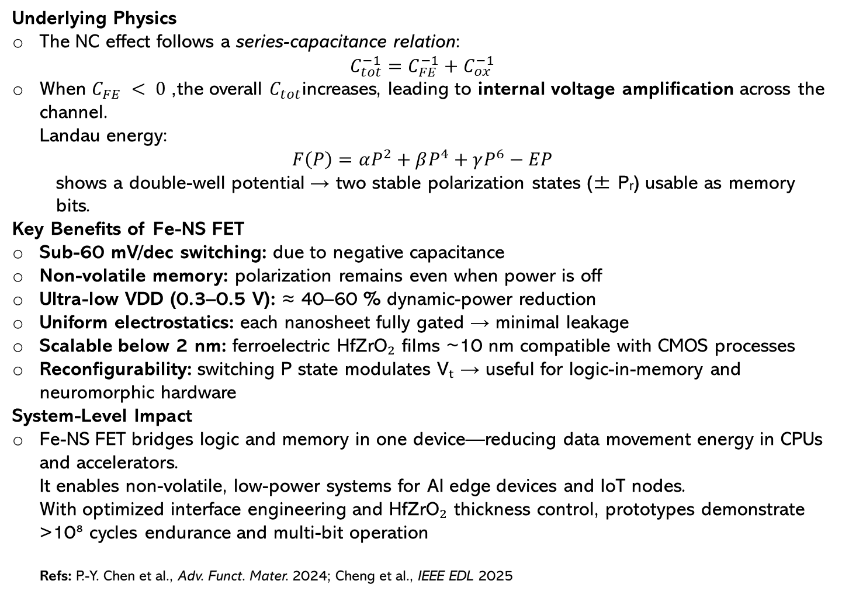
Underlying Physics
The NC effect follows a series-capacitance relation:
$$C_{tot}^{−1}=C_{FE}^{−1}+C_{ox}^{−1}$$
When $C_{FE} < 0$, the overall $C_{tot}$increases, leading to internal voltage amplification across the channel.
Landau energy:
$$F\left(P\right)=αP^{2}+βP^{4}+γP^{6}−EP$$
  shows a double-well potential → two stable polarization states (± Pᵣ) usable as memory bits.
Key Benefits of Fe-NS FET
Sub-60 mV/dec switching: due to negative capacitance
Non-volatile memory: polarization remains even when power is off
Ultra-low VDD (0.3–0.5 V): ≈ 40–60 % dynamic-power reduction
Uniform electrostatics: each nanosheet fully gated → minimal leakage
Scalable below 2 nm: ferroelectric HfZrO₂ films ~10 nm compatible with CMOS processes
Reconfigurability: switching P state modulates Vₜ → useful for logic-in-memory and neuromorphic hardware
System-Level Impact
Fe-NS FET bridges logic and memory in one device—reducing data movement energy in CPUs and accelerators.
It enables non-volatile, low-power systems for AI edge devices and IoT nodes.
With optimized interface engineering and HfZrO₂ thickness control, prototypes demonstrate >10⁸ cycles endurance and multi-bit operation
Refs: P.-Y. Chen et al., Adv. Funct. Mater. 2024; Cheng et al., IEEE EDL 2025

Slide 11
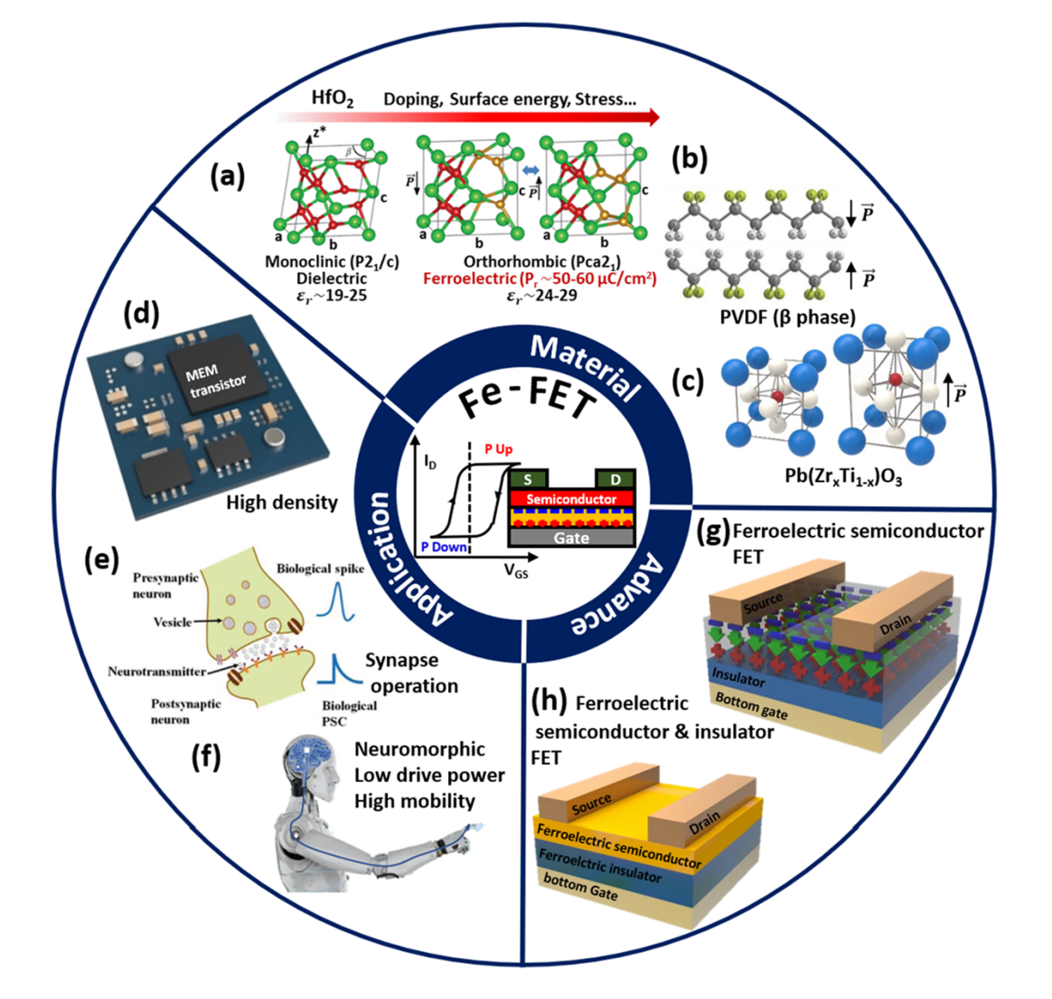
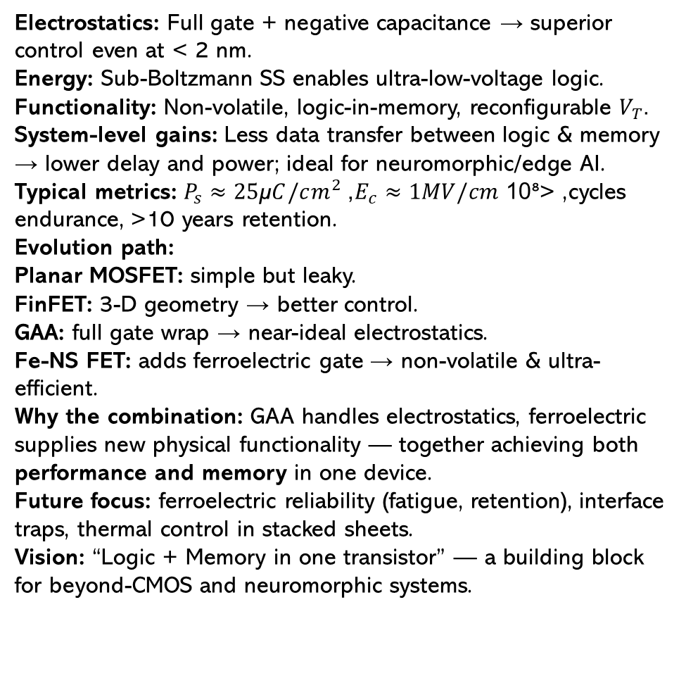
Advantages and Applications of Fe-NS FETs
Electrostatics: Full gate + negative capacitance → superior control even at < 2 nm.
Energy: Sub-Boltzmann SS enables ultra-low-voltage logic.
Functionality: Non-volatile, logic-in-memory, reconfigurable $V_{T}$.
System-level gains: Less data transfer between logic & memory → lower delay and power; ideal for neuromorphic/edge AI.
Typical metrics: $P_{s}≈25\text{µ}C/cm^{2}$, $E_{c}≈1MV/cm$, >10⁸ cycles endurance, >10 years retention.
Evolution path:
Planar MOSFET: simple but leaky.
FinFET: 3-D geometry → better control.
GAA: full gate wrap → near-ideal electrostatics.
Fe-NS FET: adds ferroelectric gate → non-volatile & ultra-efficient.
Why the combination: GAA handles electrostatics, ferroelectric supplies new physical functionality — together achieving both performance and memory in one device.
Future focus: ferroelectric reliability (fatigue, retention), interface traps, thermal control in stacked sheets.
Vision: “Logic + Memory in one transistor” — a building block for beyond-CMOS and neuromorphic systems.
Refs: Hoffmann et al., AIP Adv. 2020; Chen APR 2022; Adv. Funct. Mater. 2024

Slide 12
References
D. Hisamoto, W.-C. Lee, J. Kedzierski, H. Takeuchi, K. Asano, C. Kuo, E. Anderson, T.-J. King, J. Bokor, and C. Hu, “FinFET—A Self-Aligned Double-Gate MOSFET Scalable to 20 nm,” IEEE Trans. Electron Devices, vol. 47, no. 12, pp. 2320–2325, Dec. 2000. doi:10.1109/16.887014. SCIRP+1
B. Yu, L. Chang, S. Ahmed, H. Wang, S. Bell, C.-Y. Yang, C. Tabery, C. Ho, Q. Xiang, T.-J. King, and C. Hu, “FinFET Scaling to 10 nm Gate Length,” IEDM Tech. Dig., 2002, pp. 251–254. doi:10.1109/IEDM.2002.1175825. ResearchGate+2Semantic Scholar+2
Q. Zhang, Y. Zhang, Y. Luo, H. Yin, et al., “New structure transistors for advanced technology node CMOS ICs,” National Science Review, vol. 11, no. 3, article nwae008, 2024. doi:10.1093/nsr/nwae008. OUP Academic+2PubMed+2
S. Mukesh and J. Zhang, “A Review of the Gate-All-Around Nanosheet FET Process Opportunities,” Electronics, vol. 11, no. 21, 3589, 2022. doi:10.3390/electronics11213589. MDPI
S. Salahuddin and S. Datta, “Use of Negative Capacitance to Provide Voltage Amplification for Low Power Nanoscale Devices,” Nano Letters, vol. 8, no. 2, pp. 405–410, 2008. doi:10.1021/nl071804g. American Chemical Society+2PubMed+2
T. S. Böscke, J. Müller, D. Bräuhaus, U. Schröder, and U. Böttger, “Ferroelectricity in hafnium oxide thin films,” Applied Physics Letters, vol. 99, 102903, 2011. doi:10.1063/1.3634052. AIP Publishing+1
H. Chen, H. Liu, H. Zhang, et al., “HfO₂-based ferroelectrics: From enhancing performance, material design to applications,” Applied Physics Reviews, vol. 9, 011307, 2022. doi:10.1063/5.0066607. AIP Publishing+1
J.-Y. Kim, J.-H. Lee, H.-S. Kim, and J.-P. Hong, “Ferroelectric field-effect transistors: Progress and perspective,” APL Materials, vol. 9, 021102, 2021. doi:10.1063/5.0039636. AIP Publishing
Y. Yang, Z.-D. Luo, X. Wang, et al., “Emerging Opportunities for Ferroelectric Field-Effect Transistors: Integration of 2D Materials,” Advanced Functional Materials, vol. 34, no. 21, 2024, 230?—Article ID 2310438. doi:10.1002/adfm.202310438. Astrophysics Data System
H. Wong and K. Kakushima, “On the Vertically Stacked Gate-All-Around Nanosheet and Nanowire Transistor Scaling beyond the 5 nm Technology Node,” Nanomaterials, vol. 12, 1739, 2022 (open-access tutorial/analysis). PMC
Y. Zhao, S. Wang, J. Xiong, et al., “Compact Modeling of Advanced Gate-All-Around Nanosheet FETs Enabled by Artificial Neural Networks,” Micromachines, vol. 15, no. 2, 218, 2024. MDPI

Slide 13
THE END

