Slide 1
MOS Devices Literature Review
Ferroelectric Nanosheets
Presented by:
Divya Gavane (A0329221M)
G Krishna Kumar Teja (A0329735U)
Vellanki Priyanka (A0329806W)

Slide 2
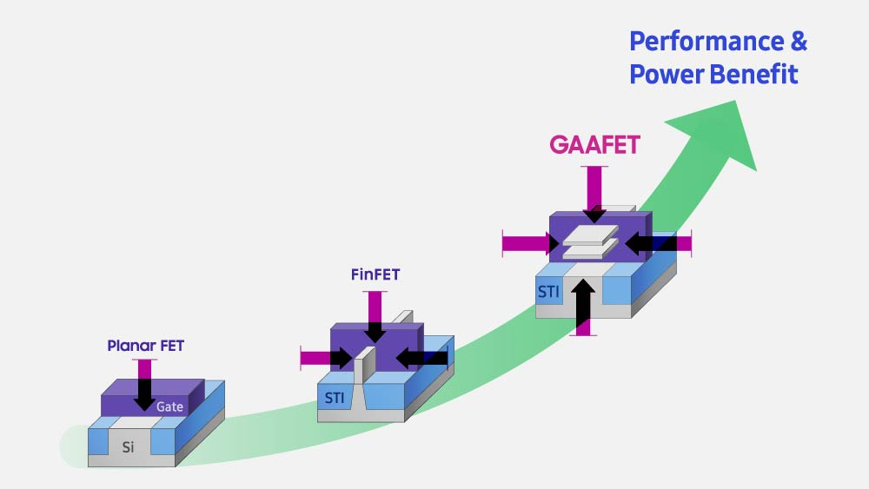
Transistors Evolution

Slide 3
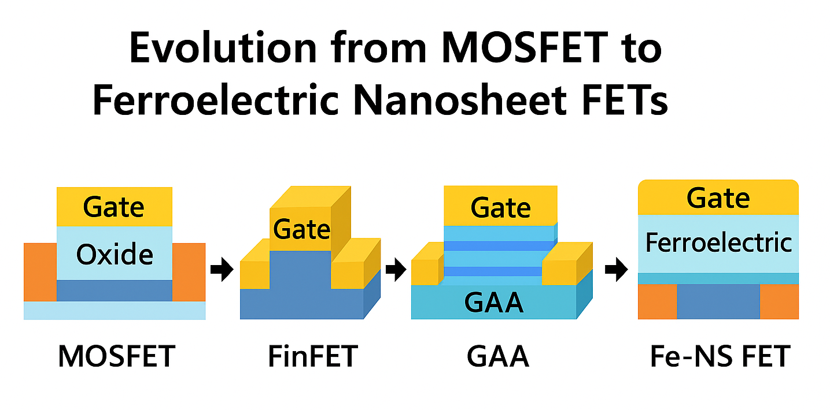
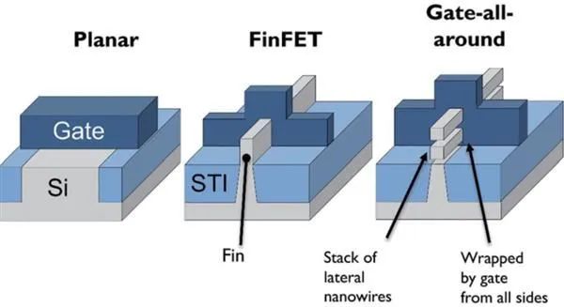
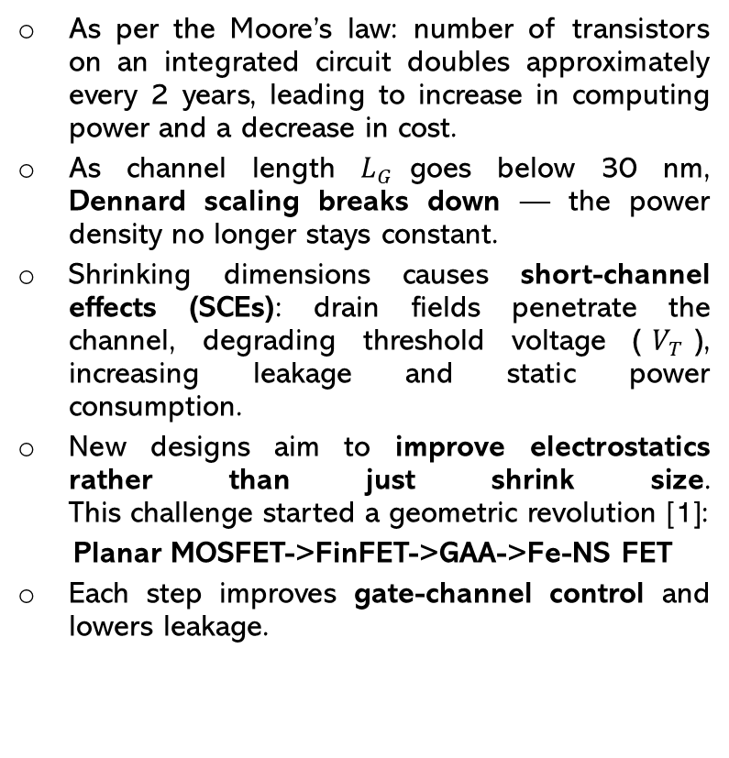
Evolution of Transistor Architectures
As per the Moore’s law: number of transistors on an integrated circuit doubles approximately every 2 years, leading to increase in computing power and a decrease in cost.
As channel length $L_{G}$goes below 30 nm, Dennard scaling breaks down — the power density no longer stays constant.
Shrinking dimensions causes short-channel effects (SCEs): drain fields penetrate the channel, degrading threshold voltage ($V_{T}$), increasing leakage and static power consumption.
New designs aim to improve electrostatics rather than just shrink size.
This challenge started a geometric revolution [1]:
Planar MOSFET->FinFET->GAA->Fe-NS FET
Each step improves gate-channel control and lowers leakage.

Slide 4
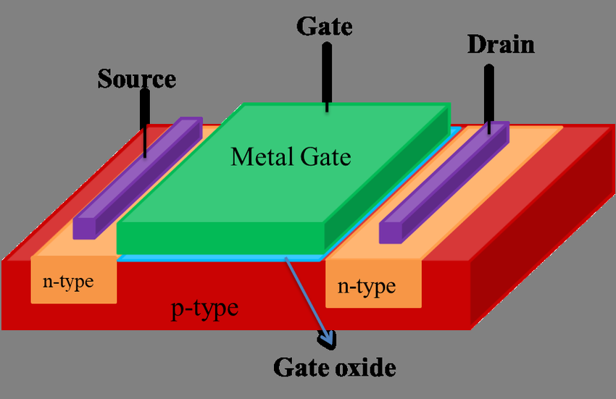
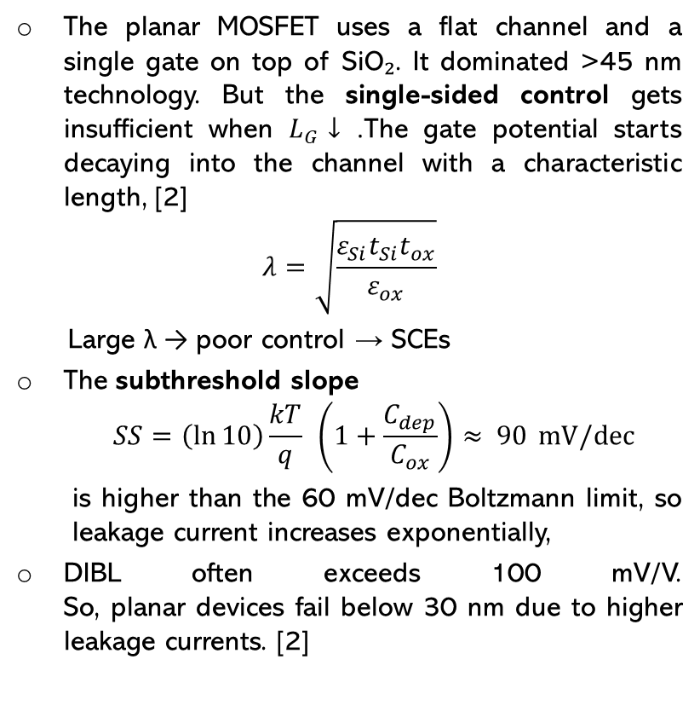
Planar MOSFET
The planar MOSFET uses a flat channel and a single gate on top of SiO₂. It dominated >45 nm technology. But the single-sided control gets insufficient when $L_{G}↓$. The gate potential starts decaying into the channel with a characteristic length, [2]
$$λ=\sqrt{\frac{ε_{Si}t_{Si}t_{ox}}{ε_{ox}}}$$
Large λ → poor control → SCEs
The subthreshold slope
$$SS=\left(\ln{10}\right)\frac{kT}{q} \left(1+\frac{C_{dep}}{C_{ox}}\right)≈ 90 mV/dec$$
  is higher than the 60 mV/dec Boltzmann limit, so leakage current increases exponentially,
DIBL often exceeds 100 mV/V.
So, planar devices fail below 30 nm due to higher leakage currents. [2]

Slide 5
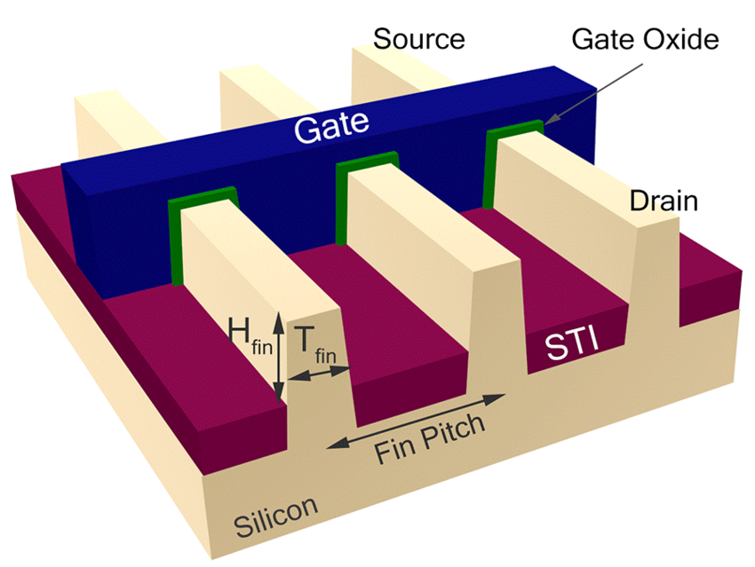
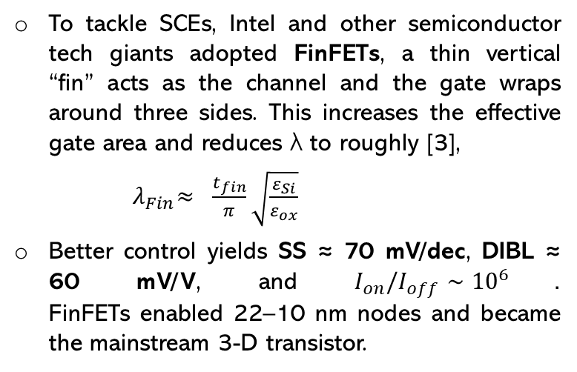
FinFET: First 3D solution
To tackle SCEs, Intel and other semiconductor tech giants adopted FinFETs, a thin vertical “fin” acts as the channel and the gate wraps around three sides. This increases the effective gate area and reduces λ to roughly [3],
${ λ}_{Fin}≈ \frac{t_{fin}}{π}\sqrt{\frac{ε_{Si}}{ε_{ox}}}$
Better control yields SS ≈ 70 mV/dec, DIBL ≈ 60 mV/V, and $I_{on}/I_{off}∼{10}^{6}$.
FinFETs enabled 22–10 nm nodes and became the mainstream 3-D transistor.

Slide 6
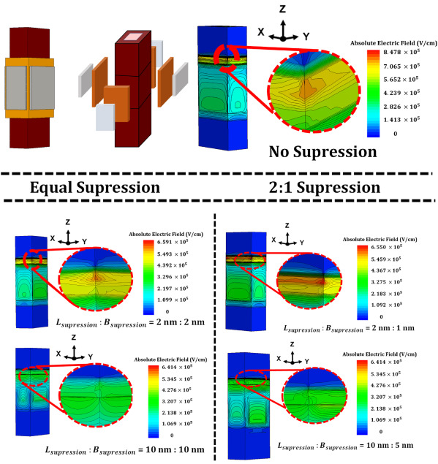
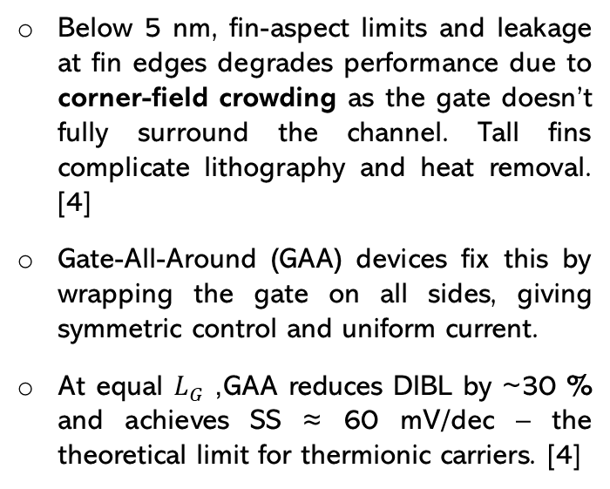
FinFET Limits and GAA Transition
Below 5 nm, fin-aspect limits and leakage at fin edges degrades performance due to corner-field crowding as the gate doesn’t fully surround the channel. Tall fins complicate lithography and heat removal. [4]
Gate-All-Around (GAA) devices fix this by wrapping the gate on all sides, giving symmetric control and uniform current.
At equal $L_{G}$, GAA reduces DIBL by ~30 % and achieves SS ≈ 60 mV/dec – the theoretical limit for thermionic carriers. [4]

Slide 7
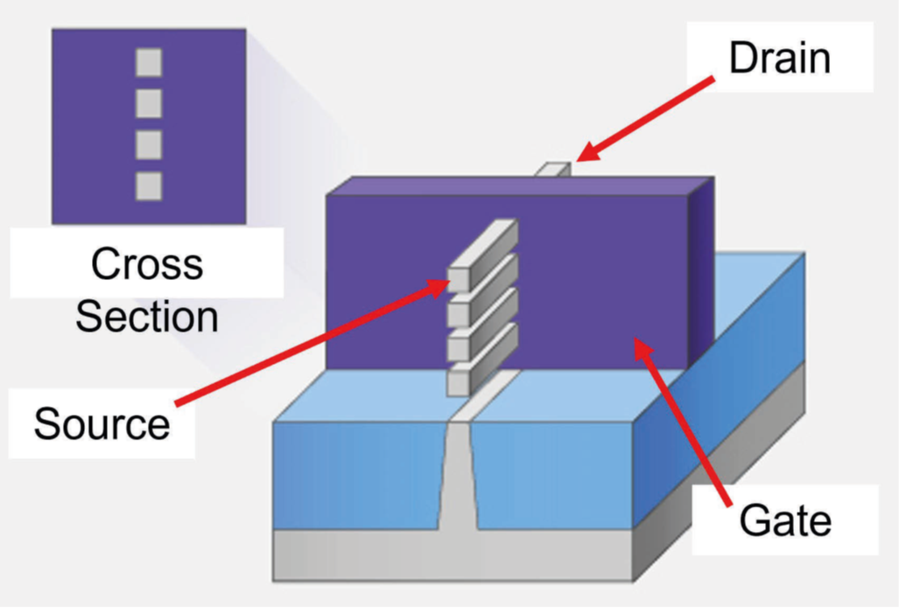
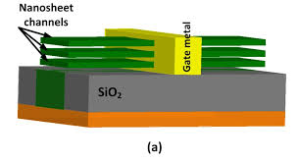
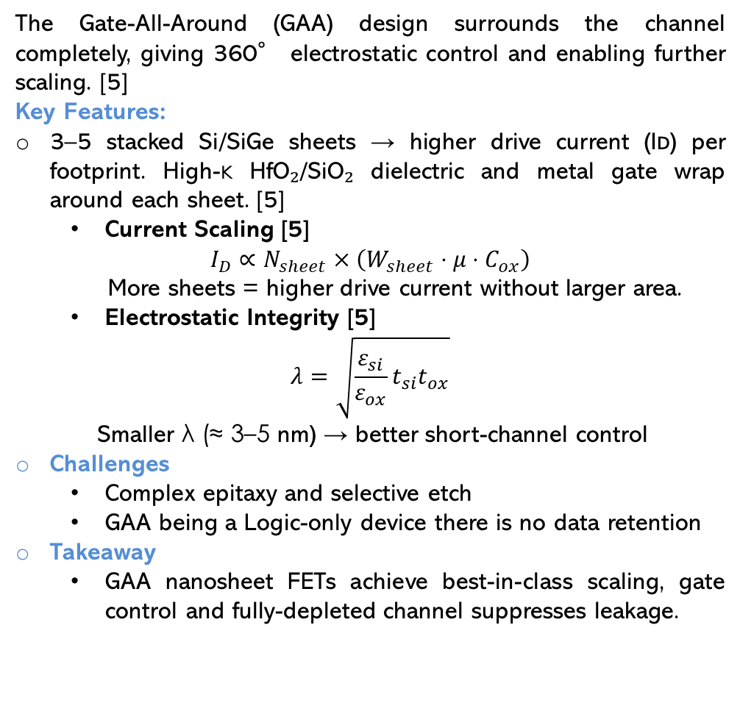
Nanosheet FET
The Gate-All-Around (GAA) design surrounds the channel completely, giving 360° electrostatic control and enabling further scaling. [5]
Key Features:
3–5 stacked Si/SiGe sheets → higher drive current (Iᴅ) per footprint. High-κ HfO₂/SiO₂ dielectric and metal gate wrap around each sheet. [5]
  Current Scaling [5]
$$I_{D}∝N_{sheet}×\left(W_{sheet} ⋅ μ ⋅ C_{ox}\right)$$
  More sheets = higher drive current without larger area.
  Electrostatic Integrity [5]
$$λ=\sqrt{\frac{ε_{si}}{ε_{ox}}t_{si}t_{ox}}$$
Smaller λ (≈ 3–5 nm) → better short-channel control
Challenges
  Complex epitaxy and selective etch
  GAA being a Logic-only device there is no data retention
Takeaway
  GAA nanosheet FETs achieve best-in-class scaling, gate control and fully-depleted channel suppresses leakage.

Slide 8
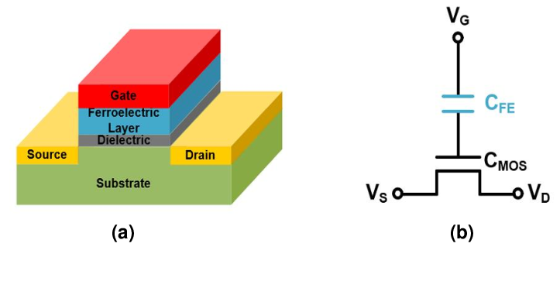
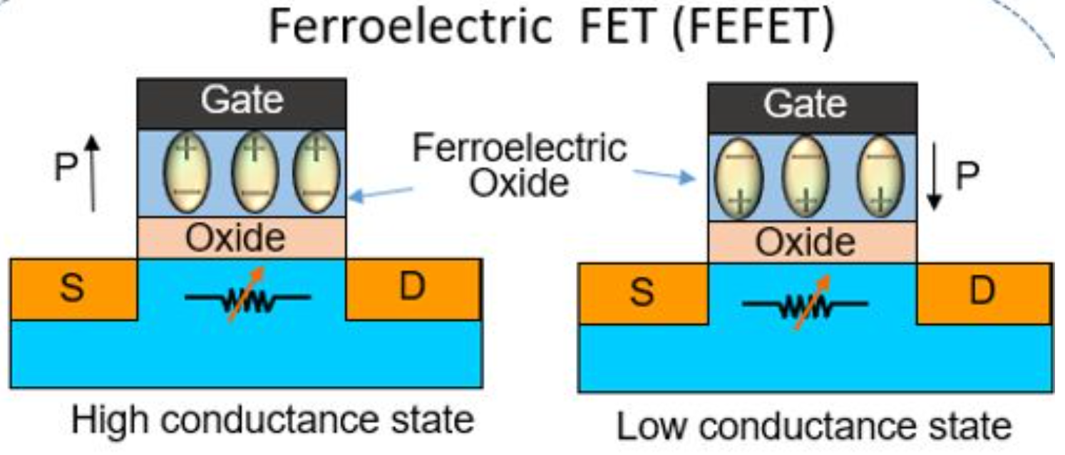
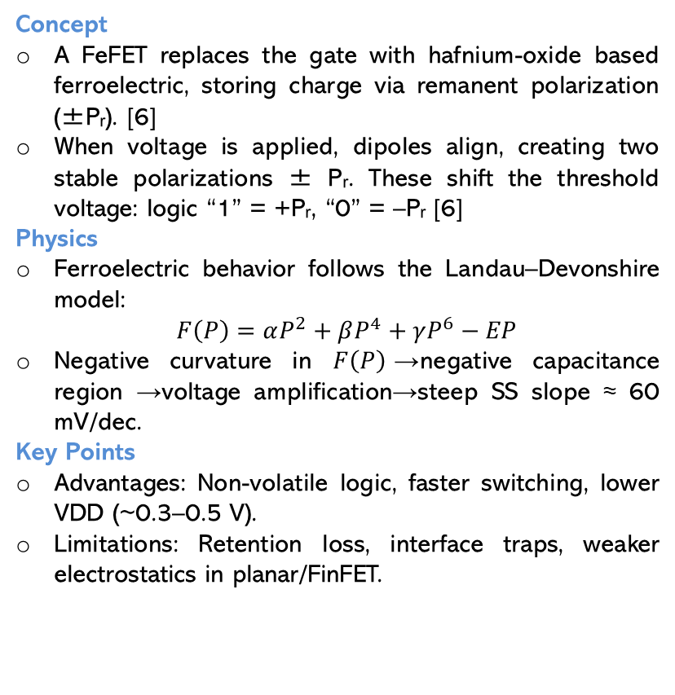
Ferroelectric FET (FeFET)
Concept
A FeFET replaces the gate with hafnium-oxide based ferroelectric, storing charge via remanent polarization (±Pᵣ). [6]
When voltage is applied, dipoles align, creating two stable polarizations ± Pᵣ. These shift the threshold voltage: logic “1” = +Pᵣ, “0” = –Pᵣ [6]
Physics
Ferroelectric behavior follows the Landau–Devonshire model:
$F\left(P\right)=αP^{2}+βP^{4}+γP^{6}−EP$
Negative curvature in $F\left(P\right)$→negative capacitance region →voltage amplification→steep SS slope ≈ 60 mV/dec.
Key Points
Advantages: Non-volatile logic, faster switching, lower VDD (~0.3–0.5 V).
Limitations: Retention loss, interface traps, weaker electrostatics in planar/FinFET.
+Pᵣ state
-Pᵣ state

Slide 9
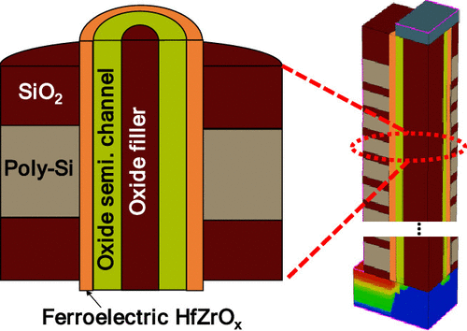
Ferroelectric Nanosheet FET (Fe-NS FET):
Features:
  Metal Gate: provides work-function tuning
  Ferroelectric Layer: switchable polarization (± Pᵣ)
  Interfacial Oxide: ensures stability & leakage suppression
  Nanosheet Channel: high mobility Si/SiGe stacked layers fully enclosed by gate
Combining both GAA and Ferroelectric provides:
  GAA geometry → perfect electrostatics & scalability
  Ferroelectric gate → new functionality: non-volatile polarization & voltage gain

Slide 10
MATERIALS & MULTIFERROIC CONTROL

Slide 11
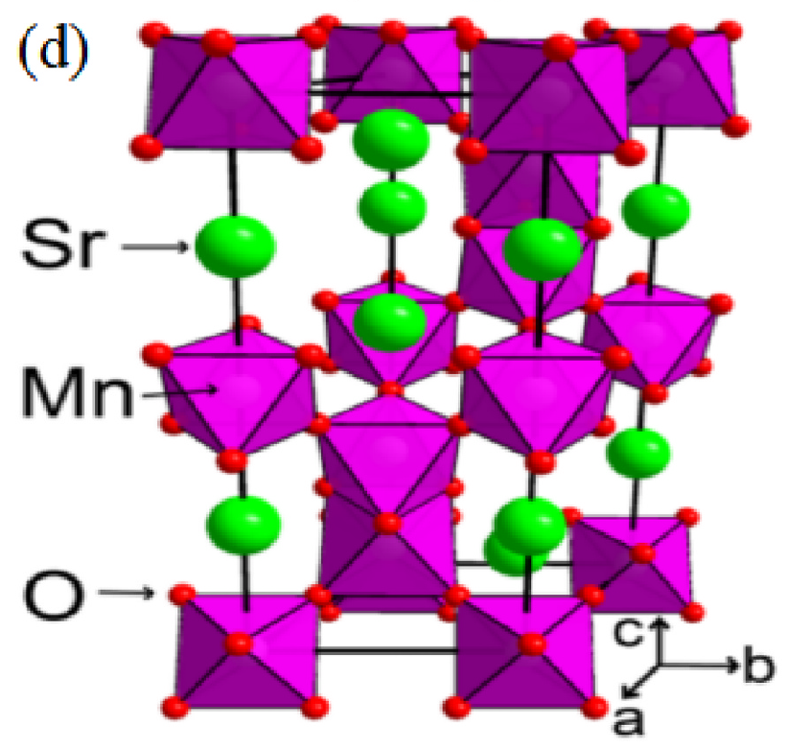
Recent advancements in Ferroelectric Materials
SMO Compounds
  SMO based compounds such as SrMnO3, a perovskite multifunctional oxide material are ideal candidates for next generation memory. [7]
  They have strong ferroelectric behaviour and exhibit spontaneous polarization which can be reversed when electric field is applied. This also allows to store large amount of data per volume.
  They also exhibit ferromagnetic properties which helps us to encode data in both electric and magnetic states enhancing functionality and speed.
  The main challenge is maintaining or optimizing the multiferroic properties as material dimensions reach nanoscale.
  It is crucial to understand the material properties under external stimuli (temperature, pressure, strain, electric fields), over dimensionality (nanosheets) and internal composition (doping, defects, strain).
6H SMO compound
Rui He, Inpyo Hong, Sangmo Kim, Chung Wung Bark, Review on recent developments in the ferroelectric material SrMnO3

Slide 12
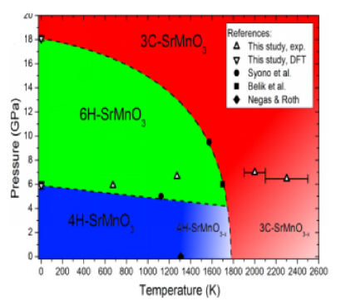
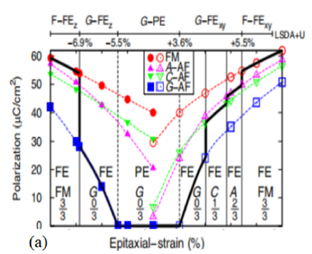
Control strategies of multiferroicity
Temperature, Pressure, Strain variations [7]
  Phase transitions of these compounds are influenced by change in temperature and pressure.
  Below 1035 °C in air, SMO is a stable four-layer hexagonal phase. As the temperature increases, oxygen content gradually reduces and forms vacancies which acts as charge carriers.
  Oxygen deficiency also results in the enhancement of ferromagnetic coupling (Mn3+ - Mn3+).
  The ferroelectricity of SMO is mainly induced by epitaxial strain. SMO films grown on SrTiO3 (STO) substrates are strained due to lattice mismatch, inducing ferroelectricity.
  Its ferroelectricity and magnetism can be further regulated by doping (such as Ca and Ba) or interface engineering.
Phase transitions due to dt and dp
Effect of strain on polarization
Rui He, Inpyo Hong, Sangmo Kim, Chung Wung Bark, Review on recent developments in the ferroelectric material SrMnO3

Slide 13
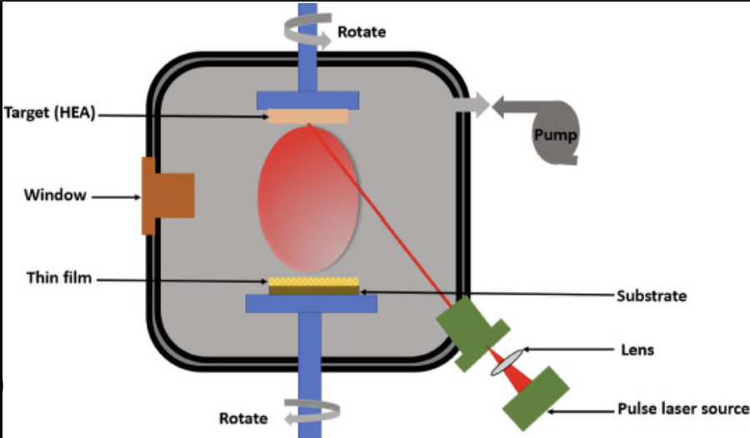
Control strategies of multiferroicity
Epitaxial Growth Techniques [7]
Vast amount of research is being carrying out for tailing properties through growth control on thin films.
  Pulsed Laser Deposition: PLD is one of the most popular methods for fabricating SMO thin films. Here, the SMO target is exposed to high-energy laser pulses, which evaporate the surface material and generate plasma. It can be used to fabricate high-quality epitaxial films on a range of substrates because it can accurately control the thickness and composition of the film.

Slide 14
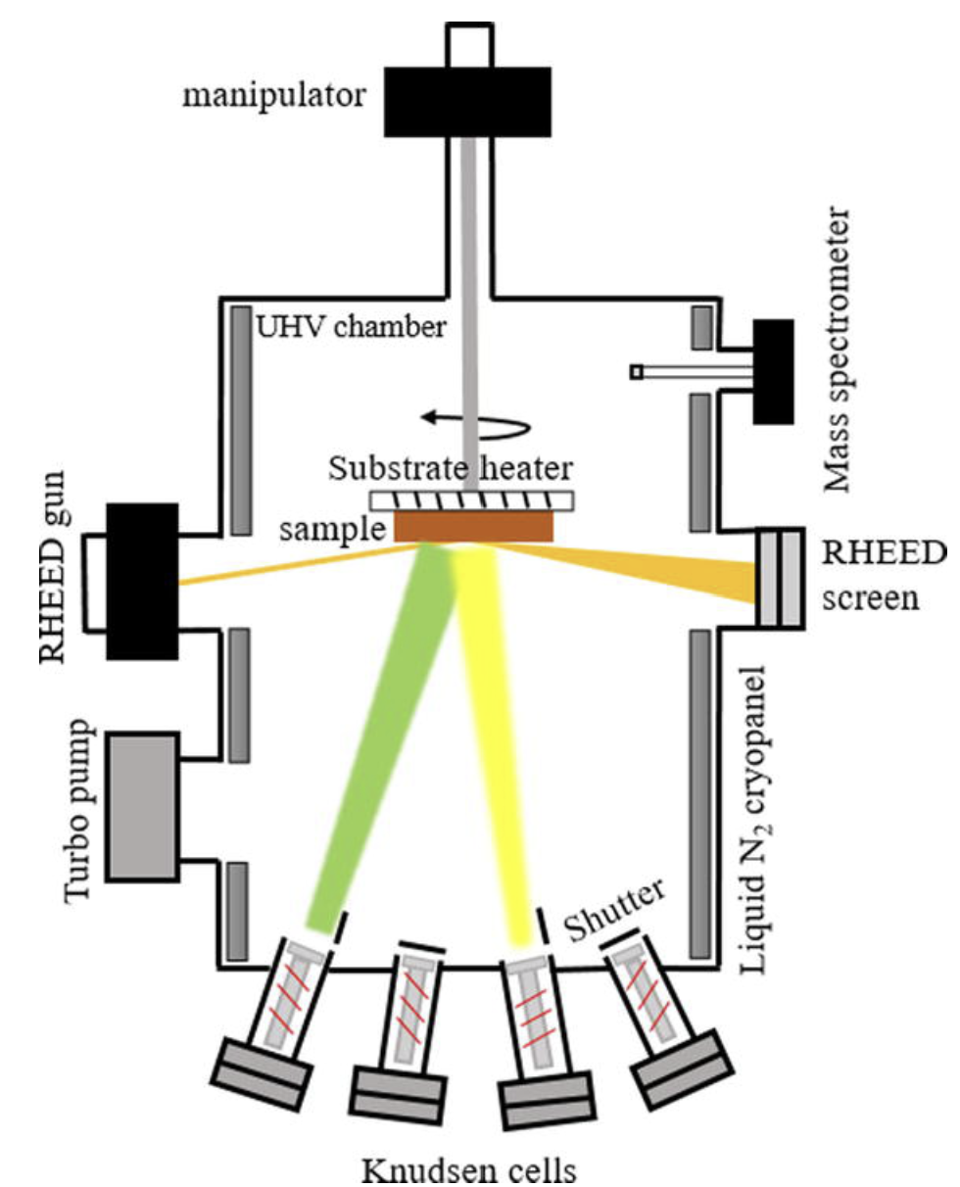
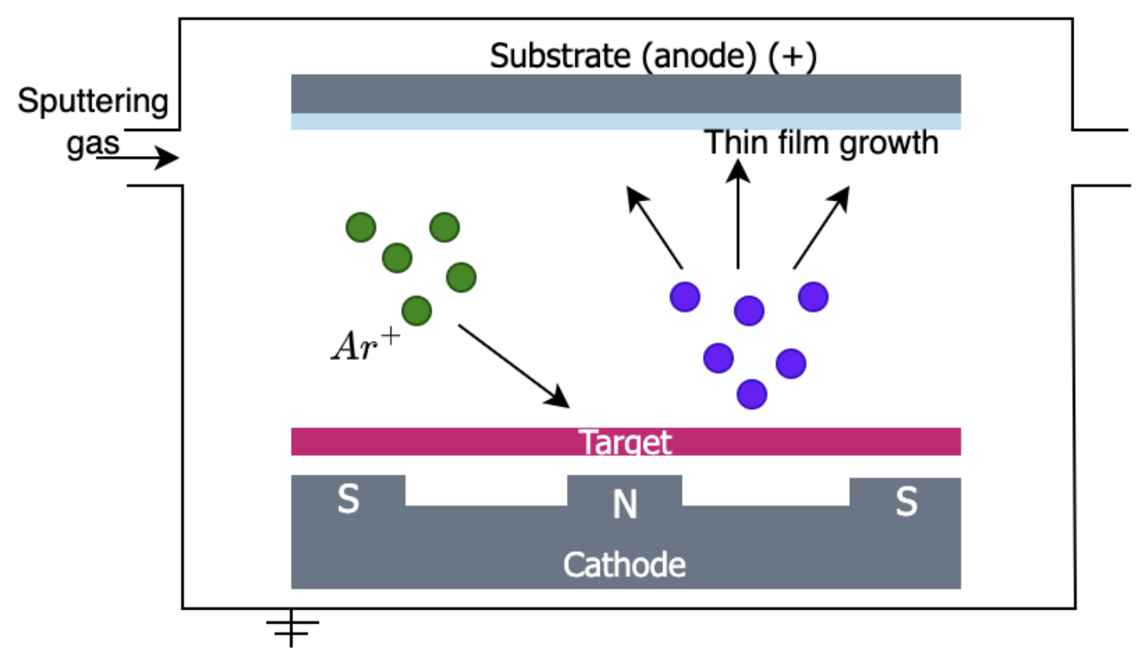
Control strategies of multiferroicity
Epitaxial Growth Techniques [7]
  Molecular Beam Epitaxy: MBE is used to obtain precise atomic layer growth with very good crystal quality. The substrates fabricated using MBE have an average thickness of 21.6 nm with a good control over tensile strain, polarization and magnetic properties.
  Magnetron Sputtering: This method is used to prepare thin films with high dielectric constants (K). The principle of sputtering involves ion bombardment on a target. They offer low temperature processing and controlled growth.
MBE Setup
Magnetron Sputtering Deposition
Rui He, Inpyo Hong, Sangmo Kim, Chung Wung Bark, Review on recent developments in the ferroelectric material SrMnO3​
​

Slide 15
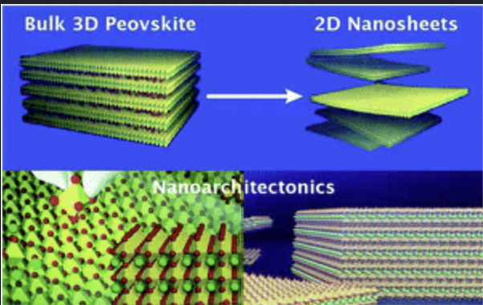
Ferroelectric nanosheets
  Traditional ferro-electric materials, like PbTiO3 (PTO) and BaTiO3, the ferroelectricity becomes weak or even disappears when their thickness reaches the nanoscale due to the depolarization field. [8]
  This takes us to research on synthesis of 2D CuCrS2 nanosheets with thicknesses down to one unit cell via van der Waals epitaxy in a chemical vapor deposition (CVD) system.
  The crystal structure of CuCrS2 is non-centro symmetric, which can be regarded as inserting Cu atoms between 1T-CrS2 layers.
  The key to this process is utilizing freshly cleaved mica sheets, which have an atomically smooth and chemically inert surface, as the van der Waals epitaxial substrates. [8]
  A 1.8 nm nanosheet was synthesized using van der Waals epitaxy via CVD which can be used for scalable synthesis.
Yangchang Zhou, Ruiqing Cheng, Hao Wang, Baoxing Zhai, Lei Yin, Yao Wen, Yawei Lv and Jun He, van der Waals Epitaxial Growth of One-Unit-Cell-Thick Ferroelectric CuCrS2 Nanosheets

Slide 16
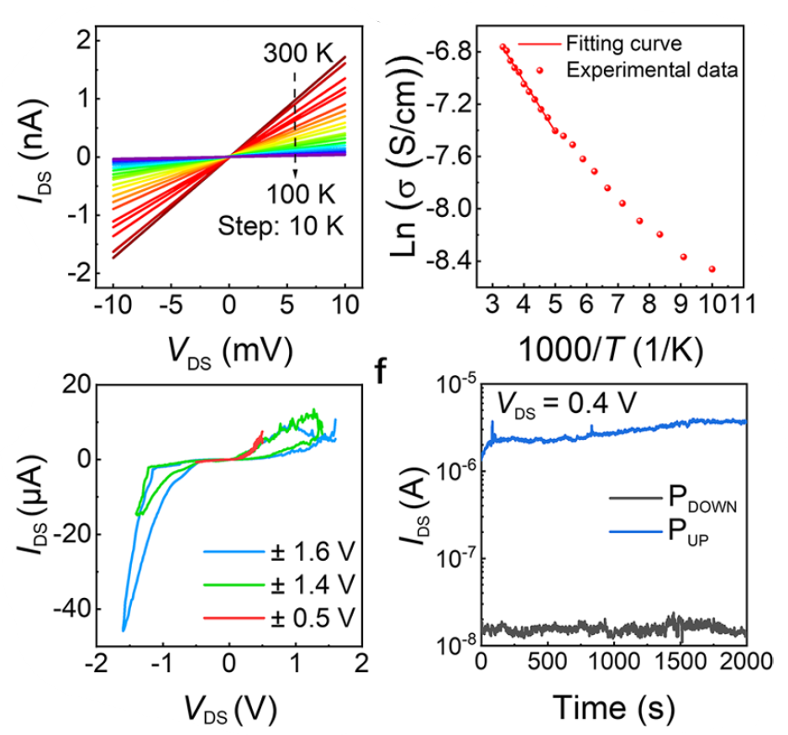
Performance of CuCrS2
  Ferroelectricity was directly measured by piezo response force microscopy (PFM) at room temperature in samples as thin as 10 nm.
  The material has a high curie temperature of approximately 700 K.
  The fabricated nanosheet exhibited a robust and stable performance proving its potential for future 2D ferroelectric memory and computing.
I-V, conductivity-Temperature and endurance characteristics of FSJ device [8]

Slide 17
Ferroelectric nanosheets – electro strain
  Generally ferroelectric materials such as lead zirconate titanate (PZT) ceramics show positive strain under electric field, piezoelectric polymer polyvinylidene fluoride (PVDF), an inorganic ceramic filler exhibits negative electro-strain. [9]
  The reason behind this is still under research, however, this unique property of this material is also an avenue explore.
  The addition of dopants like PVDF has improved the control of negative strain by about 91% which in turn increased the polarization by about 22%.
  The reason behind this negative strain property of PVTF along with PTO nanosheets is the interaction between them altering their molecular chain arrangement in the amorphous phase enhancing contraction effect.
  There is also an increase in the degree of crystallinity (Xc) is observed in the doped nanosheet indicating that in-situ electrostatic field is very effective thereby increasing the controllability of the ferroelectric device.
Kaiqi Zhu, Fu Lv, Jiamin Lin, Ziajian Hong, Yonngjun Wu, Yuhui Huang, Optimization of electro-strain and ferroelectric properties of P (VDF-TrFe) films under the synergistic effect of PTO nanosheets and in-situ electrostatic field

Slide 18
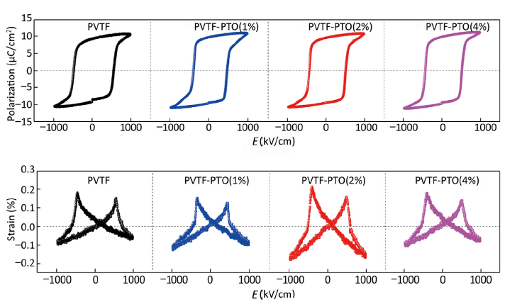
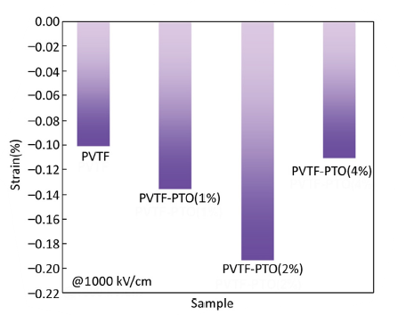
Effect of electric field on polarization and strain
Negative strain values of PVTF-PTO piezo electric films

Slide 19
APPLICATIONS

Slide 20
Existing Limitations
Traditional transistors can typically perform only a single function at a time, restricting versatility in multifunctional circuits.
Schottky FETs suffer from high leakage currents, and realizing multifunctional operations demands multiple transistors, increasing circuit complexity and area.
CMOS scaling has slowed down, limiting further improvements in transistor performance, energy efficiency, and integration density.
Conventional FETs struggle to achieve subthreshold slopes below 60 mV/dec, making it difficult to design low-voltage, energy-efficient systems.
Emerging fields like AI and neuromorphic computing require compact, low-power, multi-level devices—driving interest in ferroelectric-CMOS integration, which offers potential but demands careful design and optimization.

Slide 21
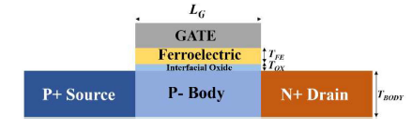
Technological Advancements
The Proposal of an n-type Germanium-based Fe-TFET with a hafnium-oxide-based ferroelectric (Hf₀.₅Zr₀.₅O₂) layer [10] for low-power analog operations came as a game changer, which can perform many operations, such as a frequency doubler, phase shifter, signal follower, along with the modulation of V_{th.}
The Fe-TFET exhibits band-to-band tunneling currents
ISC: Source-to-channel current.
ICD: Channel-to-drain ambipolar current.
Ferroelectric polarization modulates the tunneling barrier height, effectively shifting the threshold voltage (VTH).
By programming the ferroelectric polarization with short voltage pulses (VPROG), the device can switch between frequency doubler, phase shifter, and signal follower modes.
B. Kwak, D. Kwon, and H. Kim, "Signal-Processing Application Based on Ferroelectric Tunnel Field-Effect Transistor," in IEEE Transactions on Nanotechnology, vol. 23, pp. 562-566, 2024, doi: 10.1109/TNANO.2024.3421263.

Slide 22
Technological Advancements
1. Frequency Doubler (VPROG = 0 V)
Symmetric currents (ISC ≈ ICD) produce an output at twice the input frequency.
Works across 1–10 MHz with minimal higher-order harmonics.
2. Phase Shifter (VPROG = +4 V)
Upward polarization makes ISC dominate.
The output waveform is inverted, resulting in a 180-degree phase shift.
3. Signal Follower (VPROG = -4 V)
Downward polarization makes ICD dominate.
Output follows the input waveform with a 0-degree phase shift.
The Fe-TFET achieves low-power, non-volatile, and high-frequency signal processing in a single device by dynamically controlling tunneling barriers via ferroelectric polarization

Slide 23
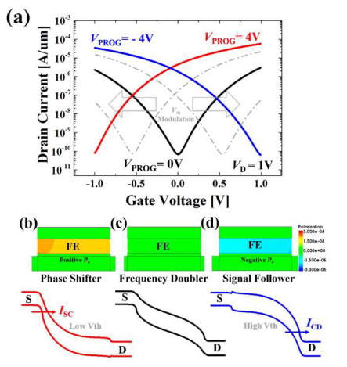
Exploring Negative Capacitance Devices, Ferroelectric FETs, and Ferroelectric Tunneling Junctions (FTJs) [11] paved the way for next-generation low-power and multifunctional electronic devices by enabling voltage amplification, polarization-controlled conduction, and ultra-low-energy memory operations.
These devices collectively address the challenges of energy efficiency, scaling limitations, and multifunctionality in modern transistor technologies
Esseni, D. & Fontanini, Riccardo & Lizzit, Daniel & Massarotto, Marco & Driussi, Francesco & Loghi, Mirko. (2021). Ferroelectric-based FETs and synaptic devices for highly energy-efficient computational technologies. 10.48550/arXiv.2105.00864.

Slide 24
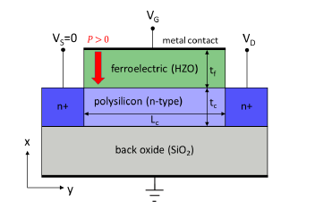
Negative Capacitance (NC) Devices:
The ferroelectric layer shows smooth switching without hysteresis, where its voltage increases faster than the applied voltage.
This voltage boost (gain >1) helps achieve a steeper subthreshold slope, allowing transistors to work efficiently at lower supply voltages.
Ferroelectric FETs (FeFETs):
The polarization in the ferroelectric layer controls the channel current (IDS), enabling programmable conductance.
High channel doping keeps polarization stable but weakens current modulation, while low doping improves read current difference but needs extra charge from recombination or Schottky contacts.

Slide 25
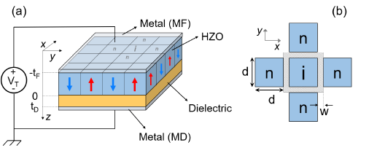
Ferroelectric Tunneling Junctions (FTJs):
The tunneling current depends on ferroelectric polarization, enabling ultra-low-energy memristive behavior.​
MFIM structures separate switching and tunneling, but designers must balance oxide voltage, depolarization field, retention, and read current for optimal performance.

Slide 26
Gaps and Opportunities for Improvement
Current results are simulation-based; no real devices or prototypes have been tested, including FeFETs with low-doped channels.
Effects of thermal noise, parasitic elements, and large-scale array behavior are not fully explored.
FTJs face challenges in retention and depolarization stability, and long-term reliability of NC transistors remains untested.
Build and test actual device prototypes, optimizing fabrication and integration with standard CMOS technology.
Study and improve device performance under real conditions, including thermal noise, parasitics, and large-scale array behavior, ensuring reliable operation over time.

Slide 27
References
[1] M. Bohr and I. Young, “CMOS scaling trends and beyond”, IEEE Micro, 2017
[2] Y. Taur and T. H. Ning, Fundamentals of Modern VLSI Devices, 2009
[3] D. Hisamoto et al., “FinFET—A self-aligned double-gate MOSFET scalable to 20 nm,” IEEE TED 2000
[4] Q. Zhang et al., “New structure transistors for advanced node CMOS ICs,” Nat. Sci. Rev., 2024
[5] J. P. Duarte et al., “DTCO for nanosheet transistors,” IEEE TED, 2023
[6] T. S. Böscke et al., “Ferroelectricity in HfO₂ thin films,” Appl. Phys. Lett., 2011
  [7] Rui He, Inpyo Hong, Sangmo Kim, Chung Wung Bark, "Review on recent developments in the ferroelectric material SrMnO3", Elsevier, 2025.
  [8] Yangchang Zhou, Ruiqing Cheng, Hao Wang, Baoxing Zhai, Lei Yin, Yao Wen, Yawei Lv and Jun He, "van der Waals Epitaxial Growth of One-Unit-Cell-Thick Ferroelectric CuCrS2 Nanosheets", Nanoletters, 2024.
  [9] Kaiqi Zhu, Fu Lv, Jiamin Lin, Ziajian Hong, Yonngjun Wu, Yuhui Huang, "Optimization of electro-strain and ferroelectric properties of P (VDF-TrFe) films under the synergistic effect of PTO nanosheets and in-situ electrostatic field", Elsevier,2025.
[10] B. Kwak, D. Kwon, and H. Kim, "Signal-Processing Application Based on Ferroelectric Tunnel Field-Effect Transistor," in IEEE Transactions on Nanotechnology, vol. 23, pp. 562-566, 2024.
[11] Esseni, D. & Fontanini, Riccardo & Lizzit, Daniel & Massarotto, Marco & Driussi, Francesco & Loghi, Mirko. (2021). Ferroelectric-based FETs and synaptic devices for highly energy-efficient computational-technologies.

Slide 28
THANK YOU

