Slide 1
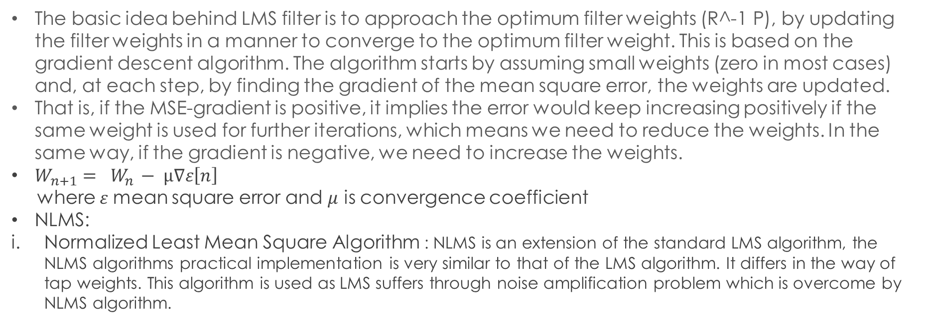
Algorithm Selection :
Least Mean Square Filter (LSM) :
The basic idea behind LMS filter is to approach the optimum filter weights (R^-1 P), by updating the filter weights in a manner to converge to the optimum filter weight. This is based on the gradient descent algorithm. The algorithm starts by assuming small weights (zero in most cases) and, at each step, by finding the gradient of the mean square error, the weights are updated.
That is, if the MSE-gradient is positive, it implies the error would keep increasing positively if the same weight is used for further iterations, which means we need to reduce the weights. In the same way, if the gradient is negative, we need to increase the weights.
$W_{n+1}$ $= W_{n }− µ∇ε\left[n\right]$
where $ε$mean square error and $μ$ is convergence coefficient
NLMS:
Normalized Least Mean Square Algorithm : NLMS is an extension of the standard LMS algorithm, the NLMS algorithms practical implementation is very similar to that of the LMS algorithm. It differs in the way of tap weights. This algorithm is used as LMS suffers through noise amplification problem which is overcome by NLMS algorithm.

Slide 2
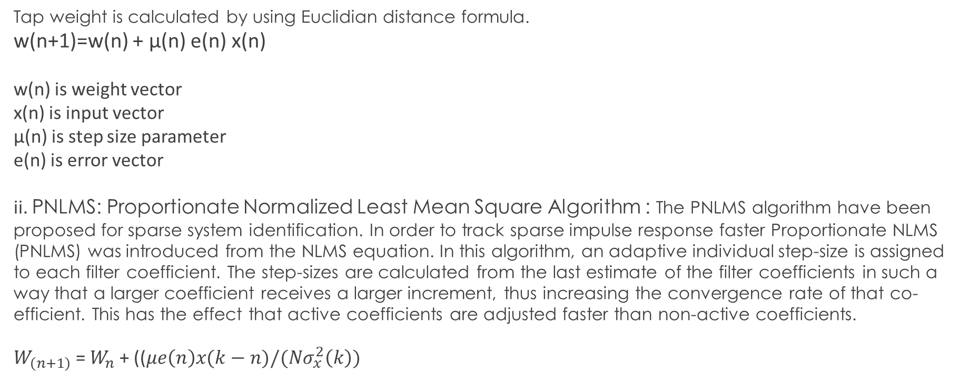
Tap weight is calculated by using Euclidian distance formula.
w(n+1)=w(n) + µ(n) e(n) x(n)
w(n) is weight vector
x(n) is input vector
µ(n) is step size parameter
e(n) is error vector
ii. PNLMS: Proportionate Normalized Least Mean Square Algorithm : The PNLMS algorithm have been proposed for sparse system identification. In order to track sparse impulse response faster Proportionate NLMS (PNLMS) was introduced from the NLMS equation. In this algorithm, an adaptive individual step-size is assigned to each filter coefficient. The step-sizes are calculated from the last estimate of the filter coefficients in such a way that a larger coefficient receives a larger increment, thus increasing the convergence rate of that co-efficient. This has the effect that active coefficients are adjusted faster than non-active coefficients.
$W_{\left(n+1\right)}$ = $W_{n}$ + (($μe\left(n\right)x(k−n)/(Nσ_{x}^{2}\left(k\right))$

Slide 3
Conclusion :
The NLMS algorithm achieves good convergence in dispersive AIRs and for non sparse system. Its response time is less but in case of system containing sparse it shows low convergence. Thus, PNLMS gives the best performance in terms of the measures MSE and ERLE as compared to NLMS adaptive filtering algorithms but at the cost of increased computational complexity PNLMS performs well in sparse impulse response system than NLMS.
The increase in complexity is compromised by the algorithm’s performance. Here the computational Complexity of PNLMS is more than NLMS.
One thing is that NLMS and PNLMS takes more time for execution so this system can be further develop to work in real time environment.
Our work done is in offline mode thus it is necessary to implement in real communication world. Some advanced algorithms such as MPNLMS, IPNLMS can be implemented to achieve better convergence for the system containing sparse.

