Slide 1
ECHO ADDITION AND REMOVAL
IN AUDIO SIGNALS
USING MATLAB
Digital Signal Processing
(Project Based Learning)

Slide 2
NAME ROLL NO.S
1. DIVYA GAVANE 3122
2. VAISHNAVI FULSUNDAR 3123
3. SHITAL INDULWAR 3131
4. SAMIRA JADHAV 3132

Slide 3
WORKFLOW
PHASE 1
PHASE 2
PHASE 3
1.finding out the topic for project.(aim)
2.Research and literature survey related to finalized project topic
3.understanding the need of project and theory behind particular topic.
4.preparing the block diagram inclusive of all ideas as per observation and need of the chosen project.
5.understanding scope and prerequisites for signal processing project.
1.Understanding the actual circuit diagram .
2.Finalizing the design of the system.
3.Finalising the algorithm to be used.
4.Understanding the related attributes , parameters and their relation with the system performance.
1.Collection of samples to be operated on.
2.Software implementation using MATLAB.
3.Recording the project results.
4.Analysing the correctness and behavior of the system based on recorded results.

Slide 4
‘Echo addition and removal from audio signals’ is all related to processing audio signals using MATLAB , where we are specifically generating echo in the clean signal using transfer function parameters. After we generate such a signal , we again are going to attempt the reverse , that is to remove the echo from signal . We have referenced a 2018 IJERT research paper ,a YouTube video that explains the techniques for selected PBL topic and a Simple Echo Cancellation project for understanding system/block requirements and algorithm that needs to be followed.

Slide 5
What is an Echo?
In audio signal processing, Echo is a reflection of sound that arrives at the listener with a delay after the direct sound. The delay is directly proportional to the distance of the reflecting surface from the source and the listener.
Echo is audible because the speed of sound is relatively slow, about 400 meters per second.
If we consider only one echo path, then an echo can be simulated using the following equation:
Output = Input + Delayed Input × Gain
where Gain < 1, due to losses in the echo path.
The most important factor in echoes is called end-to-end delay, which is also known as latency.
Latency is the time between the generation of the sound at one end of the call and its reception at the other end.

Slide 6
Round trip delay is the time taken to reflect an echo and is approximately twice the end-to-end delay.
Echoes become annoying when the round trip delay exceeds 30 ms . Such an echo is typically heard as a hollow sound.
Echoes must be loud enough to be heard. Those less than thirty (30) decibels (dB) are unlikely to be noticed.
However, when round trip delay exceeds 30 ms and echo strength exceeds 30 dB, echoes become steadily more disruptive.
The acoustic echo, which is also known as a “multipath echo”, is produced by poor voice coupling between the earpiece and microphone in handsets and hands-free devices.

Slide 7
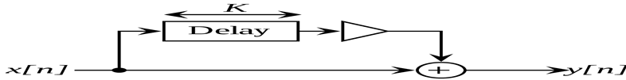
USE OF COMB FILTER IN ECHO ADDITION SYSTEM
Comb filtering occurs when two or more identical audio signals are mixed together with a slight delay between them.
The resulting frequency response graph resembles a comb because frequencies that are in phase sum together, while frequencies that are out of phase cancel.
Block Diagram of comb filter :

Slide 8
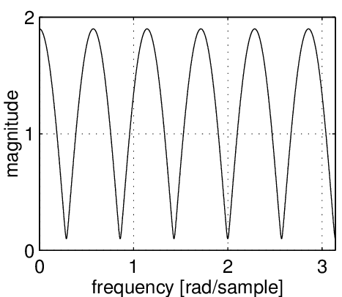
Frequency Response of Comb Filter

Slide 9
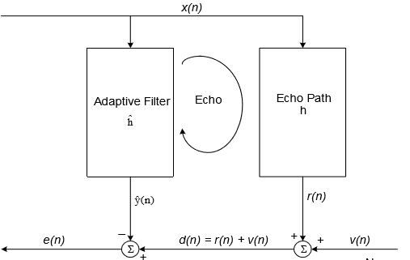
Process of Echo Cancellation :
An echo canceller is basically a device that detects and removes the echo of the signal from the far end after it has echoed on the local end’s equipment.
FIG: A Generic Adaptive Echo Canceller

Slide 10
NEED OF THE ADAPTIVE FILTER IN THE ECHO CANCELLATION SYSTEM
An adaptive filter is a system with a linear filter that has a transfer function controlled by variable parameters and a means to adjust those parameters according to an optimization algorithm.
The adaptive filter structure employed in acoustic echo cancellation is an FIR filter because of its guaranteed stability. This means that, in order to model a given echo path, the adaptive filter is likely to require thousands of coefficients.

Slide 11
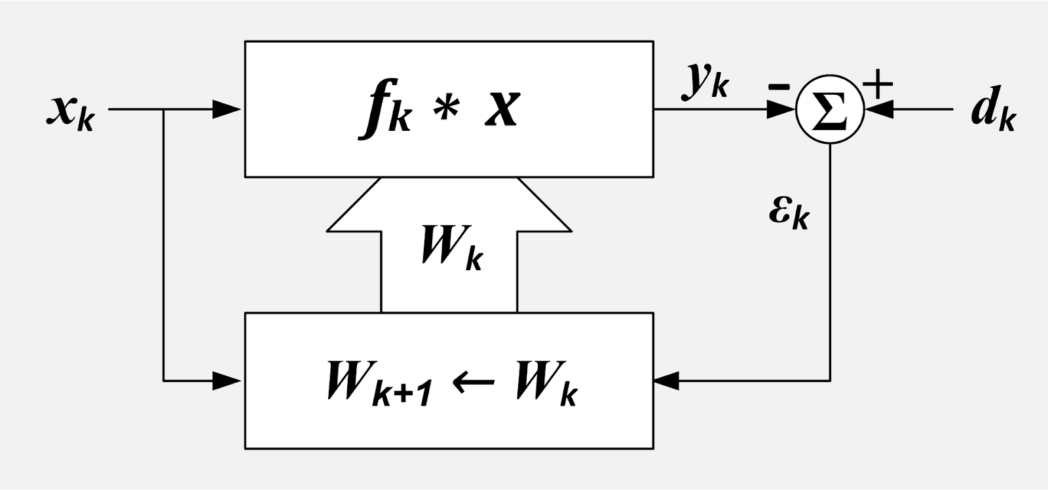
Block Diagram of Adaptive Filter

Slide 12
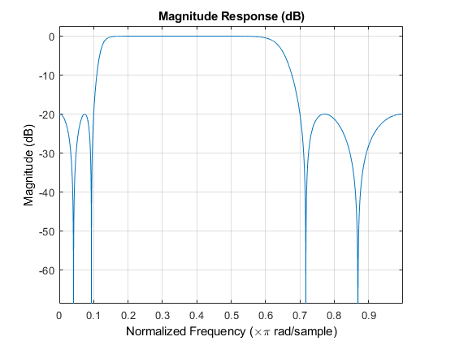
Frequency Response of Adaptive Filter

Slide 13
Algorithm selection :
Method | Specifications
Comb Filter for echo addition | Using comb filter delayed version of a input audio signal is added in the input signal to generate an echo added audio signal.
NLMS(Normalised Least Mean Square) Algorithm for echo cancellation | The normalized LMS, (NLMS), algorithm utilizes a variable convergence factor that minimizes the instantaneous error. Such a convergence factor usually reduces the convergence time .

Slide 14
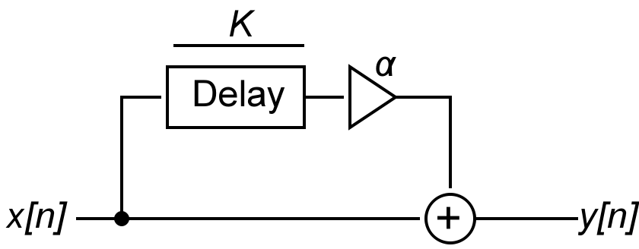
Echo Addition Algorithm:
Step: 1]Input audio signal is taken as x[n]
2]Delayed version of x[n] with delay k and feedback if α is
=αx[n-k]
3]Final output function of a comb filter is
y[n]=x[n]+αx[n-k]
Above generated function will be desired echo added signal which will be input function
for echo cancellation system.

Slide 15
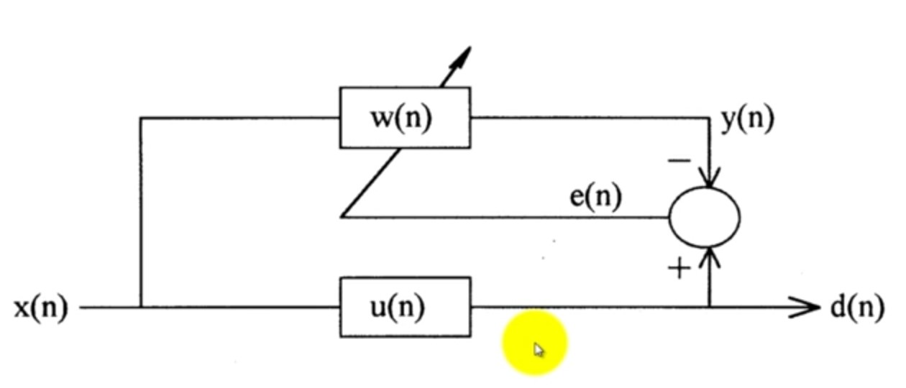
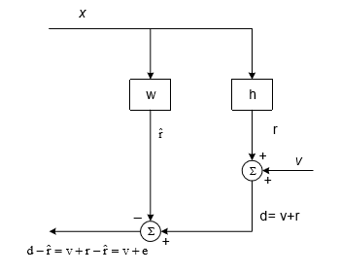
Echo Cancellation Algorithm
Steps :
1] Firstly the transfer function of the filter is unknown. In NLMS algo estimation of transfer function of the filter is done.
2]
Fig: NLMS Algorithm

Slide 16
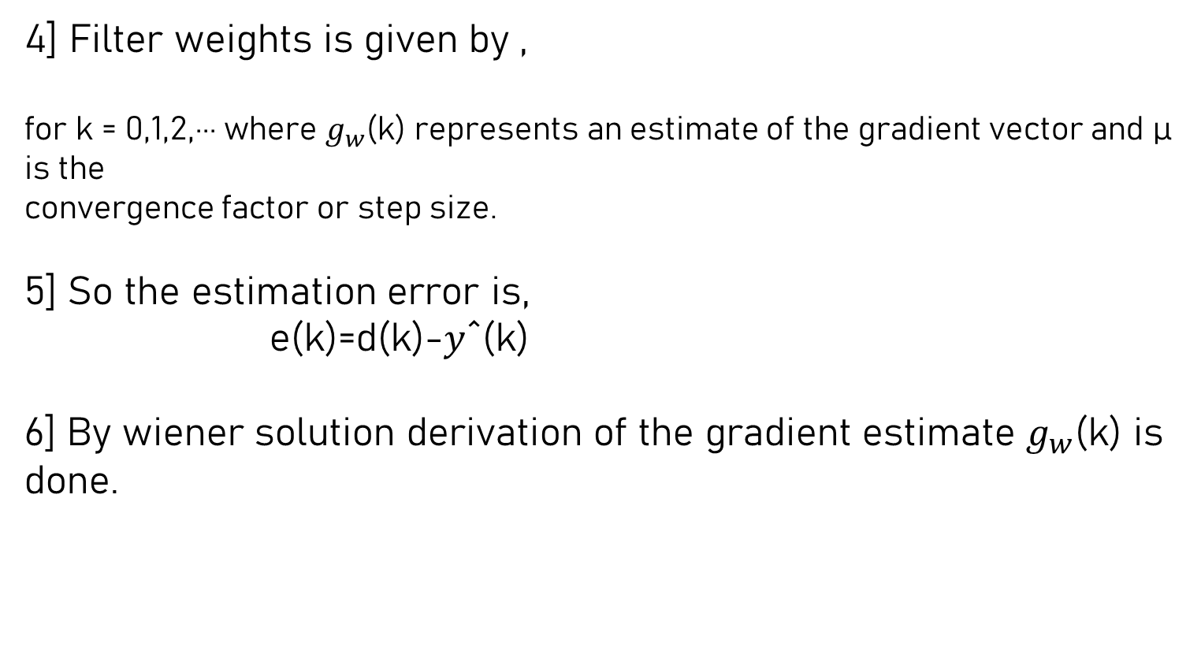
3] Output signal from the diagram is
where, r is echo , v is near end speed signal, r^ is echo estimate , e is error signal

Slide 17



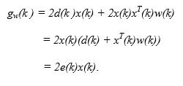

Where , aaaaa and
Gradient vector of R and p a and respectively.
Hence,
Updating formula is,
7] In NLMS factor u(k) must be chosen with the objective of achieving a faster convergence, so, value is given by,

Slide 18
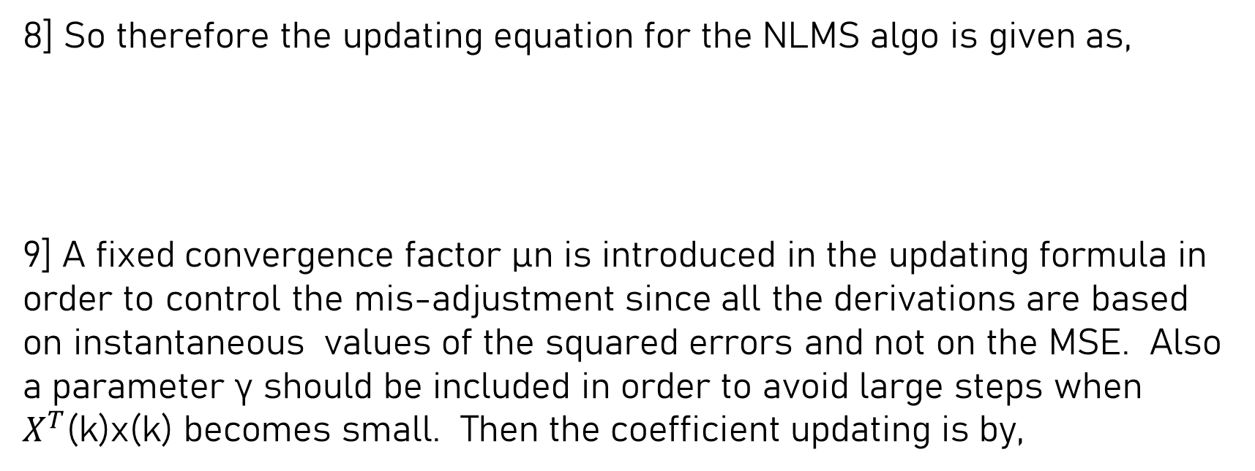



Slide 19
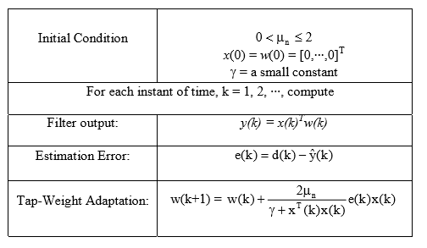
Tabular form of NLMS Algorithm:

Slide 20
REFERENCES
YouTube Videos :
https://youtu.be/xpl2AYlvm0k
https://youtu.be/Wdph4eLv6zw
Simple Echo Cancellation :
http://www.dip.ee.uct.ac.za/~nicolls/lectures/eee401f/projects/project05_2up.pdf
2018 IJERT Research paper :
https://www.ijert.org/research/a-comparison-of-nlms-pnlms-algorithms-for-echo-cancellation-IJERTV7IS060080.pdf

Slide 21
THANK YOU

