Slide 1
BDTCI – UCC
Internship Project
Divya Gavane
T.Y. Electronics and Telecommunications
MKSSS’s Cummins College of Engineering for Women, Pune

Slide 2




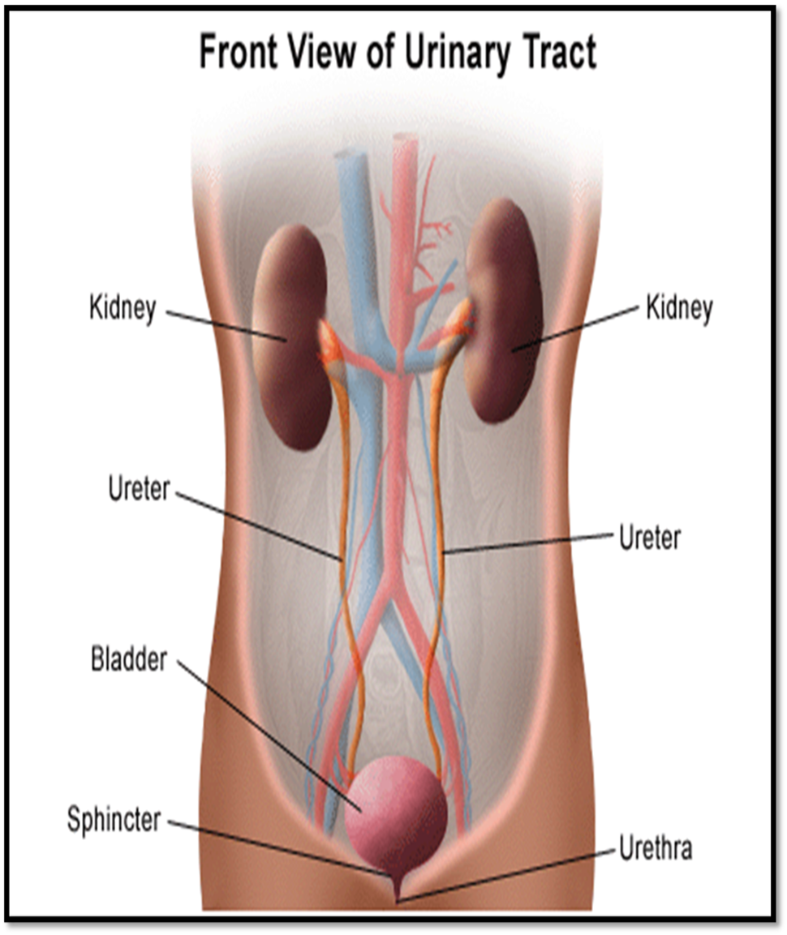

Non-Technical Learnings at BDTCI
Professional Etiquettes
Interactions with Leaders
Meetings / Conferences
Soft Skills
Human Anatomy (Urinary System)
Insight in Healthcare

Slide 3
What is Human Anatomy ?
Human anatomy is the study of the structures of the human body.
Urinary System :
The organs that make urine and remove it from the body.
Main organs of Urinary System are Kidneys, Renal Pelvis, Ureters, Bladder and Urethra.
The system filters blood and create urine as a waste by-product. Urine is made up of Urea (produced when foods containing protein broken down),water and other waste products.

Slide 4
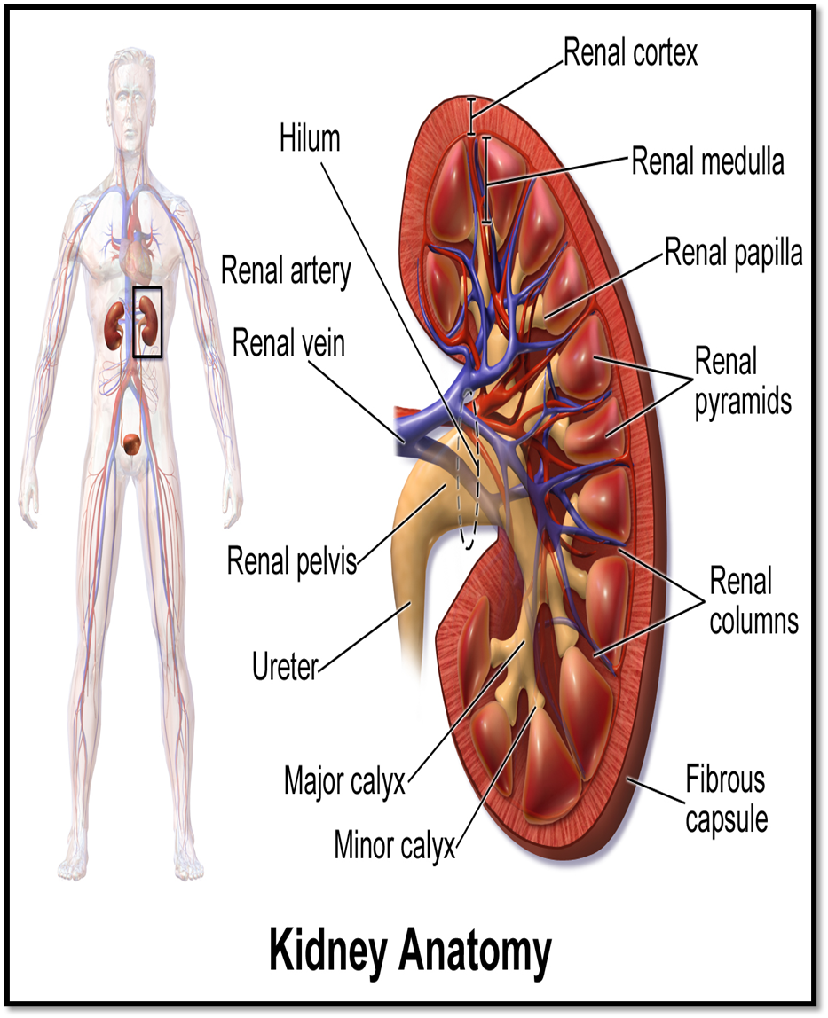
Kidneys
The kidneys are a pair of bean-shaped organs on either side of the spine, below the ribs and behind the belly.
Functions of Kidney :
  Removes waste products and medicines from the body.
  Balances the body’s fluids.
  Balances variety of electrolytes.
  Releases hormones to control blood pressure.
  Releases Erythropoietin to stimulate RBCs production.
  Helps with bone health by controlling Calcium and Phosphorus.

Slide 5
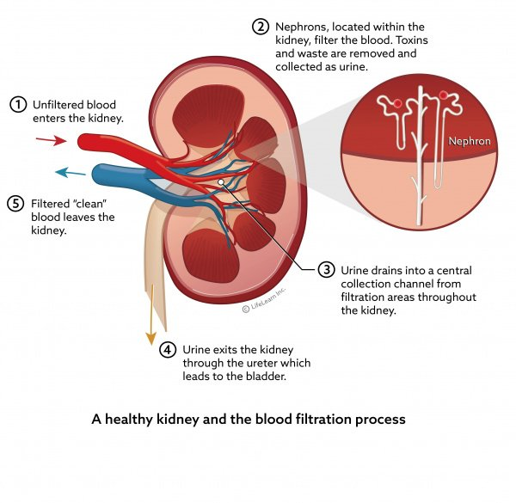

Slide 6

The kidneys remove waste and extra fluid from the blood to make urine.
The urine flows from the kidneys through the ureters, which are tube like structures, then to the bladder.
Bladder is a hollow organ with muscular walls distensible (stretchable) structure.
  Upper part of the bladder is called as Head while the lower one called as Neck.
  Neck of the bladder contains ring of smooth muscles that remains contracted and keeps opening of bladder closed, this ring is called Sphincter.
The urine is expelled through a tube-like structure called Urethra.

Slide 7
Medical Condition : Urinary Incontinence
Urinary incontinence is the involuntary leakage of urine. It means a person urinates when they do not want to. Control over the urinary sphincter is either lost or weakened.
Urinary incontinence is more common among women than men. An estimated 30 percent of females aged 30-60 are thought to suffer from it, compared to 1.5-5 percent of men.
7

Slide 8
Types of Urinary Incontinence
Stress
Urine leaks out while coughing, laughing, or doing some activity, such as running or jumping.
Overflow
The inability to empty the bladder completely can result in leaking.
Urge
There is a sudden and intense urge to urinate, and urine leaks at the same time or just after.
Total
The bladder cannot store urine.
Functional
Urine escapes because a person cannot reach the bathroom in time, possibly due to a mobility issue.
Mixed
A combination of types.

Slide 9
Causes
Stress Incontinence
pregnancy and childbirth
Urge Incontinence
cystitis
Overflow Incontinence
an enlarged prostate gland
menopause
hysterectomy and some other surgical procedures
Age
Obesity
neurological conditions
enlarged prostate
Sclerosis, stroke, and Parkinson’s disease
a tumor pressing against the bladder
urinary stones
Constipation
urinary incontinence surgery
Total Incontinence
an anatomical defect
Other Causes
some medications, especially some diuretics, antihypertensive drugs, sleeping tablets, sedatives, and muscle relaxants
a spinal cord injury that impairs the nerve signals between the brain and the bladder
a fistula
Alcohol
urinary tract infections (UTIs)

Slide 10
Symptoms :
Urinary incontinence is not a disease by itself. Urinary incontinence is a symptom of another health problem, usually weak pelvic floor muscles.
Pressure or spasms in the pelvic area that causes a strong urge to urinate
Going to the restroom more than usual (more than eight times a day or more than twice at night)
Urinating while sleeping (bedwetting)
Complications :
Skin problems
Urinary tract infections
Prolapse

Slide 11
Treatment
Behavioral Techniques
Medications
Electrical Simulation
Medical Devices
Interventional Therapy
Surgery
Treatment :
Treatment for urinary incontinence depends on the type of incontinence, its severity and the underlying cause. A combination of treatments may be needed.

Slide 12
Bladder Training
Double Voiding
Fluid and Diet Management
Pelvic Floor Muscle Exercise
Electrodes are temporarily inserted into one’s rectum or vagina to stimulate and strengthen pelvic floor muscles
Anticholinergics
Mirabegron
Alpha Blockers
Topical estrogens
Urethral Insert
Pessary
Bulking material injections
Botox
Nerve Stimulators
Sling Procedures
Bladder neck suspension
Prolapse Surgery
Artificial Urinary Sphincter
Behavioral Techniques
Electrical Simulation
Medical Devices
Interventional Therapies
Medications
Surgery

Slide 13
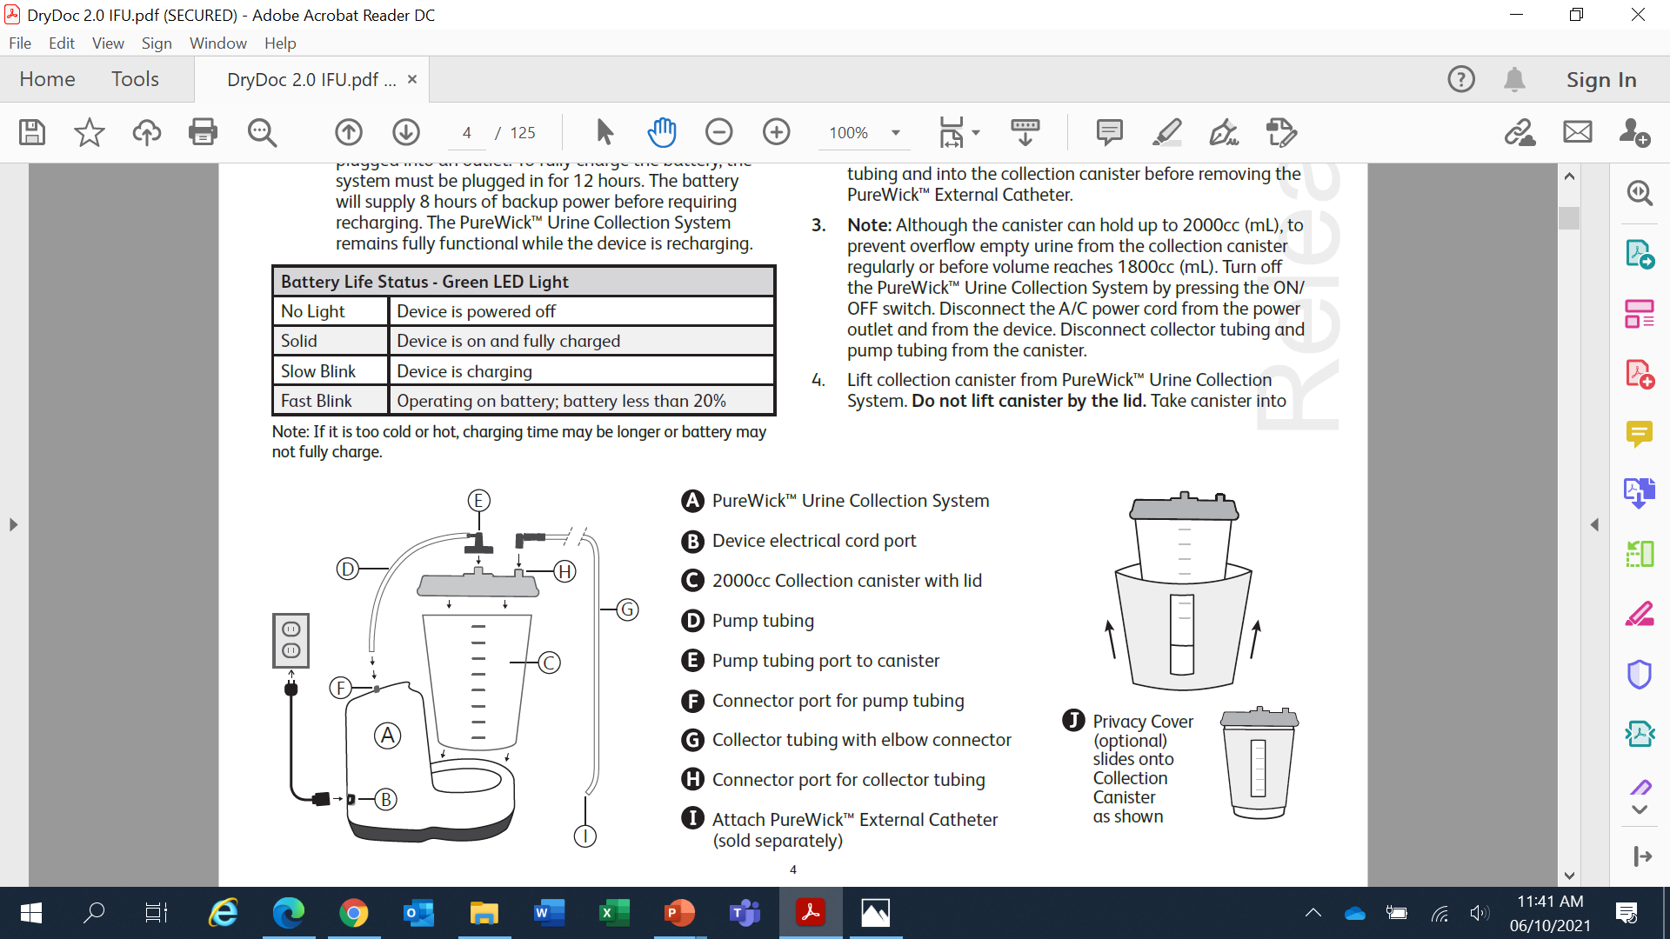
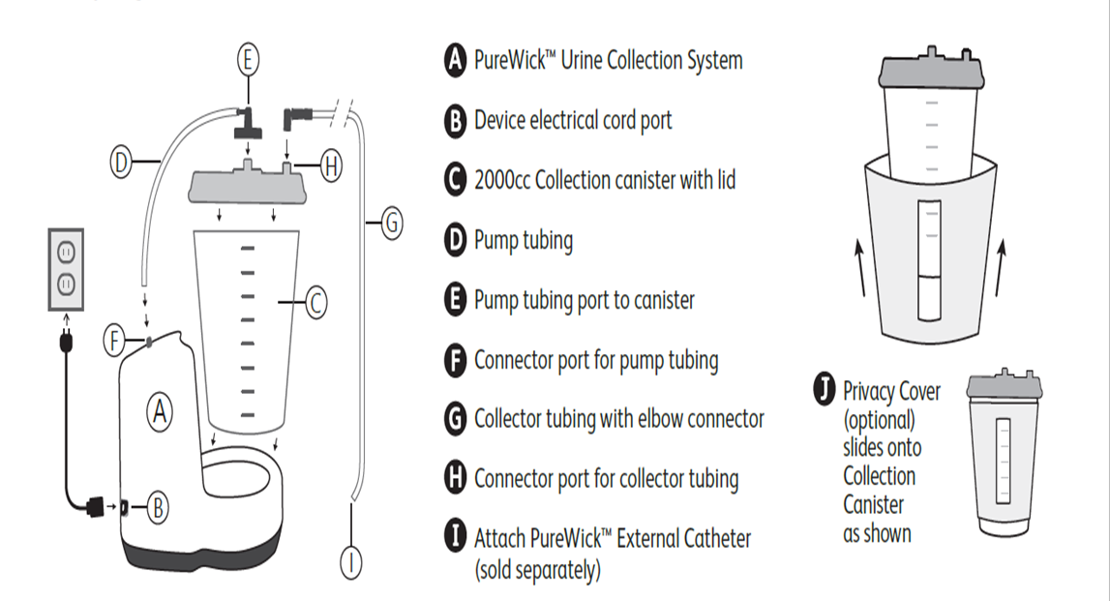
BD PureWick™ Urine Collection System :
After the PureWick™ Urine Collection System has been set up, place the PureWick™ External Catheter according to the PureWick™ External Catheter’s instructions for use.
When the canister is ready to be emptied, remove the PureWick™ External Catheter according to the PureWick™ External Catheter’s instructions for use and throw away.
Though canister can hold up to 2000 cc, the urine must be emptied before volume reaches 1800 cc.

Slide 14
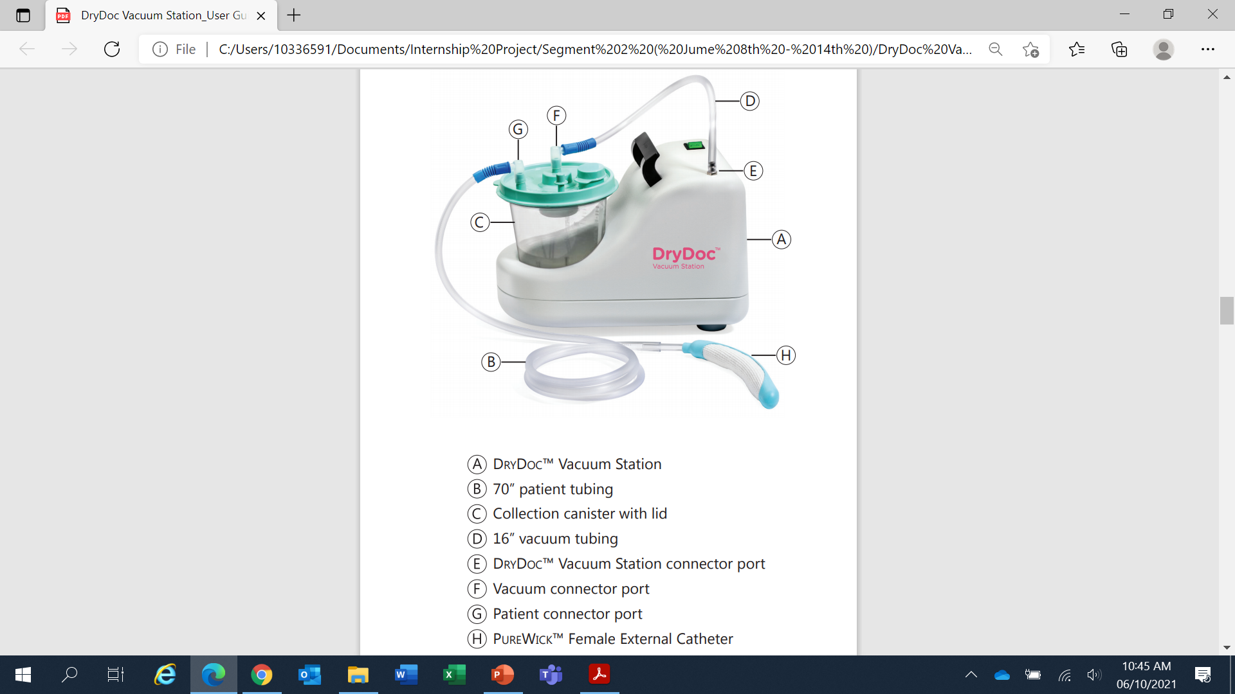
DryDoc™ Vacuum Station :
It is a vacuum station, used for creating a suction pull.
Due to the suction created, the urine flows from the PureWick™ Female External Catheter to the Collection Canister.
It has mechanical, electrical and pneumatic architecture, combinedly working as a system
The DryDoc™ Vacuum Station functions when the switch illuminates and the pump makes a soft humming sound.

Slide 15
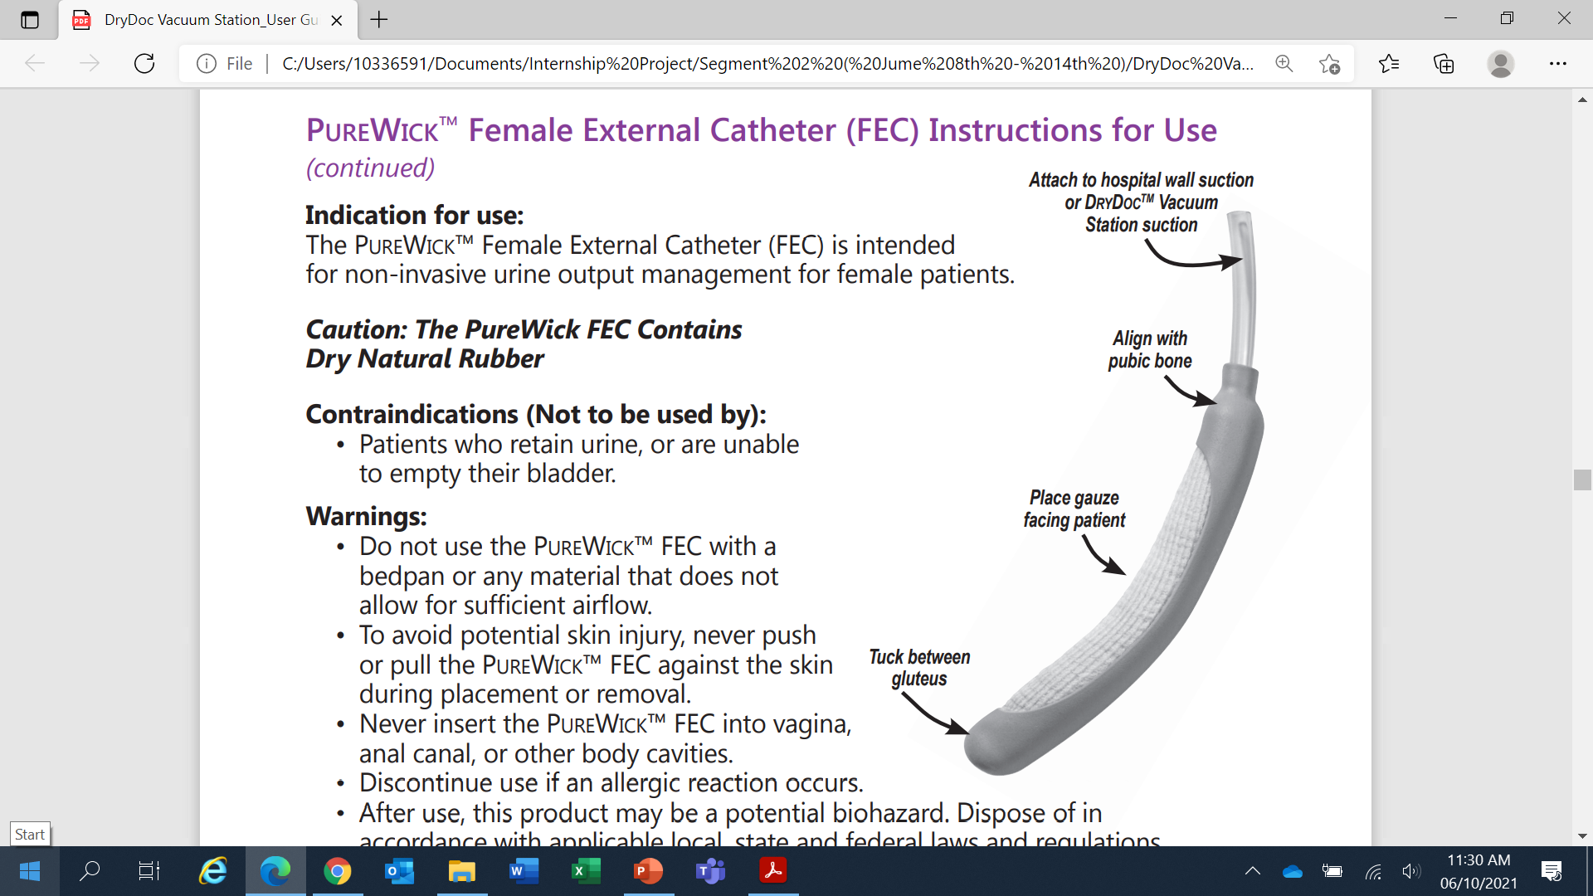
FEC – Female External Catheter
Female External Catheter :
The PureWick™ Female External Catheter (FEC) is intended for non-invasive urine output management for female patients.
Properly place the PureWick™ FEC snugly between the labia and gluteus.
Replace the PureWick™ FEC every 8-12 hours or when soiled with feces or blood.
Change suction tubing at least every thirty (30) days.

Slide 16
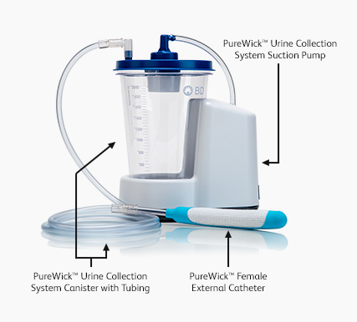
Summary
Components | Functions
Canister ( 2000 cc) | Urine collection unit
Female External Catheter (FEC) | Catheter for non-invasive urine output management
Vacuum Station | Diaphragm pump present inside creates a negative pressure/ suction pull in the canister
16’’ vacuum tubing | Creates a vacuum in the canister by moving air out from vacuum connector port
70’’ patient tubing | Carries away urine from the FEC to the canister
Electrical Circuit ( PCBA) | Provides information on the Battery Life Status using LED light

Slide 17
Internship Assignment
Design an electronic architecture for new version of BD PureWick™ Urine Collection System, aimed at achieving some improvements.
Improvement Features:
Reduce the overall footprint and make the system portable
Making the system smart and intuitive

Slide 18
Proposed Electronic Architecture:
Sensor detecting urine in FEC
Bluetooth (Transmitter)
Bluetooth (Receiver)
Microcontroller
Level Detection Sensor at Canister’s lid
Level not reached
Level
reached
Alert System (Buzzer)
Microcontroller
Urine detected in FEC and level of urine < threshold
Urine not detected in FEC or level of urine >= threshold
Pump starts working
Pump not works

Slide 19
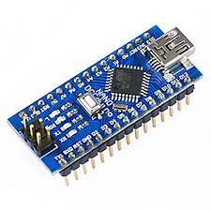
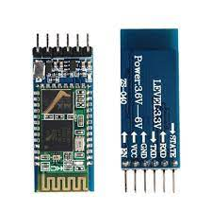
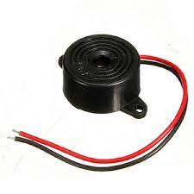
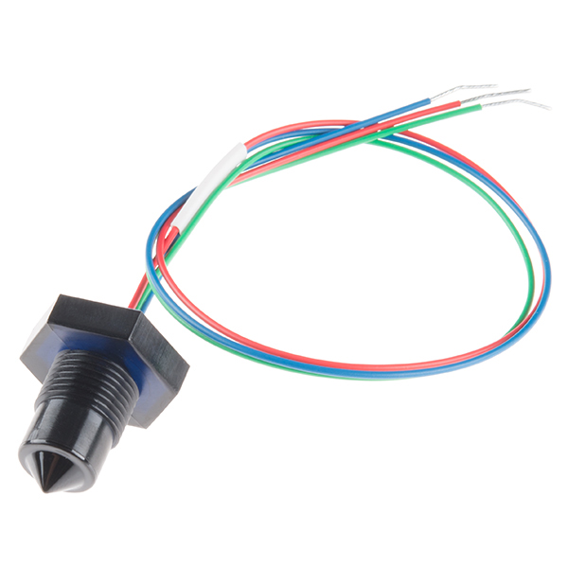

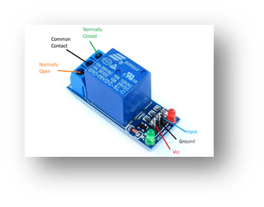
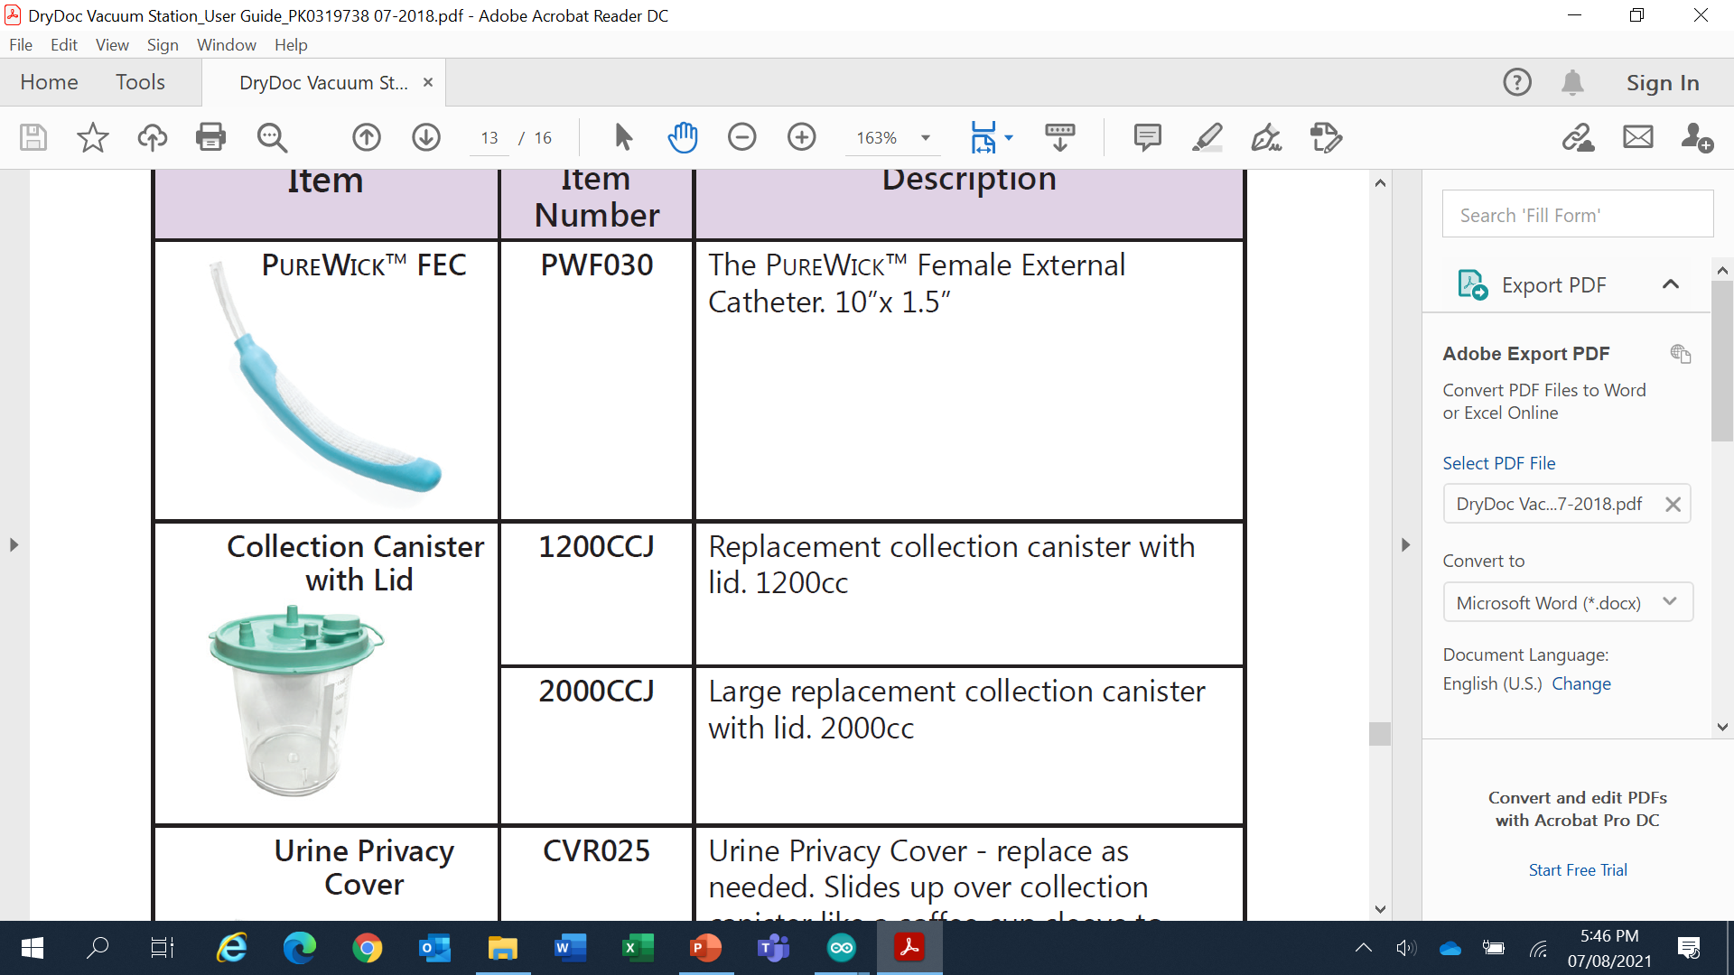
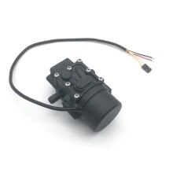
Microcontroller
Bluetooth – Transmitter
Bluetooth – Receiver
Microcontroller
Liquid detection sensor
Level detection sensor
Alert generation system
Pump
Relay – 1 channel

Slide 20
Thank you

