Slide 1

LOW-ENERGY ADAPTIVE CLUSTERING HIERARCHY (LEACH) FOR WIRELESS SENSOR NETWORK
Submitted to Jawaharlal Nehru Technological University, Kakinada
In partial Fulfillment of the requirements for the Award of degree of
BACHELOR OF TECHNOLOGY
In
ELECTRONICS AND COMMUNICATION ENGINEERING
Submitted by
B.KAVYASRI
 | (21KN5A0413)
S.VINAY KUMAR | V.DIVYA | P.PADMA PRIYA
(20KNIA04F2) | (20KN1A04H7) | (20KN IA04D1)
 | Under the Guidance of
Mr. M.Mahesh..,M.Tech,(Ph.D) Assistant professor
DEPARTMENT OF ELECTRONS & COMMUNICATION ENGINEERING
NRI INSTITUTE OF TECHNOLOGY
(Autonomous)
(Approved by A.I.C.T.E Permanently Affiliated to JNTUK, Kakinada) (Accredited by NAAC with GRADE, An ISO 9001 : 2015 Certified Institution)
Pothavarappadu (V), Agiripalli (M), Eluru (DT)- 521212
(2020-2024)

Slide 2
Abstract:
In wireless sensor networks (WSNs), the Low-Energy Adaptive Clustering Hierarchy (LEACH) algorithm stands out as a promising approach to optimize energy consumption and extend network lifetime. This study delves into LEACH's capabilities and performance, with a focus on energy efficiency and network longevity. Through rigorous evaluation, we investigate how LEACH dynamically forms clusters, assigns cluster heads, and aggregates data from member nodes, distributing energy consumption evenly. Key metrics, including energy consumption, network lifetime, and data transmission reliability, are employed to assess LEACH's effectiveness in various WSN deployment scenarios. Furthermore, comparative analyses with alternative energy optimization algorithms shed light on LEACH's advantages and limitations. By validating our findings through simulations and real-world experiments, we offer practical insights for WSN design and deployment, aiding in informed decision-making. This research not only explores LEACH's potential but also paves the way for potential enhancements and adaptations, contributing to the on-going evolution of energy-efficient WSNs for diverse applications.
Key words:
Keywords: Energy Consumption, Wireless sensor networks, Low-Energy Adaptive Clustering Hierarchy, Cluster Heads,
Existing System:
Ant Colony Optimization (ACO) is a nature-inspired algorithm that simulates the foraging behaviour of ants to solve complex optimization problems. It employs artificial ants that construct solutions iteratively, guided by pheromone trails and problem-specific heuristics. ACO has applications in routing, scheduling, manufacturing, and various optimization tasks, known for its ability to efficiently explore large solution spaces and adapt to dynamic conditions.
Disadvantages:
Complexity
Energy Overhead
Resource Requirements
Deployment Challenges
Latency

Slide 3
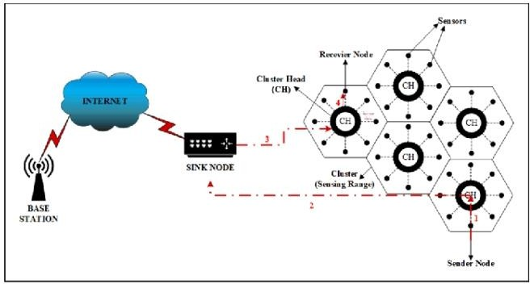
Proposed System:
The proposed system (LEACH) introduces an advanced approach to enhance wireless sensor network (WSN) efficiency. It integrates adaptive clustering, energy-aware routing, data aggregation, machine learning, QoS optimization, and robust security mechanisms. Expected benefits include extended network lifespan, improved data reliability, adaptability to changing conditions, and enhanced security. This holistic system aims to address WSN challenges and provide efficient and reliable data communication for diverse applications.
Advantages:
Extended Network Lifetime
Improved Data Reliability
Adaptability
Enhanced Security
Efficient Resource Utilization
Quality of Service (QoS)Holistic Approach

Slide 4
Applications:
Environmental Monitoring: The system can be used for monitoring environmental parameters such as temperature, humidity, air quality, and pollution levels. It enables long-term data collection for climate research, ecological studies, and natural disaster detection.
Healthcare: In healthcare applications, the system can monitor patient vital signs, track medical equipment, and assist in telemedicine. It ensures data accuracy and timely alerts for critical conditions.
Home Automation: For smart homes, the system can manage energy consumption, control appliances, and provide security through motion detection and intrusion detection.
Wildlife Conservation: In wildlife tracking and conservation, the system aids in tracking animal movements, monitoring habitats, and detecting poaching activities.
Transportation: In intelligent transportation systems, it can monitor traffic conditions, optimize traffic signals, and provide real-time updates to commuters for efficient travel.
Disaster Management: In disaster-prone areas, it can provide early warning systems for earthquakes, floods, and wildfires, assisting in evacuation and response planning.
Software Required:
MATLAB Software
Personal Computer
Signature of Guide
Signature of HOD

