Slide 1

FLIGHT PRICE PREDICTION
Author : Divya Trivedi
SME: Gulshana Chaudhary

Slide 2
Index:
Introduction
Problem Statement.
Problem Understanding.
What is Flight Price Prediction?
Importance of flight price prediction.
Exploratory data analysis.
Visualizations.
Analysis.
Model Building.
Hyper Parameter Tuning.
Saving the model and predictions from saved best model.
Conclusion.

Slide 3
Introduction:
Airline industry is one of the most sophisticated in its use of dynamic pricing strategies to maximize revenue, based on proprietary algorithms and hidden variables. That is why the airline companies use complex algorithms to calculate the flight ticket prices.
There are several different factors on which the price of the flight ticket depends. The seller has information about all the factors, but buyers are able to access limited information only which is not enough to predict the airfare prices. Considering the features such as departure time, arrival time and time of the day it will give the best time to buy the ticket.
Nowadays, the number of people using flights has increased significantly. It is difficult for airlines to maintain prices since prices change dynamically due to different conditions. That’s why we will try to use machine learning models to solve this problem. This can help airlines by predicting what prices they can maintain. It can also help customers to predict future flight prices and plan their journey accordingly.

Slide 4
PROBLEM STATEMENT :
Anyone who has booked a flight ticket knows how unexpectedly the prices vary. The cheapest available ticket on a given flight gets more and less expensive over time. This usually happens as an attempt to maximize revenue based on -
Time of purchase patterns (making sure last-minute purchases are expensive).
Keeping the flight as full as they want it (raising prices on a flight which is filling up in order to reduce sales and hold back inventory for those expensive last-minute expensive purchases).
Business goal: The main aim of this project is to predict the price of flight tickets based on various features. The purpose of the paper is to study the factors which influence the fluctuations in the airfare prices and how they are related to the change in the prices.
Then using this information, build a system that can help buyers whether to buy a ticket or not. So, we will deploy a Machine Learning model for flight ticket price prediction and analysis. This model will provide the approximate selling price for the flight tickets based on different features.

Slide 5
Problem Statement :
Airlines implement dynamic pricing for their tickets and base their pricing decisions on demand estimation models. The reason for such a complicated system is that each flight only has a set number of seats to sell, so airlines must regulate demand. In the case where demand is expected to exceed capacity, the airline may increase prices, to decrease the rate at which seats fill. On the other hand, a seat that goes unsold represents a loss of revenue and selling that seat for any price above the service cost for a single passenger would have been a preferable scenario.
Here we are trying to help the buyers to understand the price of the flight tickets by deploying machine learning models. These models would help the sellers/buyers to understand the flight ticket prices in market and accordingly they would be able to book their tickets.

Slide 6
Benefits of Flight Price Prediction
Pricing in the airline industry is often compared to a brain game between carriers and passengers where each party pursues the best rates. Carriers love selling tickets at the highest price possible while still not losing consumers to competitors. Passengers are crazy about buying flights at the lowest cost available while not missing the chance to get on board. All this makes flight prices fluctuant and hard to predict. But nothing is impossible for people armed with intellect and algorithms. Predicting flight prices helps an individuals to know and understand the future price of the flight tickets.
There are two main use cases of flight price prediction in the travel industry. OTAs and other travel platforms integrate this feature to attract more visitors looking for the best rates. Airlines employ the technology to forecast rates of competitors and adjust their pricing strategies accordingly.

Slide 7
Import Libraries
Import Datasets
Data Preprocessing
Identifying Outliers and Skewness
EDA & Visualizations
Finding and Treating Null Values
Ordinal Encoding
Checking Correlation & VIF
Model Building
Saving the Model & Prediction
Hyper Parameter Tuning
R2 score, CV & evaluation metrics

Slide 8
Exploratory Data Analysis
As a first step I have imported required libraries and I have imported the datasets which were in csv format.
Then I did all the statistical analysis like checking shape, nunique(unique value each column contains), value counts, info etc…..
While checking the info of the datasets I found some columns with more than 80% null values, so these columns will create skewness in datasets so I decided to drop those columns, since it seem to me as unnecessary.
Then while looking into the value counts I found some columns with more than 85% zero values this also creates skewness in the model and there are chances of getting model bias so I have dropped those columns with more than 85% zero values.

Slide 9
Exploratory Data Analysis (EDA) Steps :
Importing necessary libraries and loading collected dataset as a data frame.
➢ Checked some statistical information like shape, number of unique values present, info, unique (), data types, value count function etc.
➢ Checked null values and found some missing values on column “Meal_Availability” and filled the null values by using mode method.
➢ Taking care of Timestamp variables by converting data types of “Dep_Time” and “Arrival_Time” from object data type into datetime data types.
➢ Extracted Departure_Hour, Deparutre_Min and Arrival_Hour, Arrival_Min columns from Dep_time and Arrival_Time columns and dropped these columns after extraction.
➢ The target variable "price" should be continuous numeric data but due to some string values like “,” it was showing as object data type. So, I replaced this sign by empty space and converted into float data type.
➢ From the value count function of Total_Stops, I found categorical data so replaced them with numeric data according to stops.
➢ Checked statistical description of the data and separated categorical and numeric features.
➢Visualized each feature using seaborn and matplotlib libraries by plotting several categorical and numerical plots.
➢ Identified outliers using box plots.
➢ Checked for skewness and removed skewness in numerical column “Duration” using square root transformation method.
➢ Encoded the columns having object data type using Label Encoder method. Used Pearson’s correlation coefficient to check the correlation between label and features. With the help of heatmap and correlation bar graph was able to understand the Feature vs Label relativity.
➢ Separated feature and label data and feature scaling is performed using Standard Scaler method to avoid any kind of data biasness.

Slide 10
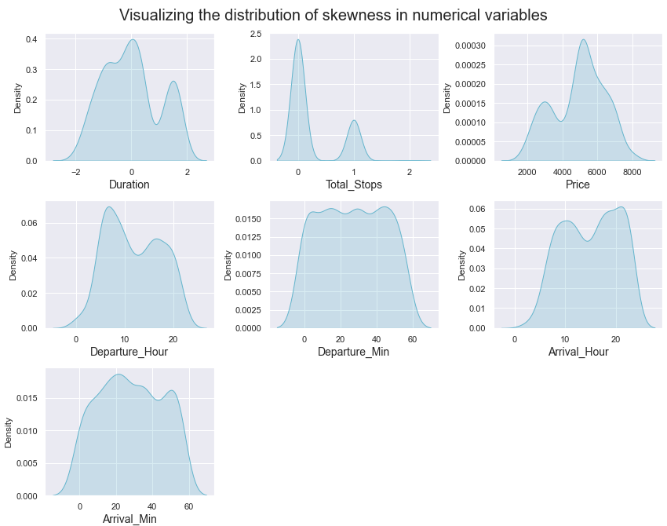
Visualization : Univariate Analysis for Numerical Variables :
The distribution plot shows how the data has been distributed in each of the columns.
From the distribution plot we can observe the columns are somewhat distributed normally as they have no proper bell shape curve.
The columns like "Duration", " Total_Stops " and "Price" are skewed to right as the mean value in these columns are much greater than the median(50%).
Also the data in the column Arrival_Hour
skewed to left since the mean values
is less than the median.
Since there is presence of skewness in
the data, we need to remove skewness in
the numerical columns to overcome
with any kind
of data biasness.

Slide 11
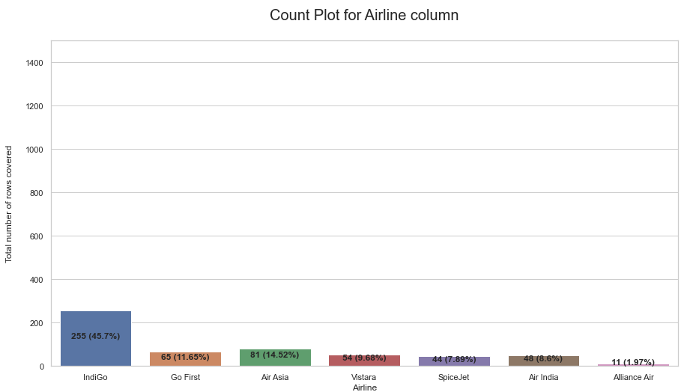
Highest number of airline preferred by people are Indigo covering 45.7% of the total record. Go First and Vistara and similar in range. Alliance air has the lowest numbers.

Slide 12
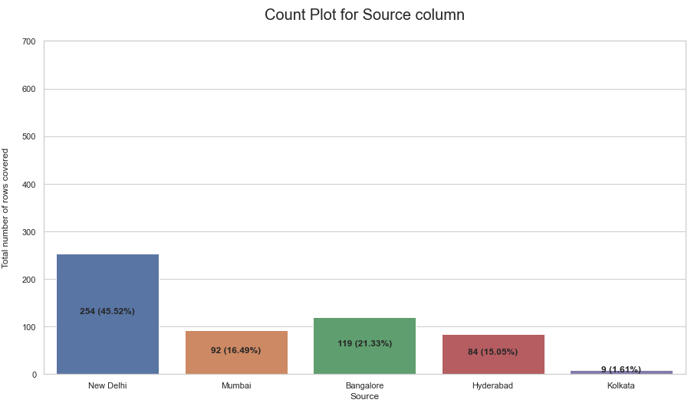
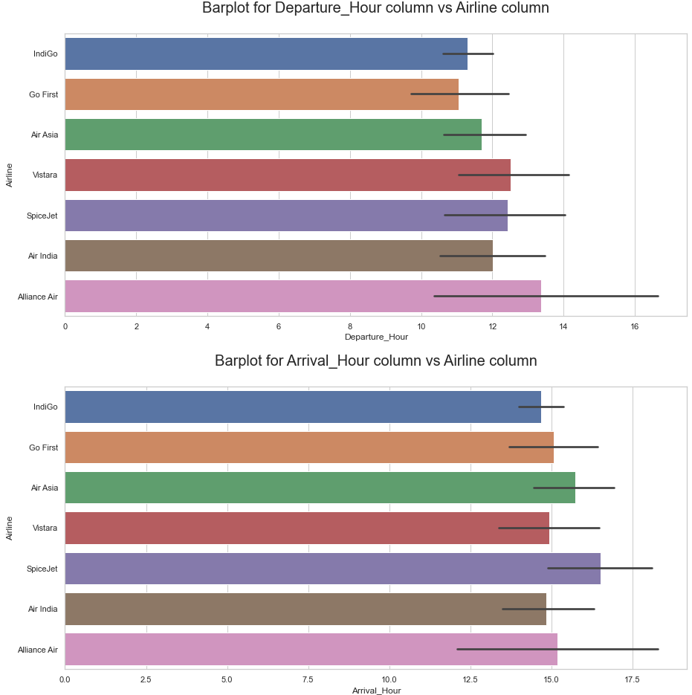
The departure area or source place highly used or people majorly flying from the city is "New Delhi" covering 45.52% record in the column
We see that "Banglore" is a close second wherein it covers 21.85% records in the column
Other two famous locations where people chose to fly from are "Mumbai" and "Hyderabad"
The least travel from location is "Kolkata“
When we observe the bar plot for Departure hour vs Airline we can see that Alliance Air has the highest departure time while Go First has the lowest departure time
Considering the bar plot for Arrival time vs Airline we can see that Spicejet has the highest arrival time while Indigo have the lowest arrival time

Slide 13
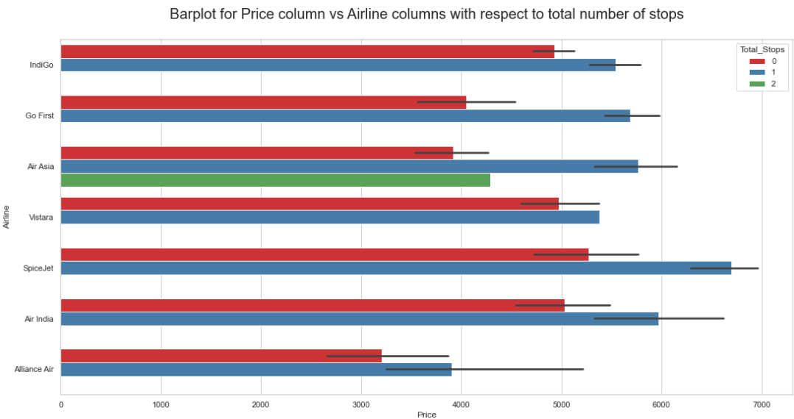
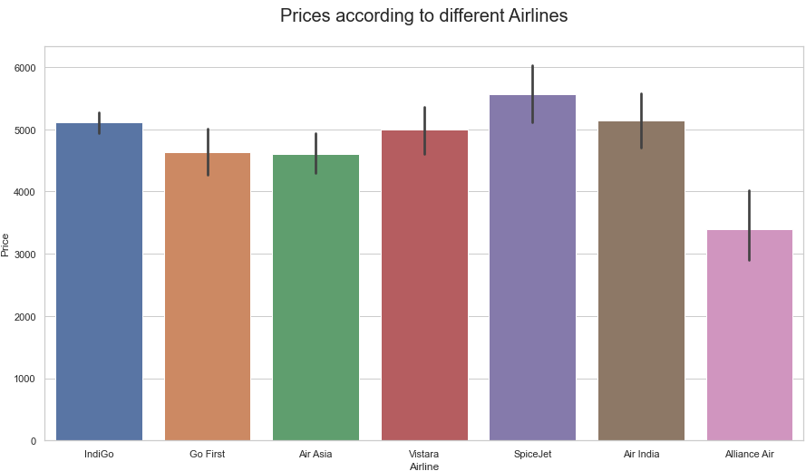
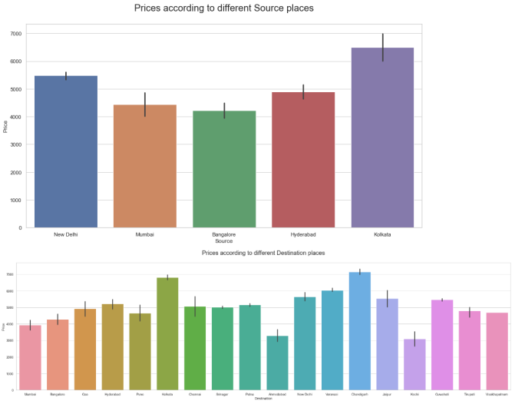
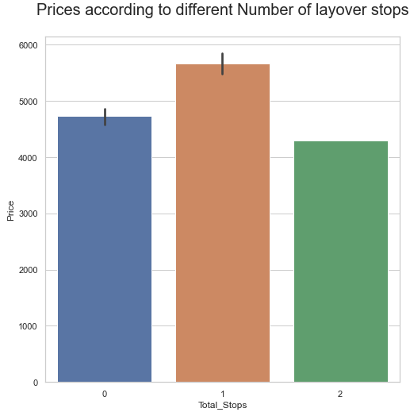
Airfares in SpiceJet and Air India are high when compared to other airlines. Flight prices when departing from cities like Kolkata and New Delhi have higher price range but the others are around the similar range a bit lesser in pricing but not providing a huge difference as such Similarly, prices when arriving in cities Chandigarh and Kolkata have high price range When we consider the layovers for pricing situation then obviously direct flights are cheaper when compared to flights that have 1 or more stops.
Spicejet has the maximum non stop flight and also has the maximum no of 1 stop flights
Air Asia has 2 stop flights

Slide 14
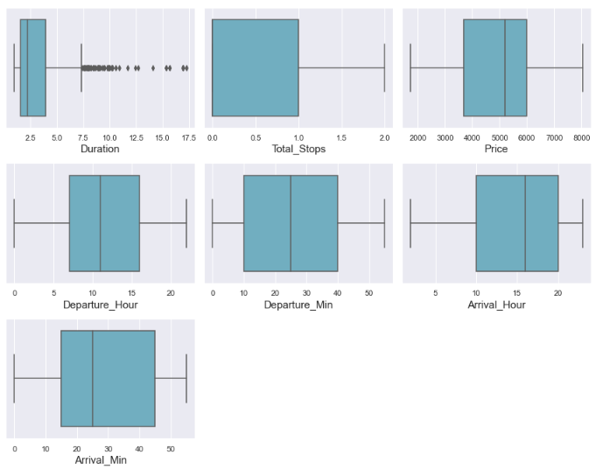
outliers :
A box plot is used to summarize data sets by using the box and whisker plot method. This function helps to understand the data summary properly. Box plots can be very useful when we want to know how the data is distributed and spread. Three types of quartiles are used in the box plot to plot the data. These values include the median, maximum, minimum, upper-quartile, and lower-quartile statistical values. A box plot summarizes this data in the 25th, 50th, and 75th percentiles.
From the box plot we can notice the outliers present in Duration and "Price" columns.
Since Price is our target variable so no need to remove outliers in this column. We have removed Outliers from Duration column by using Zscore method.

Slide 15
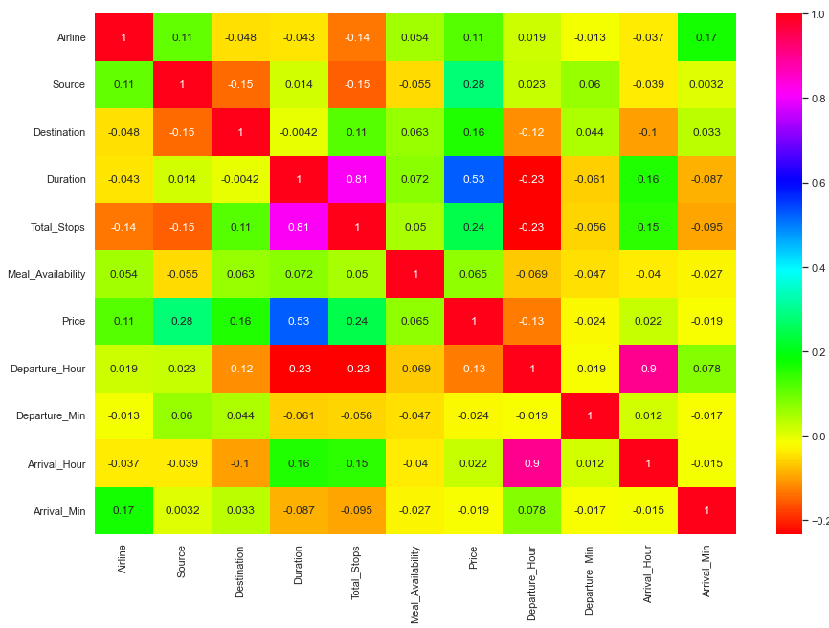
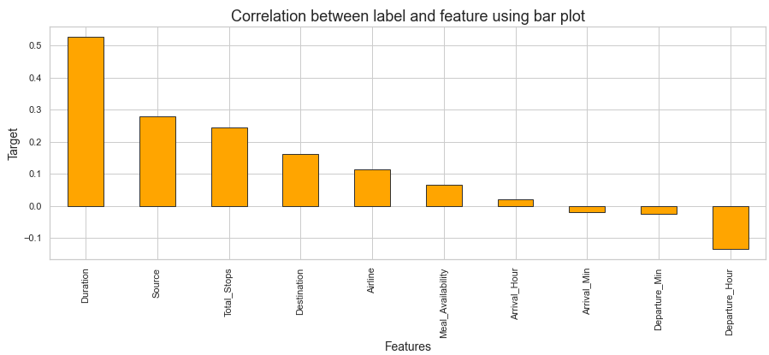
Correlation :
From the heat map and bar
plot we can clearly observe
the positive and negative
correlation between the
label and features.

Slide 16
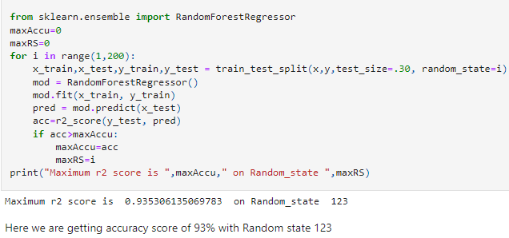
Best Random State
Here we are getting accuracy score of 93% with Random state 123

Slide 17
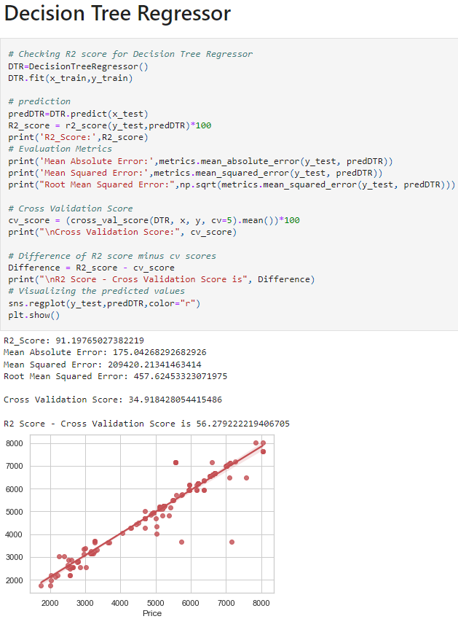
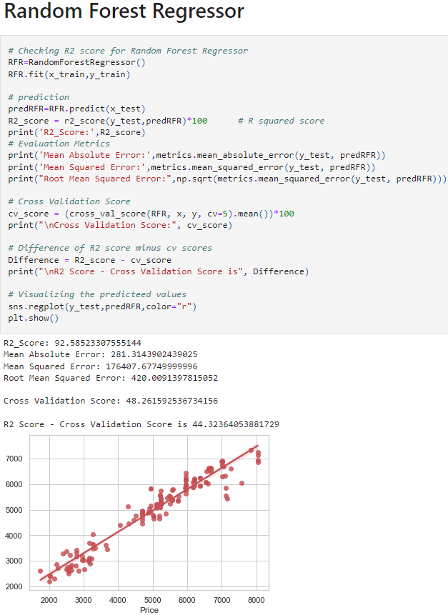
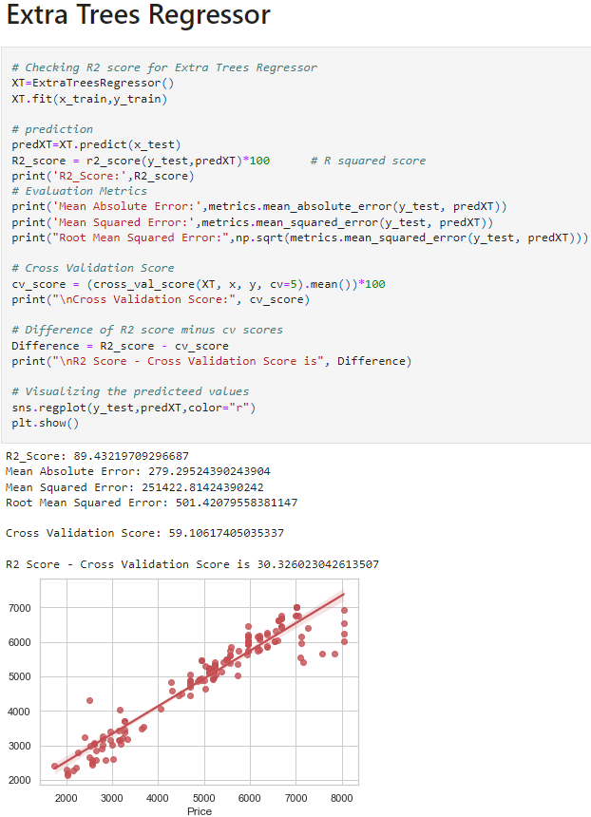

Slide 18
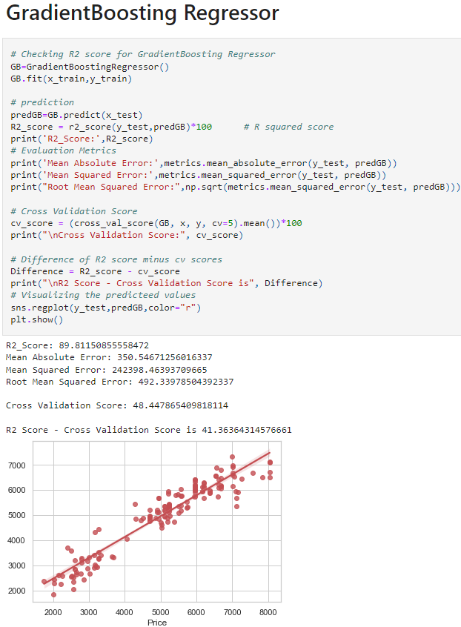
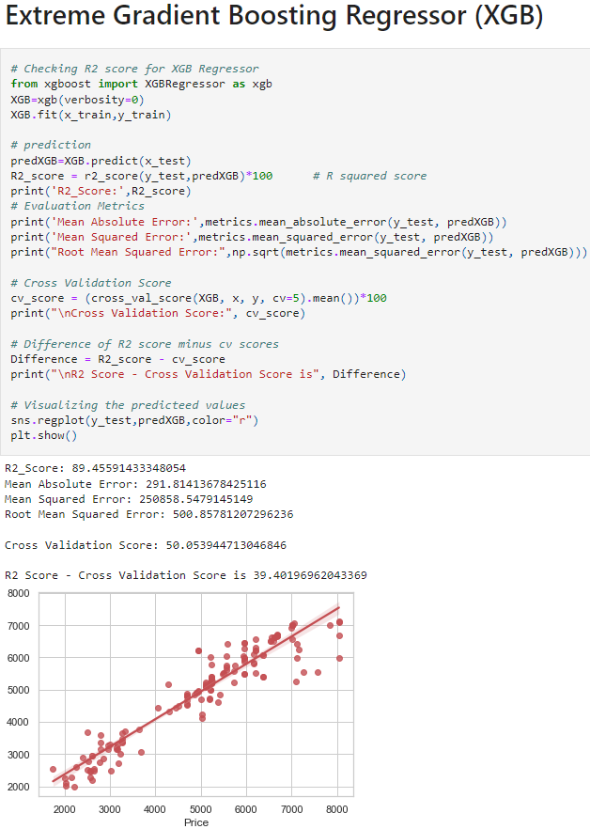
Conclusion.

Slide 19
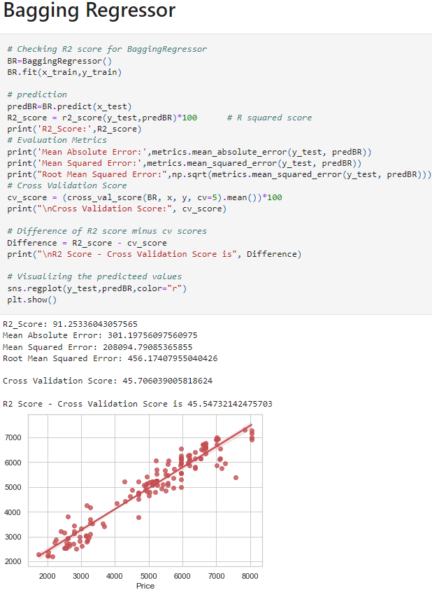
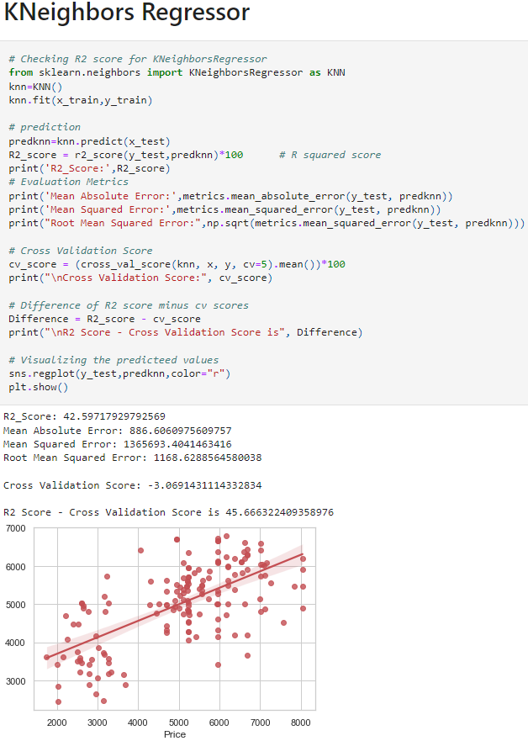

Slide 20
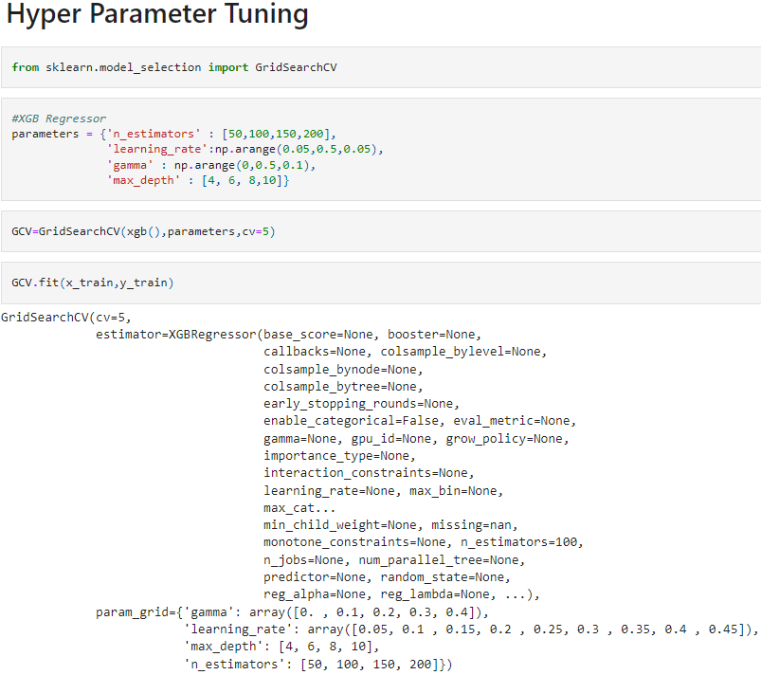
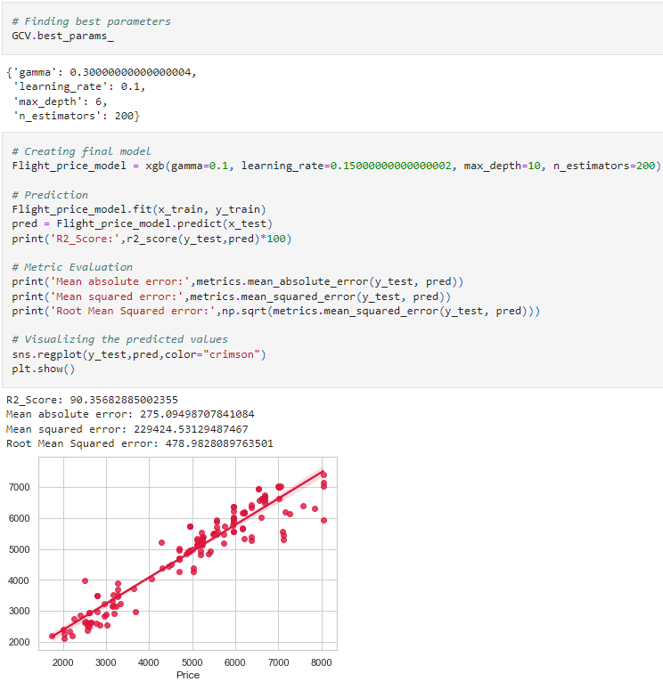
I have used GridSearchCV to get the best parameters of XGB Regressor. And used all the obtained parameters to get the accuracy of final model.

Slide 21
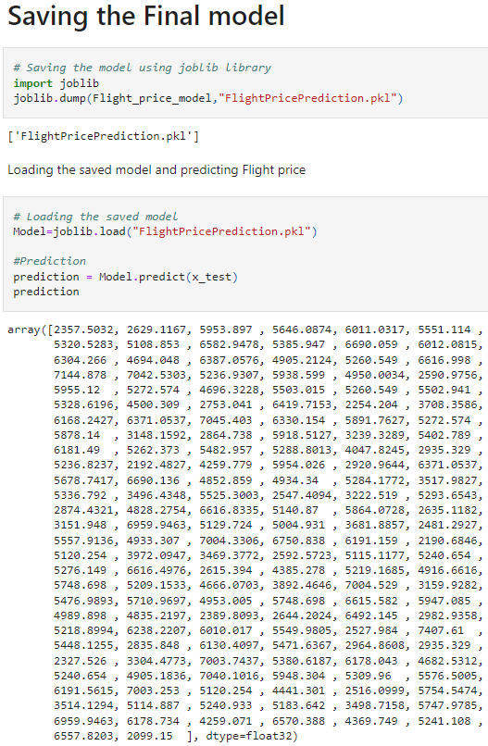
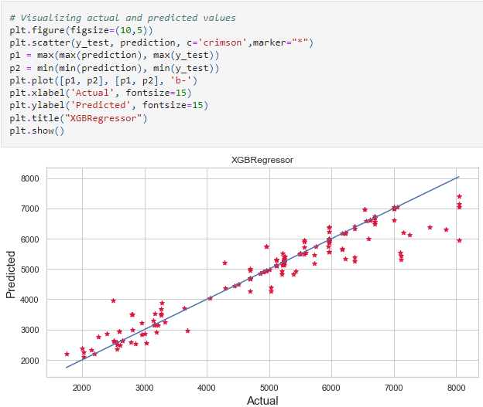
Saving the Model :
I have saved my best model using .pkl as follows.
Now after saving the best model, loading my saved model and predicting the test values.

Slide 22
CONCLUSION :
The case study aims to give an idea of applying Machine Learning algorithms to predict the price of the flight tickets. After the completion of this project, we got an insight of how to collect data, pre-processing the data, analyze the data, cleaning the data and building a model.
First we collected the flights data from website yatra and it was done by using Web scraping. The framework used for web scraping was Selenium, which has an advantage of automating our process of collecting data. We collected almost 5303 of data which contained the ticket price of the flights and other related features. Then, the scrapped data was saved in a excel file so that we can use further and analyze the data.
Then we loaded the dataset and have done data cleaning, EDA process and pre-processing techniques like checking outliers, skewness, correlation, scaling data etc. And got better insights from data visualization.

Slide 23
CONCLUSION :
From the visualizations we got to know that flight ticket prices change during morning and evening time of the day. From the distribution plots we came to know that the prices of the flight tickets are going up and down, they are not fixed at a time. Also, from this graph we found prices are increasing in large amounts. From plots we found that the prices are tending to go up as the time is approaching from morning to evening. From the categorical plots (bar and box) we came to know that early morning and late night flights are cheaper compared to working hours. From the categorical plots we found that the flight ticket prices increases as the person get near to departure time. That is last minute flights are very expensive. From the bar plot we got to know that both Indigo and Spicejet airways almost having same ticket fares.
After separating our train and test data, we started running different ML regression algorithms to find out the best performing model on the basis of different metrics like R2 Score MAE, MSE, RMSE. We got Extra Trees Regressor as the best model among all the models. On this basis we performed the Hyperparameter tuning to find out the best parameter and improving the scores. The R2 score increased after tuning so, we concluded that Extra Trees Regressor as the best model as it was giving high R2 score after tuning.

Slide 24
Thank You
.

