Slide 1
Project Title: Talk to Your Document — OCR
Subtitle: Conversational AI with Document Understanding
By: Divyam Pandey

Slide 2
Objective
The main objective of this project is to develop an AI-driven application that allows users to upload a document — either in PDF or image format — and interact with its content conversationally.
The system automatically extracts text using Optical Character Recognition (OCR), processes it into meaningful chunks, creates semantic embeddings, and enables the user to ask questions about the document. The answers are generated contextually using Large Language Models (LLMs) integrated with a retrieval mechanism.
Key Goals:
Automate reading and understanding of documents.
Build an interactive question–answer interface.
Demonstrate end-to-end AI engineering workflow — from OCR to LLM integration.
Provide accurate, context-aware answers to user queries.

Slide 3
Problem Understanding
The Problem:
Reading long documents manually is inefficient and error-prone. Professionals and students often need to search for specific information or summarize large reports, research papers, or scanned images. Doing this manually consumes time and effort.
The Solution:
“Talk to Your Document” aims to solve this by leveraging AI. It can:
Extract text automatically from scanned documents using OCR.
Understand the document context via embeddings.
Allow natural conversation with the document using an LLM.
In short, instead of manually searching, the user can simply ask — “What is this document about?” — and get an intelligent, summarized response.

Slide 4
System Architecture / Flow Diagram:-
1) File Upload: The user uploads a PDF or image file through the Streamlit web interface.
If it’s an image, OCR is used.
If it’s a PDF, text extraction is done using PyMuPDF.
2)Text Extraction (OCR / Parser):
For images → pytesseract extracts text line by line.
For PDFs → PyMuPDF or pdfminer.six extracts structured text.
3)Text Preprocessing and Chunking:
Clean the extracted text (remove special characters, line breaks).
Split it into smaller chunks (e.g., 500–1000 words) for efficient retrieva
4) Embedding Generation:
Convert each text chunk into numerical vectors using models like sentence-transformers (e.g., all-MiniLM-L6-v2).
These embeddings help measure semantic similarity between the user’s query and document text.

Slide 5
5) Vector Store (FAISS):
Store embeddings in a FAISS vector database for quick similarity searches.
During a query, FAISS retrieves the most relevant chunks.
6) Query Processing:
The user inputs a question.
The system embeds the query and searches for similar text vectors.
7) LLM Integration:
The retrieved text chunks are passed as context to an LLM (like GPT or a HuggingFace model).
The LLM generates a natural-language response.
8) Answer Display:
The final answer is displayed in the chat-like Streamlit interface.

Slide 6
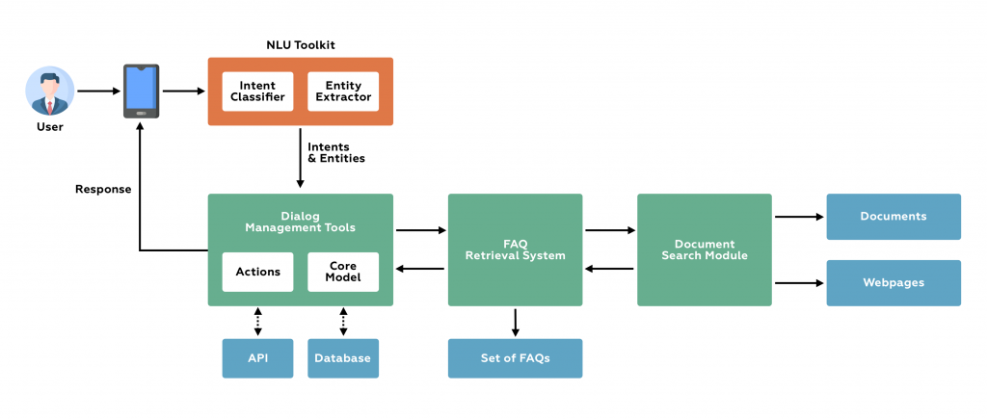

Slide 7
Libraries and Tools Used:-
langchain-community>=0.1.2
langchain-huggingface>=0.0.9
huggingface-hub>=0.23.0
sentence-transformers>=2.7.0
faiss-cpu>=1.8.0
pytesseract
pillow
pymupdf
python-dotenv
streamlit

Slide 8
Challenges Faced & Solutions:-
Challenge | Explanation | Solution
OCR errors due to poor image quality | Blurred or noisy images reduced text accuracy. | Used OpenCV preprocessing (thresholding, denoising).
Handling large text beyond LLM context limits | LLMs cannot process entire documents at once. | Implemented text chunking and embedding retrieval.
Slow response time | Large text comparisons were time-consuming. | Used FAISS vector index for optimized similarity search.
Mixed file types (PDF, image) | Needed flexible parsing. | Added conditional logic for different file types.
Maintaining context across multiple questions | Hard to keep conversation consistent. | Used session memory in Streamlit and LangChain.

Slide 9
Key Learnings:-
Learned how to integrate OCR + NLP + LLM for real-world AI applications.
Understood Retrieval-Augmented Generation (RAG) pipelines.
Gained experience in vector databases and semantic embeddings.
Improved debugging and problem-solving for end-to-end AI workflows.
Enhanced deployment and UI design skills using Streamlit.

Slide 10
Future Enhancements:-
Support multi-document uploads and cross-document Q&A.
Add summarization & keyword extraction features.
Integrate voice input/output for speech-based interaction.
Deploy on cloud platforms (HuggingFace Spaces, AWS, or Streamlit Cloud).
Use multimodal LLMs (text + image understanding).

Slide 11
Conclusion:-
"This project demonstrates an end-to-end understanding of OCR, text processing, embedding-based retrieval, and LLM integration. Thank you for your time."

Slide 12
THANK YOU
DIVYAM PANDEY
Email id:- divyampandey08032003@gmail.com
Linkedin:- https://www.linkedin.com/in/divyam-pandey-2533b0225/

