Slide 1


COMP 8547-ADVANCED COMPUTING CONCEPTS
FINAL PROJECT:
WEB SEARCH ENGINE
INSTRUCTOR : DR. MAHDI
FIROOZJAEI

Slide 2

TEAM MEMBERS
Shruti Paresh Hindocha(110065671)
Aarsh Makwana(110059619)
Manan Dharmendrakumar Vaghela(110071186)
Divyangkumar Kishorbhai Chodvadiya(110059541)

Slide 3
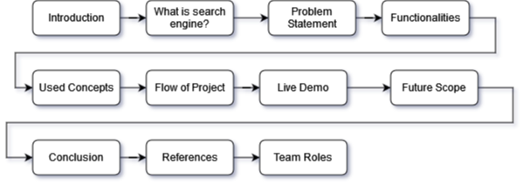
Presentation Outline

Slide 4

Introduction
A web search engine is a piece of software that refers to a huge database of internet resources that assists to locate information on world wide web
The main motive of web search engine algorithm is to provide relevant search results that responds to the keyword entered by the user as fast as possible.

Slide 5
What is a web search engine?
A web search engine is a program that allows user to enter keywords or phrases and then it assists them to find the information they are looking for from all over the world.
As soon as user enters the search phrase, the website page titles, contents, keywords which are indexed are examined by the search engine and then it applies the algorithm step by step to generate a list of relevant websites with the most matching websites at the top.
Examples of Web Search Engine : Google, Bing, Yahoo.
Spiders, also known as crawlers, are types of search engine software that automatically navigate the web by following links from page to page and site to site. The search results were used to build a constructible web index.

Slide 6
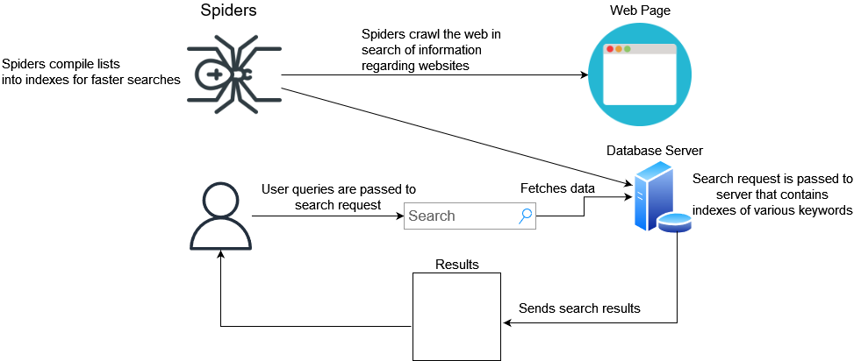
Working of Web Search Engine

Slide 7

Problem Statement
In this course of Advanced Computing concepts, we learned detailed theoretical and practical features of data structures, algorithm and its analysis.
We learned many concepts related to online search engines such as web crawler, HTML to Text and many others.
Thus we created a web search engine using core concepts of data structures and algorithm and its analysis and were able to learn the inner working of various algorithms and analysed the overall efficiency and performance of algorithms in various circumstances.

Slide 8

Functionalities
Web Crawler
Pattern Matching
HTML to Text
Searching Word
Word Suggestion
Page Ranking

Slide 9

Web Crawler
Web crawlers are basically an internet bot that browses and index content on the Internet.
They are operated by search engines like Google, Yahoo and is responsible for understanding the contents of the web page so that the result of web crawling can be used to show the links of websites as requested by the user.
The other name of web crawler is spider bot or spider crawler.
Hash table is used as a data structure to store the web links which are visited for tracking purpose.

Slide 10
Pattern Matching (Boyer Moore Algorithm)
This algorithm is one of the fastest pattern matching algorithm which compares each characters of substrings to search words or characters from the string.
The functionality of the algorithm is such that it scans the character from right to left starting with the rightmost character.
Boyer Moore is the combination of two approaches: 1) Bad Characters Heuristic Character- Characters that do not match the pattern in the text are called bad characters. The pattern continues to match until mismatch occurs and then the pattern moves beyond mismatched characters.
2) Good Suffix Heuristic : Just like the bad character heuristic, a pre-processing table is generated for the good suffix heuristic

Slide 11

HTML to Text
The automatic download of HTML web pages is called crawling. HTML files are downloaded from particular URL as requested by the user and then further stored in specific local directory.
HTML files are read and it gets converted into text files. The process of HTML parsing parses the text from the HTML files by using text function of Jsoup. It removes HTML tags for getting the plain text.
The functionality of Jsoup is to parse HTML data to text data.

Slide 12
Page Ranking Algorithm
Page ranking algorithm has the functionality to rank web in the search engine results.
The process of this algorithm works by calculating the quality and amount of time to determine the priorities of the website according to google.
Merge Sort is used to sort the ranked pages.

Slide 13

Searching Word
In this functionality, user can search for the particular word in the text file that is previously converted from html files at the time of web crawling.
Here, we are storing the count of the searched word that is present in the particular file into the hashtable.
In the output, the file with maximum count of the searched word will be displayed first using sorting algorithm.

Slide 14

Word Suggestion
In this functionality, if user can search the particular word that is not correct word but it is very close to the actual real word, then our program tries to match this word with the another similar kind of word using edit distance algorithm.
By doing this, the system will suggest the actual real word with somewhat similar alphabets.

Slide 15

Overall Used Concepts
Boyer Moore Algorithm
Edit Distance
Sorting
Hash Table
Regular Expression

Slide 16
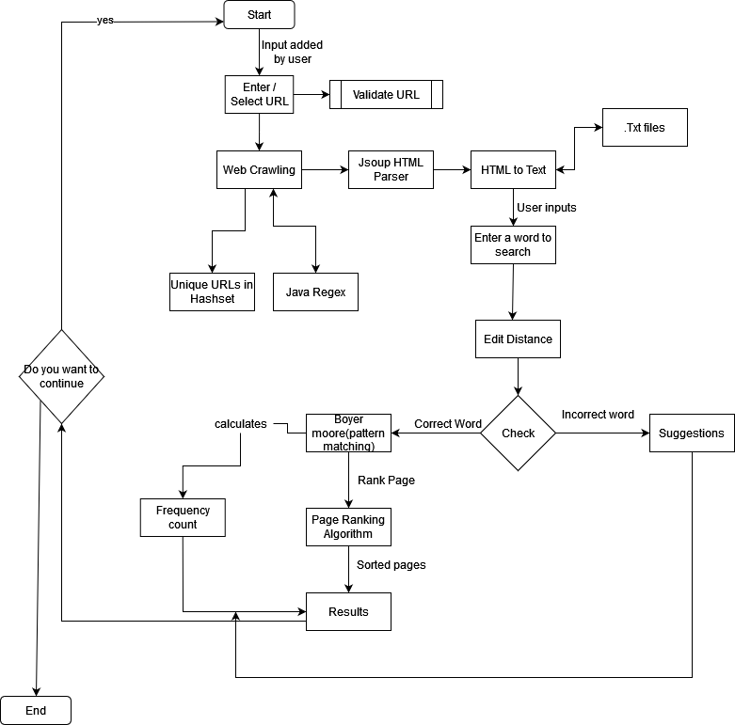
Flow of Project

Slide 17

Online Live Virtual Demo

Slide 18

Future Scope
Currently we have implemented console based application. So, for future scope we would like to develop cross platform application with interactive user interface.
Introducing advanced database storing techniques to store various types of data.

Slide 19

Conclusion
In this project, we have successfully implemented a web search engine by using various algorithms like Boyer Moore, edit distance, page ranking, pattern matching, etc.
We learned about advanced concepts of data structures, algorithms design and analysis, inner working of various algorithms and analysed their performance.

Slide 20
References
https://www.javatpoint.com/search-engines
https://mkyong.com/java/jsoup-basic-web-crawler-example/
https://journals.plos.org/plosone/article?id=10.1371/journal.pone.0200912

Slide 21
Team Contribution
Name | Contribution
Aarsh Makwana | Word searching and suggestion(3rd option in project)
Divyangkumar Kishorbhai Chodvadiya | Web crawling(user can add URL(4th option in project))
Shruti Paresh Hindocha | Web crawling(w3schools(1st option in project))
Manan Dharmendrakumar Vaghela | URL pattern matching and Sorting(2nd option in project)

Slide 22
THANK YOU!
Aarsh Makwana( makwan21@uwindsor.ca)
Divyangkumar Kishorbhai Chodvadiya( chodvadd@uwindsor.ca)
Shruti Paresh Hindocha( hindoch@uwindsor.ca)
Manan Dharmendrakumar Vaghela( vaghel21@uwindsor.ca)

