Slide 1
Predicting Employee Attrition Using Explainable Machine Learning
Branch: CSE
Group No. – 10
Members’ Details:
Divyansh Gupta (22CS3025)
Manish Kumar (22CS3037)
Jigyasu Patel (22CS3031)
Nishant Nischal (22CS3042)

Slide 2
Introduction & Problem Statement
Employee attrition is costly: replacing an employee can cost ≈33% of their annual salary and includes hidden costs like lost productivity and morale.
Modern HR teams use data-driven methods and explainable AI (e.g., SHAP) to identify at-risk employees.
Project goal: Build interpretable models to predict attrition and help managers simulate retention scenarios.

Slide 3
Dataset Description
IBM HR Analytics Employee Attrition & Performance dataset (1,470 employees, 35 variables).
Demographics: Age, Gender, MaritalStatus
Organisation: Department, JobRole, JobLevel
Compensation: MonthlyIncome, PercentSalaryHike, StockOptionLevel
Satisfaction: JobSatisfaction, EnvironmentSatisfaction, WorkLifeBalance
Work conditions: OverTime, BusinessTravel, YearsAtCompany
Target: Attrition (Yes/No)

Slide 4
Data Cleaning & Preprocessing
Key steps:
Removed constant features (EmployeeCount, StandardHours, Over18, EmployeeNumber)
One-hot encoded categorical variables and standardised numeric features
Split data into training (75%) and test (25%) sets with balanced class distribution

Slide 5
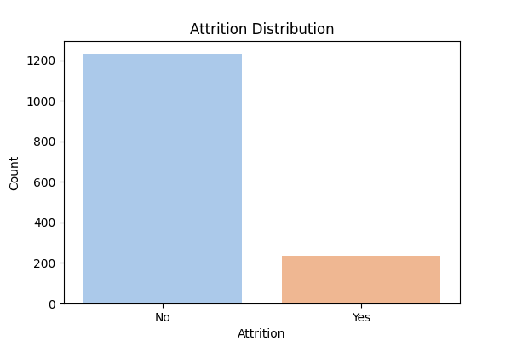
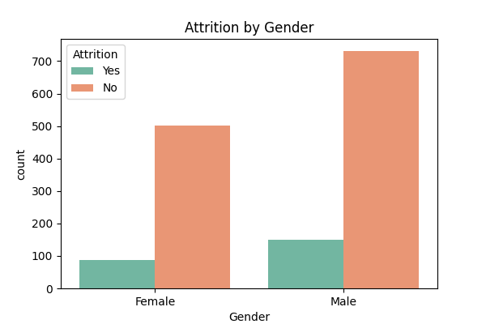
Exploratory Data Analysis: Attrition & Gender
About 16% of employees left (class imbalance)
Attrition is similar across genders; job factors matter more than gender

Slide 6
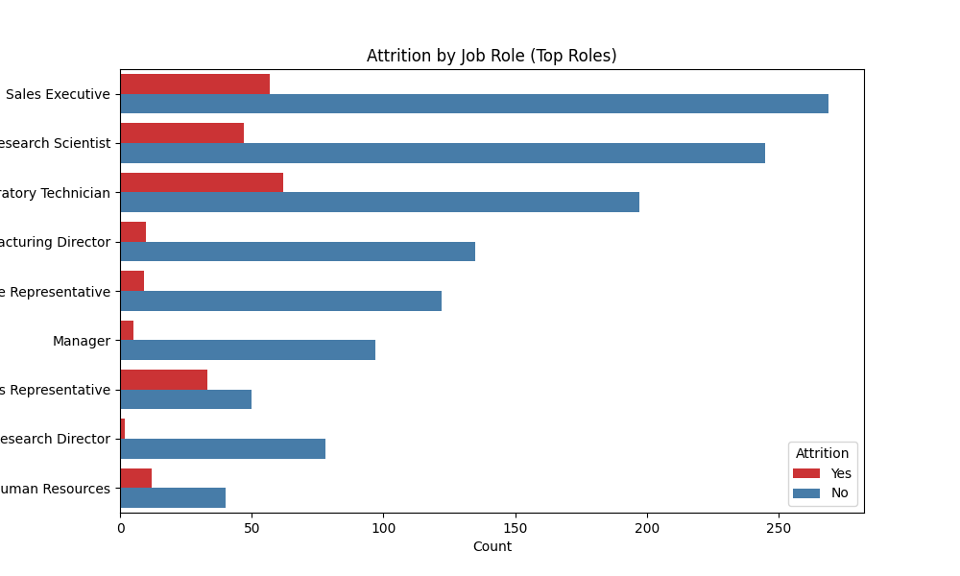
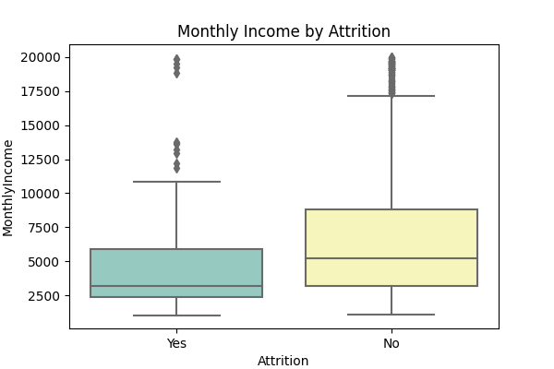
EDA: Job Role & Monthly Income
High attrition among Laboratory Technicians, Sales Representatives
Employees who left generally had lower monthly income

Slide 7
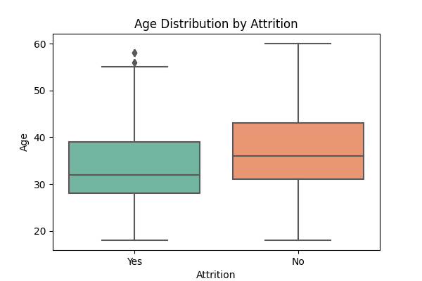
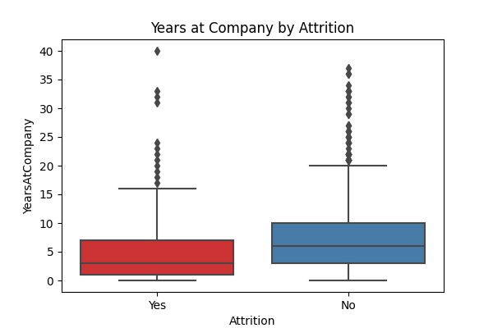
EDA: Age & Tenure
Employees who left are younger and have shorter tenure
Retention issues often occur early in employment

Slide 8
Methodology & Models
Models trained with scikit-learn using a preprocessing pipeline:
Logistic Regression: interpretable, uses balanced class weights
Random Forest: ensemble of decision trees capturing non-linear relationships
Gradient Boosting: boosting model with strong accuracy but less interpretability
Preprocessing: one-hot encoding and standardisation to prevent data leakage

Slide 9
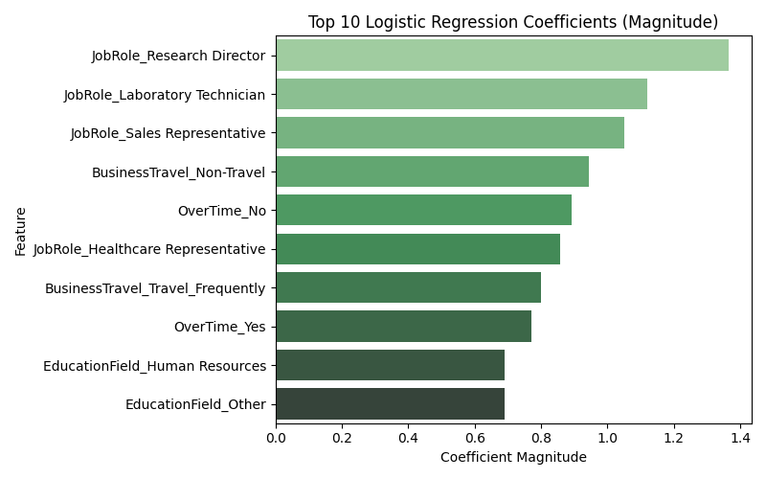
Results & Interpretation
Model | Test Accuracy | ROC AUC | Notes
Logistic Regression | 0.77 | 0.81 | Best balance of precision and recall
Random Forest | 0.85 | 0.78 | Highest accuracy but slight overfitting
Gradient Boosting | 0.85 | 0.78 | Good accuracy; less interpretable
Job role, BusinessTravel, OverTime and EducationField are key drivers
Research Directors less likely to leave, Laboratory Technicians more likely to leave
Overtime and frequent travel increase attrition risk

Slide 10
Validation & Conclusion
Validation and next steps:
Hold-out evaluation: Test accuracy ≈77%, AUC ≈0.81
5-fold cross-validation: mean AUC ≈0.83 confirming stability
Balanced class weights mitigate imbalanced data; SMOTE or cost-sensitive learning could further improve
Actionable recommendations: reduce overtime and travel, improve satisfaction, adjust compensation, create clear career paths

