Slide 1
Employee Data Analysis using Excel
STUDENT NAME: DIVYA S
REGISTER NO: 9A028A52A6B33FDA9C34C86086025520
DEPARTMENT: BCOM GENERAL
COLLEGE : MEENAKSHI COLLEGE FOR WOMEN

Slide 2
PROJECT TITLE
Employee Attrition

Slide 3


AGENDA
Problem Statement
Project Overview
End Users
Our Solution and Proposition
Dataset Description
Modelling Approach
Results and Discussion
Conclusion
3/21/2024 Annual Review

Slide 4

PROBLEM STATEMENT
High employee attrition is causing significant challenges for our organization, leading to increased costs, loss of key talent, and disruptions in productivity. Addressing these factors is essential to reducing turnover, improving employee engagement, and maintaining a stable workforce. Failure to do so could result in ongoing operational inefficiencies and damage to our reputation as an employer.

Slide 5

PROJECT OVERVIEW
.
The project aims to analyze employee attrition within the organization, identify key causes, and develop effective strategies to reduce turnover and improve employee retention. The goal is to enhance workforce stability, reduce associated costs, and improve overall organizational performance.

Slide 6

WHO ARE THE END USERS?
● HUMAN RESOURCE DEPARTMENTS
● MANAGEMENT AND LEADERSHIP
● TEAM LEADERS AND SUPERVISORS
● EMPLOYEES
● EXECUTIVE LEADERSHIP
● BUSINESS ANALYSTS
● RECRUITERS

Slide 7

OUR SOLUTION AND ITS VALUE PROPOSITION
FILTERING- REMOVE VALUES
PIVOT TABLE - SUMMARY OF EMPLOYEE PERFORMANCE
BAR DIAGRAM - FINAL REPORT

Slide 8
Dataset Description
● EMPLOYEE DATA SET- KAGGLE
● 9 FEATURES IN EXCEL:
EMPLOYEE ID- ALPHANUMERIC(TEXT)
NAME- ALPHABETICAL(TEXT)
AGE- NUMERICAL
GENDER- ALPHABETICAL(TEXT)
DEPARTMENT - ALPHABETICAL(TEXT)
JOB ROLE- ALPHABETICAL (TEXT)
MONTHLY INCOME- NUMERICAL
SALARY - NUMERICAL START
REMOTE WORK- ALPHABETICAL (TEXT)
WORK LIFE BALANCE – ALPHABETICAL(TEXT)
JOB SATISFACTION – ALPHABETICAL(TEXT)
PERFORMANCE RATING – NUMERICAL
NUMBER OF PROMOTION- NUMERICAL
EDUCATION LEVEL –ALPHABETICAL(TEXT)
MARITAL STATUS – ALPHABETICAL(TEXT)
JOB LEVEL- ALPHABETICAL(TEXT)
EMPLOYEE RECOGNITION –ALPHABETICAL (TEXT)
ATTRITION- NUMERICAL

Slide 9

THE "WOW" IN OUR SOLUTION
New employees can bring innovative ideas and fresh perspectives that rejuvenate teams and processes.
Attrition can facilitate increased diversity by allowing the organization to recruit from a broader and more varied talent pool.
3/21/2024 Annual Review
9

Slide 10
MODELLING
● STEP -1
DOWNLOAD THE EMPLOYEE DATASET AND OPEN THE EMPLOYEE DATASET IN EXCEL.
● STEP -2
SELECT THE ENTIRE DATA AND CLICK ON DATA AND CLICK ON FILTER OPTION.
● STEP -3
FILTER FROM A TO Z ORDER.
● STEP -4
SELECT THE ENTIRE DATA AND CLICK ON INSERT AND CLICK ON PIVOT TABLE TO CREATE PIVOT TABLE.
10

Slide 11
● STEP -5
DRAG THE NEEDED DATA AND CREATE A PIVOT TABLE.
●STEP -6
SELECT THE PIVOT TABLE AND CLICK ON INSERT.
● STEP-7
NOW CLICK ON THE CHART THAT YOU WANT.
● STEP -8
THE CHART IS CREATED.

Slide 12
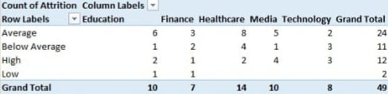
RESULTS
12

Slide 13
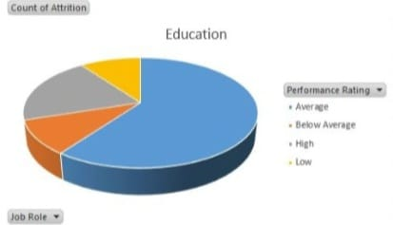

Slide 14
conclusion
Employee attrition, while challenging, presents opportunities for organizational growth and improvement. Understanding its causes and impacts is crucial for developing effective strategies to enhance retention, reduce costs, and maintain a stable and productive workforce. By addressing underlying issues and leveraging the benefits of turnover, organizations can improve their talent management practices, foster a positive work environment, and strengthen their competitive position in the market.

