Slide 1


InsurAI – Corporate Policy Automation & Intelligence System
SUBTITLE: AI-Driven Corporate Policy Management, Claims Automation & Employee Engagement
PS Category- Software
PREPARED BY:
DIVYASRI P.E

Slide 2
Abstract
InsurAI is an AI-driven web-based system designed to automate and manage corporate insurance policies.
It streamlines policy generation, claim processing, compliance checks, and analytics.
Built with a full stack web development approach (React, Node.js/Express, MongoDB, REST APIs).
Enhances operational efficiency, reduces manual errors, and improves transparency for corporate clients.
AI-powered modules for fraud detection, risk assessment, and predictive analytics.
Corporate dashboard with data visualization and role-based access control.
Streamlines policy creation, claim management, and compliance validation.
Reduces manual effort, increases accuracy, enhances transparency, and supports faster corporate decision-making.
By combining AI-driven automation, a robust full-stack architecture, and real-time analytics, InsurAI offers corporations a transparent, efficient, and employee-friendly insurance ecosystem that reduces fraud, ensures compliance, and provides data-driven insights for decision-making.

Slide 3

Introduction
In today’s corporate environment, managing employee insurance policies, claims, and compliance processes is complex and time-consuming.
Traditional systems rely heavily on manual workflows, leading to inefficiencies and data errors.
InsurAI introduces automation and artificial intelligence to transform the way organizations handle corporate insurance management.
The system ensures faster claims processing, AI-driven policy recommendations, and real-time insights for better decision-making.
It aims to enhance transparency, efficiency, and employee satisfaction across all organizational levels.

Slide 4

Proposed Solution
1. Centralized Portal – Unified platform for employees, admins, and policy managers.
2. AI-Driven Policy Recommendation – Tailored policy suggestions based on employee profiles.
3. Automated Claims Processing – Fraud detection & rule-based claim validation using AI.
4. Seamless Enrollment & Payments – Simple policy selection, approvals, and premium handling.
5. Analytics & Predictive Insights – Trends, fraud detection, and risk assessment dashboards.
6. 24/7 AI Chatbot – Multilingual support for FAQs, claims guidance, and quick help.

Slide 5
Existing System
Corporate insurance policies are managed through paper-based or spreadsheet systems.
Employees depend on HR or insurance agents for policy details and enrollment.
Policy management, approvals, and claims are processed manually.
Frequent delays and human errors in policy updates and claims verification.
Claims require physical document submission.
Verification and approval take days to weeks.
Employees are informed manually (via email or phone) about renewals or claims.
No real-time alerts or chatbot support.

Slide 6
Technical Approach
Tools & Technologies:
Frontend: React.js / Tailwind CSS – responsive, interactive UI.
Backend: Springboot (Maven)& business logic.
Database: MYSQL(MongoDB / PostgreSQL – secure data storage.)
AI/ML Layer: Python (scikit-learn / TensorFlow) – recommendation, fraud detection, analytics.
Authentication & Security: JWT, Bcrypt /Argon2, RBAC, HTTPS.
Payment Integration: Razorpay / Stripe.
Chatbot: Dialogflow / Rasa – NLP-based conversation handling.

Slide 7
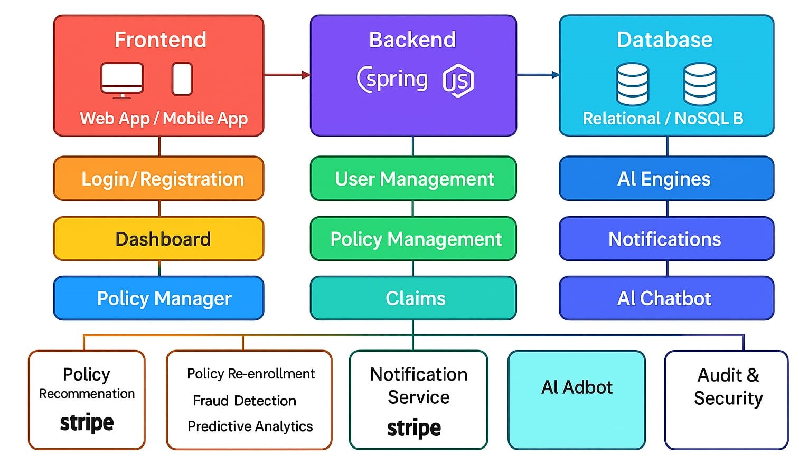
BLOCK DIAGRAM

Slide 8
Feasibility & Viability
1. Technical Feasibility: Uses proven frameworks, cloud-ready, scalable.
2. Economic Viability: Cost-effective via cloud and open-source tools.
3. Operational Feasibility: User-friendly UI, multilingual chatbot.
4. Legal & Compliance Feasibility: Data encryption, audit trails.
5. Schedule Feasibility: Modular rollout – User Mgmt → Policies → Claims → AI.

Slide 9
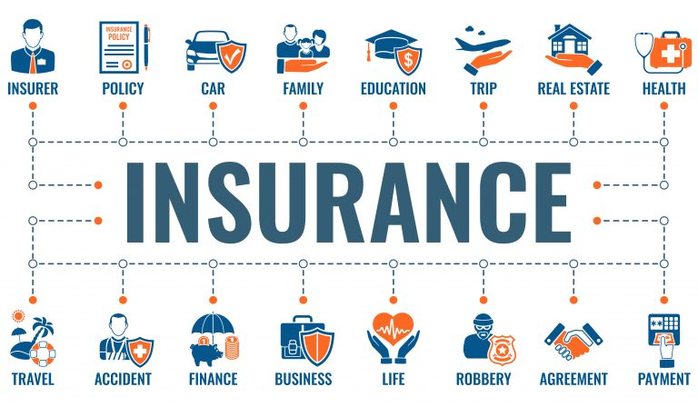
Impacts & Benefits
For Employees:
Easy policy enrollment & claim submission.
Personalized recommendations.
Transparent claim tracking.
24/7 chatbot support.
For Organizations:
Streamlined policy management.
Fraud detection & reduced errors.
Real-time analytics for planning.
Compliance and audit readiness.
For Insurers & Policy Managers:
Automated workflows & approvals.
Improved risk assessment using AI.
Better policy adoption insights.
Enhanced customer engagement.

Slide 10
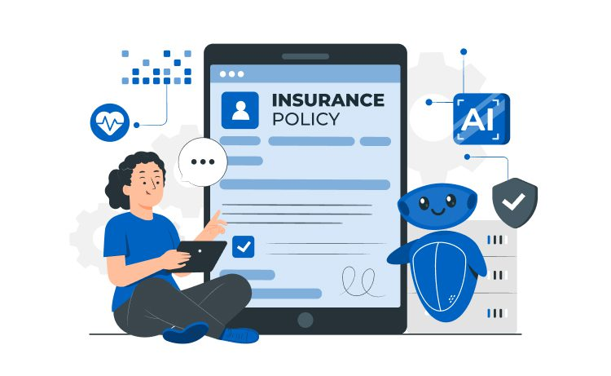
Research & References
1. Artificial Intelligence: A Guide for Thinking Humans – Melanie Mitchell
2. Machine Learning Yearning – Andrew Ng
3. Hands-On Machine Learning with Scikit-Learn, Keras & TensorFlow – Aurélien Géron
4. Insurance 4.0: Benefits and Challenges of AI in Insurance – Josias Humphrey
5. Data Science for Business – Foster Provost & Tom Fawcett
6. Applied Artificial Intelligence: A Handbook for Business Leaders – Mariya Yao, Adelyn Zhou, Marlene Jia

Slide 11
CONCLUSION
InsurAI provides a unified and intelligent platform for automating corporate insurance operations.
Combines AI, automation, and data analytics to ensure accuracy, security, and efficiency.
Enables HR teams, employees, and managers to manage policies, claims, and reports seamlessly.
Scalable architecture allows integration with enterprise systems and future technologies.
Future Enhancements: Blockchain for secure claims and multilingual AI chatbot for support.
Overall Impact: Simplifies processes, improves productivity, and ensures transparent policy management.

Slide 12
THANK YOU!!!!!

