Slide 1
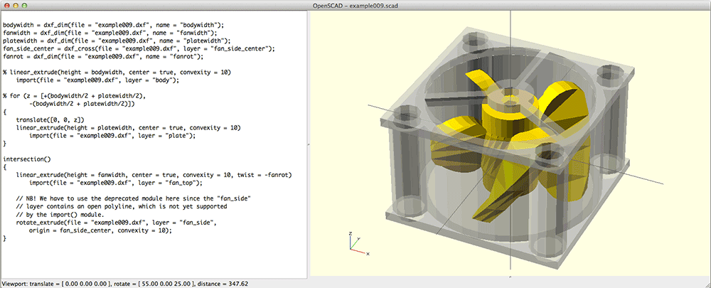
OpenScad

Slide 2
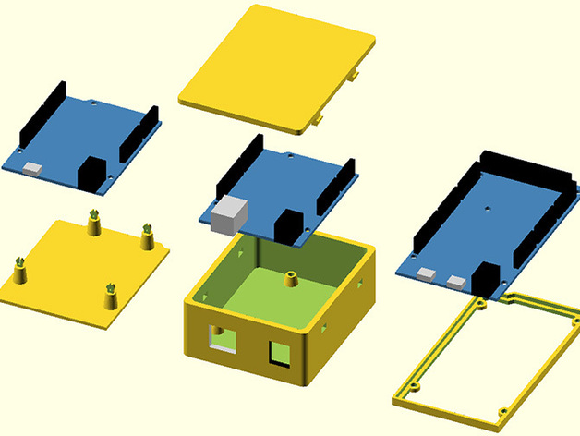
Why use it?
  Free!
  Large community: http://forum.openscad.org/
  Easier to get started than other softwares;

Slide 3
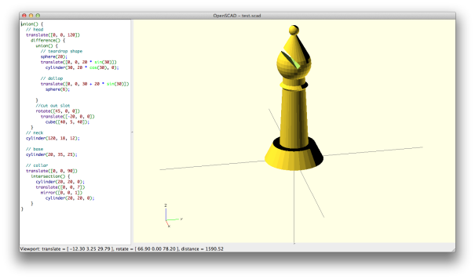
The Basics
CSG
Geometric Figures
  Cube
  Sphere
  Cylinder
Transformations
  Translating
  Scaling
  Rotating
  Mirroring
Constructive Solid Geometry
  Union
  Difference
  Intersection

Slide 4
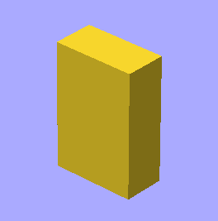
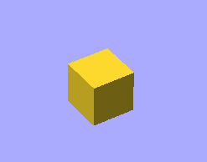
The Basics
Cube
  $ cube([x,y,z]);
  Cube([10,10,10]); cube([10,20,30], center = true);

Slide 5
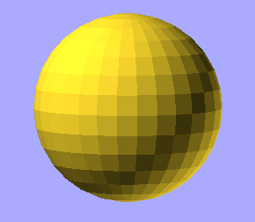
The Basics
Sphere
  $ sphere(r);
  sphere(r=20); // already centered

Slide 6
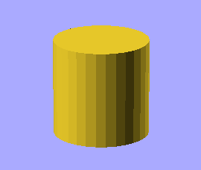
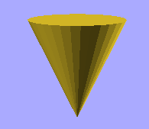
The Basics
Cylinder
  $ cylinder(h,r1,r2);
  Cylinder(h=20,r=10); Cylinder(h=20,r=10, r2=0, center = true);

Slide 7
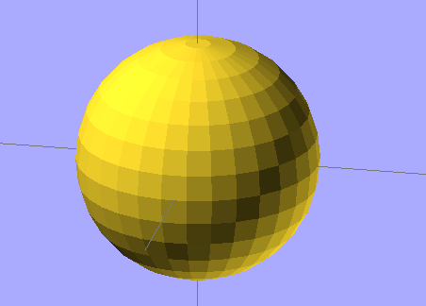
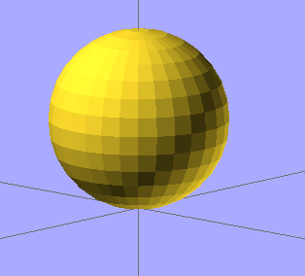
Transformations
Translation => Move to somewhere else;
Sphere(r=20); translate([0,0,20] Sphere(r=20);

Slide 8
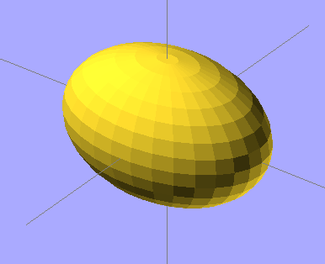
Transformation
Scaling=> multiply for some value;
Sphere(r=20); scale([1.5,1,1] Sphere(r=20);

Slide 9
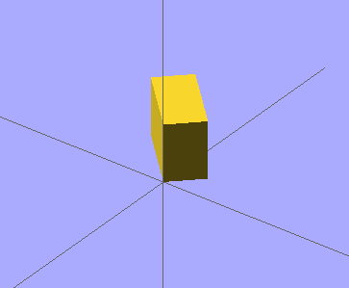
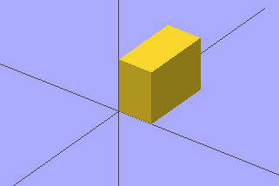
Transformation
Rotate=> change position in relation to an axis;
cube([10, 20, 15]); rotate([0,0,45] cube([10, 20, 15]);

Slide 10
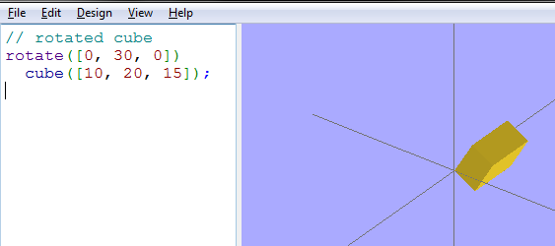
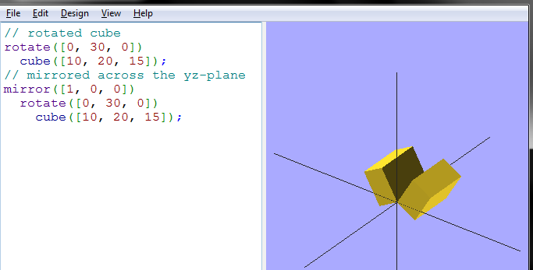
Transformation
Mirror=> reflect in relation to an axis;

Slide 11
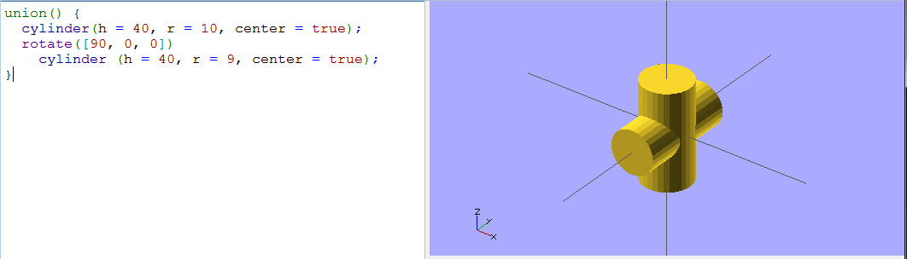
Constructive Solid Geometry Operations
Union

Slide 12
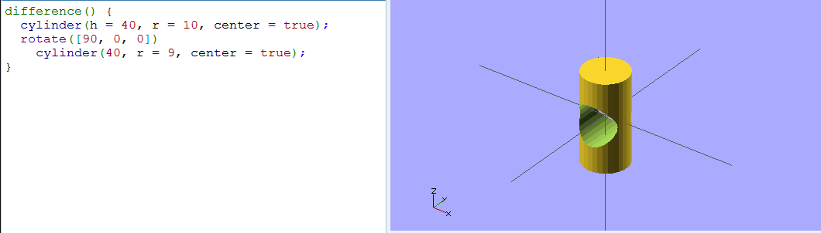
Constructive Solid Geometry Operations
Difference

Slide 13
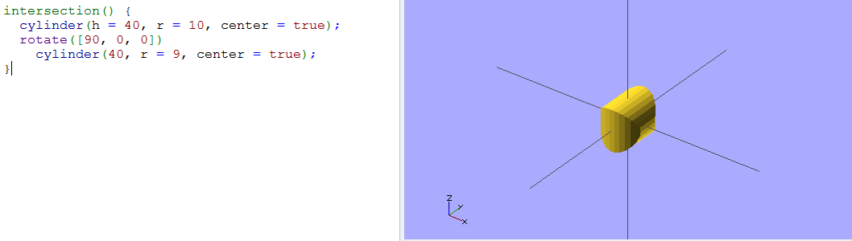
Constructive Solid Geometry Operations
Intersection => What will overlap?

Slide 14
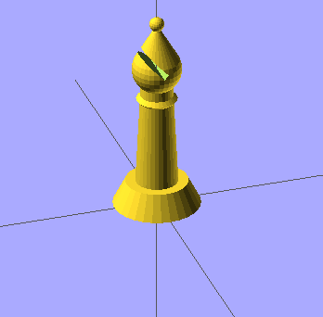
Got the basics?
Practice, practice, practice!
  And one example

Slide 15
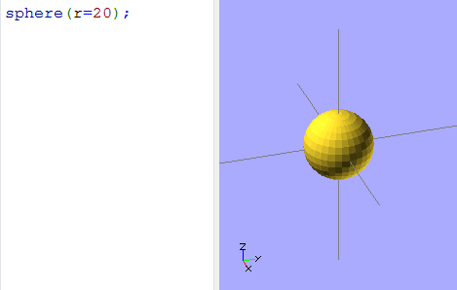
Bishop
Start with the “teardrop” shape;

Slide 16
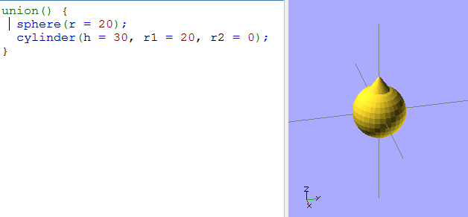
Bishop
Start with the “teardrop” shape;
Add a cone to the sphere;

Slide 17
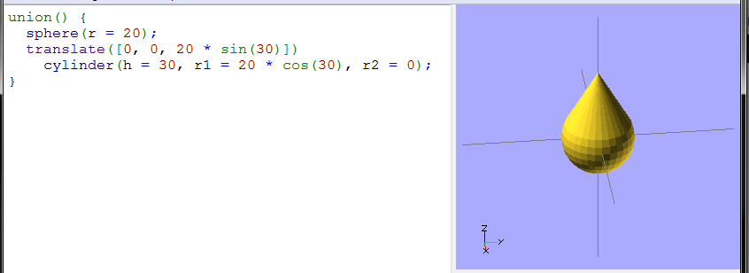
Bishop
Start with the “teardrop” shape;
Add a cone to the sphere;
Match the cone with the sphere

Slide 18
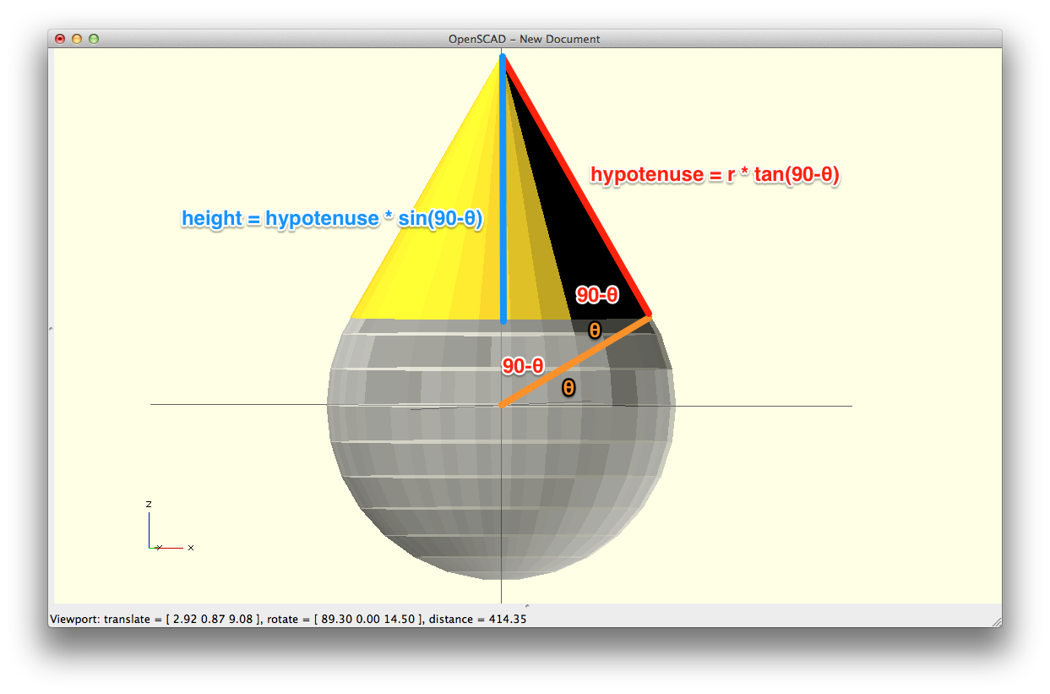
Why sin(30)???

Slide 19
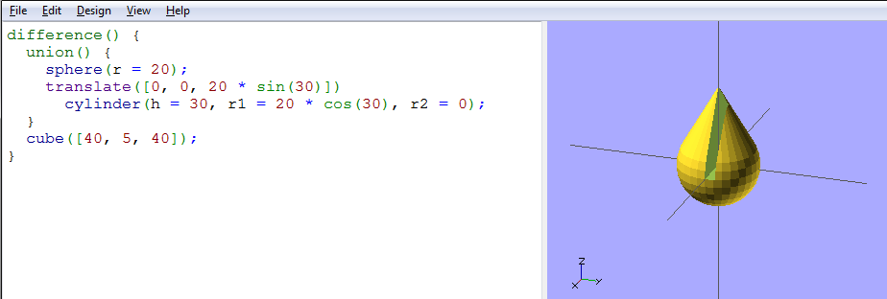
Bishop
Cut the piece (difference)

Slide 20
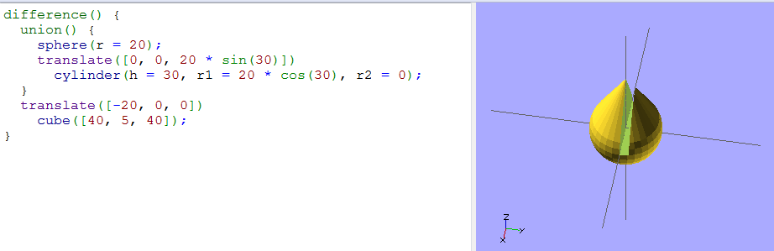
Bishop
Correct the cut position

Slide 21
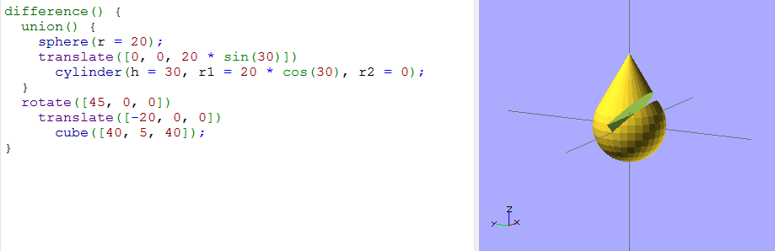
Bishop
Still missing the rotation!

Slide 22
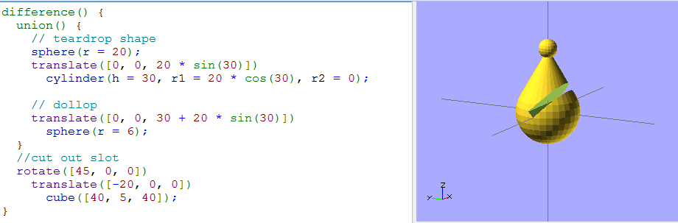
Bishop
Now, let’s add a dollop on top. Since we know the height of the cone is 30, and we moved it up 20 * sin(30), we’ll need to translate the dollop 30 + 20 * sin(30). We’ll also comment the parts so we don’t get confused.

Slide 23
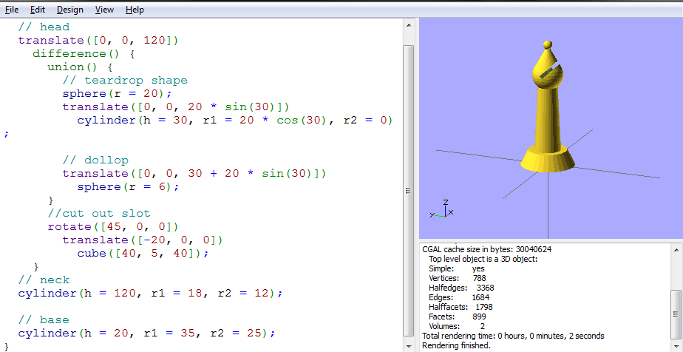
Bishop
Add the neck and the base!

Slide 24
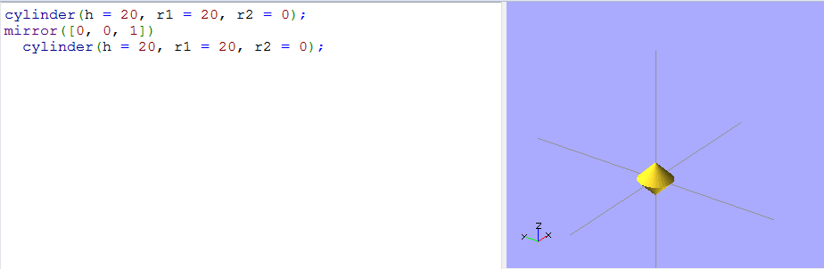
Bishop
Making a fancy collar

Slide 25
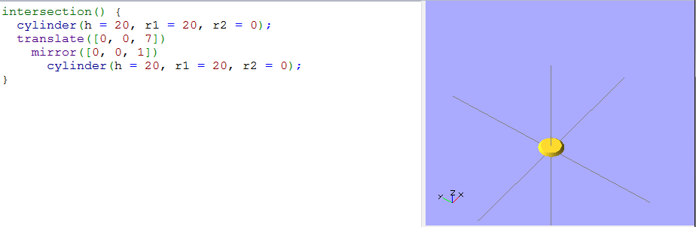
Bishop
Making a fancy collar

Slide 26
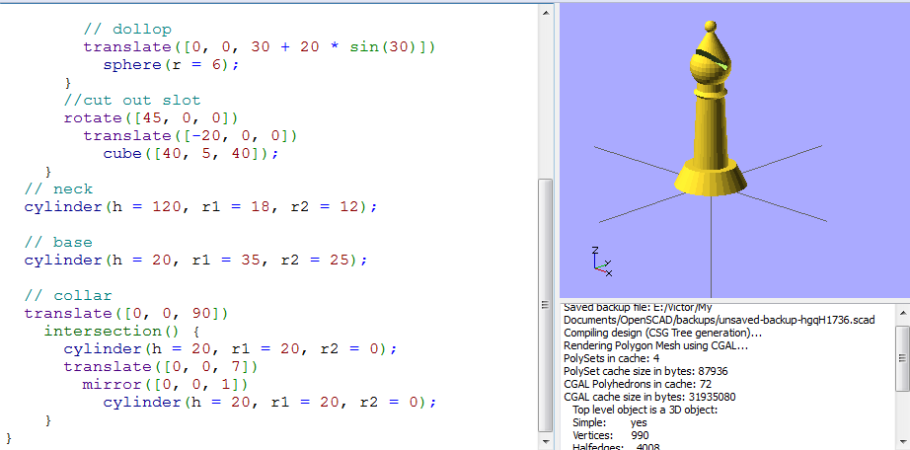
Bishop
Everything together!

