Slide 1
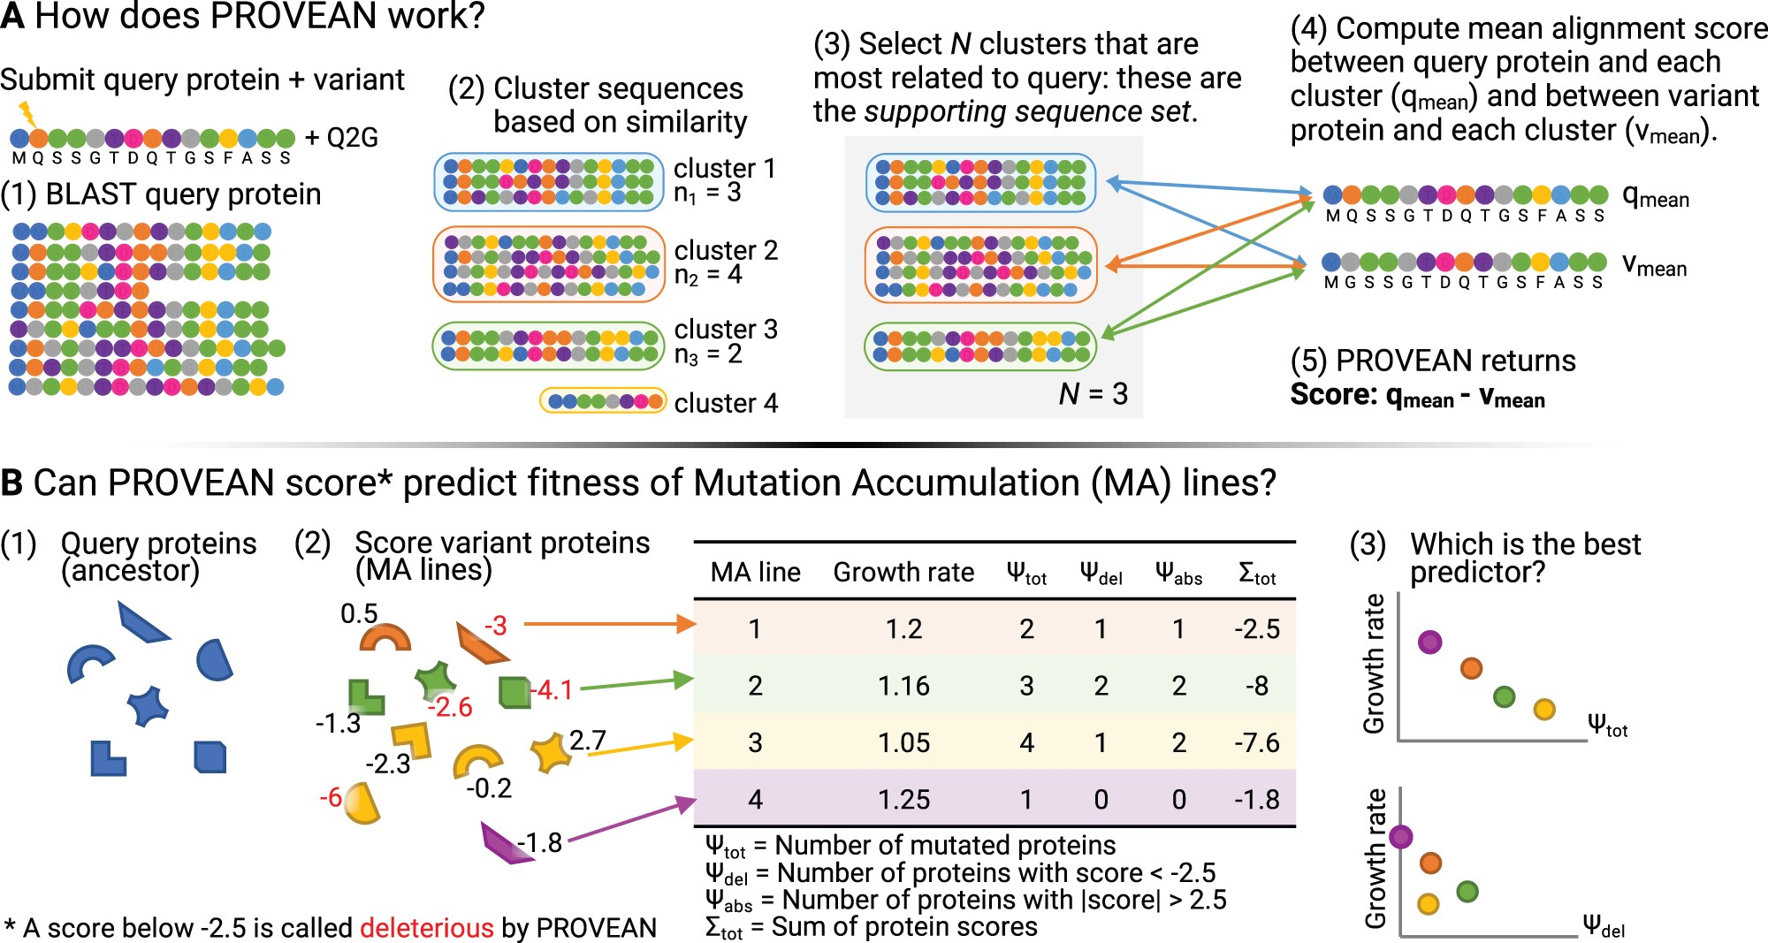

Fig. 1. Conceptual figure of project. (A) Outline of PROVEAN process, inspired by figure 10 in Choi et al. (2012). ...
Notes:
Fig. 1. Conceptual figure of project. (A) Outline of PROVEAN process, inspired by figure 10 in Choi et al. (2012). (B) The shapes in the bottom left represent different proteins within the ancestor. Each MA line (represented by color) has some number of protein(s) mutated compared with the ancestor. The same protein can have different mutations in different MA lines, causing the score given by PROVEAN to differ (the variant of the rainbow protein carried by the orange MA line is given a score 0.5, whereas the variant of the rainbow protein carried by the yellow line receives a score of −0.2). All proteins with variants between the MA ancestor and MA lines were submitted to PROVEAN. Each MA line had the number and PROVEAN scores of their mutant proteins summarized (table). Finally, we looked for correlations between the fitness of MA lines and their number of mutant proteins (top graph in 3) or the number of mutant proteins scored as deleterious by PROVEAN (bottom graph in 3).
Unless provided in the caption above, the following copyright applies to the content of this slide: © The Author(s) 2022. Published by Oxford University Press on behalf of the Society for Molecular Biology and Evolution.This is an Open Access article distributed under the terms of the Creative Commons Attribution License (https://creativecommons.org/licenses/by/4.0/), which permits unrestricted reuse, distribution, and reproduction in any medium, provided the original work is properly cited.

