Slide 1
ARM Processor
CSN-221

Slide 2
Problem statement
The basic idea of this project was to implement a CPU that includes ALU , register files, control circuitry, instructions flow etc. on Logisim simulator. Rigorous benchmark evaluation on different instructions has to be performed while working on this project.

Slide 3
Our Solution
We designed a CPU using the ARM instruction set. Different components of the CPU such as ALU (Arithmetic and Logic unit), control unit, instruction memory, data memory were designed in the Logisim simulator. Also, benchmark evaluations were done regularly in the Logisim simulator itself by testing the processor on some custom instructions.
The following report describes the various Architectural implementations and the flow of instructions and data with all the diagrams being made by us as Drawings or Screenshots of our implementation to help describe the same.

Slide 4
The Novelty of Work Done

Slide 5
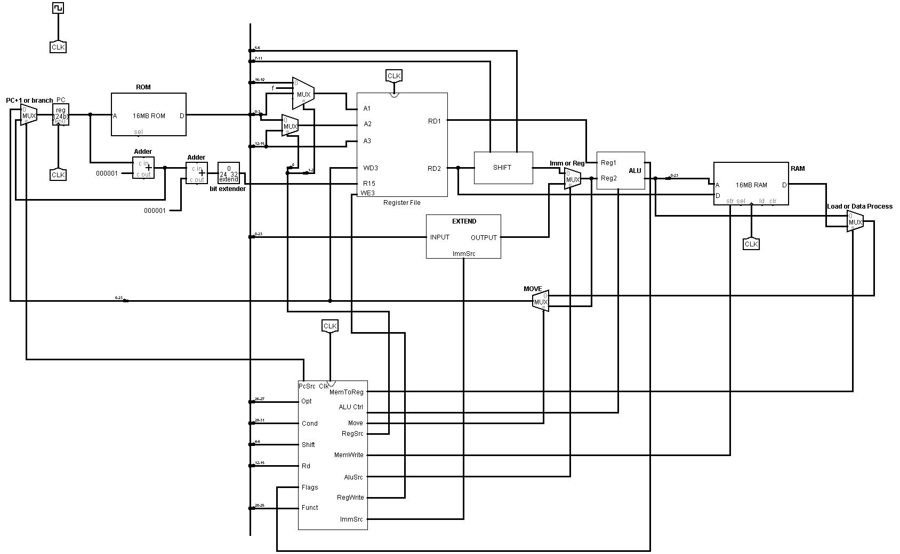
Main Circuit

Slide 6
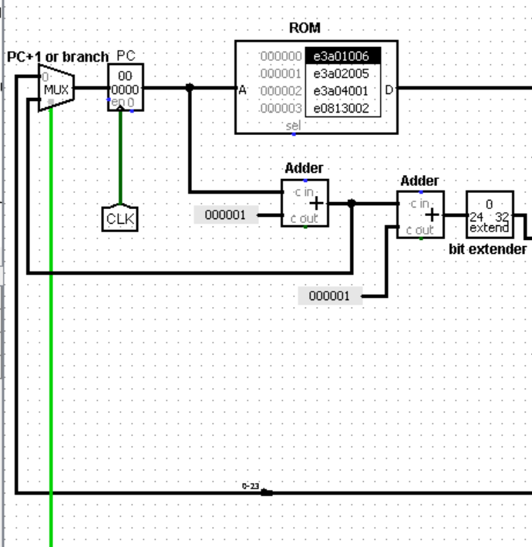
Program Counter And Instruction Memory (ROM)
Controls flow of program
Uses a multiplexer to decide the next instruction
The ROM holds the instructions used for benchmark evaluations.

Slide 7
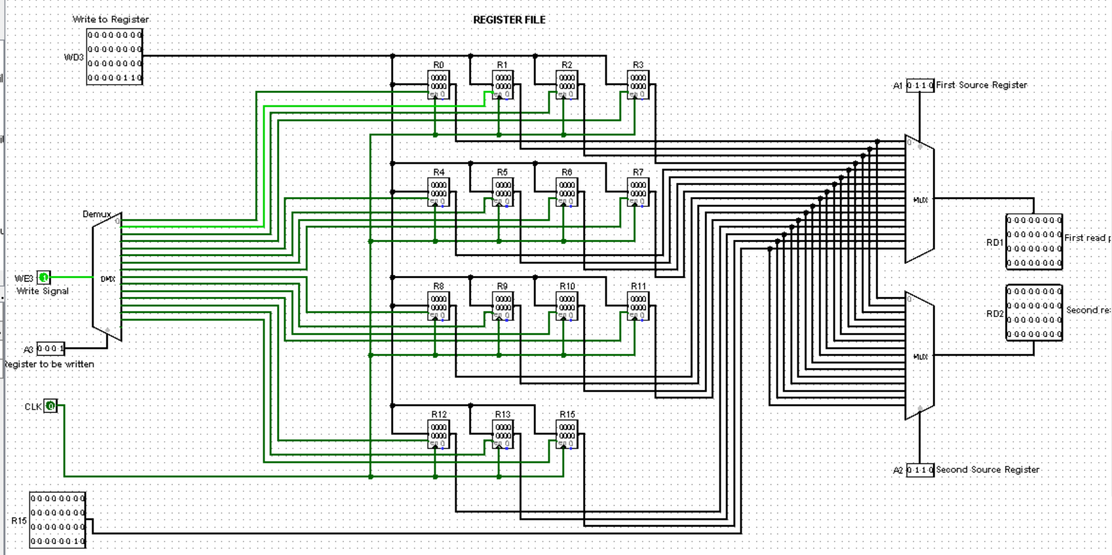
Register File
Consist of several ports used for accessing the registers.
WD3 brings the data to be written in the register files.

Slide 8
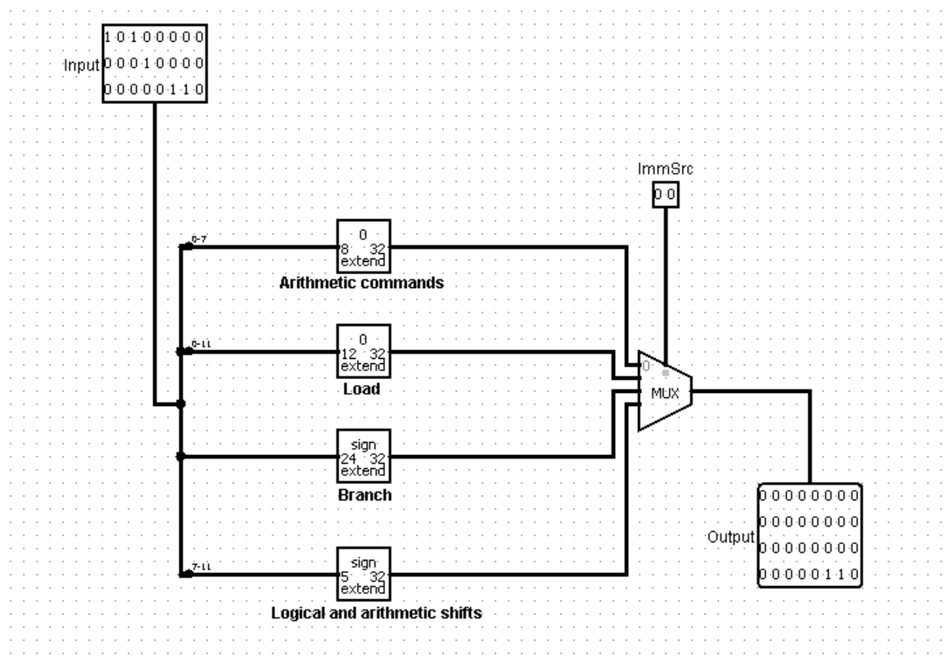
Extender
Extends the immediate according to the ImmSrc signal

Slide 9
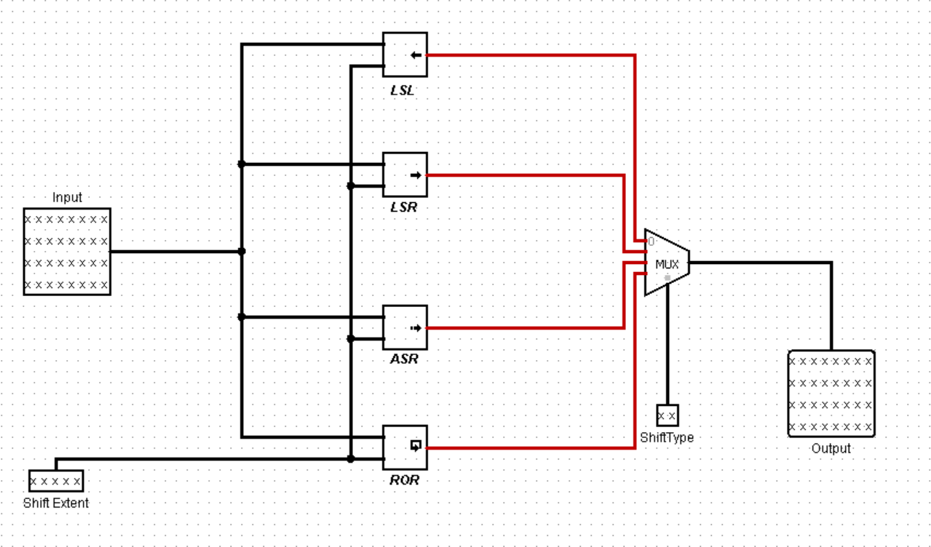
Shifter
If the second source might have some shift associated with it, thus we pass the value through a shifter

Slide 10
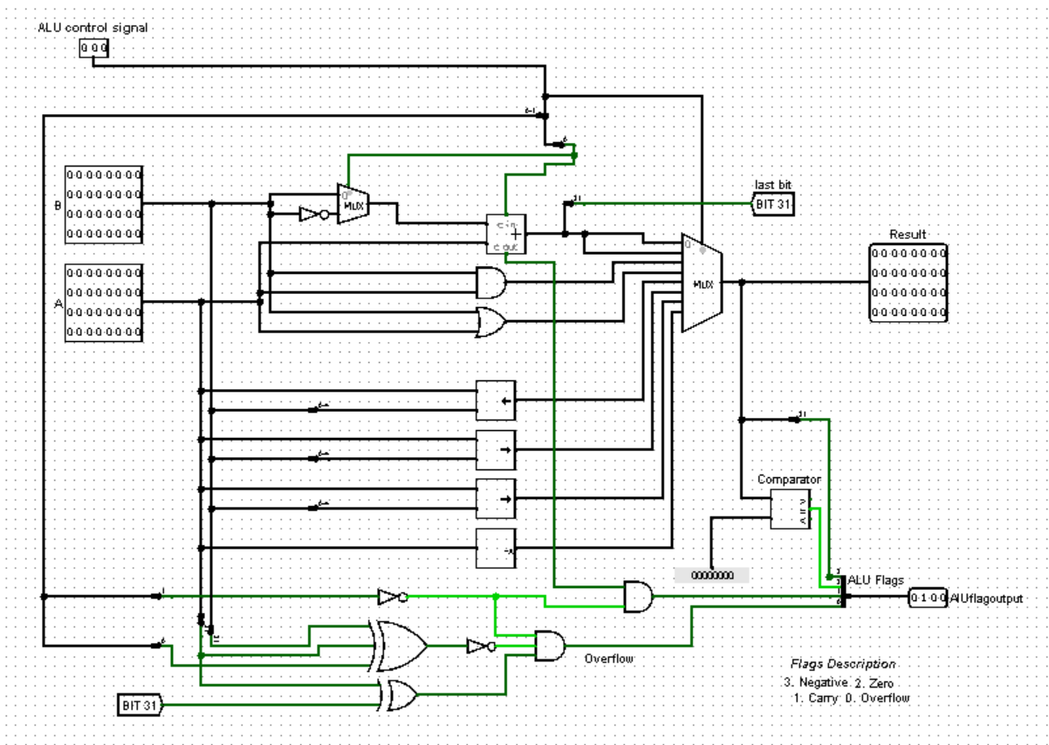
ALU

Slide 11
Instruction Encoding
General Format
Cond | Type
32 29 | 28 27
Data Processing Instruction
Cond | 00 | I | opcode | S | rs | rd | Shifter operand/ immediate
32 29 | 28 27 | 26 | 25 22 | 21 | 20 17 | 16 13 | 12 0

Slide 12
Instruction Encoding
Encoding shifter operand
Shift immediate | type | 0 | rt
12 8 | 7 6 | 5 | 4 1
Shift immediate |  | type | 1 | rt
12 9 |  | 7 6 | 5 | 4 1

Slide 13
Instruction Encoding
Load And Store Instruction
cond | 01 | I | P | U | B | W | L | rs | rd | Shifter operand /immediate
32 29 | 28 27 | 26 | 25 | 24 | 23 | 22 | 21 | 20 17 | 16 13 | 12 0
Branch Instruction
cond | 101 | L | offset
32 29 | 28 26 | 25 | 24 0

Slide 14
Control Unit

Slide 15
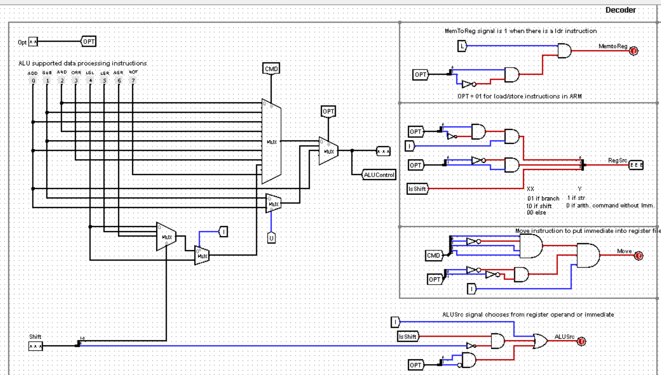
Decoder

Slide 16
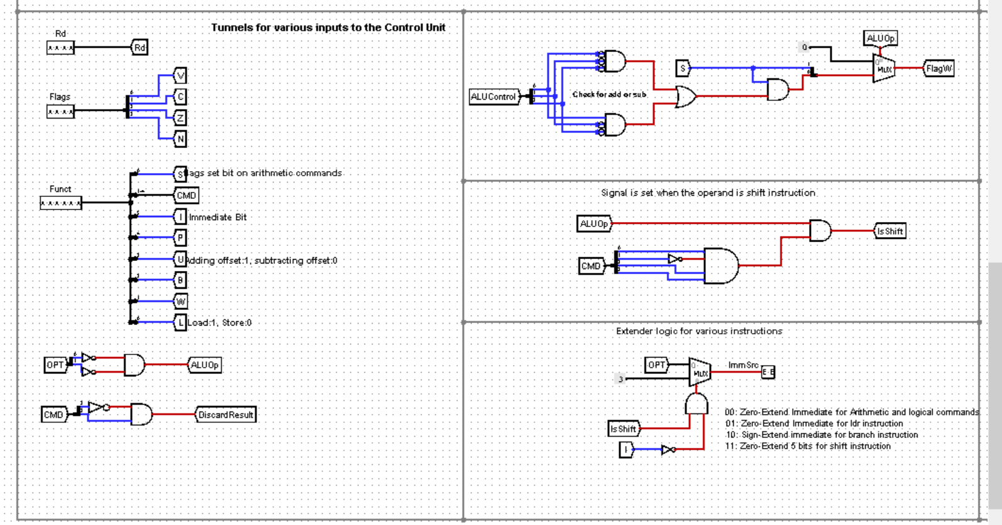
Decoder

Slide 17
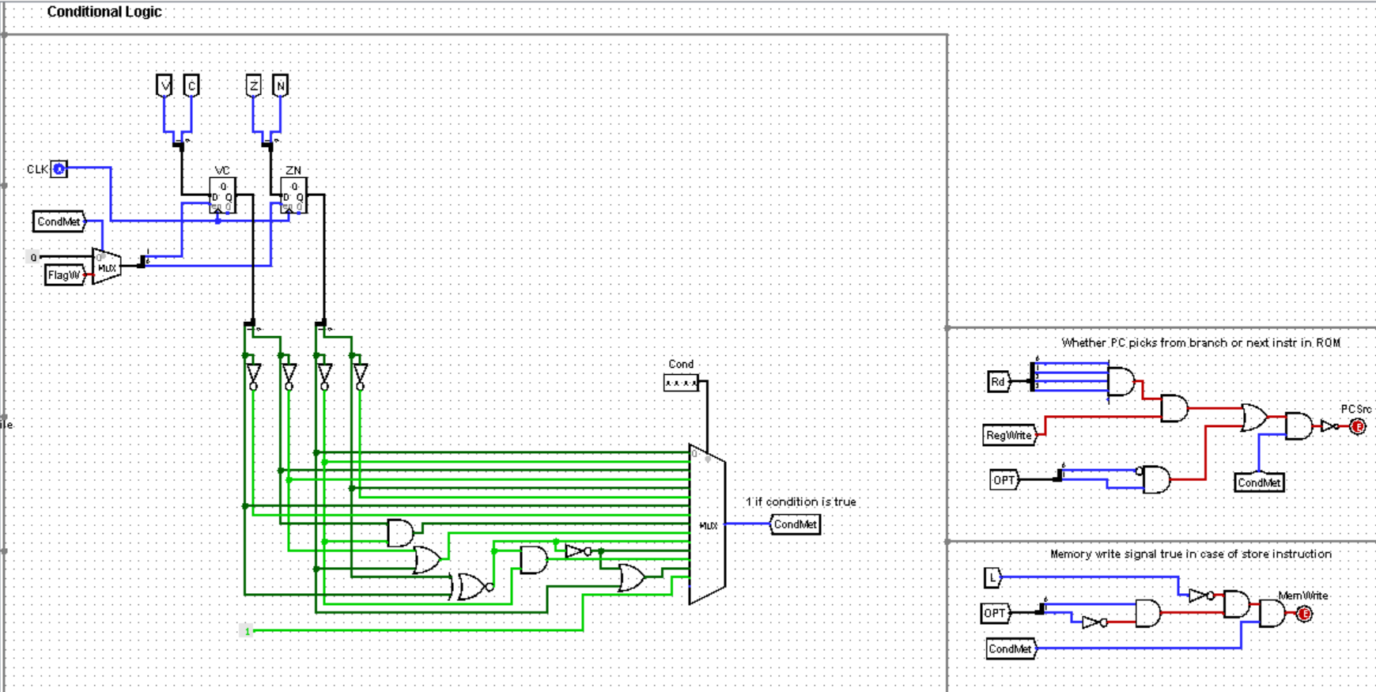
Conditional Logic

Slide 18
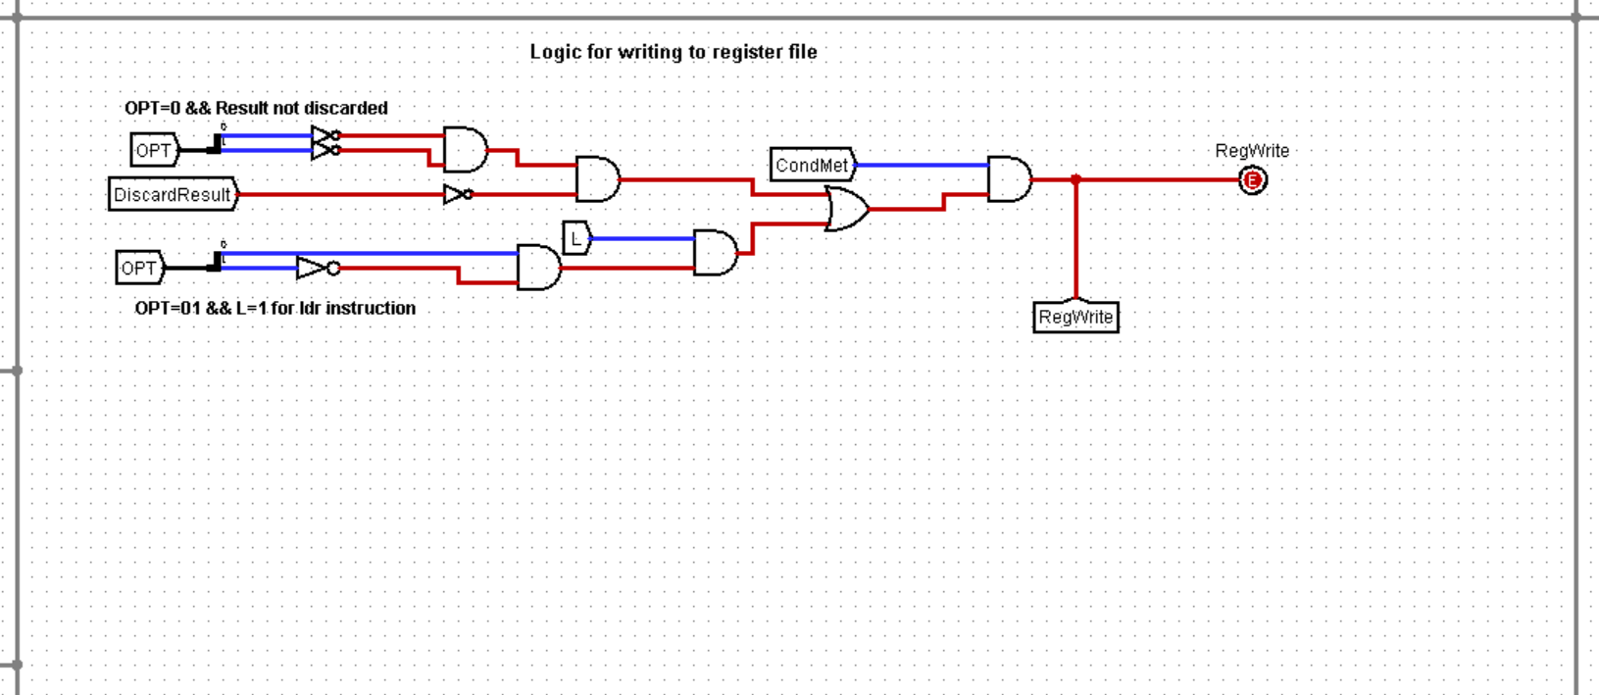
Conditional Logic

Slide 19
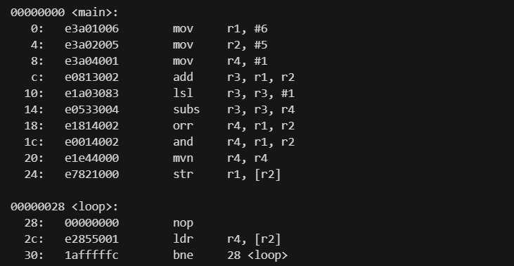
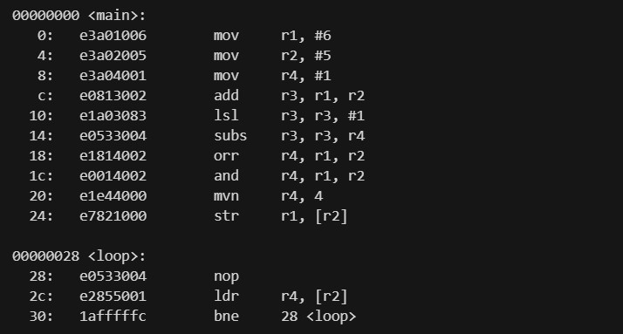
Tests For Data Transfer Instructions

Slide 20
Tests For Load Store And Branch Instructions

Slide 21
Conclusion
Thus, we have designed an ARM processor with all the essential features and working. Our processor is capable of executing the following instructions in 24-bit format with 32-bit data:
Branch Instructions
LOAD & STORE Instructions
ALU Instructions:-
AND
OR
SUB
NOT
AND
LSR
ASR
LSL

Slide 22
thanks!

