Slide 1

Single Precision Floating Point ALU in Verilog
Divyank Beniwal • Sagnik Majumdar Pereira Smith • Aaryan Garg

Slide 2
Introduction
1
Let’s introduce you to our project.

Slide 3

IEEE-754 Format:
The IEEE-754 Single Precision Floating point format is used to represent a large range of numbers with limited computational or storage resources.
The numbers are stored in 32 bits, where the first bit denotes the sign, the next 8 denote the exponent, and the rest of them denote the mantissa.

Slide 4
ALU
An Arithmetic-Logic Unit (ALU) is a combinational digital electronic circuit and represents the fundamental building block of the Central Processing Unit (CPU) of a computer.
An ALU performs Addition, Subtraction, Multiplication, Division and Bitwise logical operations such as AND, OR, NOT on numbers in the IEEE-754 format.

Slide 5
Conversion of Decimal to Floating Point
Decimal to Binary
Mantissa and Exponent
Placing Signed Bit
Convert Decimal to Binary form.
Shift radix point until there remains only one bit to the left.
Number after the radix is mantissa.
If radix is shifted X times then exponent value is 127+X (in binary)
Place a signed bit (0 for +ve, 1 for -ve)
Then exponent value followed by mantissa.

Slide 6
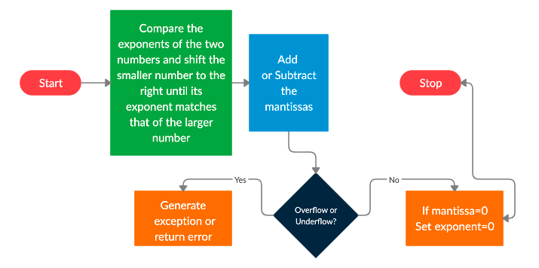
Addition/Subtraction operations:

Slide 7
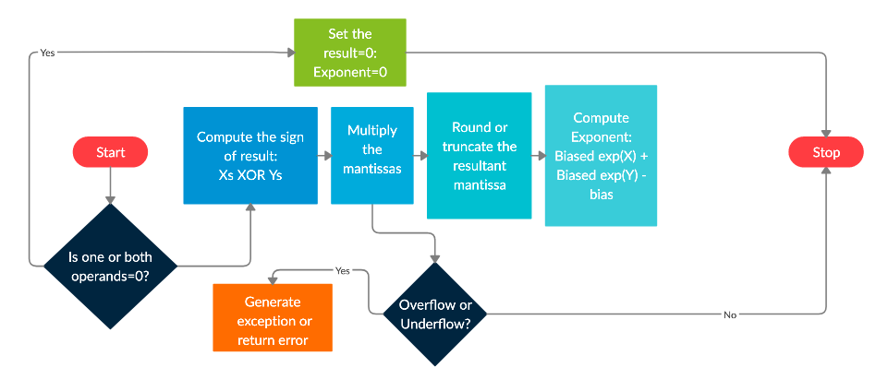
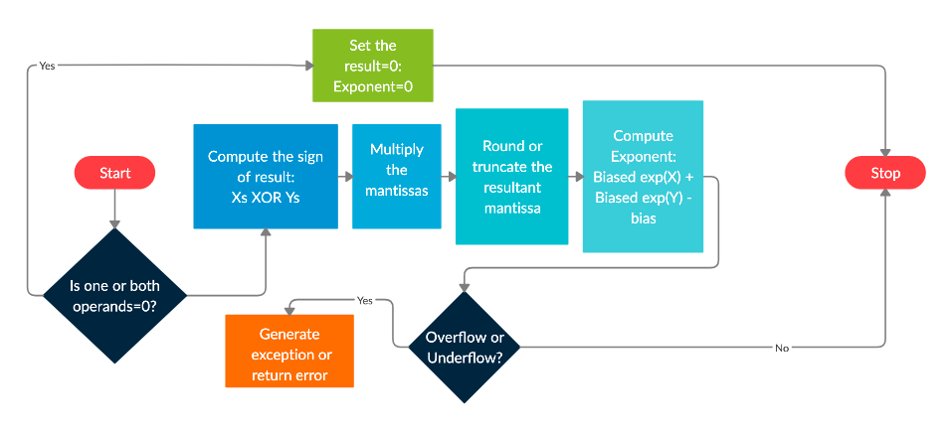
Multiplication operations:

Slide 8
Major Challenges Faced
Challenges during learning Verilog due to limited Internet facilities and frequent power-cuts.
Novice errors in writing the Verilog code due to a lot of Compile-time errors and writing the wrong code.
Underflow and Overflow troubled our multiplier and divider module quite a lot throughout testing. It was significantly reduced though.

Slide 9
Architecture
2
Let’s discuss the architecture of our modules.

Slide 10
Adder-Subtractor Module:
We have implemented the FP32 rules of addition and subtraction in this module.
We then checked the result for Underflow and Overflow.
This module had an accuracy of 99.75% on the test bench.

Slide 11
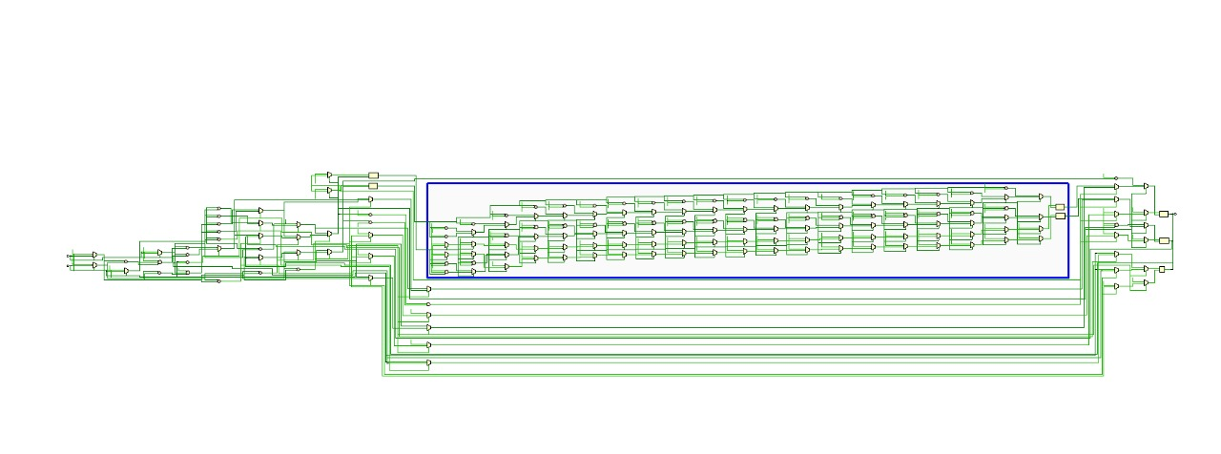
This is the Block diagram of the complete Adder-Subtractor Module

Slide 12
Addition-Normalizer Module:
We normalized the resulting mantissa by detecting the leading one by locally one-dimensional method in this module.
We adjusted the resulting exponent accordingly. Then, we gave the result in IEEE-754 format.
We then checked the result for Underflow and Overflow.
This module had an accuracy of 99.75% on the test bench.

Slide 13
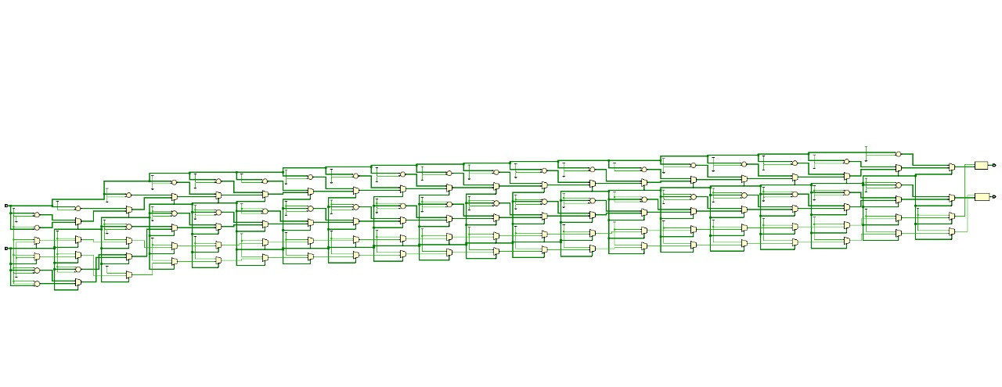
This is the Block diagram of the complete Addition-Normalizer Module

Slide 14
Multiplier Module:
Multiplies the mantissas of A and B.
The speed of the operation is determined by the 24*24 bit multiplier which is used to calculate the resulting 48 bit mantissa.
Since, this is the most intensive operation, it is the slowest hence, the rate determining step.

Slide 15
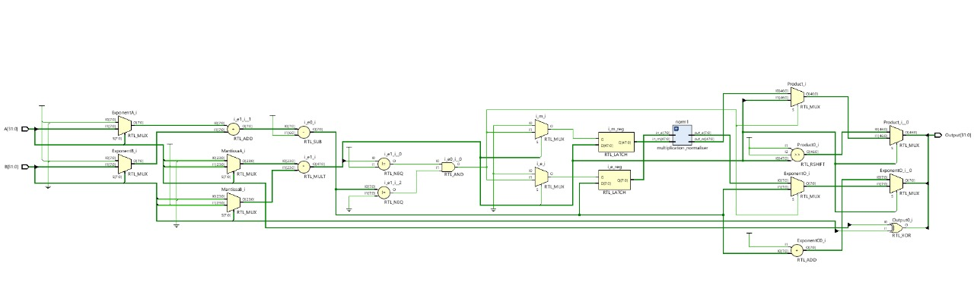
This is the Block diagram of the complete Multiplier Module

Slide 16
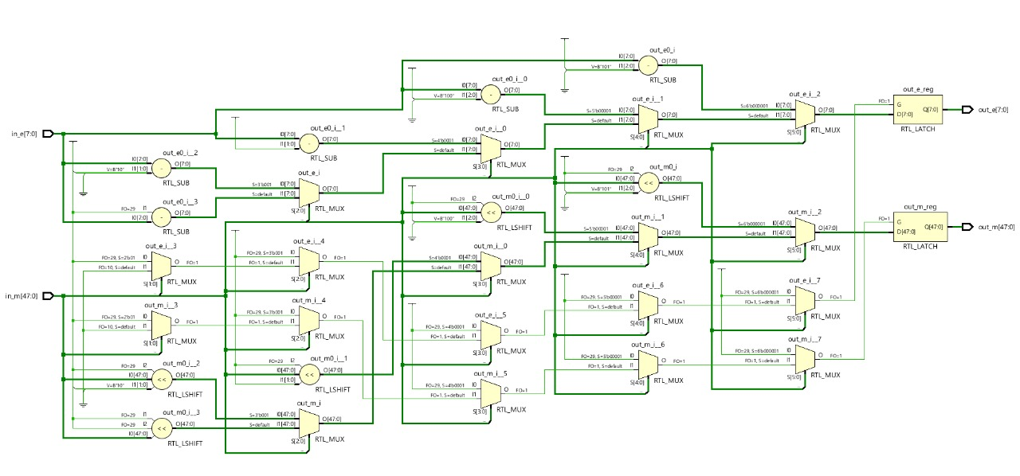
This is the Block diagram of the complete Multiplication-Normalizer Module

Slide 17
Divider Module:
We first shift the dividend by 1 towards the left. Then, we subtract the divisor.
We then place the carry as the Least Significant Bit of the intermediate answer. We do this procedure 24 times.

Slide 18
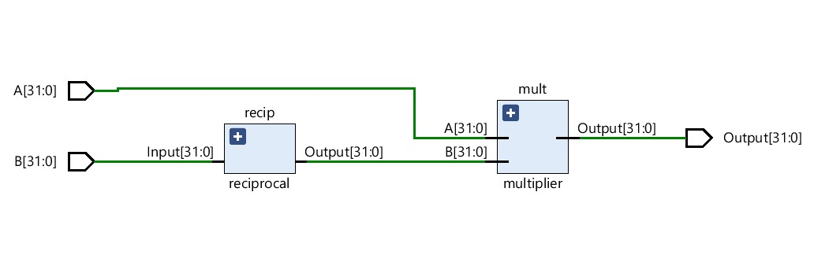
This is the Block diagram of the complete Divider Module

Slide 19
Reciprocal Module:
This module was used to calculate the reciprocal of B.
Together with the Multiplier Module, this gives the Divider Module.
Its result had to be checked and handled for Underflow and Overflow.

Slide 20
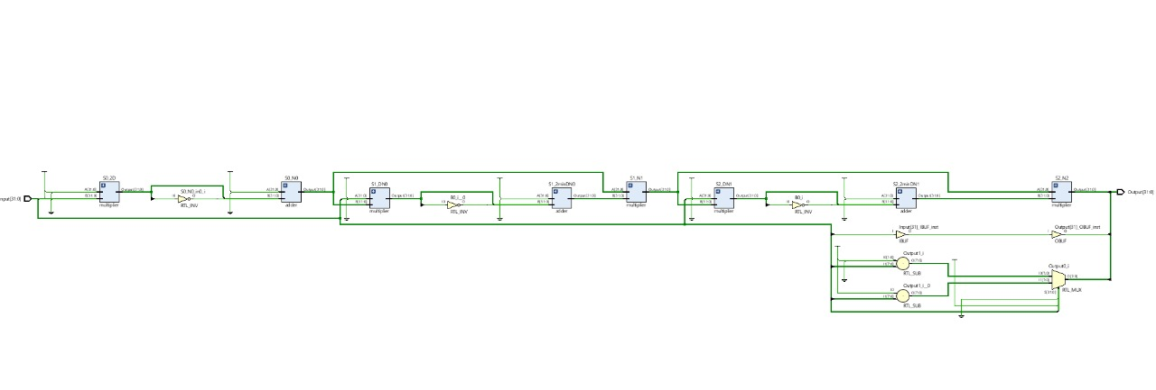
This is the Block diagram of the complete Reciprocal Module

Slide 21
ALU as a whole

Slide 22
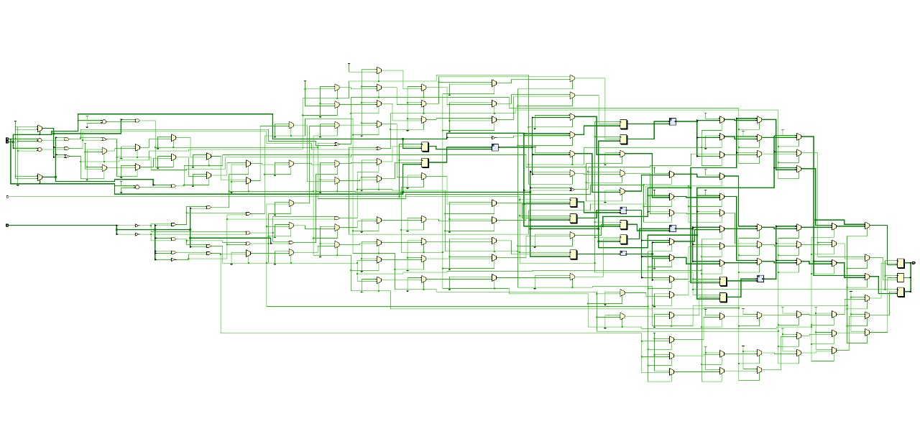
This is the Block diagram of the complete ALU

Slide 23
Simulation Results
3
Let’s discuss the Simulation Results of our testbenches.

Slide 24
Accuracy
We ran around 1000 tests each for each operation’s testbenches.
Except Multiply, Divide, we received very high accuracies for all of our operations.
The problem of Overflow and Underflow plagued the Multiply and Divide operations.

Slide 25
Operation Name (Code) | Total no. of tests failed | Total no. of tests passed | Total no. of tests failed | Accuracy (in %)
Addition (000) | 1000 | 998 | 2 | 99.8%
Subtraction (001) | 1000 | 997 | 3 | 99.7%
Multiplication (011) | 1000 | 752 | 248 | 75.2%
Division (010) | 1000 | 766 | 234 | 76.6%
Bitwise-AND (100) | 1000 | 1000 | 0 | 100%
Bitwise-OR (101) | 1000 | 1000 | 0 | 100%
Bitwise-NOT (110) | 1000 | 1000 | 0 | 100%
The Accuracy results for all of the testbenches

Slide 26
Waveforms
We ran the simulations on Vivado with a clock of time period 1ns.
We got the Waveforms for all of our test benches.

Slide 27
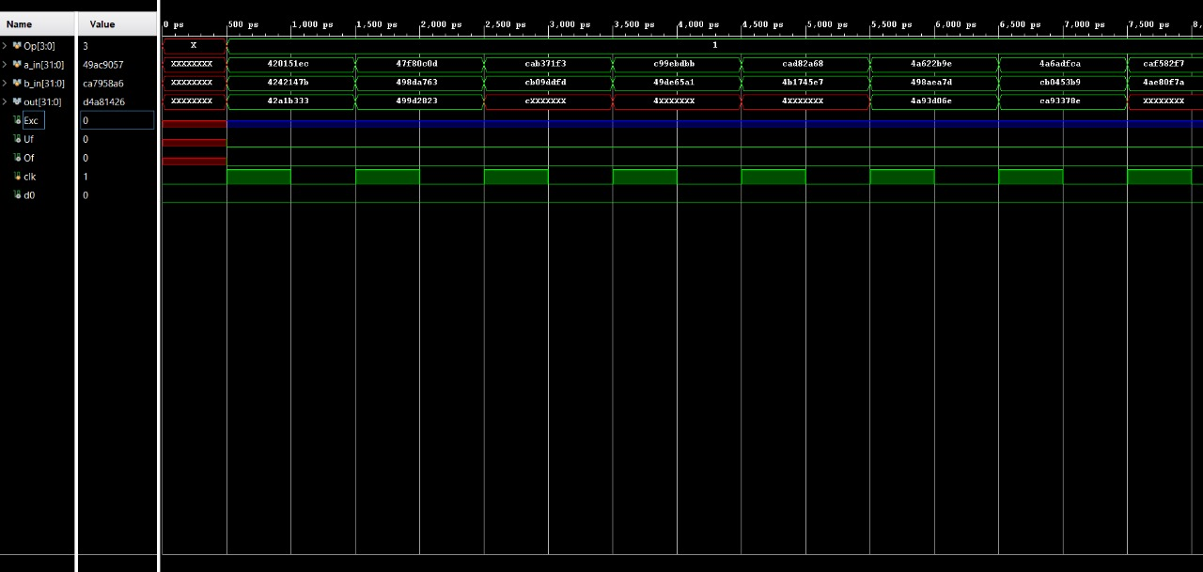
Addition Waveform:

Slide 28
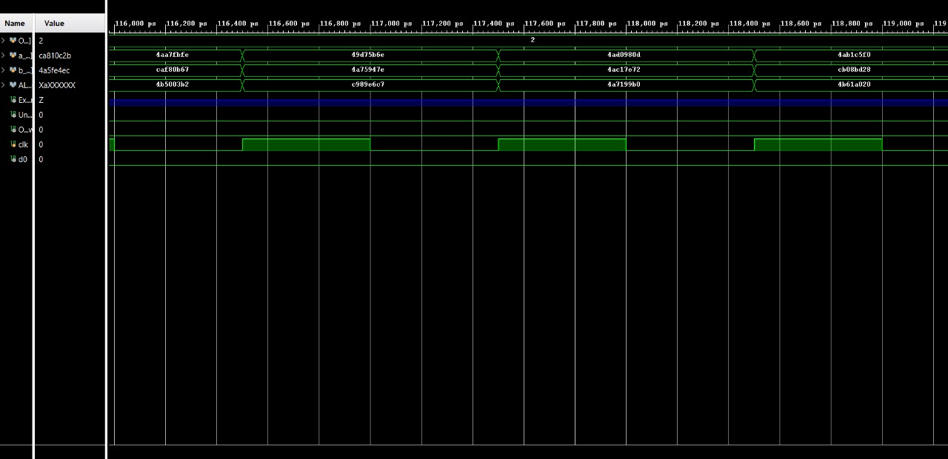
Subtraction Waveform:

Slide 29
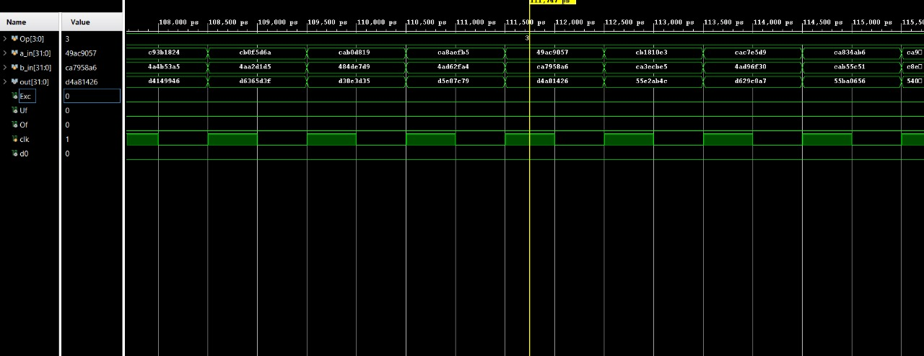
Multiplication Waveform:

Slide 30
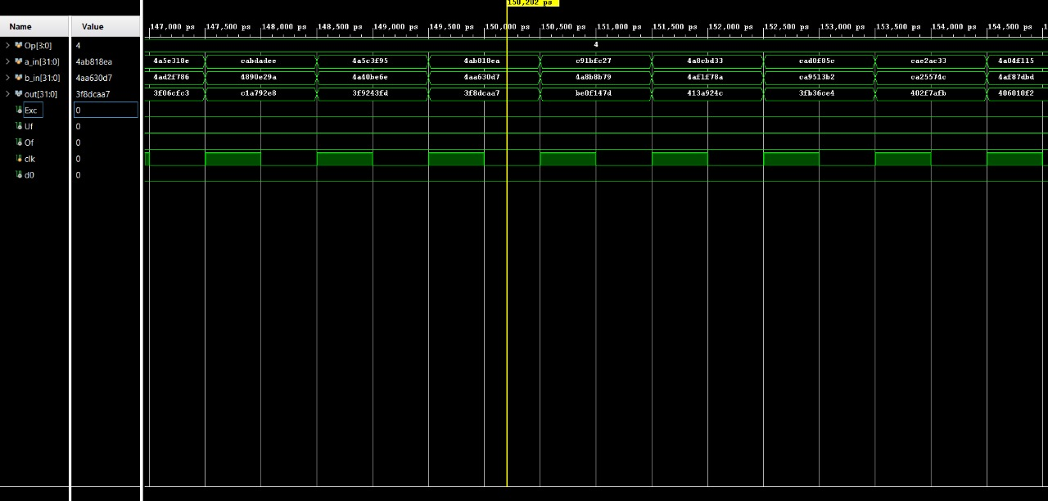
Division Waveform:

Slide 31
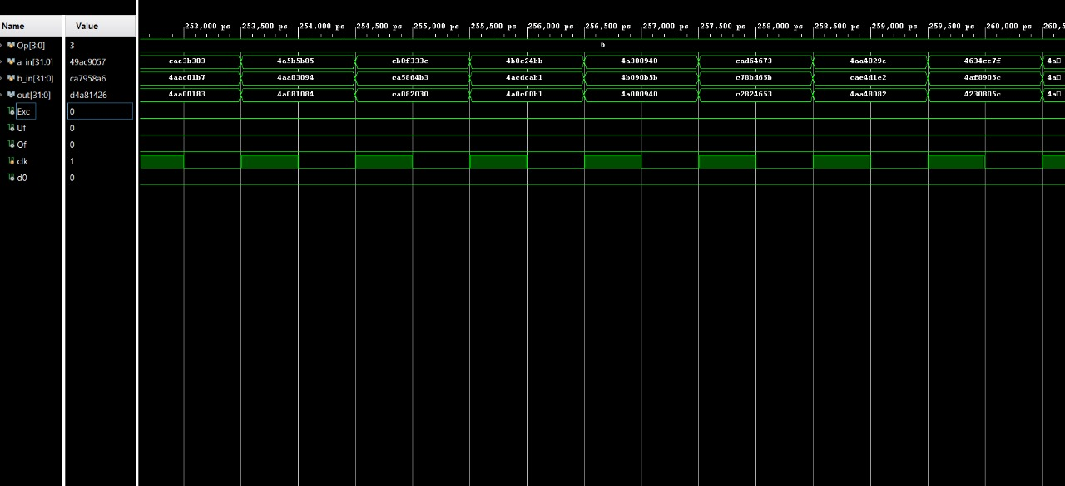
Bitwise AND Waveform:

Slide 32
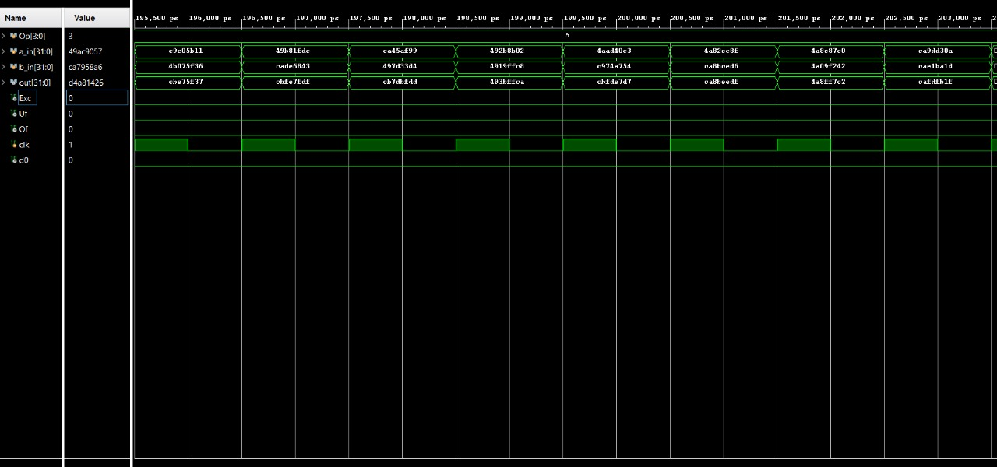
Bitwise OR Waveform:

Slide 33
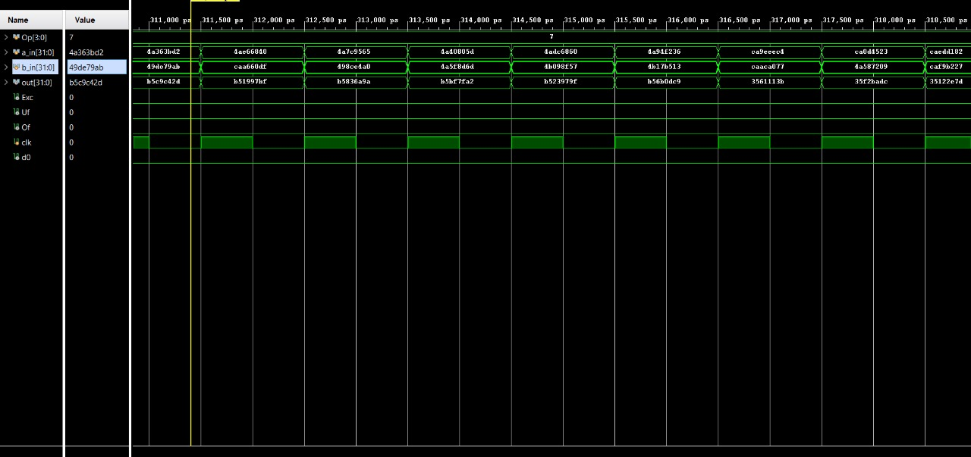
Bitwise NOT Waveform:

Slide 34
Summary
The Floating-Point Single-Precision ALU has been discussed extensively in depth.
A suitable algorithm has been developed to successfully carry out various arithmetic and logic operations.
The algorithm has been implemented in a pipelined way so as to minimize delay and maximize computational efficiency.

Slide 35
Project Team Members
4

Slide 36

Aaryan Garg
1
19116001

Slide 37

Sagnik Majumdar
2
19116063

Slide 38

Pereira Smith
3
19116047

Slide 39

Divyank Beniwal
4
19116022

