Slide 1
BoldMove
Team DJDB:
Dan Ulie, Julie Ly, Dev Shrestha & Brent Woodward

Slide 2
Team D.J.D.B.
Dan Ulie
Julie Ly
Dev Shrestha
Brent Woodward

Slide 3
Problem Scope, Domain & Solution

Slide 4
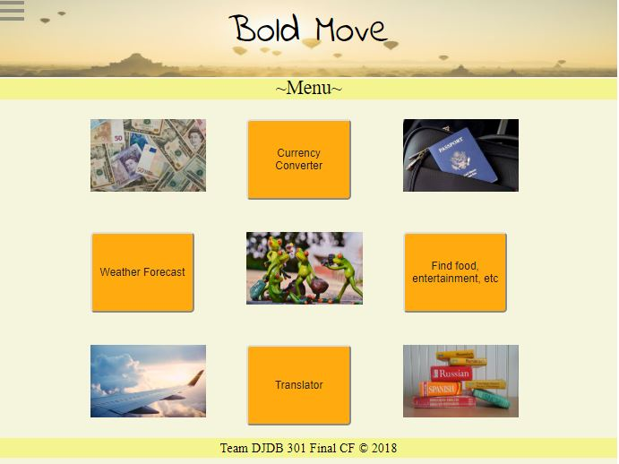
Demo

Slide 5
Technical Challenge
Persistence
Async

Slide 6
Technical Challenge
Chaining API’s
EJS

Slide 7
OPTIONAL SLIDE Project Successes
Chaining API’s

Slide 8
OPTIONAL SLIDE BoldMove Expansion
Convert both direction for currency and translation

Slide 9
Questions?

