Slide 1
BoldMove
Team DJDB

Slide 2
Team D.J.D.B.
Brent Woodward
Dan Ulie
Julie Ly
Dev Shrestha

Slide 3
Problem Scope, Domain & Solution

Slide 4
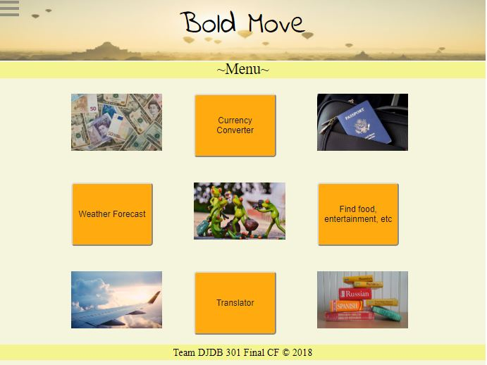
Demo

Slide 5
Technical Challenge
Chaining API’s
EJS

Slide 6
Technical Challenge
Persistence
Async

Slide 7
BoldMove Expansion
Convert both directions for currency and translation
For translation: add phonetic
Sentimental evaluation utilizing word cloud
For “nearby” (aka Yelp) add filters/sorts for categories
Various user interface improvements

Slide 8
Questions?

