Slide 1
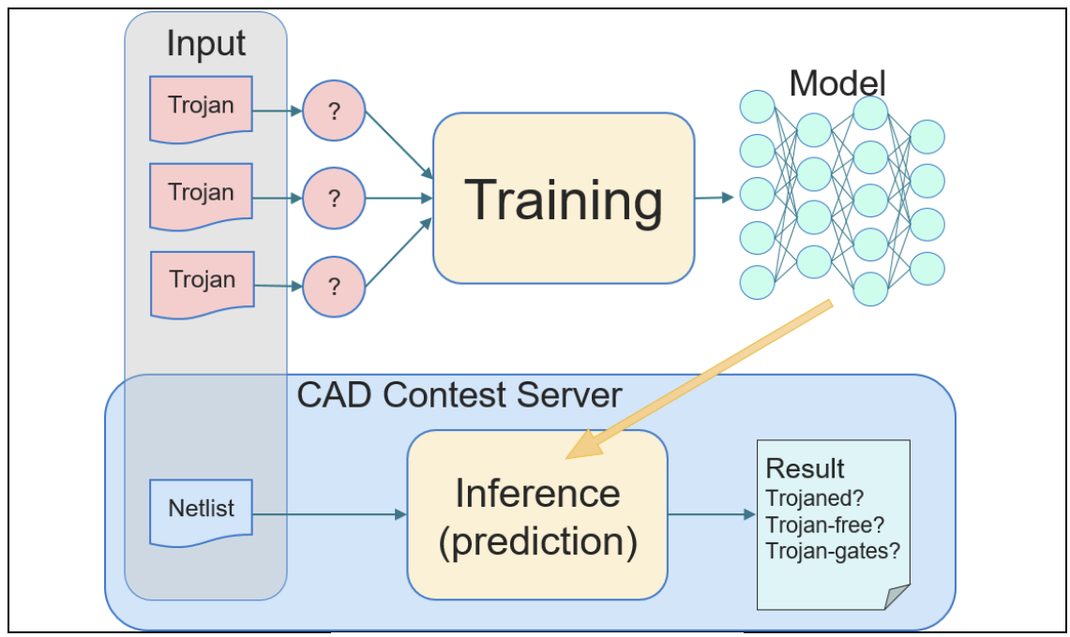
ICCAD 2025 CAD Contest Problem A: Hardware Trojan Detection on Gate Level Netlists
組員：熊恩伶、李彥呈、楊力衡、黃梓齊、陳啟綸、謝采晏
Abstract
Traditionally, hardware security has been addressed through functional verification and side-channel analysis. However, as integrated circuits grow in complexity and third-party IP usage increases, hardware Trojans (HTs) have become a major threat to the integrity of modern designs. Conventional detection techniques often fail to generalize across unseen designs due to their reliance on handcrafted features or simulation-based methods.
In this work, we propose a graph-based detection framework that leverages deep learning on gate-level netlists to identify Trojan-inserted gates. Each circuit is modeled as a graph, where nodes represent logic gates and edges capture signal connectivity. We adopt and compare multiple architectures, including Graph Convolutional Networks (GCN), GraphSAGE, and a hybrid GCN–GraphSAGE model that combines global structure learning with inductive neighborhood aggregation. The proposed approach effectively captures both topological and functional characteristics of circuits, enabling accurate and generalizable Trojan detection.
All members of this project participated in the CAD Contest 2025, and has won one 特優 awards and four 佳作 awards in this contest.
Problem Formulation
The problem is to detect hardware Trojans in a flattened gate-level Verilog netlist. Each input netlist contains only primitive gates, wires, constants, and flip-flops. The task is to develop a program that determines whether the circuit is Trojan-free or Trojaned and, if Trojaned, identifies the specific Trojan gates. The output must list the detection result and Trojan gate names, with correctness and F1 score used for evaluation.
Approach
……………………………………………………………………………..
…..
…
Abstract
Traditionally, hardware security has been addressed through functional verification and side-channel analysis. However, as integrated circuits grow in complexity and third-party IP usage increases, hardware Trojans (HTs) have become a major threat to the integrity of modern designs. Conventional detection techniques often fail to generalize across unseen designs due to their reliance on handcrafted features or simulation-based methods.
In this work, we propose a graph-based detection framework that leverages deep learning on gate-level netlists to identify Trojan-inserted gates. Each circuit is modeled as a graph, where nodes represent logic gates and edges capture signal connectivity. We adopt and compare multiple architectures, including Graph Convolutional Networks (GCN), GraphSAGE, and a hybrid GCN–GraphSAGE model that combines global structure learning with inductive neighborhood aggregation. The proposed approach effectively captures both topological and functional characteristics of circuits, enabling accurate and generalizable Trojan detection.
All members of this project participated in the CAD Contest 2025, and has won one 特優 awards and four 佳作 awards in this contest.
Best Results
The two tables below demonstate the best results achieved in the CAD Contest@ICCAD 2025, including both public and hidden test cases. The results are summarized in two tables: the first presents our scores on Trojaned cases, while the second shows our scores on Trojan-free cases. These outstanding results earned us one 特優 award and four 佳作 awards in the contest.
testcase00 | 2.5126 | testcase10 | 2.1459 | testcase20 | 2.4511 | testcase30 | 0
testcase01 | 2.3843 | testcase11 | 2.1449 | testcase21 | 2 | testcase31 | 2.6154
testcase02 | 0 | testcase12 | 2.1481 | testcase22 | 3 | testcase32 | 2.814
testcase03 | 0 | testcase13 | 2.1489 | testcase23 | 2.7723 | testcase33 | 2.7652
testcase04 | 2.1984 | testcase14 | 2.2615 | testcase24 | 2.8158 | testcase34 | 2.9618
testcase05 | 2.3226 | testcase15 | 2.2599 | testcase25 | 2.9535 | testcase35 | 2.8899
testcase06 | 2.1976 | testcase16 | 2.955 | testcase26 | 0 | testcase36 | 2.9812
testcase07 | 2.594 | testcase17 | 2.9548 | testcase27 | 2.896 | testcase37 | 0
testcase08 | 2.6652 | testcase18 | 2.8925 | testcase28 | 2.9383 | testcase38 | 2.975
testcase09 | 2.6652 | testcase19 | 2.8928 | testcase29 | 2.9154 | testcase39 | 2.8
testcase40 | 2 | testcase50 | 2
testcase41 | 2 | testcase51 | 2
testcase42 | 0 | testcase52 | 2
testcase43 | 0 | testcase53 | 2
testcase44 | 0 | testcase54 | 2
testcase45 | 2 | testcase55 | 2
testcase46 | 2 | testcase56 | 2
testcase47 | 2 | testcase57 | 2
testcase48 | 0 | testcase58 | 0
testcase49 | 2 | testcase59 | 2

