Slide 1
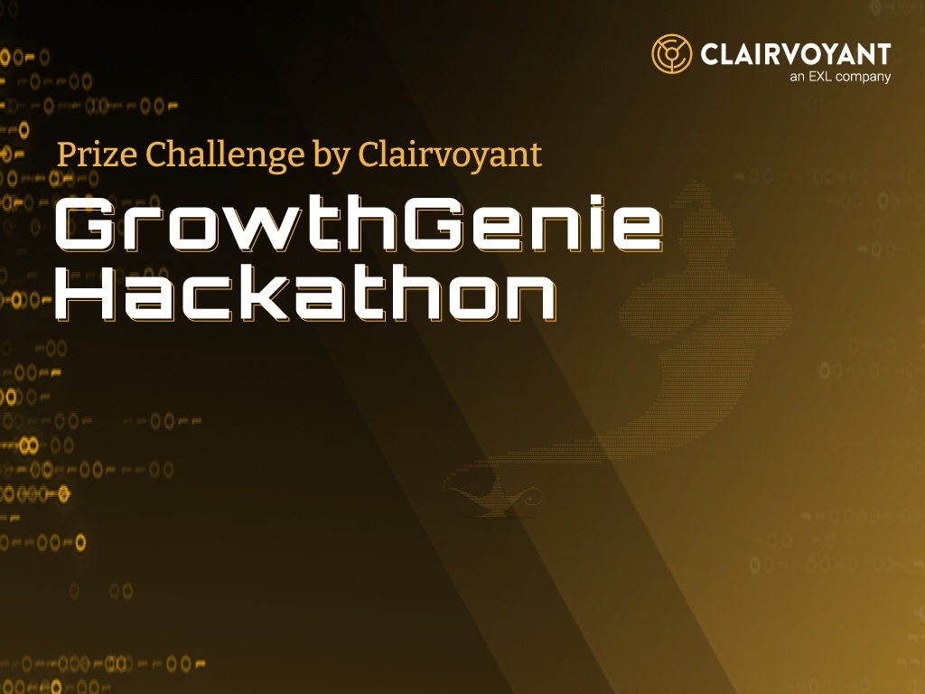

Team Name : bhdream
Team Leader name: Rohit Umesh Joshi
Team Member(s) :Rohit Umesh Joshi
Team Name :
Team Leader Name:
Team Members: (Count & Names)

Slide 2

Brief Summary of Project
Which theme do you choose from the problem statement?
I am choosing THEME 1 - User Experience, Application & API Platform.
"BHDream AMC" is an investment management platform that empowers users to input their equity investment details.
The platform calculates their unrealized and realized gains, offering insights into their portfolio's performance.
It provides tailored suggestions to optimize the existing portfolio for improved returns.
Users can set investment goals, and the platform generates personalized plans leveraging their current portfolio.
The platform will help user to draft a FIRE(Retirement) plan for them

Slide 3
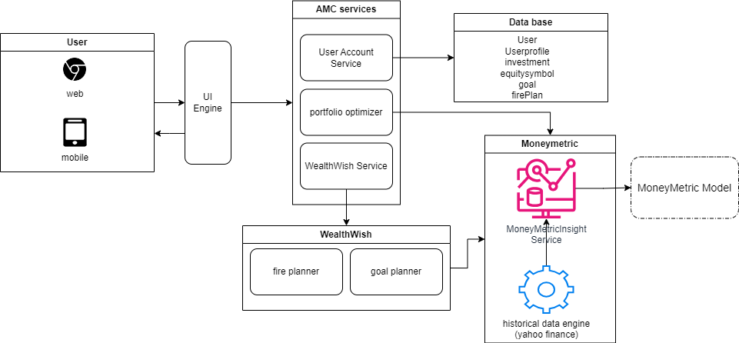
High level design diagram Solution approach

Slide 4
Solution approach
User Account Service: This service is responsible for managing all user-related data, including user information, profiles, investment details, equity symbols, goals, and FIRE (Retirement Plan) data. It serves as the primary data source for the dashboard, providing users with information about their investments and financial status.
Portfolio Optimizer: When users seek optimized performance, our service recommends an optimized portfolio using the Mean-Variance Optimization (MVO) algorithm.
MoneyMetric Engine: The MoneyMetric Engine supplies the parameters for the Portfolio Optimizer. It leverages historical data from Yahoo Finance to provide insights on returns and associated risks for the equities in the portfolio.
WealthWish Service: Our platform assists users in generating wealth through comprehensive financial planning for both their financial goals and retirement.
Goal Planner: Users have the flexibility to establish multiple goals, and our platform guides them in accomplishing these objectives through straightforward contributions (SIPs) and achievable timeframes.
FIRE Planner: We assist users in crafting a personalized retirement plan by considering their annual expenses, current portfolio distribution, and chosen retirement years.

Slide 5
Assumptions
Platform Usage Charges: It is assumed that the project does not consider any charges or fees related to the usage of the platform. Users should be aware that the platform operates under the assumption of no usage charges, and any external fees or charges from third-party services or financial institutions are not accounted for in the platform's calculations or recommendations.
Tax Consideration: This project does not account for any form of taxes in its calculations or recommendations. Users are advised to consult with tax professionals for accurate tax planning.
Supported Equities: The application exclusively supports equities whose symbols are registered in the equity symbol database, ensuring data accuracy and reliability.
Historical Data: The Money Metric service calculates daily log returns of equities using a 7-year historical dataset to provide insights and recommendations.
Calculation Gap Disclaimer: It's important to note that this project is not offered as financial advice but as a prototype. As the creator, I am not a financial advisor, and there may be potential gaps in the calculations or recommendations. Users should use the platform for informational purposes and consider consulting with financial professionals for personalized financial advice.

Slide 6
Why was specific theme chosen (optional)
I have selected this theme because it perfectly aligns with my interests and skills. As someone with a passion for finance and a background in development, this theme offers an ideal opportunity to combine these two areas. Not only do I see this as a chance to apply my technical expertise to the financial sector, but it's also a significant learning opportunity for me.
Working on a comprehensive wealth management platform for XYZ Bank allows me to delve deep into the world of finance and gain valuable insights. This project isn't just about building a platform; it's about understanding the intricacies of wealth management, financial planning, and user behavior in the financial space.
Moreover, it's a chance for personal growth, where I can expand my knowledge and expertise in the field of finance. So, this theme isn't just about creating a platform; it's about a journey of exploration and learning, where I can both contribute my development skills and acquire a wealth of financial knowledge.

Slide 7
Brief snippet of team
Project Owner: Rohit Joshi- I will be designing and developing this application. Also be doing the data analysis for the moneymetric.

Slide 8
Additional Points
Tech Stack
Frontend – React
Backend - Django(python)
Database - SQLite database
Analysis - Pandas and NumPy
Data source - Yahoo Finance

Slide 9
Thank You !!!

