Slide 1
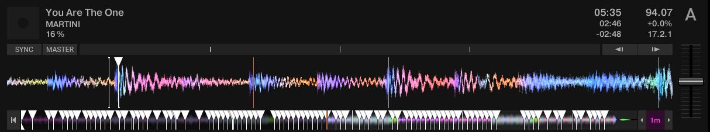
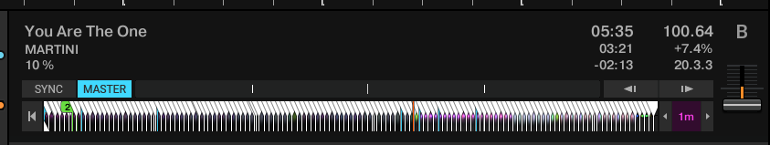
Dynamic analysis (Free - Rekordbox 5.6.0 Export mode)
Export collection
Prune collection
rekordbox_add_beatmarkers.py
Dj_data_converter (or any other converter)
Traktor_clone_cues.py

Slide 2
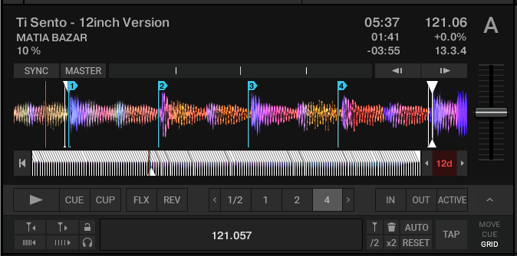
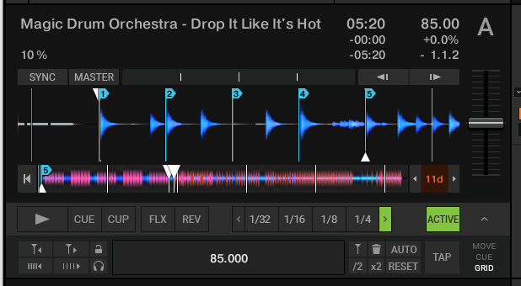
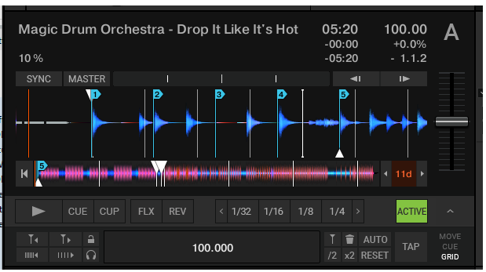
Unsteady tracks
(+-1% BPM around average)
(maximum error)
(correct BPM for first part)
Transition tracks
(sudden change 85->105BPM)
(first BPM)
(>half a beat error)
(avg BPM)
https://www.native-instruments.com/forum/threads/how-to-emulate-elastic-beatgrids-in-traktor-via-rekordbox-conversion.375229
https://www.reddit.com/r/DJs/comments/ybt30/transition_tracks/ https://support.native-instruments.com/hc/en-us/community/posts/208346569-Beatgrid-for-not-steady-tracks

