Slide 1
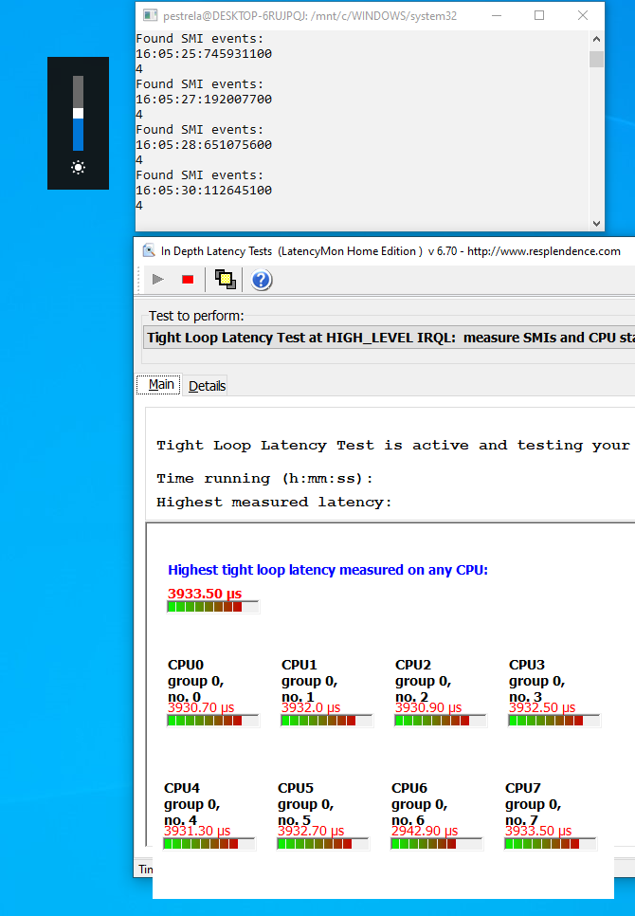
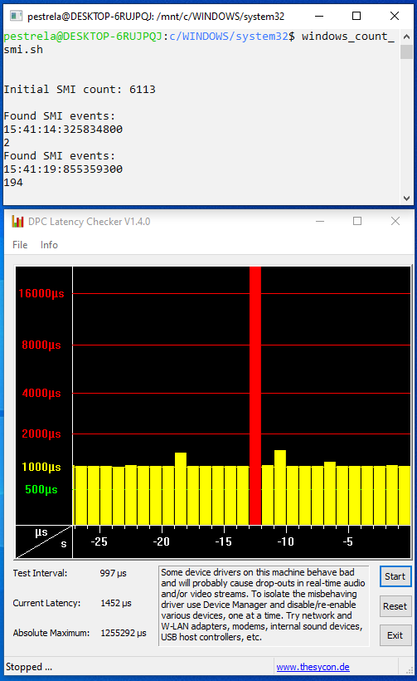
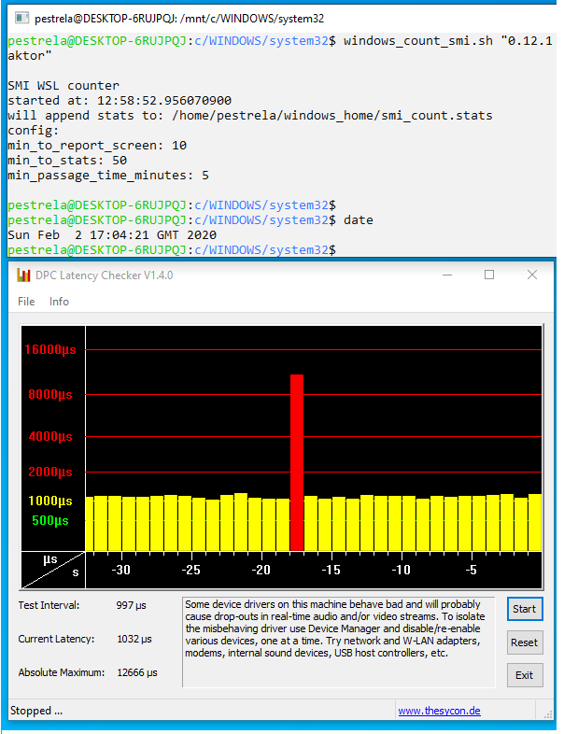
CONTROL
MEASUREMENT
QUICK FIX
Fn+Brightness = 4 SMIs:
= MILLISECONDS of latency
Random hundreds of SMI interrupts:
= SECONDS of latency
9560 old BIOS:
= no SECONDS latency
Dell XPS 15 9560 Bios 0.16.0
Dell XPS 15 9560 Bios 0.18.0
(0.16.0 same issue)
(~2 events per hour)
(10 hour test)
Dell XPS 15 9560 Bios 0.12.1
(10 hour test)

