Slide 1
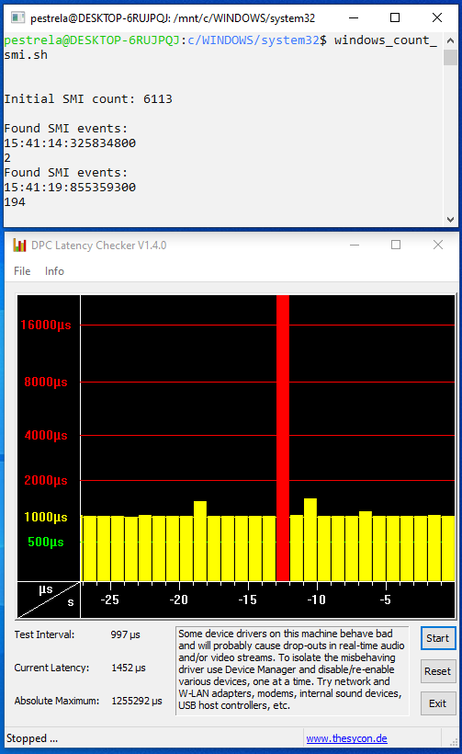
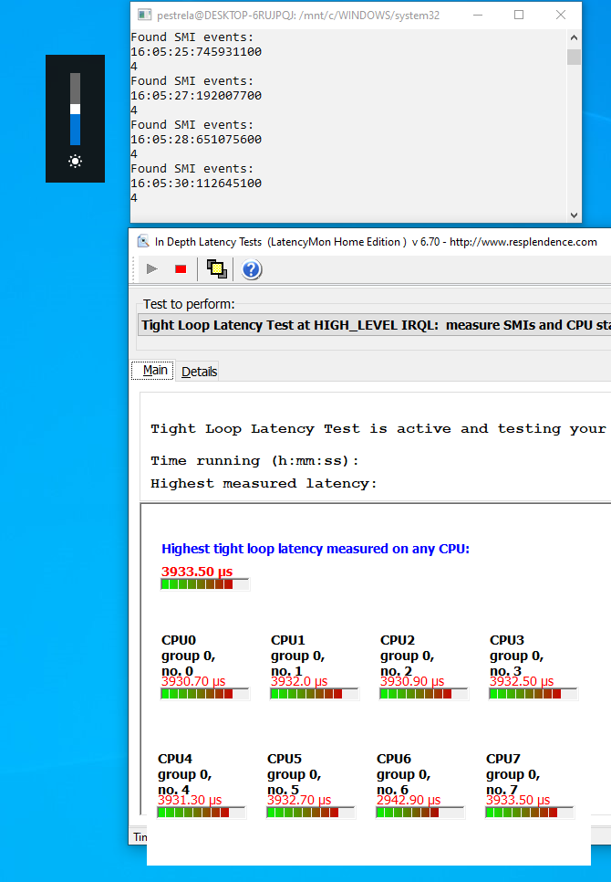
100s of SMI interrupts lock laptop for >1 second. Frequency: >2 per hour
Fn+Brightness = 4 SMIs
Causes up to 4ms latency
Dell XPS 15 9560 Bios 0.16.0
Dell XPS 15 9560 Bios 0.18.0
(0.16.0 same issue)

Slide 2
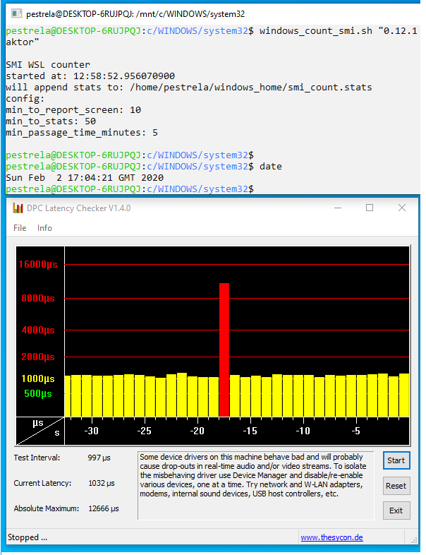
Dell XPS 15 9560 - BIOS 0.12.0 –
5 hour test – no 100s of SMI interrupts
Dell XPS 15 9560 Bios 0.12.1

