Slide 1
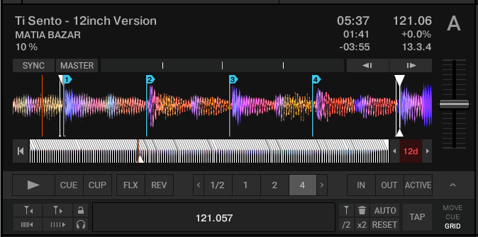
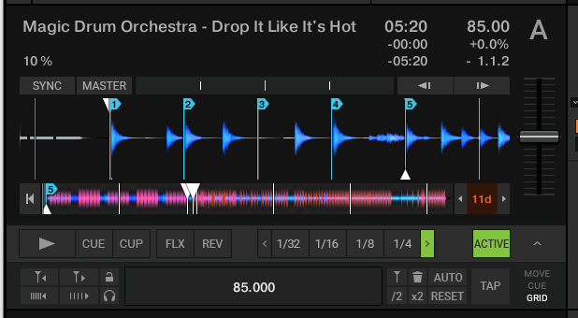
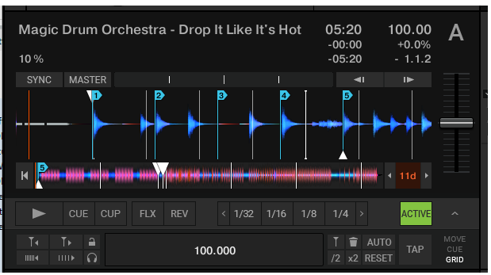
Unsteady tracks
(+-1% BPM around average)
(maximum error)
(correct BPM for first part)
Transition tracks
(sudden change 85->105BPM)
(first BPM)
(>half a beat error)
(avg BPM)
https://www.native-instruments.com/forum/threads/how-to-emulate-elastic-beatgrids-in-traktor-via-rekordbox-conversion.375229
https://www.reddit.com/r/DJs/comments/ybt30/transition_tracks/ https://support.native-instruments.com/hc/en-us/community/posts/208346569-Beatgrid-for-not-steady-tracks

Slide 2










Elastic Beatgrid emulation
(simplest case)
Files with one Unsteady BPM
(ignore files with multiple BPMs)
(Import files)
Rekordbox V5.6.0 Free
(DO NOT USE v6!)
(Dynamic analysis)
(Export collection)
XML file
Any DJ converter
NML file
(Import files)
Traktor
https://www.native-instruments.com/forum/threads/how-to-emulate-elastic-beatgrids-in-traktor-via-rekordbox-conversion.375229

Slide 3
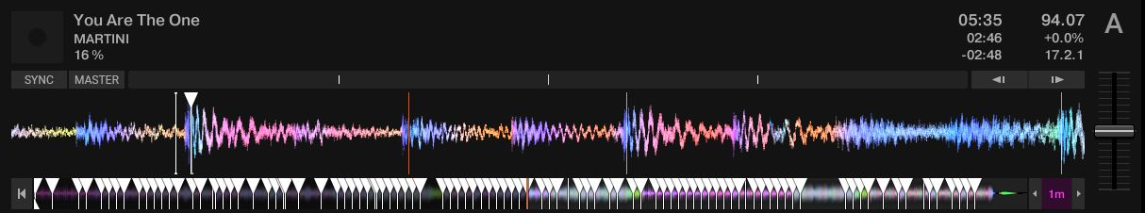
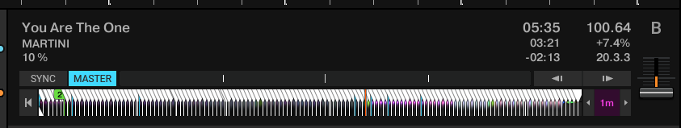
Elastic Beatgrid emulation
(more accurate case)
Rekordbox 5.6.0 Free
Dynamic analysis
Export collection
Prune collection
rekordbox_add_beatmarkers.py
Dj_data_converter (or any other converter)
Traktor_clone_cues.py

Slide 4
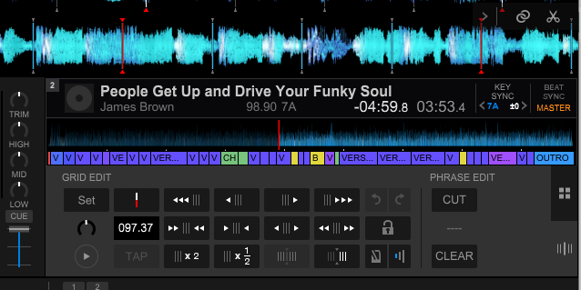
Click here first
this number needs to vary
Click here
https://www.reddit.com/r/DJs/comments/ybt30/transition_tracks/ https://support.native-instruments.com/hc/en-us/community/posts/208346569-Beatgrid-for-not-steady-tracks

