Slide 1
Video Games
The Technology

Slide 2

What You See ...
The display of game elements
  Game objects
    NPC models
    Player models
    Objects to pick up, handle, use, destroy
    Non-breakables
  Animation effects
    Spell casts
    Explosions
    Shots
1

Slide 3
Display Types
Which to use depends on
  Available RAM
  Available Storage
  Capability of Display HW in target platform
  Look you are trying to create
  The interface you want to create

Slide 4
Arcade Style
Simplest use 2D display
Animation created by having multiple images
  Each “Sprite” switches through a sequence of images as it moves
  Animation is timer controlled
    Can sometimes generate odd results

Slide 5
An Example
One of the earliest Arcade Games
Asteroids
  In a ship
  Can turn and accelerate
  Need to turn around to decelerate
  Can fire photon torpedos
  Torpedos break up asteroids
    Smaller but more numerous
    Until they are destroyed entirely
    Or player ship is

Slide 6
Animation Sets
Each moving object (player, asteroid, or shot) has a set of images representing it
  Ship: In various positions as it turns
  Asteroids: In various rotational angles
  Shot: As it pulsates

Slide 7
































Ship

Slide 8
Images
Images tend to be small
  Small display size
  Ship is only 80 x 80
Designed for 800 x 600 screen
On bigger screen, images can be larger
  Even on 1640 x 1200 images usually only 200 x 200

Slide 9
Images
Can sometimes use anti-aliasing to help
  Anti-Aliasing is process of edge blending to create illusion of smoother edge even though it is still jagged
  There are limits though

Slide 10
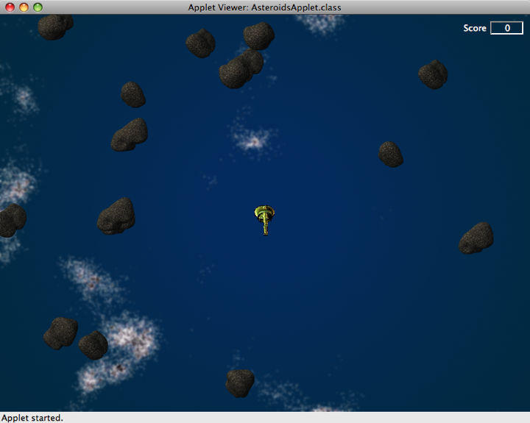
Screen Layout

Slide 11
Side Scrollers
So called because level is one huge image and you move along the level and scroll the background
  Often called “Platform” games
    Like “Mario”
  Jump from platform to platform
    Gathering treasures
    Defeating monsters

Slide 12
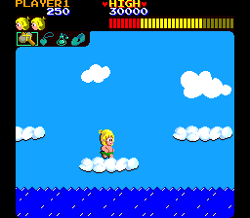
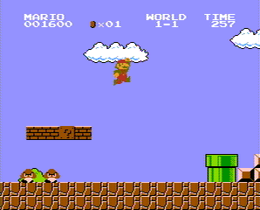
Examples
Wonder Boy
Mario Brothers

Slide 13
Orthogonal Displays
World is 2D square grid from above
  Displayed from fixed (shallow) angle
  Converts squares to diamonds
Example
  Diablo
  Warcraft

Slide 14
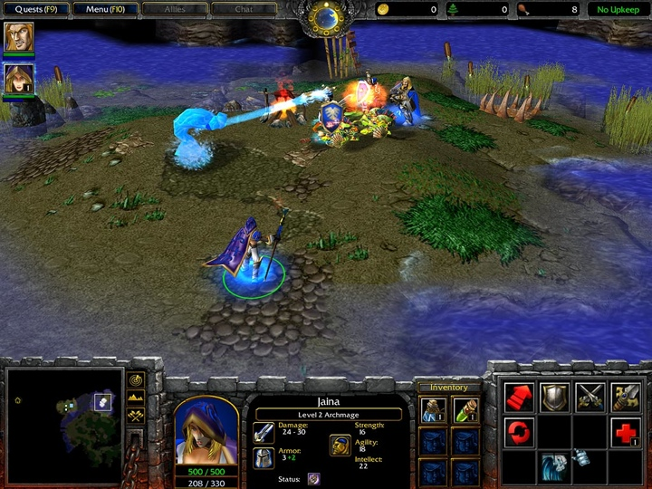
Warcraft III

Slide 15
Orthogonal Displays
Advantage:
  Gives illusion of 3D w/o actual 3D
  All Sprites are still 2D animation sets
  Need to have sets include facing as well
    Sometimes just 4 facings (to each side of square)
    Sometimes 16 (Cardinal compass points)

Slide 16
Orthogonal Displays
Common on systems w/o 3D hardware
Useful if you want to minimize memory footprint
  Cell phones, PDAs, etc.

Slide 17
Orthogonal Displays
Disadvantage:
  They look “old” (i.e. classic)
  For many players that equates to cheap
    Lower prices because of perception
  Can be used to create “antique” look though
    Good sprite images, though, can mitigate

Slide 18
3D Displays
Modern console, laptop & desktop have 3D GPUs
  GeForce
Work with object represent virtually
  3D points, lines and polygons
  Texture, bump maps
  Anti-aliasing
  Shading

Slide 19
GPUs
Graphic Processing Units
  High resolution (> 1M pixel)
  High Speed (> 50+M polygons / second)
  Automatic handling of shading, anti-aliasing and texturing
  Automatic screen refresh
    No flicker

Slide 20
Resolution
1M pixel ~ 1280 pixels / line x 1024 lines
2 M Pixel(HDTV) ~ 1920 x 1024
Dual 1M pixel needed for future VR apps
Higher resolution means greater detail
  When face is close to screen
  When wearing headset screen

Slide 21
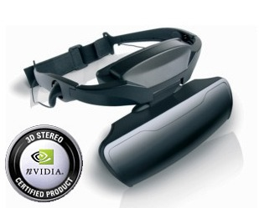
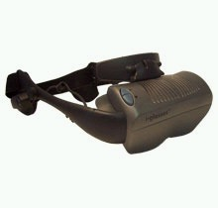
Headset Screen

Slide 22
Polygons?
All objects made up of flat facets
  Usually triangles
Smooth look is obtained by shading
Surface Detail by painting 2D picture on instead of a single colour
  Texture maps -- Multi-Image Plane Maps (MipMaps)
  Bump maps -- simulation of small surface bumps bump Tex Map

Slide 23
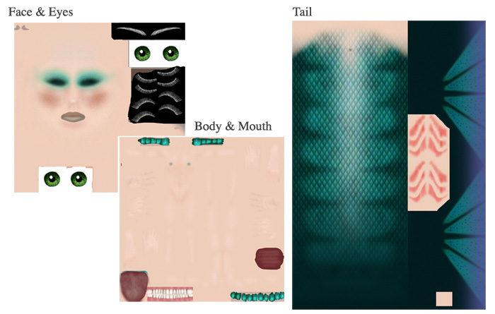
Victoria (Aquamarine) Texture Map

Slide 24
Texture Map
Poser Example
  Models: Victoria v 4.0, Lost Realms Tail, DAZ Hair
  Render without Texture Maps
    Flat colour -- plastic
  Render with Texture Maps
    Better -- looks more realistic
  Render with Bump Maps
    Best -- very realistic

Slide 25


Slide 26
nVidia Example
Very High resolution model
  >20k polygons
Very high resolution texture map
  > 100 M Pixels
Very high resolution bump map
  > 10 M Pixels

Slide 27

Nalu

Slide 28
Texture Maps
Can be as detailed as needed
  Victoria v4.0 uses actual models & scanned in images to create look

Slide 29
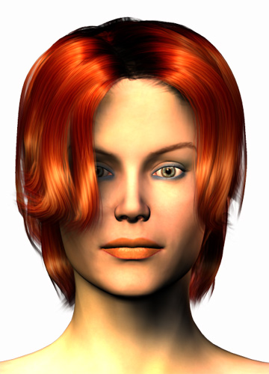
Scanned Texture Map

Slide 30
Effect of More Polygons
Advantage
  Greater image detail
  More realism
Disadvantage
  Fewer objects on screen at a time
Often, key objects (player & important NPCs) done high resolution & rest lower resolution.

Slide 31
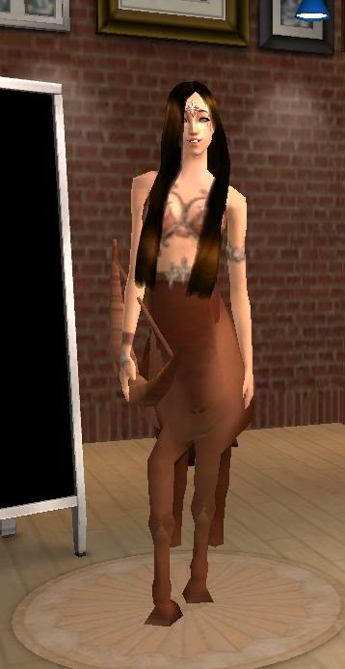
Low Poly Count
<2k Polygons
Sometimes as low as 300
  Sims & Second Life

Slide 32
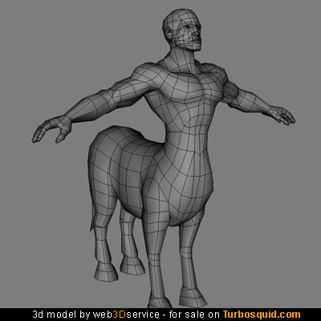
Mid Range Poly Counts
< 5k Polygons per Object
Often used for background crowds in images or as models in games where lots of objects must appear

Slide 33
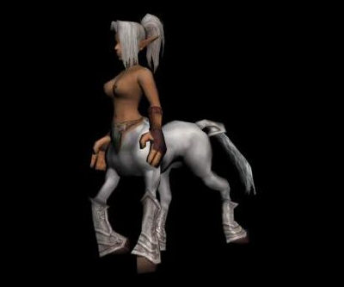
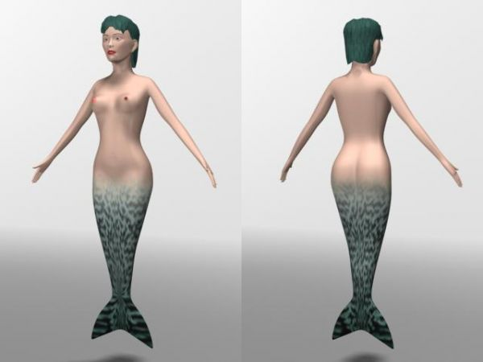
Mid Range Poly Count
Centaur & Mermaid (~ 2k-3k polygons)

Slide 34
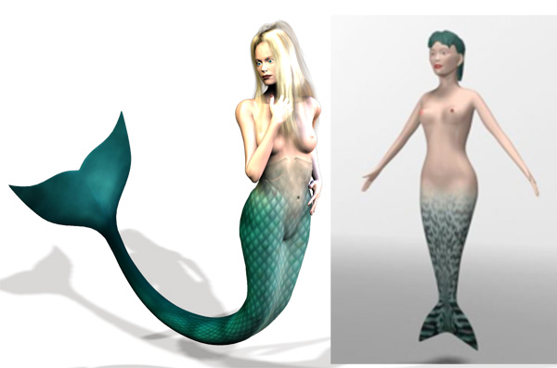
High Polygon Count
Victoria Mermaid vs Low Poly Mermaid

Slide 35
What Resolution?
Depends on GPU power (Polygons/Sec) - G
Depends on number of objects per environment - O
Depends on refresh rate (>10 Frames / second) - F
Depends on memory, too

Slide 36
Average Polygon Count / Object
PC = G / (F * O)

Slide 37
Real World Example
10 years ago
  G = 250000, O = 20, F = 10
  PC = 250000 / (20 * 10) = 1,250
  Barely better than Sims
Today (Personal Computers)
  G = 50M, O = 50, F = 30
  PC = 8800000 / (50 * 10) = 33,333
  Poser quality
Today (Console Games - PS3)
  G = 75M, O = 50, F = 60
  PC = 50,000
  Nearly video quality

Slide 38
Projections
Next generation GPU will be 10 times faster and be configured in arrays of up to 2000.
  Offset by need to build VR image pair
  Offset by need to do more frames per second
  Offset by need to have more objects on screen
Result:
  PC = 2,000,000,000 / (100 * 60 * 2)
  PC = 166,667 (Video quality)

Slide 39
Memory Down Side
Every polygon is made of at least 3 vertices
  Shared between pairs of adjacent polygons
Vertex takes 3 floating point values so takes 12-16 bytes
  Polygon takes 1 pointer (8 bytes) per vertex, too
Control structure and animation takes more memory
Rough guess for 1000 polygon object:
  100k to 200k in Memory
  Hard if you don’t have a lot of RAM in GPU
  Can sometimes share between instances of same object.

Slide 40
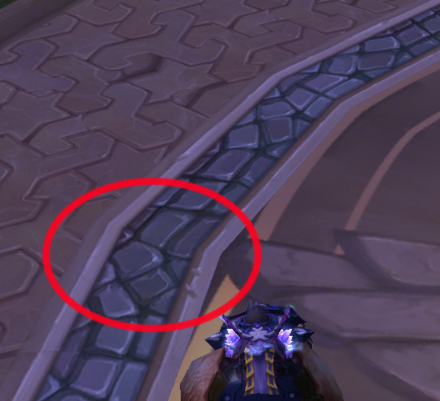
Not Enough Polygons
Dalaran Take Off Area (Circle)

Slide 41
Multiple GPUs
Many consoles (and now PCs, too) have multiple GPUs
  Image generation can be broken into chunks and each GPU assigned different piece
  More GPUs = more polygons/second
  More GPUs = more detail in images
  More GPUs = more cost ...

Slide 42
3D Drawbacks
Need to represent not only visible objects but the invisible “floor” surfaces as well
  Usually two separate structures
  Graphics high polygon count
  “Floor” polygons much fewer and usually simple flat ramps and floors
    Computationally expensive otherwise
    Can create holes if not careful
  Different “gear” means more objects for each displayed character on screen

Slide 43
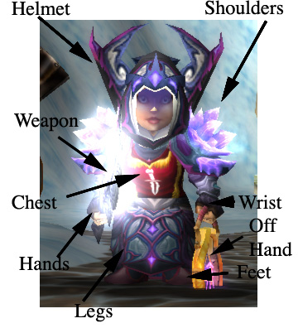
Silarion (my Mage)
Each piece of equipment is a separate object & must be represented, textured, and animated

Slide 44
Classes of Image Generation
Simple Display
  No shadows or shadows mapped as dark spot under objects
  WoW
Advantage
  Low compute cost
  Low GPU cost
Disadvantage
  Cartoony

Slide 45
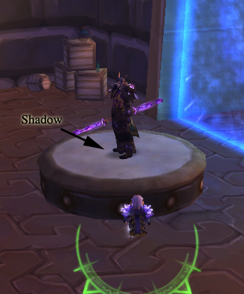

Slide 46
Radiosity Model
Map shadows from infinite sources
  Like sun or distant lights
Map linear sources
  Like spotlights
Relatively inexpensive
Reasonably good results
Lousy with shiny objects & mirrors

Slide 47


Slide 48
Ray Tracing
Generate image by casting rays from the camera outward
  Interact with surfaces
    Some reflect, some refract
    Usually bounce limits set to reduce generation cost
  Latest Generation GPUs can do Ray Tracing
    Cost is fewer polygons in image (10x less)

Slide 49
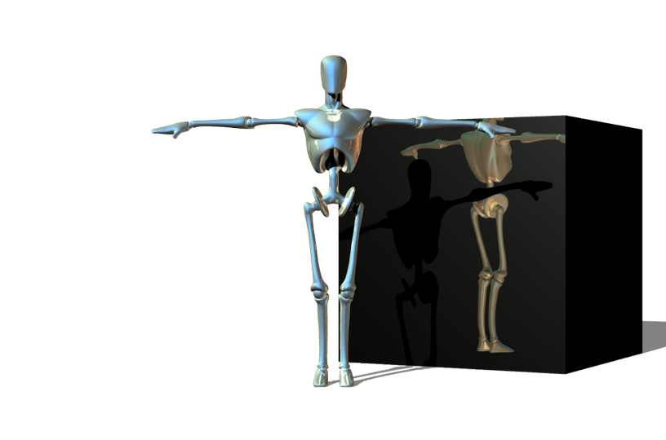

Slide 50
3D Drawbacks
Need to represent not only visible objects but the invisible “floor” surfaces as well
  Usually two separate structures
  Graphics high polygon count
  “Floor” polygons much fewer and usually simple flat ramps and floors
    Computationally expensive otherwise
    Can create holes if not careful
  Different “gear” means more objects for each displayed character on screen

Slide 51
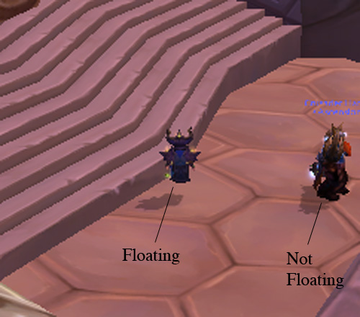
WoW Example
Floating above the stairs

Slide 52
Silarion (my Mage)
Each piece of equipment is a separate object & must be represented, textured, and animated

Slide 53
Collision Detection
RW things bump into each other
  Bounce off or stop
Collision Detection
  To detect interactions
    P vs P, P vs NPC, NPC vs NPC
    P vs Env, NPC vs Env
  Combat modelling
  Dress-up games use to make sure clothes don’t fall through model

Slide 54
Collision Detection
Another group of invisible polygons
  Used to define interaction boundary
  Simplest is sphere (3D) or circle (2D)but others are more often used because they fit closer
  Need to choose right one
    Otherwise events take place with separation between objects
    Example, balls bounce before they hit each other in billiards game

Slide 55
EXPENSIVE!!!!!
Each boundary must be tested against the boundary of every other object
M objects x (M-1) other objects
= ~M²

Slide 56
Heavy CPU Usage
Older GPUs don’t do this kind of thing
Handled by the main CPU of computer/console
  Usually only one though may be multi-core (i.e. multiple CPUs on single chip)
  Can be major bottleneck
  Main CPU handles I/O as well

Slide 57
Types of Bounding Shells
Sphere/Circle
  Advantage: Inexpensive test to determine it two spheres interact
  Disadvantage: Spheres are too far from object

Slide 58
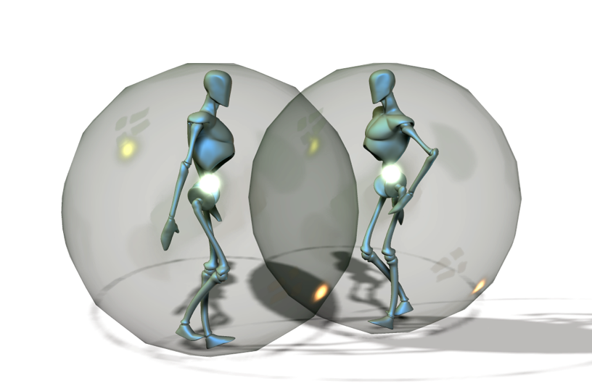
Bounding Spheres

Slide 59
Other Methods
Orthogonal Prisms
  Put a box around each object
  Align with XYZ of world
  Advantage:
    Cheap to calculate interactions
    Closer to body than sphere (usually)
    Changes as object position changes
  Disadvantage:
    Some angles can result in huge gaps

Slide 60
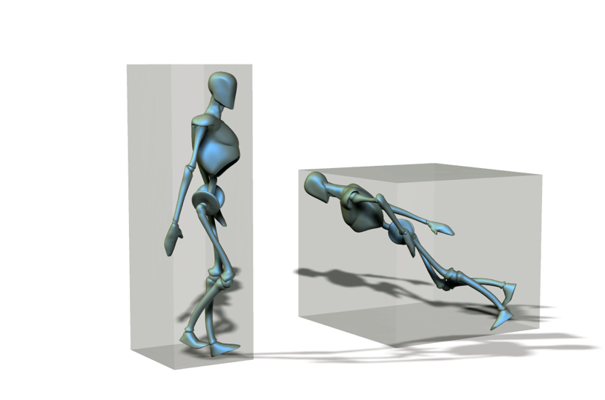

Slide 61
Expensive Methods
Align Prism so it follows object shape
  More difficult to calculate interactions
  More accurate
  GPU can do math though
Create Complex Polyhedron around Object
  Even more facets
  Very accurate
  but very expensive

Slide 62
Display & Game Design
Hardware, Software & “Look-and-Feel” of Game determine
  Resolution
  2D vs 3D
  In 3D
    Number of Polygons
    Realism and Shading
    Texture and Bump Map
    Invisible Polygons for surfaces
    Collision Detection

Slide 63
Display & Game Design
What look are you attempting to create?
What platform(s) are you building for?
What display genre are you trying to create?
How many objects will you need to show at any time?
How much memory do you have?
  Both Main CPU and GPU
How much main CPU power do you have?
How much GPU power do you have?

