Slide 1
Game Design Methods
How a Game is Designed

Slide 2
Game Design Methods
Game Design IS NOT a loner activity
Ultimate team sport
Game Design is all about creativity
Making something already made is a waste of time and money
Game Design goes through stages
Each refines the game concept
Each refines the elements and design
Final product is Game Design Document
GDD = What is to be built

Slide 3
Blue Sky
All about “Sky’s the Limit”
Wild, loose, unencumbered, creative, open-your-mind-to-all-possibilities
First step
NO censors
Only originator of idea puts limits and caveats on idea
Often by a few high-level people
Not always

Slide 4
Blue Sky
If no limits, then anything goes.
Often, publisher specifies limits
Genre
Location
General Story
Basic Characters
May be new story or new Game Mechanics
Someone did everything first
Best new games are NEW

Slide 5
One Way
Each designer comes up with their own ideal game and writes it up
Sent to a single evaluator
Eliminates old hat
Looks for “gem”
Writes up preliminary design based on “gem”
Returns to all parties for next round
Gem becomes basis of next cycle of “Blue Sky”

Slide 6
Meetings?
Some Blue-Sky is done by meetings
face-to-face
custom onLine virtual worlds
eMail is common
Companies set up a “game design” eMail address for employees to send ideas, too
Good ones fleshed out by Blue Sky teams
May be meetings
May be online ...
May be discussion boards

Slide 7
Blue Sky Killers
“That won’t work”
“That’s silly”
“That can’t be done”
YES is the antidote

Slide 8
Blue-Sky Rings
Two to five people
One person speaks at a time
Pick starting person
“I want …”
Fill in the rest
Response is “Yes”, “Okay”, etc.
Then expand the statement

Slide 9
Blue Sky Goals
Idea development
Basic level
NOT how can I build this in a program?
NOT how much would that cost?
NOT can the technology support it?

Slide 10
Brainstorming
More focused
Designed to increase details
Leads to enough detail to start creating GDD
Generates ideas but requires seed to get started
Rules in Brainstorming books aren’t cast in stone

Slide 11
Criticism
Rule is “Don’t criticize”
May not be a problem if criticism is directed at idea
NOT at originator
NOT at latest to speak on it
Can’t take it personally
Hard to do except circle-of-friends

Slide 12
Clichés
Basic Rule is
“Avoid them like the Plague”
Reality is that they come out first
Don’t fight them go beyond them
In session, once you’ve beaten the clichés to death, go beyond them
Make changes that are NOT cliché
Can end up with really interesting results
Turn clichés on head

Slide 13

Try It
“Cowboy”

Slide 14
Brainstorming
Starts with a priming question
Sets stage for brainstorming target
NOT blue-sky
Focused
“We need to figure out how to get our hero past this hero (boss) without them dying”
“We need to figure out how to put (insert product) in the game in a way that doesn’t disrupt the flow, meets the needs of marketing, and helps the player further his/her goals”

Slide 15
Brainstorming
Start with the easy and obvious
Go past it to the really creative
Stay within limits though
Description from Blue Sky limits what can happen
Deus ex Machina
Standards and Practices
Children’s games have extreme limits
Teen less so
Mature even less

Slide 16
Brainstorming
Working within the limits forces creativity
Cowboys can’t lasso cattle
Kids will try it with each other & injury can result
MacDonald’s coffee suit results
Need creative solution that doesn’t lasso
Use lassoes to create tornado to suck up cattle and drop them in corral

Slide 17
Brainstorming Process
Despite fact that rules don’t always work ...

Slide 18
Official Ground Rules
Focus on quantity
Quantity breeds Quality
Linus Pauling said “The way to have good ideas is to have lots of ideas”
Assumption: more ideas means you’re likely to find the radical/effective solution
Withhold Criticism
Put on hold (Not always if you know the group)
Extend and add to ideas
Criticism is often last stage of process
Cull all but the best ideas

Slide 19
Official Ground Rules
Welcome unusual ideas
A long list is great
Unusual ideas are great
Suspending assumptions
New perspectives
May provide better solutions
Combine and Improve Ideas
1 + 1 = 3 is often true in brainstorming
Process of association

Slide 20
How to Do It
Before the session, define the problem
Be specific
Limit the area to be discussed
If problem is too big, facilitator breaks down before
Compose memo (discussion board entry)
Session name, date, time, place
information as to problem & limits

Slide 21
How to Do It
Choose participants
< 10
Core members with key skills
Guest members with affinity to problem
Idea collector
Create a list of Lead Questions
Required if brainstorming session slows down
Can we combine ideas?
Different perspective?

Slide 22
Session Conduct
Warm-up session (novices) with simple problem
Facilitator presents problem
Asks group for ideas
If no ideas then lead question to get started
Everyone presents ideas
Clarity: participants may elaborate idea
When time up, facilitator organizes ideas and encourages discussion
Ideas categorized
Whole list is reviewed to make sure everyone understands
Duplicates and infeasible solutions eliminated
Facilitator wraps up session

Slide 23
The Process
Participants who have ideas but couldn’t present them write them down and present later
Idea collector numbers ideas
Can be used as target (we have 44 ... Let’s try for 50)
Idea collector may repeat idea to make sure they have it
Most associated ideas should have priority over less associated
Managers and superiors should NOT attend
Inhibits creativity and flow of ideas

Slide 24
Evaluation
Solution shouldn’t require resources/skills group doesn’t have or can’t acquire
If second session required, get the necessary resources
Need metric for success
Steps to accomplish must be clear and assignable to members for further work
Milestones and evaluations at milestones
Incentives to participate

Slide 25
Game Design Modifications
Incentives are not always physical
Making good game is goal
Many times, plot/design is result not something to do
Criticism (NOT personal) is allowed in close groups
Not recommended in new groups though

Slide 26
Variations
Nominal Group Technique
Equal say for all
Ideas written anonymously
Moderator collects, reads and each is voted on by group (distillation)
Top ranked ideas sent back to group or subgroup for more brainstorming
Often takes trained facilitator & practice sessions to make it work

Slide 27
Variations
Group Passing Technique
Starts with well-defined topic
Each participant brainstorms individually
All ideas merged into one huge idea map
Star map is one possibility
Looking for common understanding of issues and meanings
New ideas by association
Add to map
Finally prioritize & take action

Slide 28
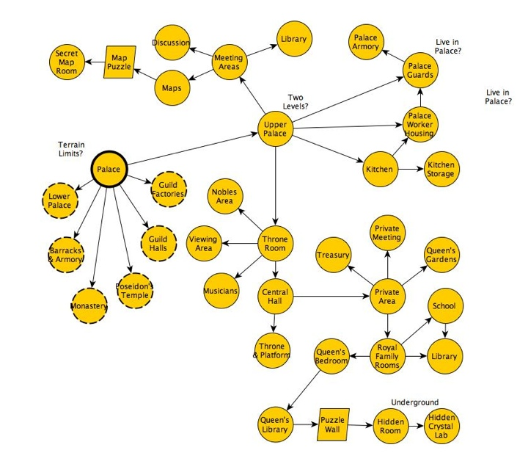
Star Map

Slide 29
Variations
Electronic Brainstorming
Uses eMail or wiki
Facilitator sends out initial memo & gets back ideas
Collates a list of ideas
List sent back by eMail for more brainstorming
Advantage
Eliminates productivity blocking and evaluation apprehension
Electronic archive of entire process for later
Larger groups
Disadvantage
Needs more “soak” time (days)

Slide 30
Directed Brainstorming
Variant on Electronic
Solution space pre-defined
Used to constrain acceptable ideas
One sheet of paper (or electronic equiv.)
Produce one response to problem & stop
Randomly swapped around
Asked to create improvement on idea they received
Rinse & Repeat

Slide 31
Bottlenecks
Group Brainstorming not as effective as Individual Brainstorming
Production Blocking
Social Loafing

Slide 32
Production Blocking
One individual blocks/inhibits other people during a group discussion.
One person talking about idea, others are “blocked” -- can’t provide their own creative input.
May not have time to think of an idea,
May be distracted or forget about their idea before they have an opportunity to share it.
Worse in larger groups

Slide 33
Social Loafing
People make less effort in a group than when alone.
“Somebody else’s problem …”
Hiding in the crowd

Slide 34
Individual Brainstorming
Some Techniques
Free writing
Free speaking
Word association
Spider web diagrams (Star Diagrams)
Useful in creative writing
superior to traditional group brainstorming

Slide 35
Free Writing
AKA Stream-Of-Consciousness Writing
Write for fixed period of time
Not long - 5, 10, 15 min
Disregard spelling, grammar, punctuation
Produces raw (often unusable) material
Can overcome blocks of apathy or self-criticism
Used for initial thoughts & ideas on topic
Game Design especially

Slide 36
Free Writing Rules
Set a time limit and stick to it.
Keep hand moving until the time is up
Do not pause, stare into space or read what’s written.
Write quickly but not in a hurry.
Pay no attention to grammar, spelling, punctuation, neatness, or style.
If you get off the topic or run out of ideas, keep writing anyway.
Write nonsense or scribble: keep the hand moving.
If bored or uncomfortable as you write, write about that.
When the time is up,
Look over what’s written
Mark passages that might be worth keeping or elaborating

