Slide 1
Video Games
The Game Design Document

Slide 2
Game Design Document
GDD is core of game under development
  Blueprint
  How game is played
  How objects work
    What they are
    What they can do
    Appearance/disappearance
    Role and Behavior
1

Slide 3
GDD Outline
Core Overview
Game Content
Core Game Objects
Conflict Resolution
Artificial Intelligence
User Interface
Game Type
Definitions
References

Slide 4
Tools for GDD
At one Time
  Word Processing
  Spreadsheets
Most common today
  Wiki
  Each group will have it’s own Wiki.
  Project is marked on Wiki Contents NOT DTF

Slide 5
Core Overview
Brief but thorough overview of game
Gets new team members up to speed
  What makes game stand out
Primary Audience: External
  Non-Technical
  Introduction to Entire Document
Level of Detail: Low
Three Parts
  Summary
  Key Aspects
  Golden Nuggets

Slide 6
Core Overview - Summary
Summary of whole game
Prose is lean NOT flowery
Game Description
  A Paragraph
  Key Features
    Scenario
    Target Audience
    Target System(s)
    Display Mode (i.e. 3D, MMO, etc)

Slide 7
Core Overview - Key Aspects
Capture Essence of Game
  Use of Technology
  Focus is on game play
Display Model
  3D, 2D, Orthographic, Scroller
  Polygon budget
Input System
  Buttons, Joysticks, Keyboard, Voice, etc
Bulleted list or short paragraph

Slide 8
Core Overview - Golden Nuggets
What is special about this game?
What is exciting about this game?
Special Features
  Interaction
  Display
  Controls
  etc.

Slide 9
Gems of Atlantis
Core Overview
Summary
  Gems of Atlantis is a single or two player action RPG that puts the player in the situation of a mermaid or merman from a small monastery who is called upon to save the entire sunken island of Atlantis from a second great volcanic eruption that threatens to annihilate everyone. The player defeat groups of enemy ranging in size from a few to entire armies. Along the way the player must discover why the volcano is erupting and how to stop it by solving a number of puzzles. In addition, the player will have to learn increasingly complex magic spells and Crystal Science skills; to use melee weapons (after all magick can't solve everything); and how to diplomatically contact all the various factions in Atlantia to accomplish the task required.

Slide 10
Game Context
Describe the world that surrounds the game
  Ancient Greece, stadium of NFL team, etc
  Context should be somewhat familiar to player
  May be interaction between player & NPCs
  May be historical background to war

Slide 11
Game Context
Game Story
Backstory (History)
Primary Players
World Maps

Slide 12
Game Context - Game Story
Details Primary Events on in Game Story Line
  Descriptions must be detailed enough for detailed design and implementation to follow
  Style of interaction
  Number of NPCs onscreen
  Style of play
  Key Goals in Game

Slide 13
Game Context - Game Story
Must include spoilers
  Essential player experience be documented completely
  REMEMBER: This is for the DESIGN TEAM not the player. The implementers and artists need to know what’s required to be able to build it!!

Slide 14
Game Context - Backstory
Everything has a history
For good game, this history is key
  May reveal why game events are happening
  May be part of the puzzles of the game
  May be used to misdirect player
  May be used to guide player
Sufficient Detail and Well Written
  Non- technical

Slide 15
The Metric Tonne Gorilla
“If games are going to be a true dominant art form in this century, we have to elevate them beyond the simple mechanics of the gameplay or the graphics. All that matters is actually the experience. When we realized this, that’s when we started focusing on story”
Denis Dyack, President, Silicon Knights

Slide 16
Game Context - Primary Players
The player is a character in story
  Often hero / heroine
  Want a good character
    Believable
    Not super hero
    Has problems & weaknesses
  Character sketches
  Link to associated GDD material

Slide 17
Game Context - Primary Players
Key NPCs also
  Allies and enemies
Describe each
  Backstory
  Special abilities
  Motivations
  How NPC will act and what role is
In large RPG, may be HUGE

Slide 18
Your Game Project
Each person in the group will create a complete description and back story for the player’s character or an important NPC in the game.
  This means more team members mean more descriptions

Slide 19
Game Context - Maps
Sketches of maps of world
  Depending on game
  Levels of detail
  Often necessary in designing levels
  Essential in defining GO / NO GO regions

Slide 20
Good STORIES & Characters
When to write the story
  As early as possible
  Just throwing a story together won’t work
  Story is underpinning of game or it shows up as an afterthought
Story?
  Critical in movie and theatre
  Just as critical in a game

Slide 21
Story structure
About characters in conflict
  antagonist & protagonist against each other
  mutually exclusive goals (only one winner)
  Ups and Downs
    Sometimes one is ahead, sometimes another
Beginning, Middle and End

Slide 22
The Beginning
A setup
  Compelling to draw in player (flow)
  First 10 minutes of a movie
  First 10% +/- of a level
Establishes lead characters
Establishes goals of lead characters

Slide 23
The middle
Bulk of the story
  Roller Coaster
  Mix of Highs and Lows or you burnout player & lose them or bore them and lose them
    Pacing is important

Slide 24
the end
Wrap-up
  In a game, can set things for sequel
  In a level, leaves player in new state
    Ready for more and more difficult challenges

Slide 25
Story-telling
Things that happen in a story happen at natural times and places for that event
  No Deus-ex-machina
Often episodic
  Each piece unrelated to one ahead or behind
    Like Saturday morning cartoon heros
Not always

Slide 26
Back story
Gives info on situation and characters before the story starts
Stage setting
  Part of GDD often called “Story Bible”
Gives depth and richness to overall story
  Makes character action more consistent
  Voice actors love the back story (“What is my motivation?”)

Slide 27
Bookending
Tie whole story together at end
Clean wrap-up
  Audiences love it in the movies
  Ties up all lose ends

Slide 28
fish-out-of-water
Splash
  Leaves ocean to search for child she met years ago
  Meets Tom Hanks and has an adventure
  Returns to ocean with new experiences

Slide 29
And-Then syndrome
Common in inexperienced writers (and game designers)
This happens and then this happens and then this happens ...
Instead use “and because”
This happens, and because this happens this causes this to happen. Because that happened, this causes a third thing to happen
  Cause and effect

Slide 30
and then ...
I walked into a dark tunnel and then two guys started shooting at me, and then I ducked around a corner, and then I jumped on a hover board.

Slide 31
and because ...
I walked into a dark tunnel, and because it was dark I couldn’t see where I was going so I tripped. Because I tripped, the two guys leaning against the far wall heard me and started shooting. Because they started shooting, I ducked around a corner. Because I ducked around the corner, I happened upon the stolen hover board so I jumped on it to get out of there. -- kills two birds with one stone if you ask me: makes me the hero for finding the prize and gives me a chance to save myself. Because the two guys were in the main part of the tunnel now, I had to find another way out and that’s when I spotted the open manhole
  Now how do I make this thing do more than just hover?

Slide 32
Why “and because?”
Same movements but now we have reasons
Beginnings of story with a purpose, tone & sense
More interesting
Can sometimes suggest other options
  What if we had a flashlight? It wouldn’t be as dark so ...

Slide 33
optional ending
I walked into a dark tunnel and because I had a flashlight, I noticed the dead body recently dropped in the middle of my path about 2 meters inside the entrance. Because I saw the body, I knew I wasn’t alone so I scanned the perimeter and that’s when I noticed the two guys leaning against the wall. Because I saw them before they saw me, I was able to take them out with my .357 Magnum, a gun I carry around for sentimental reasons. Because they fell in a split second, I felt I had some time to look around and maybe figure out what this little gathering was all about. So I went further into the tunnel with my handy flashlight and my big gun.

Slide 34
So wrapping it up a bit
When you are creating a game
  Know the game in all its details
  Back story is critical
  Makes the game more interesting
  Lets you get out of sticky situations (missing story or whatever)

Slide 35
characters rule
The player relates to the character
  Particularly “their” character
  A good game character is motivated by what has happened, what is happening and what they “want” to happen
  Also by environment -- need maps

Slide 36
Game Characters
In a game, there’s additional information that’s needed
  Mesh, Rig & Animations

Slide 37
Mesh?
Models are made from a number of flat facets.
  The “Skin” of the object
  Created by 3D edit packages such as Cheetah3D, Maya, Cinema4D, etc.

Slide 38
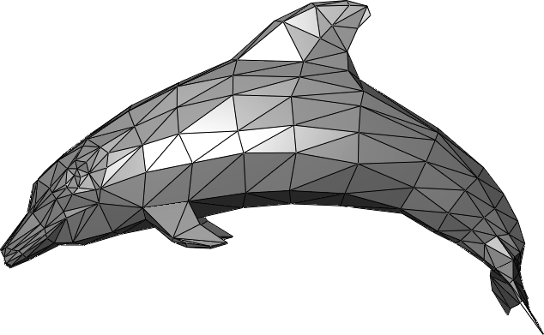
Dolphin Mesh

Slide 39
Rig
The “Skeleton”
  The bones used to move the mesh around
  Includes the weighting for the bones once the model is actually created
    Weighting is not needed for your project

Slide 40
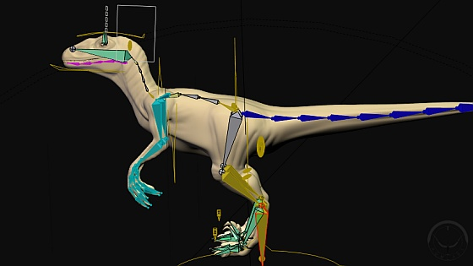
Velociraptor Rig

Slide 41
Animations
How the rig is moved to create the movements needed in the game
  Can be unique to a single rig or generic (i.e. apply to a whole family of similar rigs)
Two kinds: Forward Kinematic and Inverse Kinematic

Slide 42
Forward Kinematic
Positions (angles) of joints in rigs are set in time on a frame-by-frame basis
  Doesn’t change even if part of mesh goes into a wall

Slide 43
Inverse Kinematic
Target points (for example hand)
  Animation created by moving the target point
  Other joints are moved to make the target motion possible
  Example: Picking up a glass
    Target point is glass
    Have to adjust hand, elbow and shoulder to pick up glass

Slide 44
Game Context - World Maps
Sketches of maps of world are critical part of GDD
  Depending on game -- few or many
  Levels of detail -- from overall to floor plans of buildings (or even desk drawers)
  Essential in designing levels
  Essential in defining GO / NO GO regions

Slide 45
GDD: Core Game Objects
What is in the Game?
What can be made, handled, used, destroyed, modified?
Sometimes Low level NPCs characters as well if they are more background than active (crowd)
Key Parameters for Objects
Puzzles also game objects

Slide 46
Core Game Objects
Characters
Weapons
Structures
Objects
Puzzles

Slide 47
Core Game Objects - Characters
Parameters for characters
NPCs
  Handle exactly as for key NPCs descriptions but lower detail
General Description of NPCs
  All things that can interact with player independently

Slide 48
character information
Main characters will need all possible information
Auxiliary characters will only need that which affects them in their piece of the action
  An NPC for a single level that you never see again

Slide 49
Character information
Full Name
  Significance of name (named after a relative, etc)
Age & Birth Date
Place of Birth
Where they grew up
  If more than one place, need backstory as to why
Physical description
  May be preliminary model or sketch

Slide 50
character information
Health issues, if any
Childhood traumas (from their POV)
  Phobias
Religious beliefs
Standing in family
  Birth order
Siblings names, ages & brief description
  Relationship with each sibling

Slide 51
character information
Parents
  Descritpions
  Marital status
  Relationship with each other & with character & siblings
Extended Family
  Grandparents, etc as above

Slide 52
character information
Family pets
  History of pet, relationship to pet
What is home like?
What is neighbourhood like?
Family financial situation

Slide 53
Etc
Basically its a complete biography of the character
History often determines action
It’s a lot of work to create it
  Essential if story is to hold together

Slide 54
key personality traits
You are creating a person
  Not perfect
  Not superhuman
  Just a person
  Flaws, foibles, fears, hopes, dreams and desires
  Determines what they will and won’t do
    Socially inept? Laid back? Irresponsible?
  We all know quirky people -- good models for characters

Slide 55
character arc
Changes in character from beginning to end of story
  Or game or level ...
Push character outside comfort zone makes change that can’t be undone
  More interesting than staying at home and watching TV

Slide 56
secondary characters
(auxiliaries)
Not as detailed as with main characters
  Only supporting roles
  From “Best Supporting Actor” to “Extra”
  In game can add “Background”
Need to include in Game Object descriptions for characters

Slide 57
Villains
They’re bad because they’re the bad guy
  Lousy motivation for anything
Whether main or auxiliary, actions should be based on past history.

Slide 58
backstory rules
Should not come up in detail in main story
  But may be alluded to
More to help detail the dialog and actions

Slide 59
props department
Props required to make story happen
  With flashlight vs. without
  With Big Gun vs. without
  etc.
Unless you are dealing with completely here-and-now (or historical) environments, you’ll have to describe in detail how they work, what they look like, how they handle, etc.
Essential details for each prop in a game

Slide 60
GDD: Core Game Objects - weapons (tools?)
Most games have weapons of some kind or another
  Depends on scenario
  Accuracy depends on game
More accurate term might be “Tools” though
May include images and physical parameters as required

Slide 61
The scene
Any movie has a scene (actually many hundreds or 100s)
  Architecture & buildings
  Individual rooms
  Vehicles sometimes considered part of scene
    May be “character”, too

Slide 62
GDD: Core Game Objects - Structures
The “Architecture”
  Buildings, Cities, Rooms, Furniture, etc.
Plans range from detailed to overview
  Don’t design building to last nut-and-bolt if player only flies over it at 5000 m
  Describe solid vs movable vs. breakable portions
  Describe player and NPC interactions with structure

Slide 63
Core Game Objects - Objects
Non-moving, non-threatening
Plants, potions, rocks, light posts, etc
Level of description
  Good if player interacts with
  Less so if backgrounds only
NOT necessary to be scientifically accurate
  Coral in GoA is likely an object rather than an NPC -- unless it attacks the player

Slide 64
environment, puzzles and levels
Everyone loves to beat a level
Decision as to environment is often first thing discussed
  May take a long time to flesh out though
  What’s in the environment, how it affects game play, look and feel issues
Big step from initial ideas to something that can be implemented though

Slide 65
Notes on puzzles
Goal: Love the player not kill them
Make the puzzle challenging not impossible
  Tough to do
Puzzle should be organic part of environment not just bolted in

Slide 66
types of puzzles
Actual puzzles
  Assemble jig saw puzzle for image, open a slide lock, etc.
Problem solving
  I need to reach the handle of a door but am too short
    Use environment and tools to generate solution
  “Ah ha!” moment

Slide 67
flowcharts and game play
Actions describer easy to hard
  Short jump is easy
  Long jump is harder
  Long jump over lava is harder still

Slide 68
Each level
Level is a big puzzle
  Usually a goal in each level
Levels start easy and get harder
About 15-20 minutes each
Must fit into story line and result from backstory

Slide 69
GDD: Core Game Objects - Puzzles
Every puzzle in the game
  Description
  What the player does to beat it
  Randomization in the puzzle (if any)
  Effects of different objects on puzzle
Good idea to draw it
  Movable pieces described / marked
Prototyping often used to effect
  Can the puzzle be made to work?
  How does it play?
  Problems caught early

Slide 70
GDD: Conflict Resolution
Games and Stories Again
  Good vs. evil
  Need to allow interaction
  What can the player (and enemies) do?
  How is conflict resolved?
  How are weapons and other tools used?

Slide 71
GDD: Artificial Intelligence
NOT necessarily “Terminator” class
How does each kind of character interact with the player?
  Simple pathing is very common
  Cycling when inactive
  Direct attack (heat seeking missile style)
  More subtle fixed program attacks
  Learning from player?
  Multiple choices?
Entire Course Possible (and in proposal)

Slide 72
GDD: Game Flow
May be one of longest
  Especially for non-linear multi-level game
Address game play area
  Weapons, inventory available
  Victory conditions
  Placement of defined game objects
  Placement of puzzles in game

Slide 73
GDD: Game Flow
Guide for programmers, artists, level designers and mission designers.
Puzzles
  Should know where
  What interaction is needed
  How and why of implementation

Slide 74
GDD: Controls
User input and controls
  Mapping to input systems
  Flexible control mapping
  Not the details of the UI
    Functional Design Document
  In game only
    Not menu setup
    Not pre-game setup / selection

Slide 75
GDD: Game Type
If only a single type (I.e. FPS single player only), can leave
Describes multiple modes
  Transitions between in-game
  Setup if only at game start
  Initialization is required
  Special modifications for various modes
    Some things don’t apply to single player mode that do apply in multi-player mode

Slide 76
GDD: Definitions
Every game develops its own terminology as time goes on
Good idea to get core concepts defined early
Non-standard words and phrases and their definitions belong here

Slide 77
GDD: References
Books, magazines, Internet
  Just like a paper
  Help the team understand the background
  May contain early prototypes
  May contain (scanned) early character sketches
Competing games
Goal is to help implementation team
  Figure out how to do things.
  Answers “You need more info?” questions

Slide 78
flowcharts
Flowcharts
  start at beginning
  document all choices and paths to end
  programmers love them
  artists and writers often hate them

Slide 79
flowchart tools
Traditional methods
  Index cards
  Sticky Notes on a Wall
  Sheets of Paper (8x10)
  Rolls of art paper / butcher paper (on wall naturally)
  Whiteboard walls
    DNE messages or cell phone image these days

Slide 80
Flowchart tools
Many electronic tools
Commercial design tools for Systems Analysis
Freeware/shareware exists to do it, too
  yEd link on BlackBoard

Slide 81
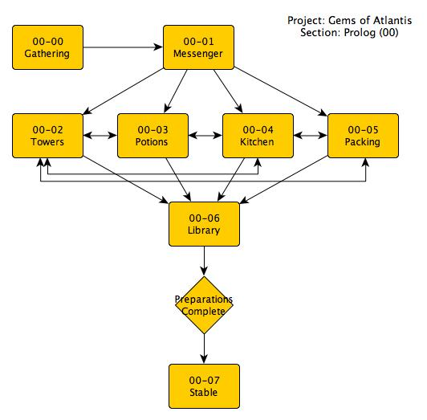
GoA Example (Prolog)

Slide 82
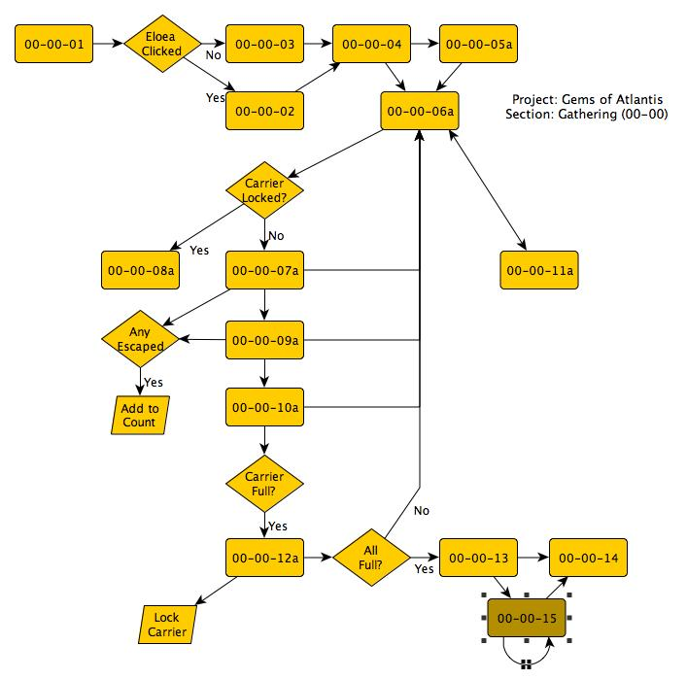
GOA-EXAMPLE (Gathering)
Event #00-00-01 -- Character Selection
Text: Please select either Eloea or Talosh as your character.
Buttons: Eloea & Talosh (with images)
Event #00-00-02 -- Eloea Button Click
Trigger: Player clicks on image of Eloea
Action: Eloea is selected as the player's character. Talosh is marked as Opposite NPC.
Event #00-00-03 -- Talosh Button Click
Trigger: Player clicks on image of Talosh
Action: Talosh is selected as the player's character. Eloea is marked as Opposite NPC.
Event #00-00-04 -- Herbology Instructor First Instructions
[Instructor]: Okay everyone. We're at the collection site. We've been given a task by the garrison in the monastery. They're running low on energizing and healing potions. Auniam, your Potions instructor, tells me you are learning these potions in classes over the next few weeks. We're going to be gathering the reagents for these potions. Each of you is to gather some of each of the plants and animals and place them in the carriers. Be careful with the live animal carriers, though. Shake them to drop the animals to the bottom before you add any new ones or you'll be chasing the previously caught ones all over the area. You'll be working in pairs for safety. The three NPC groups will immediately start to head off to gather their plants and animals.

Slide 83
flowcharting
Goal is to show the various story components
  Options as well as main line
  Initial dialogue ideas
  Reveals objects needed
  Character-NPC interactions

Slide 84
flowcharting symbols
NOT the traditional CS ones
  Related to them though

Slide 85
Decisions
Diamond shape
  Represents decision
  2+ paths out
    Each path labelled as to requirements for path

Slide 86
location / Action
Rectangle
  Indicates an action is happening
  Can be change of location also

Slide 87
connectors
Flowcharts get huge really fast
Need to connect to another part of same page or another page in flowchart
  Circle is outgoing
  Lozenge is incoming
  Often there’s a special lozenge called START and FINISH

Slide 88
LEVELS and puzzles
Likely each level / puzzle will have its own flowchart
  Often used to plan “what happens next”
    We’re stuck in the cave, now what?
  Can be used to help solve puzzles, too

Slide 89
Multiple layers
Big picture flowchart
  Overall stages
  May even indicate “Levels” in final game
  Usually fairly low detail
  Preliminary flow for the whole game

Slide 90
multiple layers
Level flowchart
  Details what happens in level
  What interactions are taking place?
  What non-Story line events are there?

Slide 91
Detail flowcharts
Dialogue / ACtion / Event detailing
  Effect of various tools / weapons
  May have multiple outcomes if game is non-linear

Slide 92
Storyboarding
An alternate to flowcharting
  Draw game as series of scenes with descriptions
  Comic book style

