Slide 1
Voxxed DAYS VIENNA | MARCH 2018 | @nilshartmann
NILS HARTMANN | HTTPS://NILSHARTMANN.NET
Let's type!
A practical introduction to TypeScript
Slides: http://bit.ly/voxxed-vienna-typescript

Slide 2
@nilshartmann
NILS HARTMANN
Software Developer from Hamburg
Java
JavaScript, TypeScript, React
Trainings, Workshops
nils@nilshartmann.net
https://github.com/nilshartmann

Slide 3
"TypeScript is probably the most important language right now (...)
TypeScript makes JavaScript twice as good, and that’s a conservative estimate (...)
In terms of impact, TypeScript is the most important thing right now possibly."
-- Rod Johnson (Creator of Spring Framework)
(https://thenewstack.io/spring-rod-johnson-enterprise-java/)
TypeScript

Slide 4
TypeScript at a Glance
TypeScript: Superset of JavaScript
Every JavaScript Code is valid TypeScript code (should be...)
Adds Type Annotations, Visibility, Enums and Decorators
Compiler compiles TypeScript- into JavaScript (ES3, ES5, ES6)-Code
Build by Microsoft
http://www.typescriptlang.org/

Slide 5
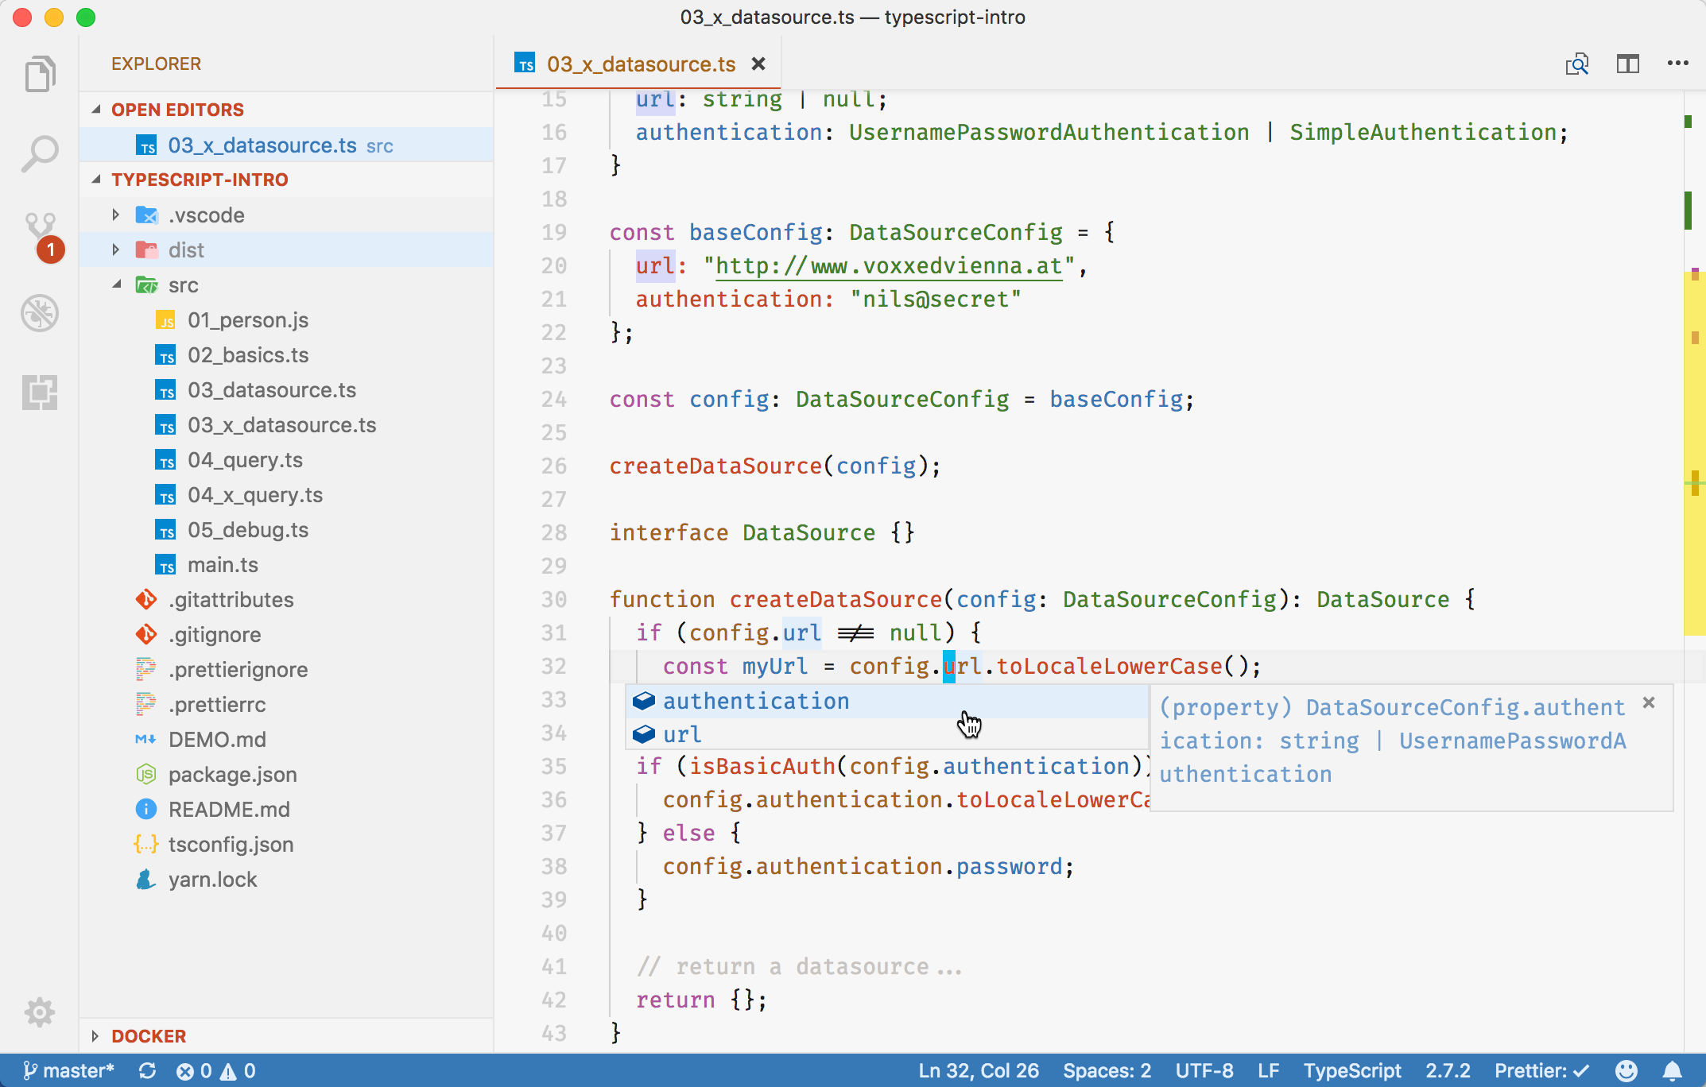
Practical introduction!
Demo

Slide 6
Syntax

Slide 7
Type annotations
Using Types
Variables
let foo: string; // built-in types, for example: string, number, boolean

Slide 8
Type annotations
Using Types
Variables
let foo: string; // built-in types, for example: string, number, boolean
Functions
function sayIt(what: string) {
return `Saying: ${what}`;
}

Slide 9
Type annotations
Using Types
Variables
let foo: string; // built-in types, for example: string, number, boolean
Functions
function sayIt(what: string) {
return `Saying: ${what}`;
}
Specifying Types is optional, Types will then be inferred:
let result = 7; inferred Type: number
result = sayIt('Lars') // Error (inferred type of sayIt: string)

Slide 10
Type annotations
any Type
let foo: any; // allow usage of all types, no typechecking
foo = "Klaus"; // OK
foo = 7; // OK
foo = null; // OK
In "strict mode" TypeScript will never assign any to a type (but you can use it explicitly)

Slide 11
Union Types
A Union Type indicates that a value can be one of several types
let foo: string | number;
foo = 7; // OK
foo = "Seven"; // also OK
foo = false; // ERROR

Slide 12
Null and undefined
null and undefined are own types in TypeScript
Types are not nullable and cannot be undefined (with "strictNullChecks")
let a: string = "Klaus";
a = null; // Error
Use union type to allow null:
let a: string | null = "Klaus;
a = null; // OK
Same for undefined:
let a: string | undefined;

Slide 13
String Literal Type
String Literal Type
You can define what actual value a string might have
type Language = "Java" | "TypeScript";
const java:Language = "Java"; // OK
const cpp:Language = "C++"; // ERROR

Slide 14
Own Types
Defining own Types – interfaces define Shape of an Object
interface Person { // alternative: type
firstName: string,
lastName: string|null, // nullable Type ("a String or null")
age?: number // optional type (might be undefined)
}

Slide 15
Own Types
Defining own Types - Usage
interface Person { // alternative: type
firstName: string,
lastName: string|null, // nullable Type ("a String or null")
age?: number // optional type (might be undefined)
}
function sayHello(p: Person) {
console.log(`Hello, ${p.lastName}`);
p.lastName.toUpperCase(); // Error: Object is possibly null
}
sayHello({firstName: 'Klaus', lastName: null}); // OK
sayHello({firstName: 'Klaus', lastName: 777}); // Error: lastName not a string
sayHello({firstName: 'Klaus', lastName: 'Mueller', age: 32}); // OK

Slide 16
Structural Identity
TypeScript uses Structural Identity for Types
interface Person {
name: string
}
interface Animal {
name: string
}
// create a Person
const p:Person = { name: 'Klaus' };
// assign the Person to an Animal
const a:Animal = p; // OK as Person and Animal have same structure
// (would not work in Java/C#)

Slide 17
Classes
Class Syntax same as ES6 but with visibility
class Person {
private name: string
constructor(name: string) {
this.name = name;
}
}
const p = new Person("Klaus");
console.log(p.name); // ERROR

Slide 18
Generics
Generics
interface Person { name: string };
interface Movie { title: string };
let persons:Array<Person> = [];
let movies:Array<Movie> = [];
persons.push({name: 'Klaus'}); // OK
movies.push({title: 'Batman'}); // OK
persons.push({title: 'Casablanca'}) // error ('title' not in Person)

Slide 19
Type Checking JavaScript Code
You can enable type checking even in a JS file!
Use the ts-check directive at the beginning of a file
You can add type information using JSDoc syntax
// @ts-check
/**
* @param {string} name The name
* @param {number} age The age
*/
function newPerson(name, age) {
name.toLowerCase(); // OK
age.toLowerCase(); // ERROR Property 'toLowerCase' does not exist on type 'number'
}

Slide 20
HTTPS://NILSHARTMANN.NET | @nilshartmann
Thank you!
Slides: http://bit.ly/voxxed-vienna-typescript
Questions?

