Slide 1


Python Dictionaries
Chapter 9
Python for Everybody
www.py4e.com
Notes:
Note from Chuck. If you are using these materials, you can remove the UM logo and replace it with your own, but please retain the CC-BY logo on the first page as well as retain the entire last page.

Slide 2
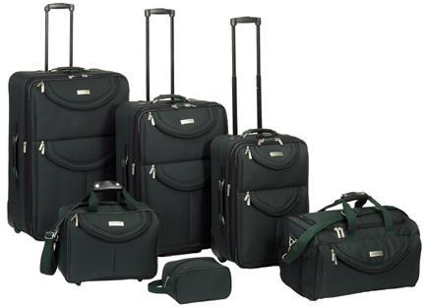
What is a Collection?
A collection is nice because we can put more than one value in it and carry them all around in one convenient package
We have a bunch of values in a single “variable”
We do this by having more than one place “in” the variable
We have ways of finding the different places in the variable

Slide 3
What is Not a “Collection”?
Most of our variables have one value in them - when we put a new value in the variable - the old value is overwritten
$ python
>>> x = 2
>>> x = 4
>>> print(x)
4

Slide 4
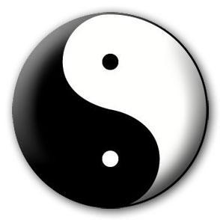
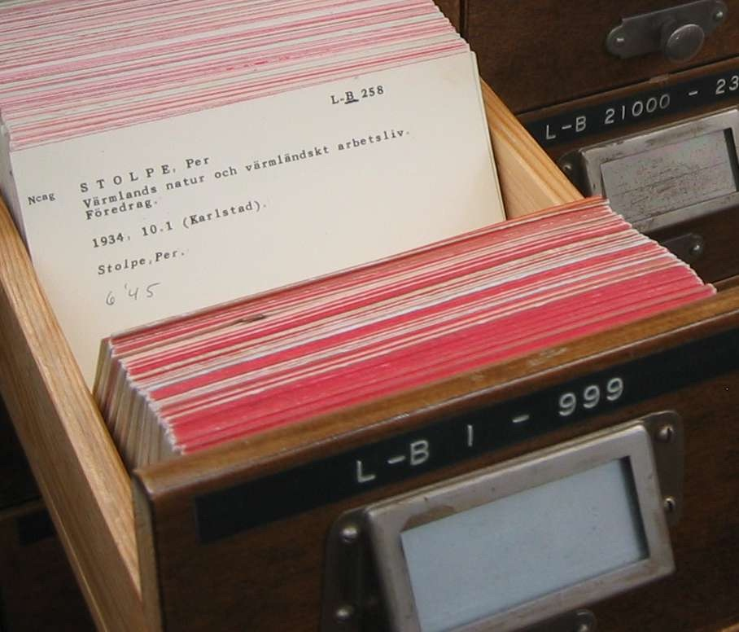
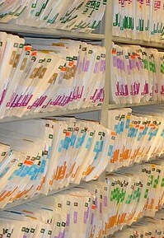
A Story of Two Collections..
List
A linear collection of values Lookup by position 0 .. length-1
Dictionary
A linear collection of key-value pairs Lookup by "tag" or "key"
https://en.wikipedia.org/wiki/Index_card#/media/File:LA2-katalogkort.jpg
https://commons.wikimedia.org/wiki/File:Shelves-of-file-folders.jpg

Slide 5
Dictionaries
Dictionaries are Python’s most powerful data collection
Dictionaries allow us to do fast database-like operations in Python
Similar concepts in different programming languages
- Associative Arrays - Perl / PHP
- Properties or Map or HashMap - Java
- Property Bag - C# / .Net

Slide 6
Dictionaries over time in Python
Python 3.7 and later dictionaries keep entries in the order they were inserted
Prior to Python 3.7 dictionaries did not keep entries in the order of insertion (a pure hash table)
"insertion order" is not "sorted by key order"

Slide 7
Below the Abstraction
Python lists, dictionaries, and tuples are "abstract objects" designed to be easy to use
For now we will just understand them and use them and thank the creators of Python for making them easy for us
Using Python collections is easy. Creating the code to support them is tricky and uses Computer Science concepts like dynamic memory, arrays, linked lists, hash maps and trees.
But that implementation detail is for a later course…

Slide 8
Dictionaries
>>> purse = dict()
>>> purse['money'] = 12
>>> purse['candy'] = 3
>>> purse['tissues'] = 75
>>> print(purse)
{'money': 12, 'candy': 3, 'tissues': 75}
>>> print(purse['candy'])
3
>>> purse['candy'] = purse['candy'] + 2
>>> print(purse)
{'money': 12, 'candy': 5, 'tissues': 75}
We append values to the end of a List and look them up by position
We insert values into a Dictionary using a key and retrieve them using a key

Slide 9
Comparing Lists and Dictionaries
Dictionaries are like lists except that they use keys instead of numbers to look up values
>>> ddd = dict()
>>> ddd['age'] = 21
>>> ddd['course'] = 182
>>> print(ddd)
{'age': 21, 'course': 182}
>>> ddd['age'] = 23
>>> print(ddd)
{'age': 23, 'course': 182}
>>> lst = list()
>>> lst.append(21)
>>> lst.append(183)
>>> print(lst)
[21, 183]
>>> lst[0] = 23
>>> print(lst)
[23, 183]

Slide 10
>>> lst = list()
>>> lst.append(21)
>>> lst.append(183)
>>> print(lst)
[21, 183]
>>> lst[0] = 23
>>> print(lst)
[23, 183]
List
Key
Value
[0]
21
lst
[1]
183
>>> ddd = dict()
>>> ddd['age'] = 21
>>> ddd['course'] = 182
>>> print(ddd)
{'age': 21, 'course': 182}
>>> ddd['age'] = 23
>>> print(ddd)
{'age': 23, 'course': 182}
Dictionary
Key
Value
['age']
21
ddd
['course']
182

Slide 11
Dictionary Literals (Constants)
Dictionary literals use curly braces and have key : value pairs
You can make an empty dictionary using empty curly braces
>>> jjj = { 'chuck' : 1 , 'fred' : 42, 'jan': 100}
>>> print(jjj)
{'chuck': 1, 'fred': 42, 'jan': 100}
>>> ooo = { }
>>> print(ooo)
{}
>>>

Slide 12
Most Common Name?

Slide 13
Most Common Name?
marquard
cwen
cwen
zhen
zhen
marquard
csev
csev
zhen
marquard
zhen
csev
zhen

Slide 14
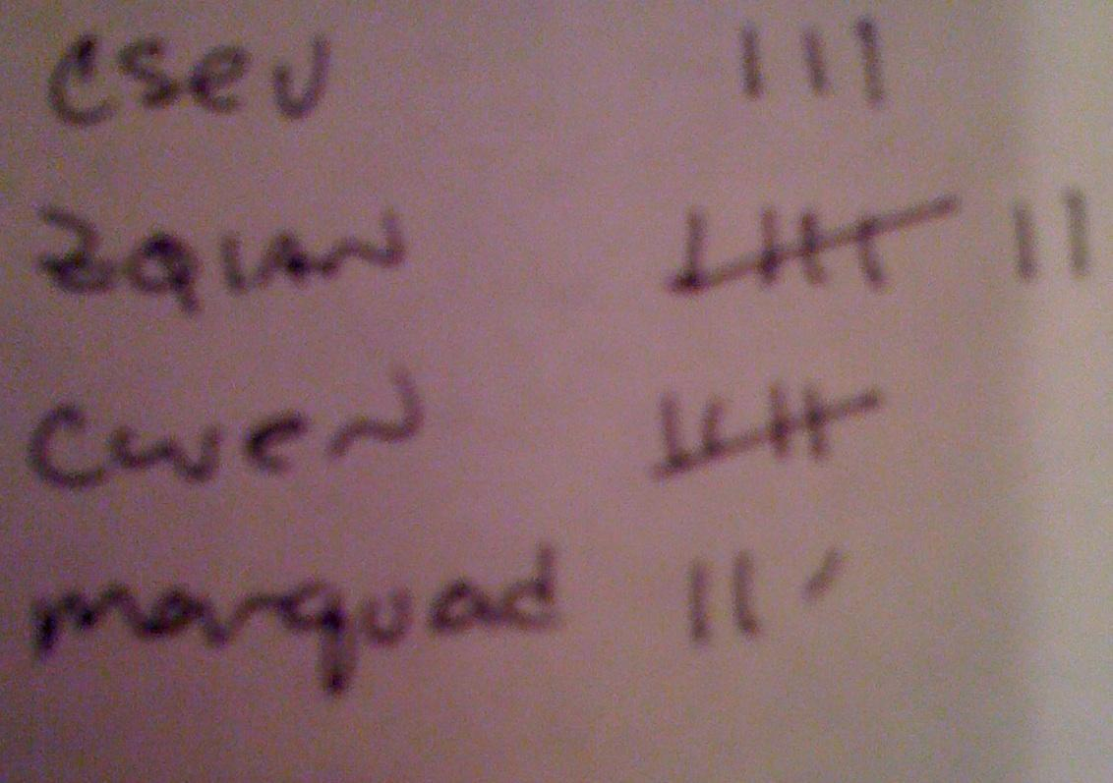
Most Common Name?
marquard
cwen
cwen
zhen
zhen
marquard
csev
csev
zhen
marquard
zhen
csev
zhen

Slide 15
Many Counters with a Dictionary
One common use of dictionaries is counting how often we “see” something
Key
Value
>>> ccc = dict()
>>> ccc['csev'] = 1
>>> ccc['cwen'] = 1
>>> print(ccc)
{'csev': 1, 'cwen': 1}
>>> ccc['cwen'] = ccc['cwen'] + 1
>>> print(ccc)
{'csev': 1, 'cwen': 2}

Slide 16
Dictionary Tracebacks
It is an error to reference a key which is not in the dictionary
We can use the in operator to see if a key is in the dictionary
>>> ccc = dict()
>>> print(ccc['csev'])
Traceback (most recent call last):
File "<stdin>", line 1, in <module>
KeyError: 'csev'
>>> 'csev' in ccc
False

Slide 17
When We See a New Name
When we encounter a new name, we need to add a new entry in the dictionary and if this the second or later time we have seen the name, we simply add one to the count in the dictionary under that name
counts = dict()
names = ['csev', 'cwen', 'csev', 'zqian', 'cwen']
for name in names :
if name not in counts:
counts[name] = 1
else :
counts[name] = counts[name] + 1
print(counts)
{'csev': 2, 'cwen': 2 , 'zqian': 1}

Slide 18
The get Method for Dictionaries
The pattern of checking to see if a key is already in a dictionary and assuming a default value if the key is not there is so common that there is a method called get() that does this for us
if name in counts:
x = counts[name]
else :
x = 0
x = counts.get(name, 0)
Default value if key does not exist (and no Traceback).
{'csev': 2, 'cwen': 2 , 'zqian': 1}

Slide 19
Simplified Counting with get()
We can use get() and provide a default value of zero when the key is not yet in the dictionary - and then just add one
counts = dict()
names = ['csev', 'cwen', 'csev', 'zqian', 'cwen']
for name in names :
counts[name] = counts.get(name, 0) + 1
print(counts)
{'csev': 2, 'cwen': 2 , 'zqian': 1}
Default

Slide 20

Simplified Counting with get()
counts = dict()
names = ['csev', 'cwen', 'csev', 'zqian', 'cwen']
for name in names :
counts[name] = counts.get(name, 0) + 1
print(counts)
Sesame Street - Counting Is Wonderful (The National Counting Day Song)

Slide 21
Counting Words in Text

Slide 22
Writing programs (or programming) is a very creative and rewarding activity. You can write programs for many reasons ranging from making your living to solving a difficult data analysis problem to having fun to helping someone else solve a problem. This book assumes that everyone needs to know how to program and that once you know how to program, you will figure out what you want to do with your newfound skills.
We are surrounded in our daily lives with computers ranging from laptops to cell phones. We can think of these computers as our “personal assistants” who can take care of many things on our behalf. The hardware in our current-day computers is essentially built to continuously ask us the question, “What would you like me to do next?”
Our computers are fast and have vast amounts of memory and could be very helpful to us if we only knew the language to speak to explain to the computer what we would like it to do next. If we knew this language we could tell the computer to do tasks on our behalf that were repetitive. Interestingly, the kinds of things computers can do best are often the kinds of things that we humans find boring and mind-numbing.

Slide 23
Counting Pattern
counts = dict()
print('Enter a line of text:')
line = input('')
words = line.split()
print('Words:', words)
print('Counting...')
for word in words:
counts[word] = counts.get(word,0) + 1
print('Counts', counts)
The general pattern to count the words in a line of text is to split the line into words, then loop through the words and use a dictionary to track the count of each word independently.

Slide 24
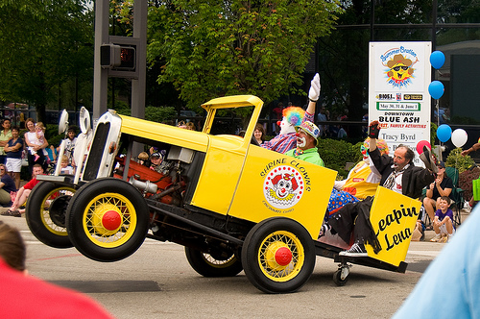
python wordcount.py
Enter a line of text:
the clown ran after the car and the car ran into the tent and the tent fell down on the clown and the car
Words: ['the', 'clown', 'ran', 'after', 'the', 'car', 'and', 'the', 'car', 'ran', 'into', 'the', 'tent', 'and', 'the', 'tent', 'fell', 'down', 'on', 'the', 'clown', 'and', 'the', 'car']
Counting…
Counts {'the': 7, 'clown': 2, 'ran': 2, 'after': 1, 'car': 3, 'and': 3, 'into': 1, 'tent': 2, 'fell': 1, 'down': 1, 'on': 1}
http://www.flickr.com/photos/71502646@N00/2526007974/

Slide 25
python wordcount.py
Enter a line of text:
the clown ran after the car and the car ran into the tent and the tent fell down on the clown and the car
Words: ['the', 'clown', 'ran', 'after', 'the', 'car', 'and', 'the', 'car', 'ran', 'into', 'the', 'tent', 'and', 'the', 'tent', 'fell', 'down', 'on', 'the', 'clown', 'and', 'the', 'car']
Counting...
Counts {'the': 7, 'clown': 2, 'ran': 2, 'after': 1, 'car': 3, 'and': 3, 'into': 1, 'tent': 2, 'fell': 1, 'down': 1, 'on': 1}
counts = dict()
line = input('Enter a line of text:')
words = line.split()
print('Words:', words)
print('Counting...’)
for word in words:
counts[word] = counts.get(word,0) + 1
print('Counts', counts)

Slide 26
Definite Loops and Dictionaries
We can write a for loop that goes through all the entries in a dictionary - actually it goes through all of the keys in the dictionary and looks up the values
>>> counts = { 'chuck' : 1 , 'fred' : 42, 'jan': 100}
>>> for key in counts:
... print(key, counts[key])
...
chuck 1
fred 42
jan 100
>>>

Slide 27
Retrieving Lists of Keys and Values
>>> jjj = { 'chuck' : 1 , 'fred' : 42, 'jan': 100}
>>> print(list(jjj))
['chuck', 'fred', 'jan']
>>> print(list(jjj.keys()))
['chuck', 'fred', 'jan']
>>> print(list(jjj.values()))
[1, 42, 100]
>>> print(list(jjj.items()))
[('chuck', 1), ('fred', 42), ('jan', 100)]
>>>
You can get a list of keys, values, or items (both) from a dictionary
What is a “tuple”? - coming soon...

Slide 28
Bonus: Two Iteration Variables!
We loop through the key-value pairs in a dictionary using *two* iteration variables
Each iteration, the first variable is the key and the second variable is the corresponding value for the key
jjj = { 'chuck' : 1 , 'fred' : 42, 'jan': 100}
for aaa,bbb in jjj.items() :
print(aaa, bbb)
chuck 1
fred 42
jan 100
aaa
bbb
[chuck]
1
[fred]
42
[jan]
100

Slide 29
name = input('Enter file:')
handle = open(name)
counts = dict()
for line in handle:
words = line.split()
for word in words:
counts[word] = counts.get(word,0) + 1
bigcount = None
bigword = None
for word,count in counts.items():
if bigcount is None or count > bigcount:
bigword = word
bigcount = count
print(bigword, bigcount)
python words.py
Enter file: words.txt
to 16
python words.py
Enter file: clown.txt
the 7
Using two nested loops

Slide 30
Summary
What is a collection
Lists versus dictionaries
Dictionary Constants
The most common word
Using the get() method
Writing dictionary loops
Sneak peek: Tuples

Slide 31
Acknowledgements / Contributions
These slides are Copyright 2010- Charles R. Severance (www.dr-chuck.com) of the University of Michigan School of Information and open.umich.edu and made available under a Creative Commons Attribution 4.0 License. Please maintain this last slide in all copies of the document to comply with the attribution requirements of the license. If you make a change, feel free to add your name and organization to the list of contributors on this page as you republish the materials.
Initial Development: Charles Severance, University of Michigan School of Information
… Insert new Contributors or translation credits here
...

