Slide 1

Propagation Model
Inhomogeneous wave equation (B = 0, cylindrical symmetry, comoving frame)
+ slowly evolving wave approx
Take further approx of splitting field into driving laser and generated harmonic components
and may then apply assumptions appropriate for each component

Slide 2






Laser Component
Can neglect absorption by gas and over small distances can approximate diffraction and nonlinear polarisation steps acting separately
(i) Diffraction
solved by Crank-Nicolson finite difference method
(ii) Polarisation
calculated in time-domain via plasma frequency
At sufficient densities plasma defocussing & blue-shifting emerge via refractive index

Slide 3




Harmonic Component
Neglect free-electron effects since XUV frequencies greatly exceed plasma frequency
Again split propagation into steps
(i) Diffraction
solved by Crank-Nicolson finite difference method
(ii) Reabsorption by gas through XUV absorption cross-section
(iii) Dipole response
calculated by single-atom SFA/QO or TDSE method

Slide 4
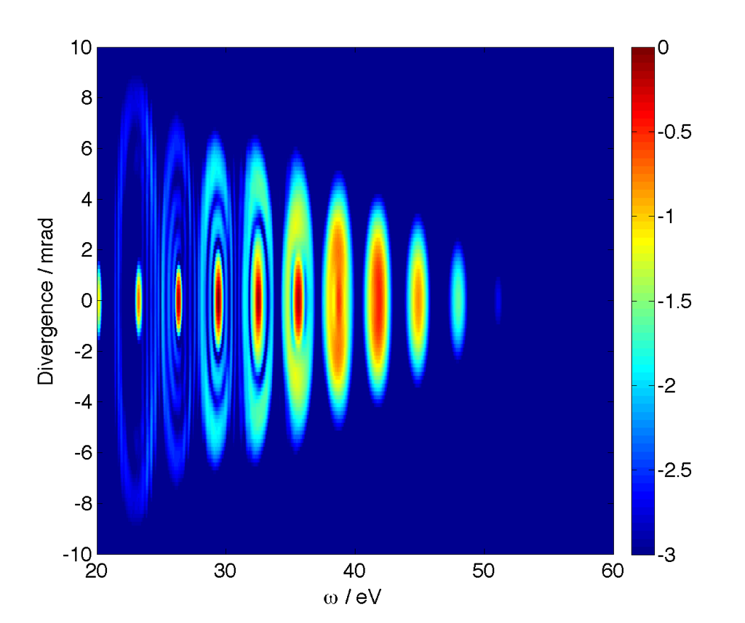
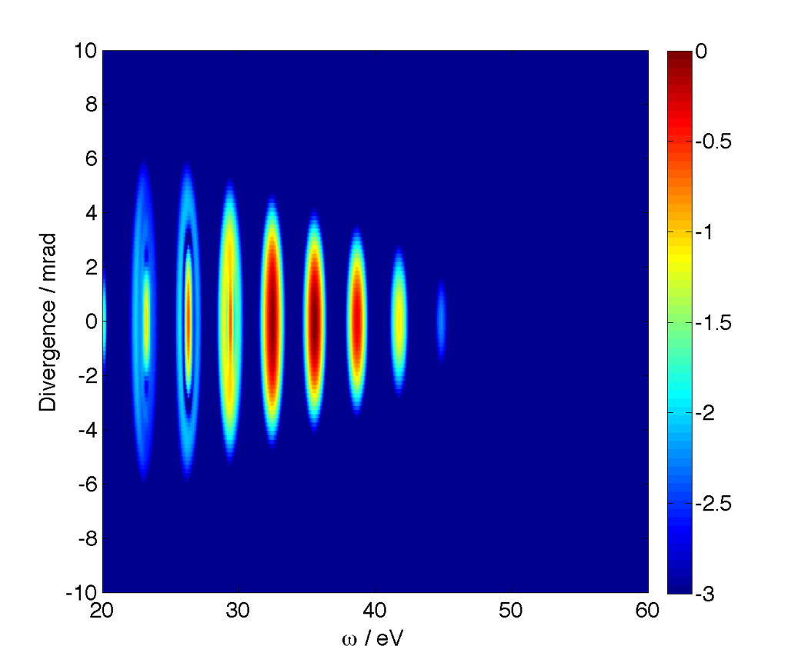
Single Colour Propagation
Harmonic emission varies greatly with gas jet position
zj = 0mm
zj = +4mm
800nm, 1.5x10¹⁴Wcm⁻², 20fs pulse focused to 40μm
Argon gas jet of 1mm width & peak density 10¹⁸ atoms/cm³

Slide 5
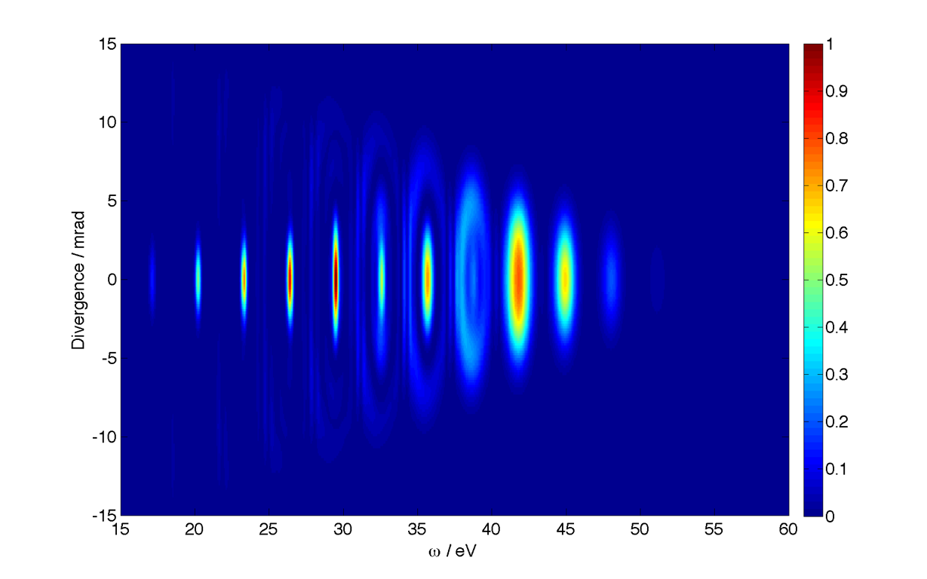
Deconstruction of Emission
800nm, 2x10¹⁴Wcm⁻², 20fs pulse focused to 30μm
zj = +1mm, Δz = 0.3mm

Slide 6
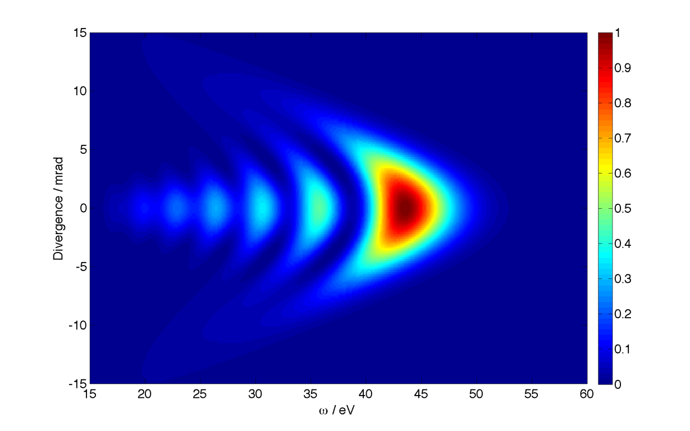
Deconstruction of Emission
5 half-cycles
1 half-cycle

Slide 7
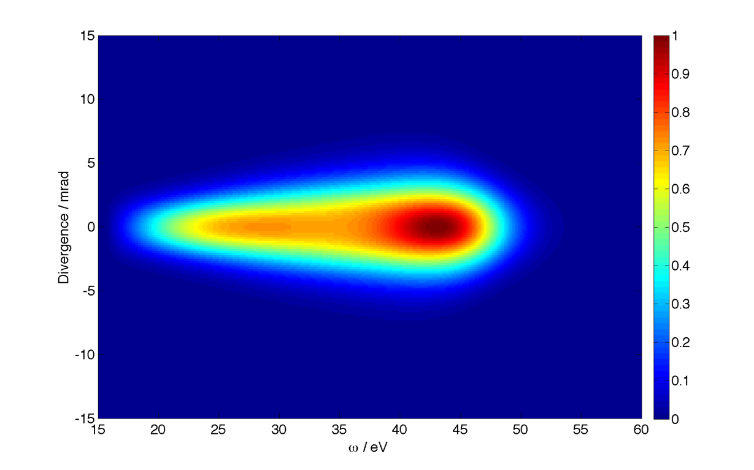
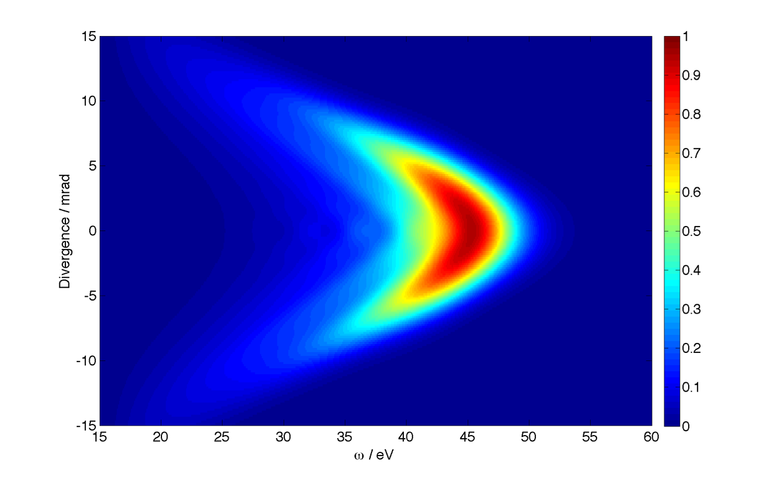
Deconstruction of Emission
short only
1 half-cycle
long only

Slide 8
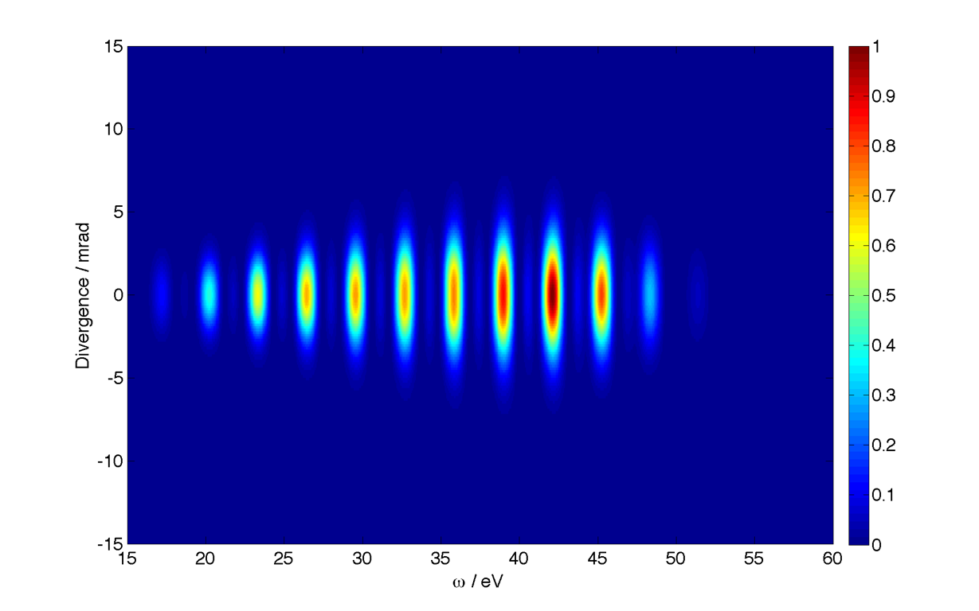
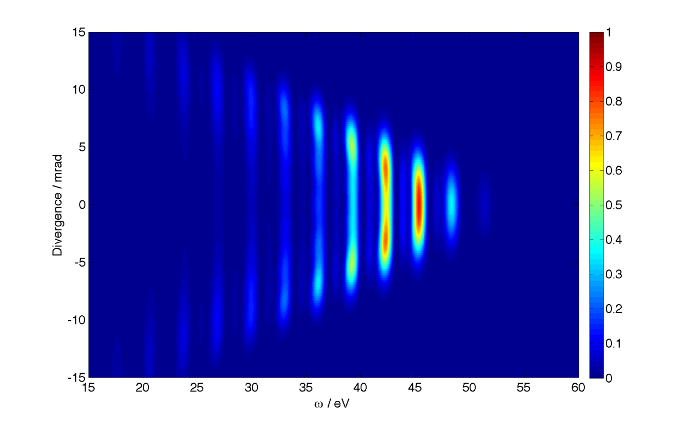
Deconstruction of Emission
short only
5 half-cycles
long only

