Slide 2
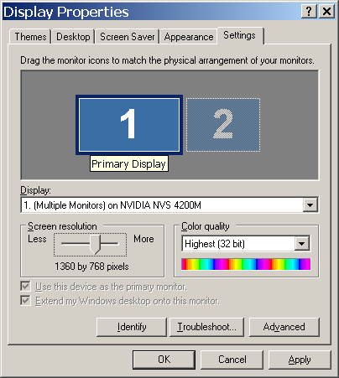

Slide 3
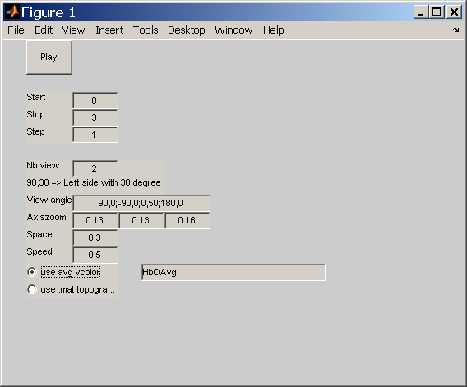
Setting cortex

Slide 4
Crop ©
X = 250:850
Y = 70:250

Slide 5
Add Title
Width de title

