Slide 2
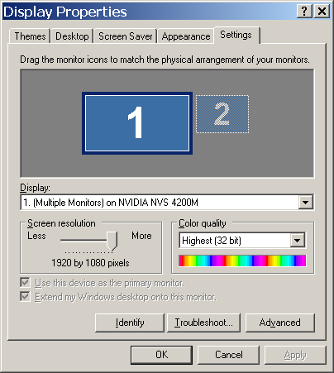

Slide 3
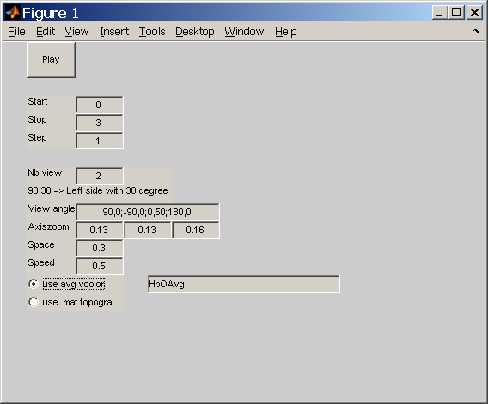
Setting cortex

Slide 4
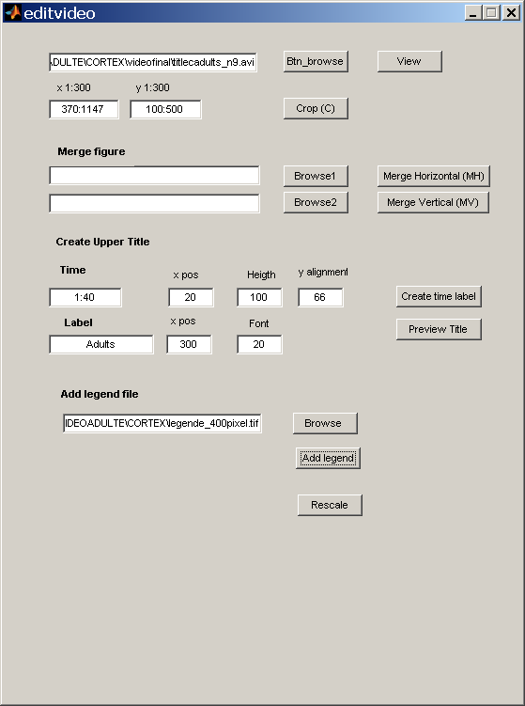

Slide 5
Final (old version)
500x840
66
300
20
150
780
40
350

