Slide 1
Building Up the Regional MOM6 for the Indian Ocean
Luyu Sun
Department of Atmospheric and Oceanic Science, University of Maryland at College Park, College Park, Maryland
lysun@umd.edu

Slide 2
Outline
Section 1: Compilation of MOM6
Section 2: Building the regional Indian Ocean Model
Building the gridding system
Setting up atmospheric forcing
Setting up the open boundary condition
Section 3: Model running and outputs

Slide 3
Section 1: Compilation of MOM6
Check out https://github.com/NOAA-GFDL/MOM6-examples/wiki/Getting-started (use MOM6-SIS2)
If MOM6 is successfully compiled, an executive file is generated at MOM6-examples/build/intel/ice_ocean_SIS2/repro/MOM6

Slide 4
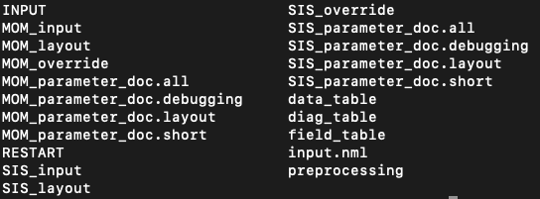
Section 2: Building the regional Indian Ocean model
Under working directory MOM6-examples/Indian:
Create a working directory (e.g. MOM6-examples/Indian)
Download/Git clone the basic files of the regional Indian Ocean model (https://github.com/lysun0725/MOM6-Indian-Ocean) under the working directory
Create a new folder RESTART under the working directory
Under Indian/INPUT:
Under Indian/preprocessing:

Slide 5
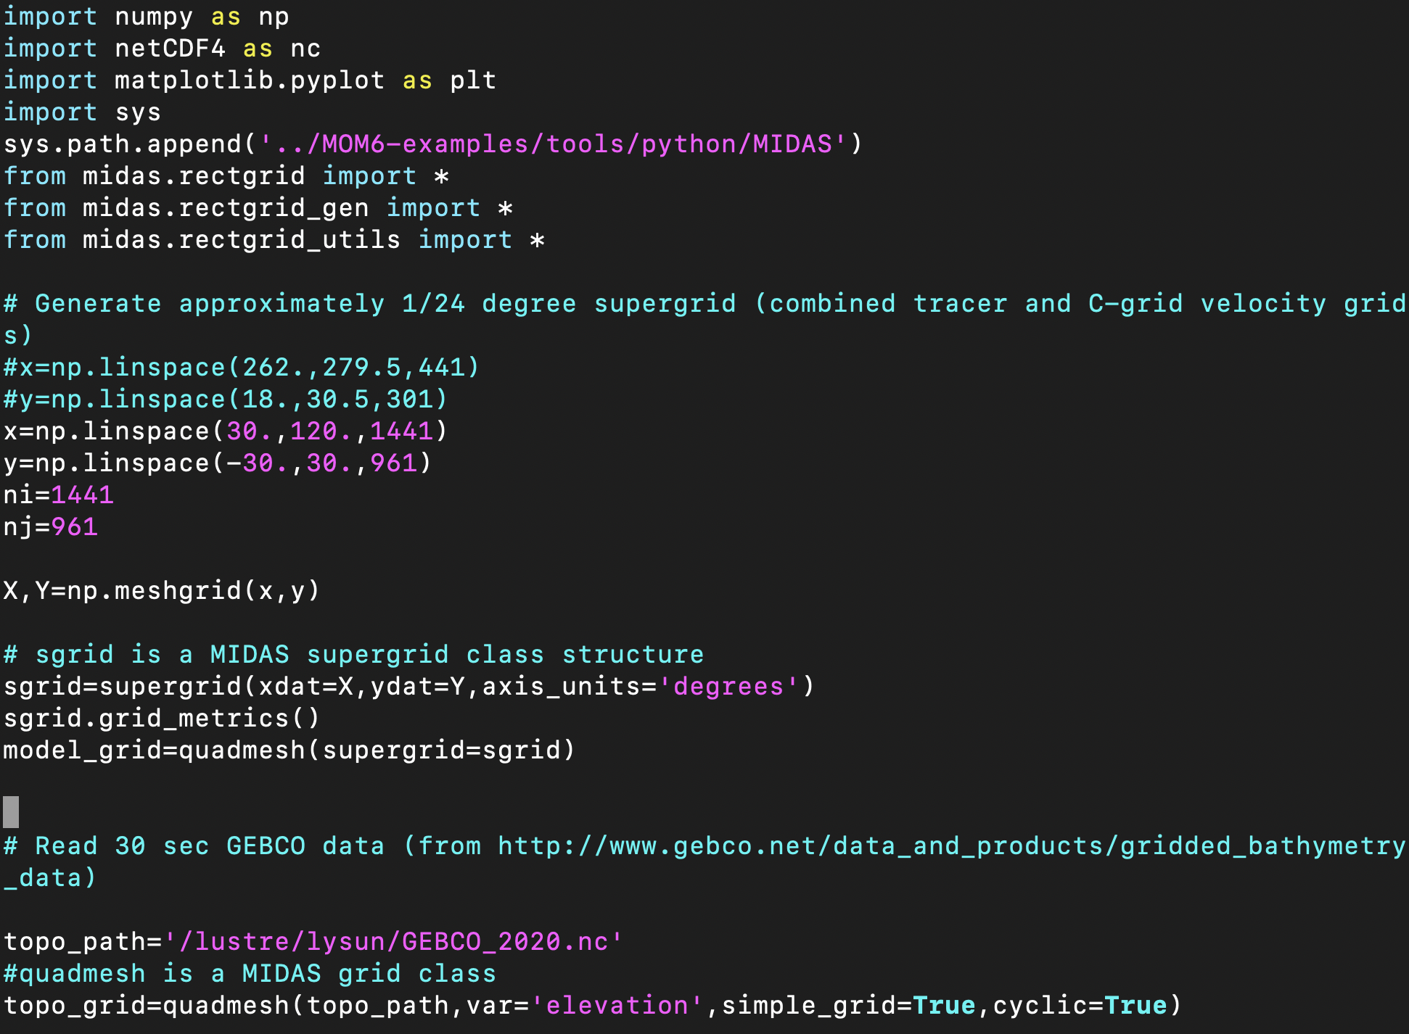
Building the gridding system for the Indian Ocean in Indian/preprocessing
Download the global GEBCO gridded bathymetry data file (e.g. GEBCO_2020.nc) and copy it to the preprocessing folder (i.e. MOM6-examples/Indian/preprocessing).
Use IndianOceanGridandTopo.py to create horizontal grids:
Compile MIDAS packages at MOM6-examples/tools/python/MIDAS first
Link the library of MIDA in the python code (line 11)
Directory of MIDAS package

Slide 6
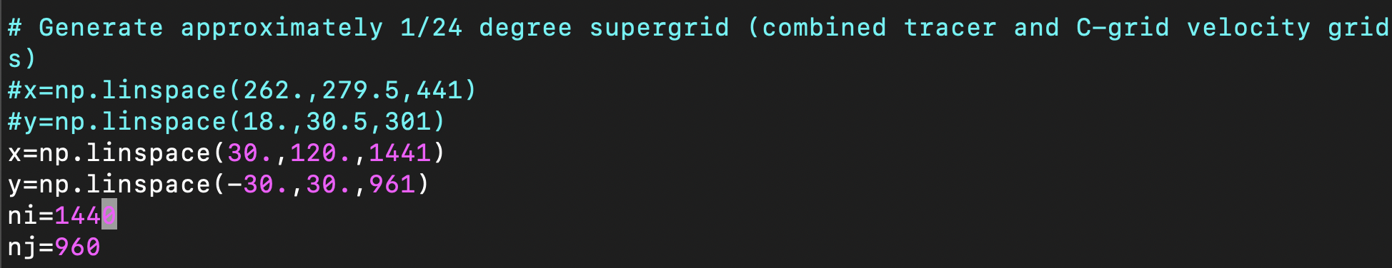
Building the gridding system for the Indian Ocean in Indian/preprocessing (Cont’d)
Use IndianOceanGridandTopo.py to create horizontal grids:
change the region boundary and number of grid points in longitude and latitude directions respectively (line 19 and 20)
e.g. the default is for 1/8-degree horizontal resolution
Setting up the grids for the super-grids (i.e. ½ of the target gridding space)
set up the path directory of GEBCO file (line 34)
Directory of the GEBCO file

Slide 7
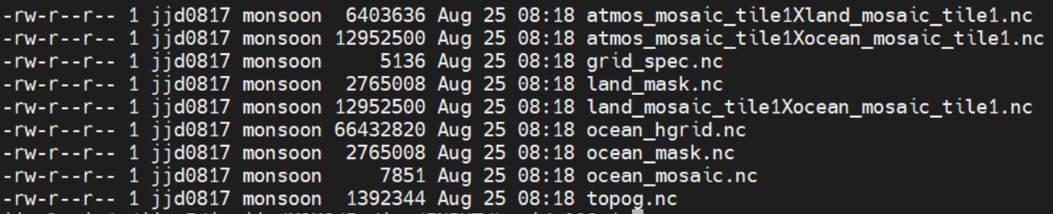
Building the gridding system for the Indian Ocean in Indian/preprocessing (Cont’d)
A successful execution of the python code can generate the following files and move them to Indian/INPUT/:
Change the horizontal grid numbers in MOM_input and SIS_input. For example, for a 1/8-degree model, the parameters NIGLOBAL and NJGLOBAL should be set as following:
NIGLOBAL = 720
NJGLOBAL = 480

Slide 8
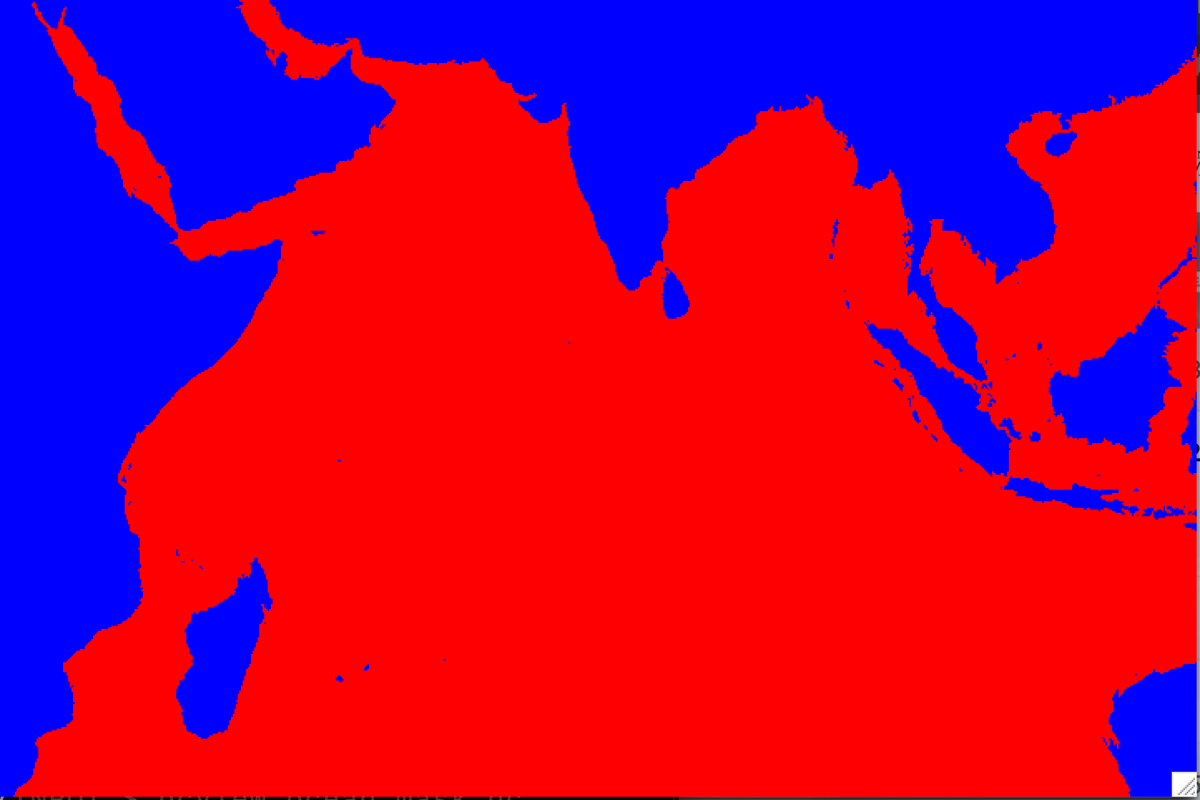
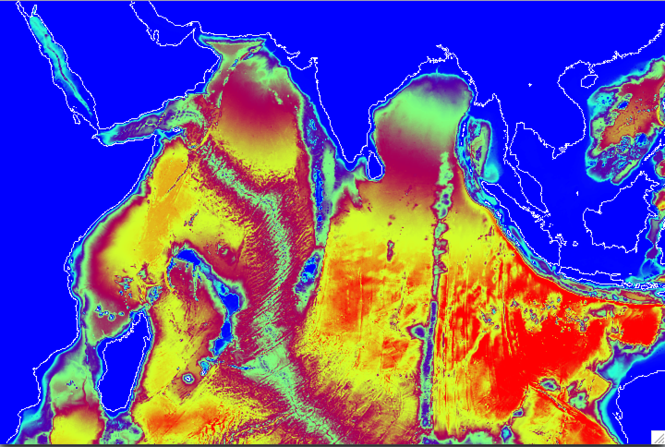
Example: ocean_mask.nc and topog.nc

Slide 9
Setting up atmospheric forcing
Download the dataset from 20 Century Reanalysis version 3 (20CRv3).
Modify the data file to adapt to MOM6
Change the attribute “calendar” of variable “time” using the following command:
ncatted -a calendar,time,m,c,gregorian <INFILE>
Change the order of latitude to monotonically increasing order:
ncpdq -a -lat <INFILE> <OUTFILE>
If there is not enough space to store all the atmospheric variables files, the 20CRv3 files can be cropped to cover only the Indian Ocean, e.g.
ncks -d lon,25.,125. -d lat,-35.,35. <INFILE> <OUTFILE>
Move all the modified atmospheric files in the INPUT/ folder

Slide 10
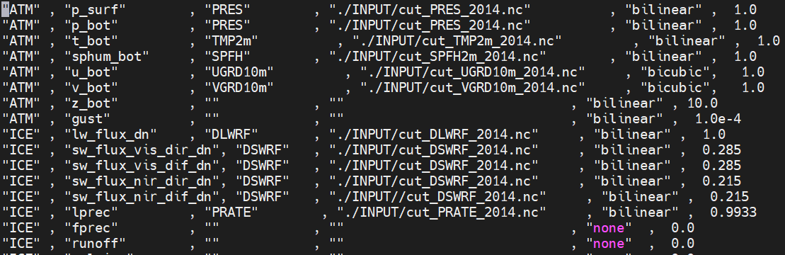
Setting up atmospheric forcing (Cont’d)
modify the data_table in the working directory (e.g. MOM6-examples/Indian).
Model variable
20CRv3 variable
20CRv3 file directory

Slide 11
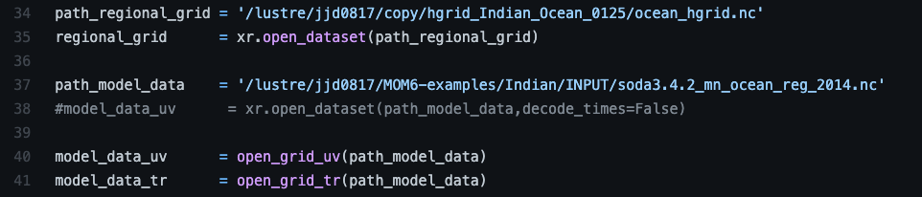
Setting up the open boundary condition based on SODA3
generate the OBC files for sea surface height (SSH), temperature, salinity and ocean current velocities using the python code:
https://github.com/DJJ0817/Aditya_MOM6/blob/main/open%20boundary%20condition/obc.py,
Directory of model grid
Directory of SODA3 file
If the code runs successfully, following files will be generated:
obc_ssh_east.nc, obc_ssh_north.nc, obc_ssh_south.nc, obc_ts_east.nc, obc_ts_north.nc, obc_ts_south.nc, obc_uv_east.nc, obc_uv_north.nc, obc_uv_south.nc.

Slide 12
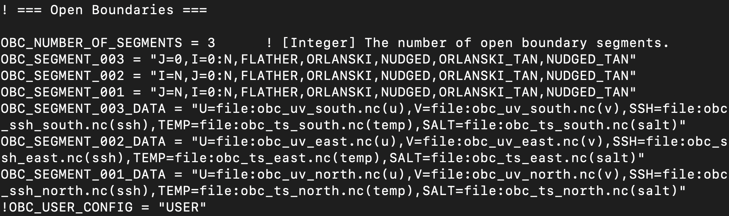
Setting up the open boundary condition based on SODA3 (Cont’d)
Move all the output files in the INPUT/ folder.
Modify MOM_override in the working directory if necessary:

Slide 13
Section 3: Model running and outputs
Copy the executive file “MOM6” in the working directory.

Slide 14
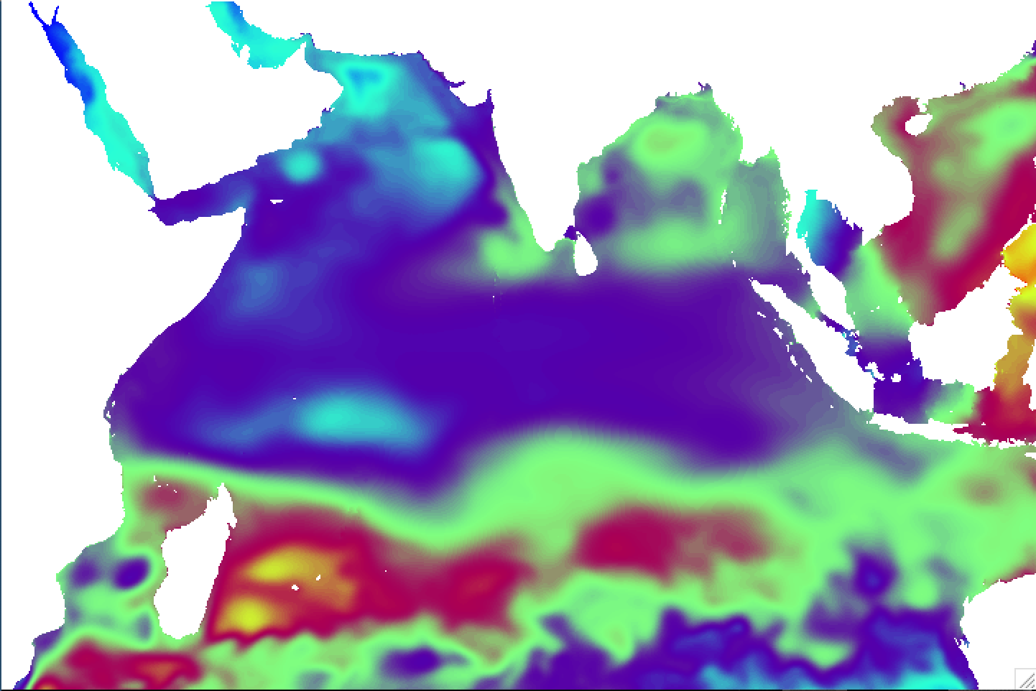
Output files
SSH (m)
RESTART files:
coupler.res
ice_model.res.nc
MOM.res.nc ( & MOM.res_1.nc)
Diagnostic files:
20140701.ocean_daily.res.nc
(use diag_table to define the output variables)

