Slide 1
Gym Management Application
David Fulton

Slide 2
Introduction
Gym management Application
Tools:
Ruby,
Postgres SQL
Sinatra (microframework)
HTML/CSS (pure)

Slide 3
Planning
Entity Relationship Diagram
Use Case
Sketches of mockup website (hand)

Slide 4
Requirement Specifications
CRUD (ADD/EDIT/DELETE/SAVE) for GymClass/Members/Booking Models
Querying the database to perform a certain action
Extensions : (optional)….
HTML/CSS Styling
TDD

Slide 5
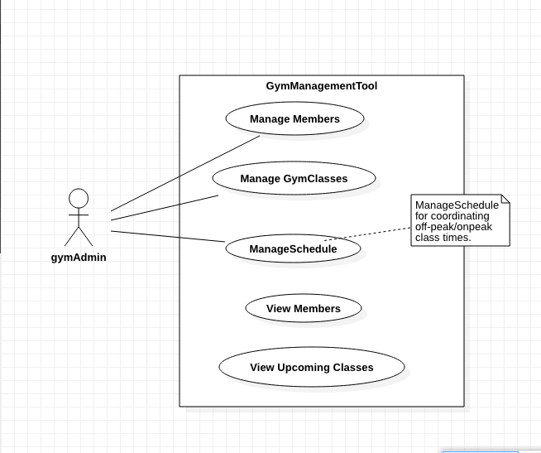

Slide 6
Challenges
Time Constraints
Understanding the meaning behind certain errors/bugs & how to resolve
Approaching the task. Where do I start?
How should the views look to the end-user?

Slide 7
Outcome
Main Requirements Achieved [CRUD features] and methods to perform certain actions such between the model-view and controller.
Extensions : 2 main . One prescribed and one of my own.

Slide 8
What Have I Learnt?
Importance of good planning
Testing is crucial
Avoiding the ‘big-bang’ approach
Avoiding trying to build ‘too much’…

Slide 9
What Could Have Been Done Differently
More time spent on planning
More rigorous testing from the onset
Model – would have added an additional table in backend

