Slide 1
Feeding the Data: Mining Patterns in Global Food Prices
Dataset Name: Global Food Prices (2000 – Present)
Team Members:
Mari
Dean
Jeremy

Slide 2
Introduction

Slide 3
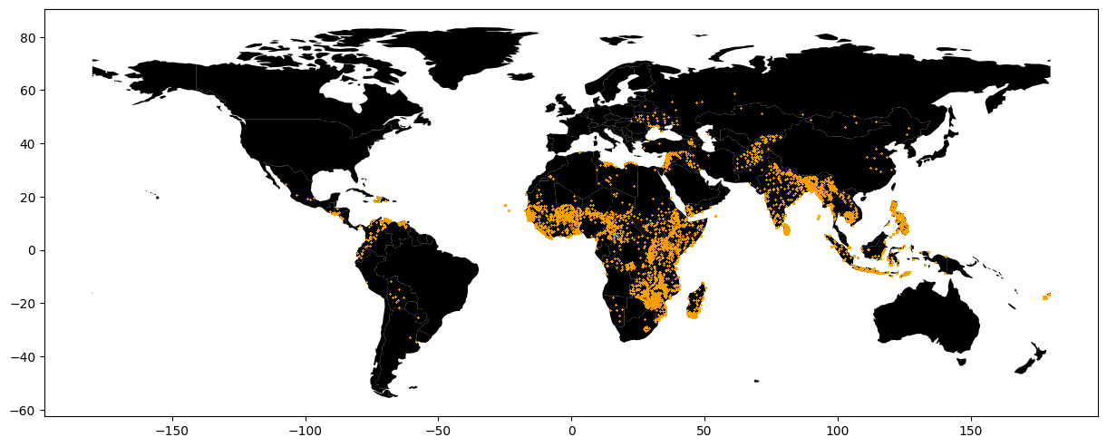
Dean: Where was this data taken from?

Slide 4
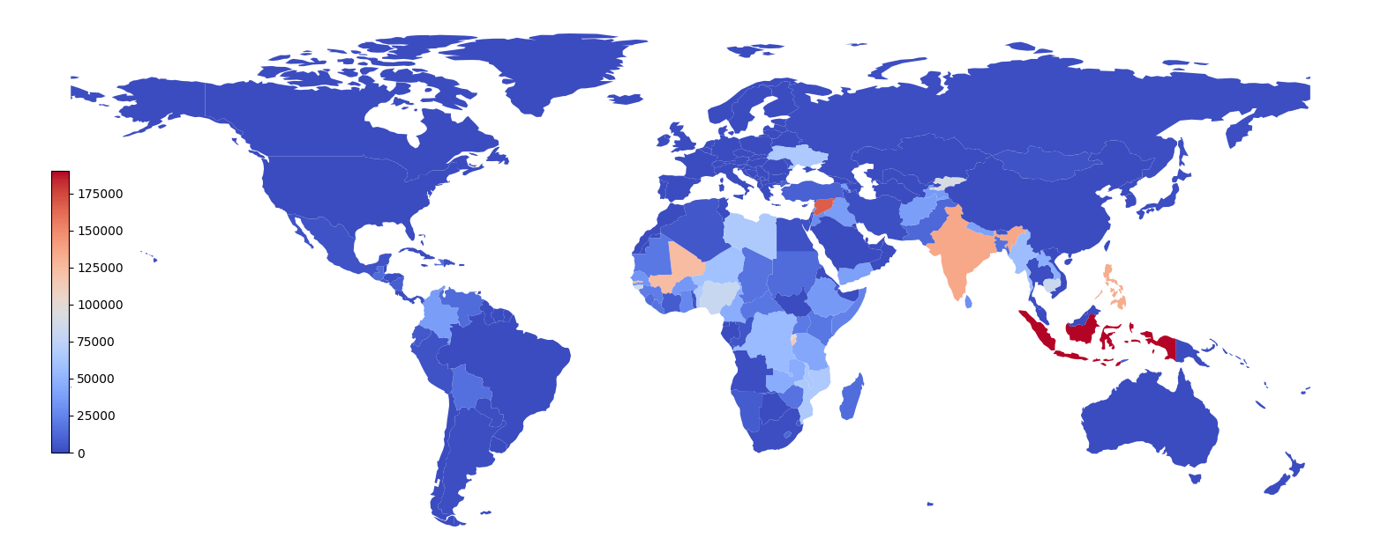
Dean: Where was this data taken from?

Slide 5
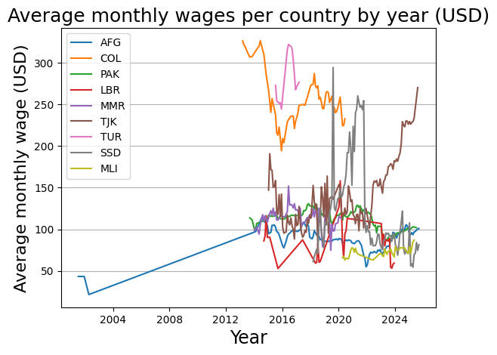
Dean: How have wages changed over time?

Slide 6
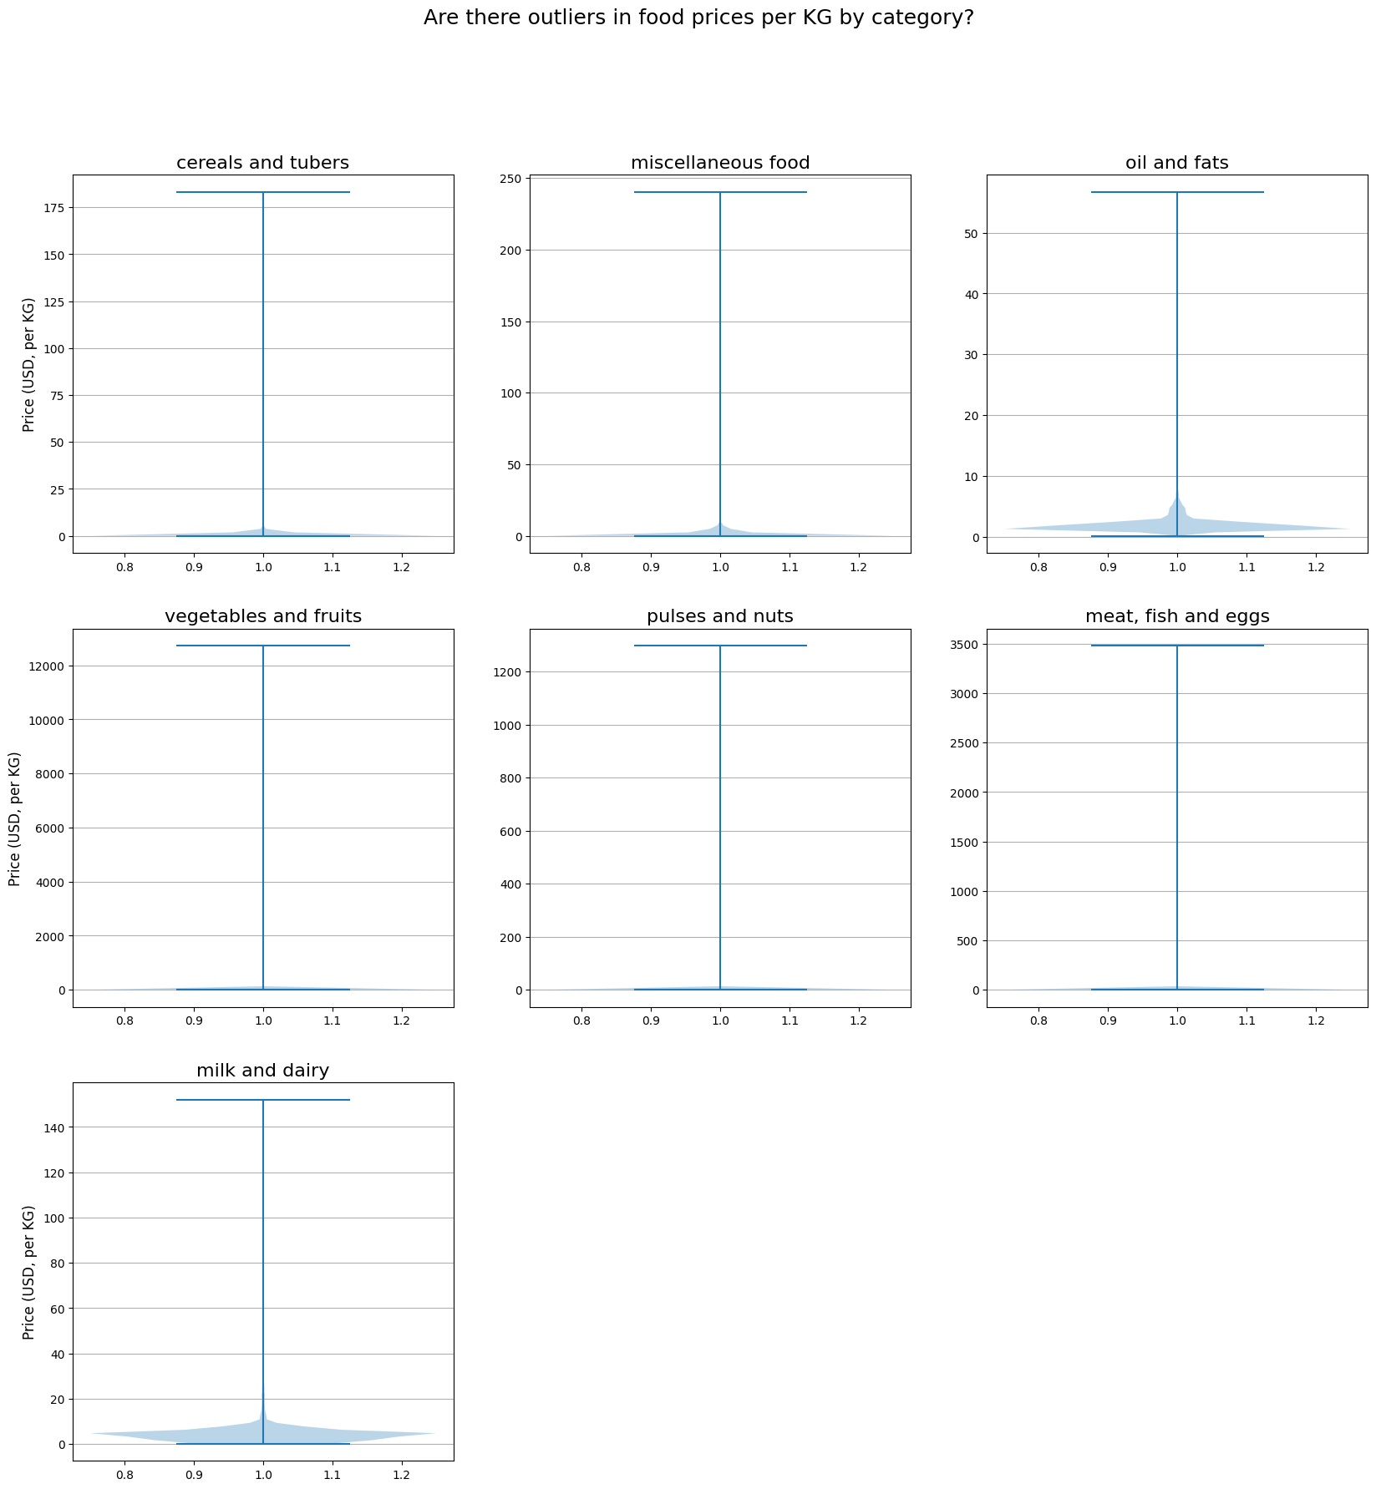
Dean: Are there outliers in the food prices?
Graph before removing outliers.

Slide 7
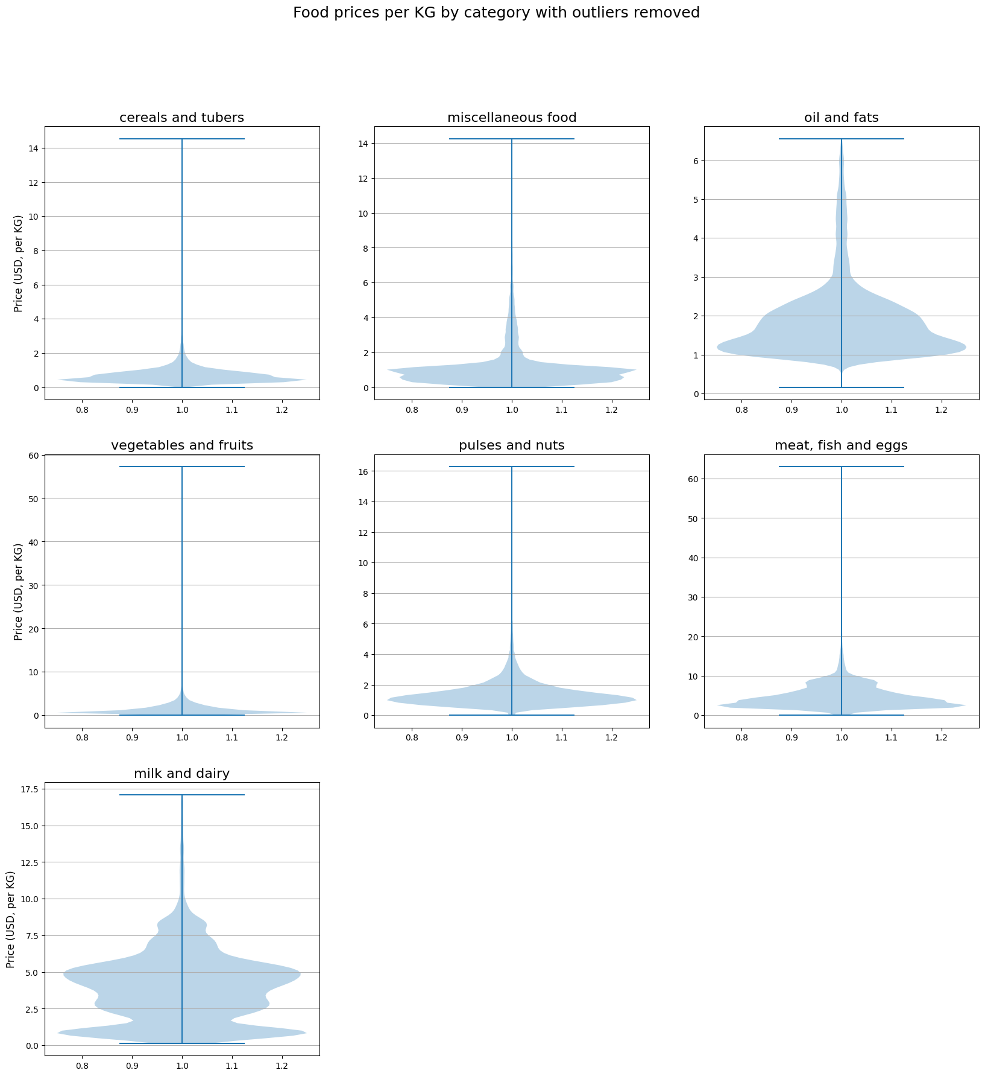
Dean: Are there outliers in the food prices?
Graph after removing outliers.

Slide 8

How have median food prices shifted between the 2000s, 2010s, and 2020s?

Slide 9
Methodology
First, I converted all dates into decade labels.
Then I cleaned the data by removing missing or invalid prices.
I calculated the median price for each decade because it handles outliers better.
Finally, I created a bar chart to compare the three decades.

Slide 10
Key Findings
Food prices increased in every decade.
The 2020s had the highest median prices.
This shows a long-term rise in global food costs.
Even with missing years, the upward trend was still very strong.

Slide 11

Can we classify foods as Perishable or Non-Perishable?

Slide 12
Methodology
I labeled foods as perishable or non-perishable using their category.
Then I selected features like price and location information.
Because the dataset was huge, I sampled 100,000 rows to avoid memory errors.
I encoded the text columns into numbers and trained a Decision Tree classifier.
I checked the model using accuracy and a confusion matrix.

Slide 13
Key Findings
The model could classify perishability fairly well.
Price and commodity type were the most helpful features.
The confusion matrix showed that some foods were still hard to predict.
Overall, the model showed that perishability can be estimated from basic market data.

Slide 14

Do different countries show unique patterns in the food items reported together?

Slide 15
Methodology
I selected the top three countries with the most records.
I grouped the data by country, market, and date to form “food baskets.”
Then I used the Apriori algorithm to find common food combinations.
I generated association rules and selected the strongest ones based on lift.
I visualized the top rules using a bar chart.

Slide 16
Key Findings
Each country showed different food combinations.
Some food pairs had very strong lift values, indicating strong relationships.
These patterns likely reflect regional diets or market habits.
Even with limited data, the rules still revealed meaningful insights.

Slide 17
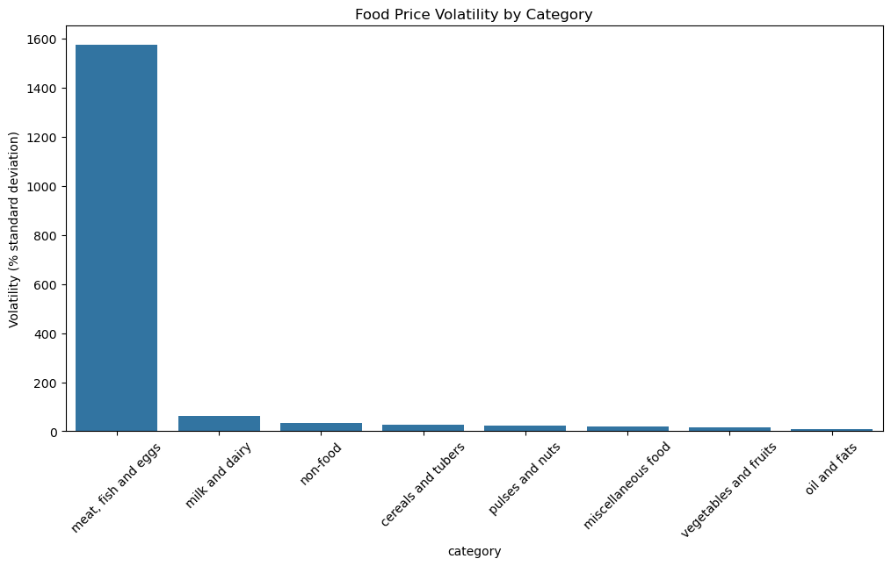
Price Volatility
How does food price volatility (month-to-month percent change) vary across very across different food categories, and which categories are the most unstable globally?

Slide 18
Methodology
Grouped by month-end dates and averaged within each food category
Used method-chained DataFrame operations, calculating every category using .pct_change()
Sorted by most to least volatile

Slide 19
Results
Graph Explanation
X-axis lists each food category
Y-axis measures volatility
Taller the bars the more the prices fluctuate more aggressively
Meat, fish, and eggs above 1500%
Other categories are more stable

Slide 20

Geographic Influence
Is there a relationship between a market's latitude/longitude and the average price level of essential staples (e.g., rice, wheat, maize)?

Slide 21
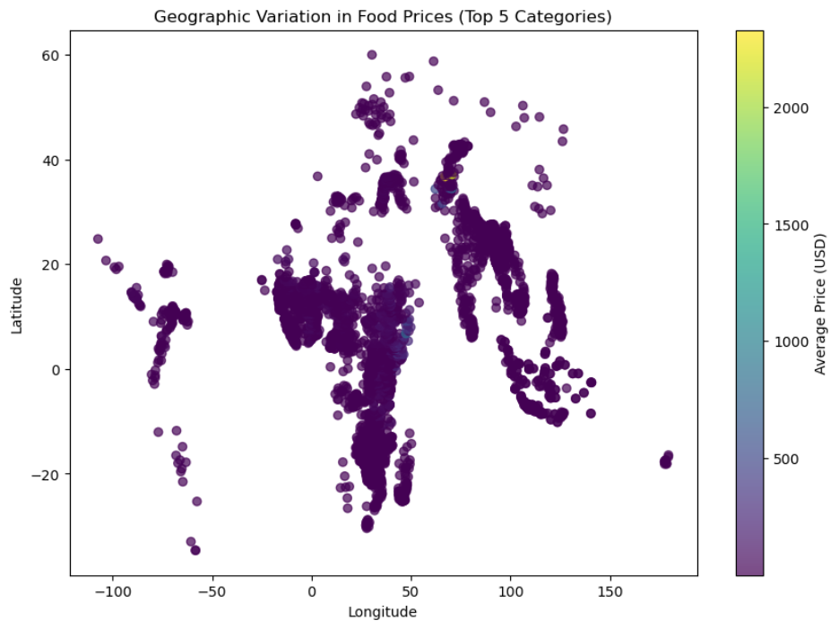
Methodology and purpose
Does geography play a role in shaping staple food prices?
Use each categories longitude and latitude and compare their location and their average prices
Lighter color represents a higher cost vs darker
Majority scattered across Africa, Middle East, and South Asia.

Slide 22
Results
Geography does not affect price separation for staple foods
Most markets fall within a similar price band
Very little color variation

Slide 23

Wages vs Affordability
How has the ratio of food prices to local wages (a proxy for affordability) changed over time in countries where wage data exists?

Slide 24
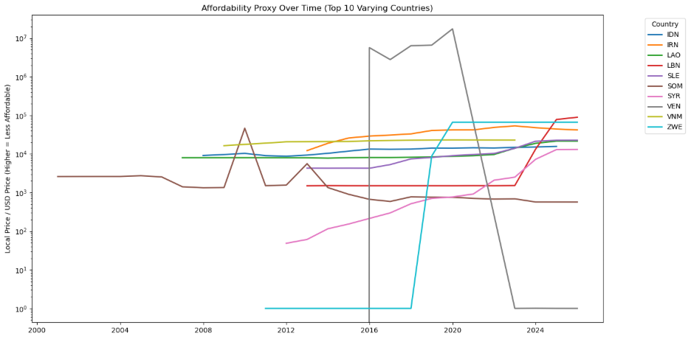
Methodology
Used a data frame pipeline to calculate an "affordablilty_ratio" column
Local market expenses vs standard global reference
Aggregated by country and year-end

Slide 25
Results
Food affordability diverged sharply across countries
Venezuela stands out with skyrocketing affordability ratios
Zimbabwe has a surge in the late 2010s
Multiple countries showing steady movement upward

