Slide 1

Air Traffic Control
AMI’s Customer marketing fatigue and eligibility model

Slide 2
Exec Summary
Problem – Growth in journey squad campaign activity is leading to the customer experiencing increasing complexity in experience, which has been proven to drive opt outs and cost the business up to £25M per year.
Solution – The AMI marketing fatigue model not only quantifies the customer’s tolerance to comms, but also provides a mechanism to evaluate if a customer is ‘Eligible’ or ‘Fatigued’ prior to sending them a future comm.
What is that? – The marketing fatigue model can forecast customer propensity to opt out upto 30 days into the future. Customer’s are observed to decay from a ‘fatigued’ state where opt out risk is high, to an ‘eligible’ state where the opt out risk is low, where the level risk is defined by the business. By forecasting when customers drop down into the low state it is possible to calculate a personal time window that customers need to be rested before they become eligible for contact again. Using this model, it is possible to estimate that on any given day, approximately 16% of the EE SMS&MMS base is fatigued, and that fatigued customers are four times model likely to opt out that eligible customers.
Estimated value to the business – Given the assumption that an opt out is valued at £3.02 per year, by excluding ‘fatigued’ customers from audiences it is estimated that this method could save the business up to £XXXX per year in lost opportunity.
What is the plan?
Q4 model build and deployment
Q1 test model in select campaigns
Q2 Agree framework for rolling out marketing fatigue in all campaigns as part of Automated Air Traffic Control

Slide 3

What is Air Traffic Control all about?
Primary KPI
Reduce opts out
Secondary KPIs
Improve engagement and marketing effectiveness
Demonstrate the value of keeping a customer
Optimise campaign performance
Unify campaign activity to deliver a consistent performance

Slide 4
What is Air Traffic Control?
“An automated decision-making process for managing the frequency and relevance of marketing”

Slide 5
ATC Ambition
Current state
Future state
Timings
Deliver Strategic Priorities
Contact strategy is product led
Contact strategy doesn’t take into account actual comms frequency at a customer level, just at a high level view
BT comms do not have contact strategy principles
Contact strategy to move to customer led utilising single customer contact view (SCCV) to provide insights into customer preferences to shape personalisation, incorporating contact strategy models (marketing fatigue, channel preference model)
Cross brand alignment across contact strategy principles
Q1 - Q2
Customer Centricity
Manual planning process and no centralised feed
Manual campaign mapping and clash management
Day to day plan management required due to lack of longer term plan visibility
No long term BT plan and daily go/no go calls required
Utilising jira/ confluence to automate CRM Planning process
Automated campaign feed from brief
Automated calendar view
6 month rolling plans updated by squads to provide longer term transparency
Cross brand calendar view to be set-up and cascaded
Q1
Data Driven
No centralised view of campaign performance
No ability to monitor in-flight campaign performance and impacts to channels, i.e. call vols
Not able to validate value of activity & contact strategy
Key metrics are not customer driven or opt out focussed
Insights hub to be set-up on Confluence & linked to squads
Finalise Qlik ‘glider’ with C1 squad for real time updates to create one source of truth
Establish campaign ROI and create ATC monthly reporting
Create optimum measurement across a range of metrics (benchmarks?) aligning with C1 squad
Q1 – Q2
Capability Automation
No framework for ATC interactions in AMI
Unable to monitor contact strategy and fully understand customer exposure to comms automatically
No understanding of optimum comms frequency
No intelligence to personalise experience for customers
Design framework for AMI across ATC & NBA
Productionise single customer contact view (SCCV) across BT & EE and enhance data quality and depth
Fatigue model roll out and testing across campaigns
Customer preference models to identify customer needs
Q1 – Q3
Ways of Working
Reliant on other areas of the business to support ATC which slows down process and quite reactionary
ATC previously seen as a barrier to deploy with recommendations fed in close to launch
Agile set-up drives efficiencies and enables ATC progress
Longer term planning and squad plan visibility allows up-front collaboration between ATC and journey, capability and enabler squads
Establish effective communication channels with squads i.e. monthly update meetings
Q1
Notes:
Data driven; Insights hub – link in with Evaluation and measurement C1 (Rich Hill) for their processes on this; Brain Hub – Sue to assess and review our requirements
Qlik glider; currently uncertainty around who owns it; Sue picked up with Shaun Smith who passed over ownership to Dave Gunnel (need clarity on ownership) in order to productionise and go live; @ understand difference between CRM production qlik app and glider
ROI; Kim liaising with Rich for a unified calculation approach (double check cookbook for alignment)
Optimum measurement across range of metrics; loop in with C1 to align

Slide 6

Marketing Fatigue
Concept

Slide 7
Marketing fatigue hypothesis
The marketing fatigue hypothesis is…
“Customers who are exposed excessively high volumes of marketing messages are more likely to opt out”

Slide 8
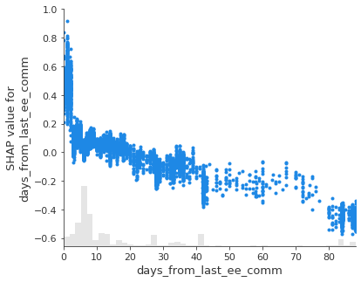
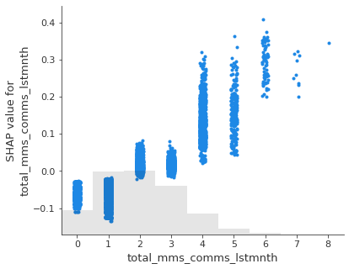
Marketing fatigue hypothesis
1)
The marketing fatigue hypothesis is…
“Customers who are exposed excessively high volumes of marketing messages are more likely to opt out”
Using the AMI opt out model, we have been able to provide empirically evidence to support this hypothesis.
1) Days from last EE comm - Customer’s with shorter breaks between comms are more likely to opt out
2) Total MMS comms in the last month – The density of comms is directly corelated with the propensity to opt out at greater than one comm per month
2)

Slide 9
The business questions behind marketing fatigue
“Can we reach a sweet spot where we can minimise the commercial impact of excluding the most fatigued customers and reducing churn??”
“Can we quantify a customer's tolerance to comms?”

Slide 10
Can we quantify a customer's tolerance to comms…?

Slide 11
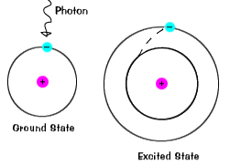
Conceptualising the problem of marketing tolerance using particle physics - Atomic excitation
Atomic excitation
Electrons bound to atoms naturally sit in a lower level ground state but, through interaction with a photon, can be excited to an unstable higher state or break free of the atom all together

Slide 12


Conceptualising the problem of marketing tolerance using particle physics - Atomic excitation
Atomic excitation
Marketing fatigue
Customers who are connected to BT naturally sit in an un-fatigued state where they are eligible to be contacted; however, through interaction with a marketing message may opt out all together, or be moved unstable fatigued state where they are more easily persuaded to opt out.
Marketing message
Customer
Eligible state
Fatigued state

Slide 13
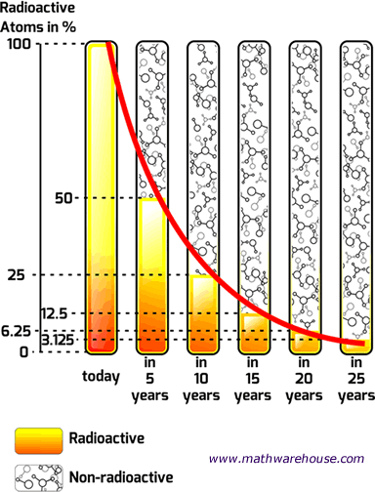
Conceptualising the problem of marketing tolerance using particle physics – Radioactive decay
Radioactive decay
A collection of unstable particles will naturally decay exponentially into a more stable state over time

Slide 14
Conceptualising the problem of marketing tolerance using particle physics – Radioactive decay
Campaign population (%)
Radioactive decay
Fatigue decay
A collection of fatigued customers who are protected from marketing messages for a period of time will naturally fall back into a more stable state over time where they are again eligible to be contacted
days days days days days
Fatigued state
14
Eligible state

Slide 15
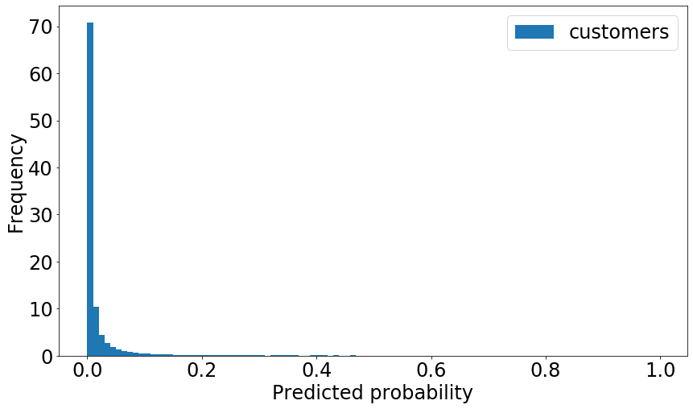
Tolerance to comms is measured through the customer’s propensity to opt out as a function of time
ELIGIBLE
FATIGUED
Using a Machine Learning method that can predict into the future, we can predict customer propensity to opt out.
If the opt opt propensity is above a certain level then the customer is considered ‘fatigued’ and should be protected, below they are ‘eligible’ to be contacted.
The threshold is free to be set by the business at a level that optimises the commercial impact
Threshold

Slide 16
Marketing Fatigue
Model

Slide 17


Foundations built from the
Single Customer Contact View
Objective – Consolidate BT and EE customer contact history into a single base with consistent schema for the purposes of generating insight and building contact strategy models
Requirements:
BT and EE marketing and service campaign drop history
Common schema across the brands
Campaign Metadata
Delivery metadata
Customer segmentation
Aggregated engagement response
Aggregated commercial response
Challenges
Ingestion and building in the cloud
Deriving a common schema
Deriving a common id across brands

Slide 18



Predicting the future requires knowledge of past behaviour
For each customer, a sequence of communication events is assembled
Days
Past
Today
Future
A
LSTM rNeural Network algorithm
B
Will the customer Opt out?

Slide 19
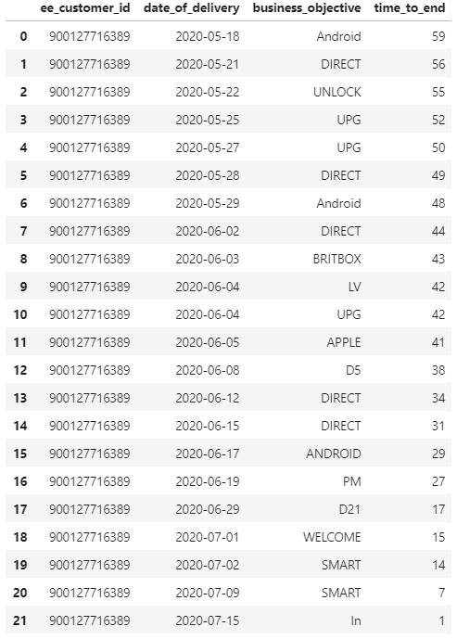
Predicting the future requires knowledge of past behaviour
For each customer, a sequence of communication events is assembled
Example of a real customer ‘event history’
‘Business objective’ is used as our event to breakdown the type of campaign sent (507 distinct categories)
Sequences were assembled over the last 60 days
Where a customer did not receive a comm, this is treated as ‘0’

Slide 20


Predicting the future requires knowledge of past behaviour
Days
Past
Today
Future
A
B
Customer A is optout risk and should not be contacted today

Slide 21
Predicting the future requires knowledge of past behaviour
Days
Past
Today
Future
A
B
Should they be contacted tomorrow though???

Slide 22
Predicting the future requires knowledge of past behaviour
Days
Past
Today
Future
A
B
How long should we leave the customer until they are eligible to be contacted again?

Slide 23
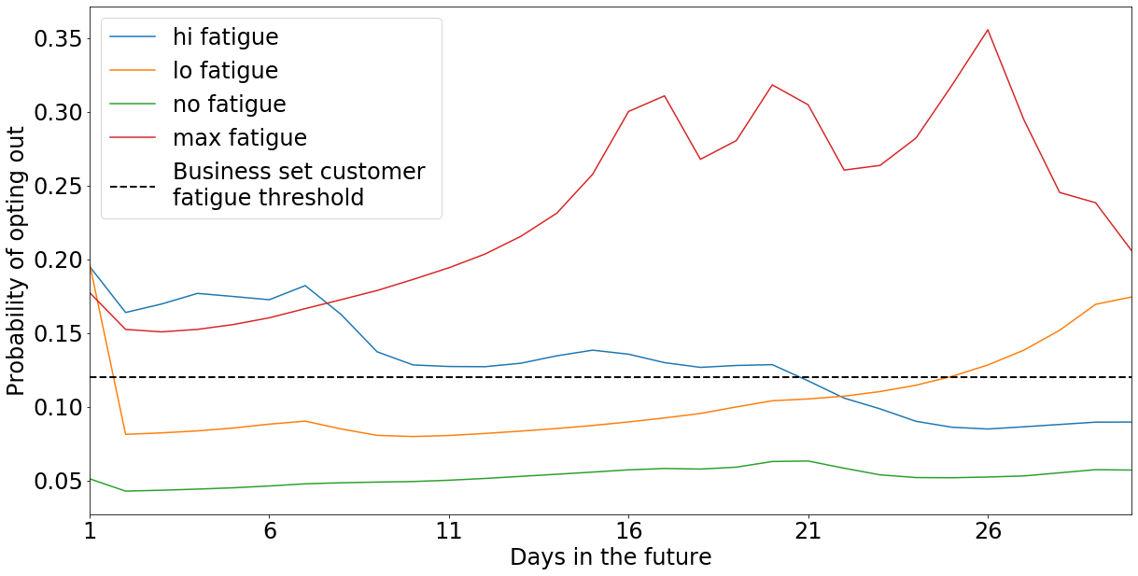
The customer fatigue window is calculated by
simulating how opt out propensity decays over time
The customer’s propensity to opt out is simulated forward by 30 days, assuming they were not contacted in that period.
The fatigue window is determined at the time (in days) when opt out propensity drops below a business defined threshold
Customers who opted out were forecast to have greater fatigue windows…
Opted in customers = 1.5 days
Opted out customers = 2.8 days
Fatigued
Eligible
EXAMPLE
Threshold
Fatigue Window

Slide 24
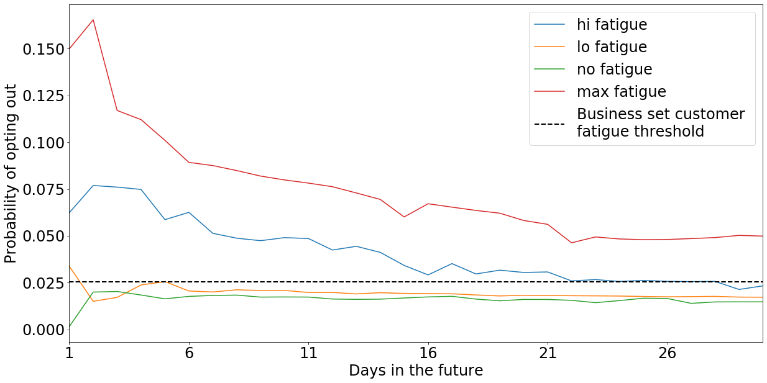
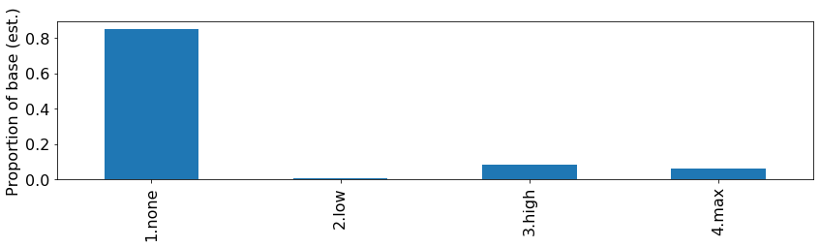
Customer Fatigue profiles – Not fatigued
Customers with no fatigue (green) are defined of having a fatigue window of one day.
This segment accounts for 84% of all customers on a given day.
These customers are initially classified as not an opt out risk and are therefore not fatigued.
Opt out levels remain nominal over time.
These customers are currently eligible to receive comms.

Slide 25
Customer Fatigue profiles – Low fatigue
Customers with low fatigue (orange) are defined of having a fatigue window of two days.
This segment accounts for <1% of all customers on a given day.
These customers are initially classified in a fatigues state, but very quickly drop down into an eligible state.
Low fatigue customers are eligible to receive comms after two days.

Slide 26
Customer Fatigue profiles – High fatigue
Customers with high fatigue (blue) are defined of having a fatigue window between 2 and 30 days.
This segment accounts for 8% of all customers on a given day.
These customers are initially in a fatigued state and slowly decay into a eligible state over a longer time frame.
On average, high fatigue customers are eligible to receive comms again after approximately three weeks.

Slide 27
Customer Fatigue profiles – Max fatigue
Customers with max fatigue (red) are defined of having a fatigue window greater than 30 days.
This segment accounts for less than 6% of customers, but these customers did not become eligible again to receive comms within the 30 day simulation.
Max fatigue customers will require a longer simulation to fully understand when they will become eligible again.
Business decision – a route forward here would be to mandate all customers become eligible after a pre-set period of time without being marketed to.

Slide 28
Marketing Fatigue
Operations

Slide 29

Using the marketing fatigue model
When deployed, customer marketing fatigue would be recalculated every day.
Should a campaign be planned/executed at a future date for the following customers
This customer has high fatigue and is ineligible at the time of delivery (and they are excluded from the send volume)
This customer never became fatigued and therefore is eligible for this campaign
This customer has low fatigue and because sufficient time has passed they have cooled off and returned to a eligible state for this campaign
In this way, marketing fatigue exclusions can be applied to remove/postpone highly fatigued customers from campaigns.
Most recent comm
(t-1)
Today
(t)
A
High
B
None
C
Low

Slide 30
Marketing fatigue will produce an ‘Eligibility flag’ at a customer level
By considering a customer specific marketing window and date, with respect to that customer’s most recent comm, the marketing fatigue model can be formulated into a customer level Eligibility flag
This can be operationalised either in conjunction with AMI’s Most Relevant Journey stacking, or as part of the implementation of business rules in the outbound delivery systems (for example UNICA).
Customer id | Days since last comm | Fatigue window | Eligibility flag
000001 | 10 | 3 | 1
000002 | 2 | 3 | 0
000003 | 0 | 1 | 0
000004 | 10 | 21 | 0
000005 | 4 | 0 | 1
000006 | 7 | 2 | 1

Slide 31
Simulations show demonstrate that fatigued customers are four times greater risk of opting out compared to eligible customers
The opt out rate for fatigued customers was over three times as high for the eligible customers.
OOR estimates are calculated using real EE SMS and MMS comm history from November 2020.
Scaling up to the entire year the opportunity lost to the business due to marketing fatigue is estimated as…
£77,266per year
Assuming the cost of an opt out to the business of £3.02 per customer per year
Assuming that fatigued customers are excluded
Assuming that November is typical of the rest of the year
Specific to EE SMS and MMS channels
Customer state | Estimated fraction of base | Estimated Opt Our Rate | Average days since last comm | Average fatigue days
Fatigued | 27.4% | 0.051% | 1.1 | 4.9
Eligible | 72.6% | 0.012% | 7.0 | 1.2

Slide 32
The challenges with marketing fatigue
Overcome the imbalance of opt outs
As with the Opt out model, the rarity of the opt outs we are trying to predict is a major problem. The model will always be biased towards predict when a customer will not opt out (as these cases are far more common).
Scaling and infrastructure
Building a 60 day history for the customer, and forecasting 30 days into the future is extremely computationally expensive. Initial runs to train and score the model took four days but these have been bought down to 16 hours.
3. Model architecture
The sequential model used to make these predictions is a LSTM network algorithm. These are powerful, but have a nearly endless arrangement of hyper parameters and architecture, and these would likely need to be updated on a daily.
4. Operationalising the model
Ideally the model should be able to score up an eligibility flag on a daily basis that can then be incorporated into AMI. However, a full assessment of the model’s impact is necessary.

Slide 33
The opportunities with marketing fatigue
Significant improvements in model accuracy to come
Through experimenting with event type, network architecture and hyper parameter tuning, we are expected to make significant gains in model performance that will reduced the pool of fatigued customers down to an ever more reliable set
Channel and Brand models indirectly built in
The current version of the model is configured for EE MMS & SMS. Rebuilding this approach for different channels and brand would be relatively easy and provision for channel prefer.
3. Engagement and conversion prediction a possibility
Marketing fatigue is trained on our customer’s history of opting out; however, there is nothing in principle to stop us from experimenting with seeing how the sequence of comm touch points impacts engagement, conversion, churn or channel shift
Relatively easy to operationalise through AMI
By including the marketing fatigue model into AMI’s stacking of customer product preferences it would be relatively easy to include and measure its impact as part of the wider Air Traffic Control Framework

